Slide 1
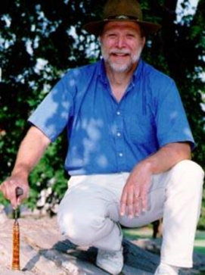
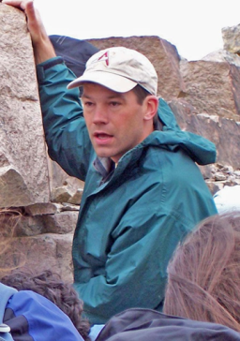
SST Geol 467 – Stratigraphy, Structure and Tectonics – Geol 467 SST
Integrating Structure, Stratigraphy and Tectonics in Undergraduate BA and BS Curricula
SST – Stratigraphy, Structure and Tectonics - SST
SST – Stratigraphy, Structure and Tectonics - SST
FICHTER, Lynn S. and WHITMEYER, Steven J.
Geology and Environmental Science, James Madison University, Harrisonburg, VA 22807, fichtels@jmu.edu, whitmesj@jmu.edu
T19. Innovative, Multidisciplinary, and Research-Oriented Approaches to Geoscience Courses
Friday, 11 April 2014: 1:00 PM-5:00 PM
SST Geol 467 – Stratigraphy, Structure and Tectonics – Geol 467 SST

Slide 2
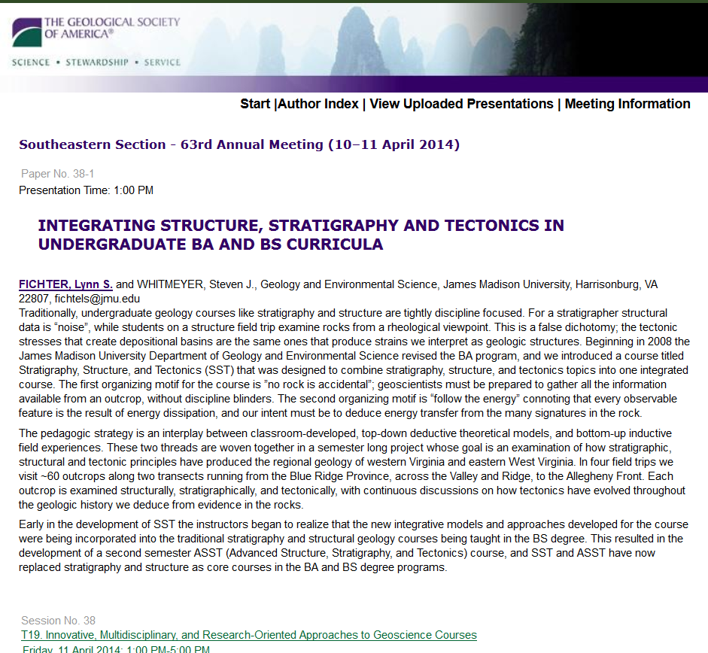

Slide 3
SST - Stratigraphy, Structure and Tectonics - SST
Premise
Stratigraphy, structure, and tectonics are not naturally compatible topics . . .
. . . just sit in on the courses; there is virtually no overlap of subject, evidence, techniques, or tools.
Yet, structure and stratigraphy are clearly related because both result from the dissipation of tectonic energy . . .
. . . and the evidence for each often exists in the same outcrop at the same time.
SST is an attempt to explore whether tectonics can serve as an organizing, integrating principle for structure and stratigraphy.

Slide 4
SST began in 2008 as a not completely thought out idea when JMU revised its BA degree in Earth Science.
But, the real question is . . .
How in hell do you combine tectonics, structure and stratigraphy in one course ?
What keeps it from being a grand chaotic mess, or simplistic pablum?
These two courses have now supplanted the traditional stratigraphy and structure courses.

Slide 5


What keeps it from being a grand chaotic mess, or simplistic pablum?
Lecture = Top-Down Theoretical Models
Theoretical
Tectonics/Basin Analysis
Theoretical
Structural
Geology
Theoretical
Stratigraphic Concepts
Developed in Nested Hierarchy
Field = Bottom-Up Empirical Applications
Every outcrop (many dozens) is analyzed for:
Tectonics (structural, stratigraphic, basin analysis)
Stratigraphy
Structure

Slide 6
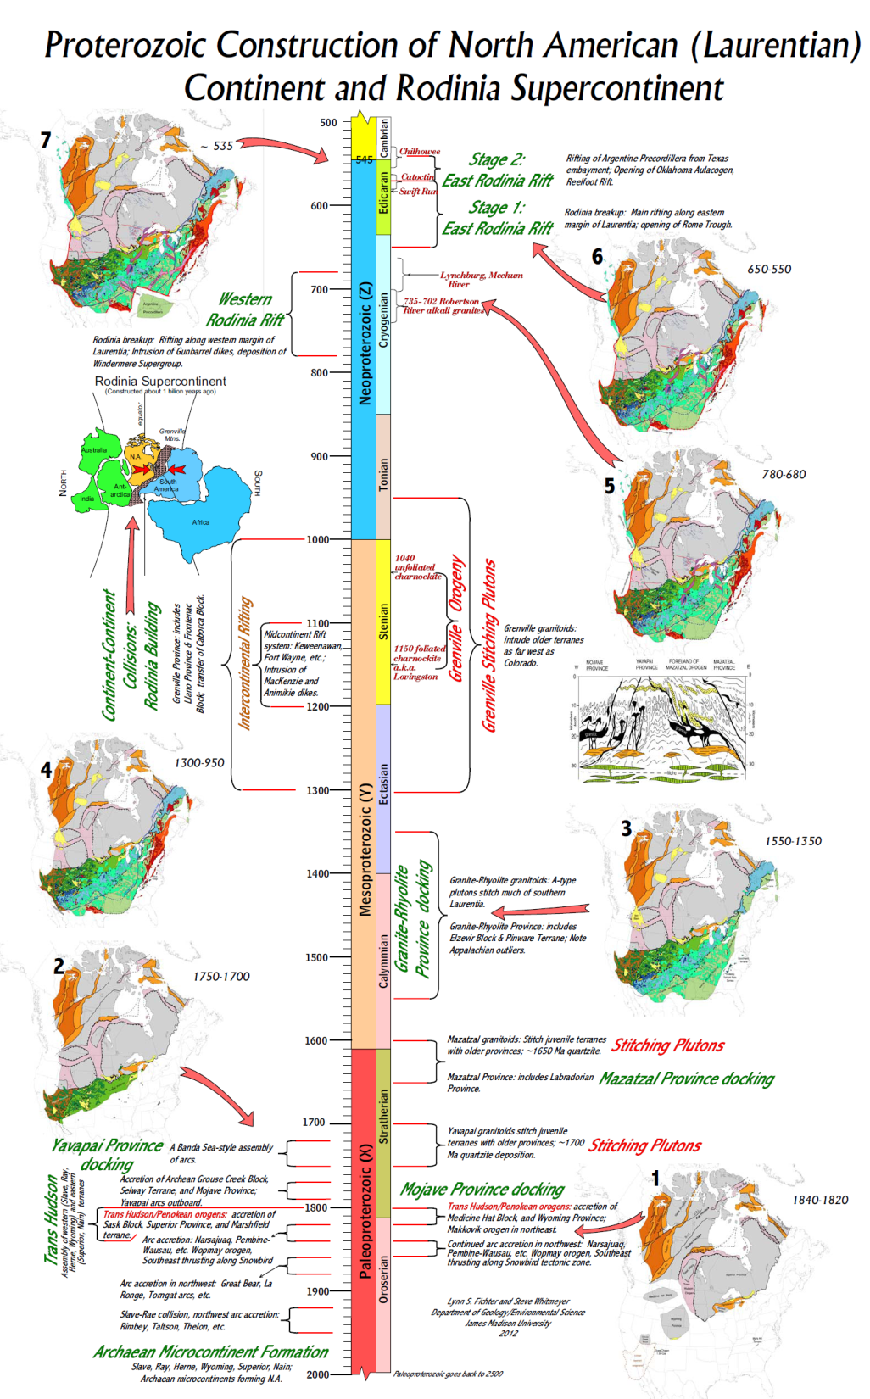
The Tectonic Theory of Lecture
Supercontinent Cycles

Slide 7
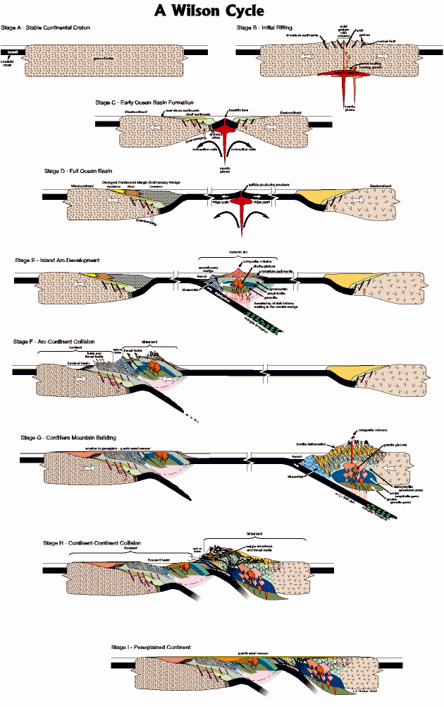
The Tectonic Theory of Lecture
Wilson Cycle

Slide 8
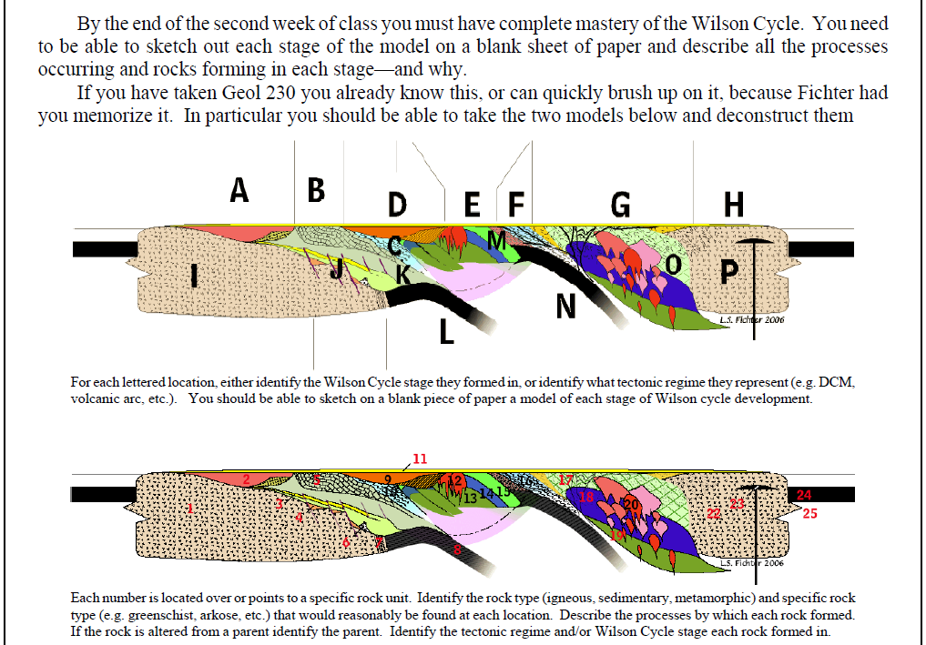
The Tectonic Theory of Lecture
Rocks/Structures in Wilson Cycle

Slide 9
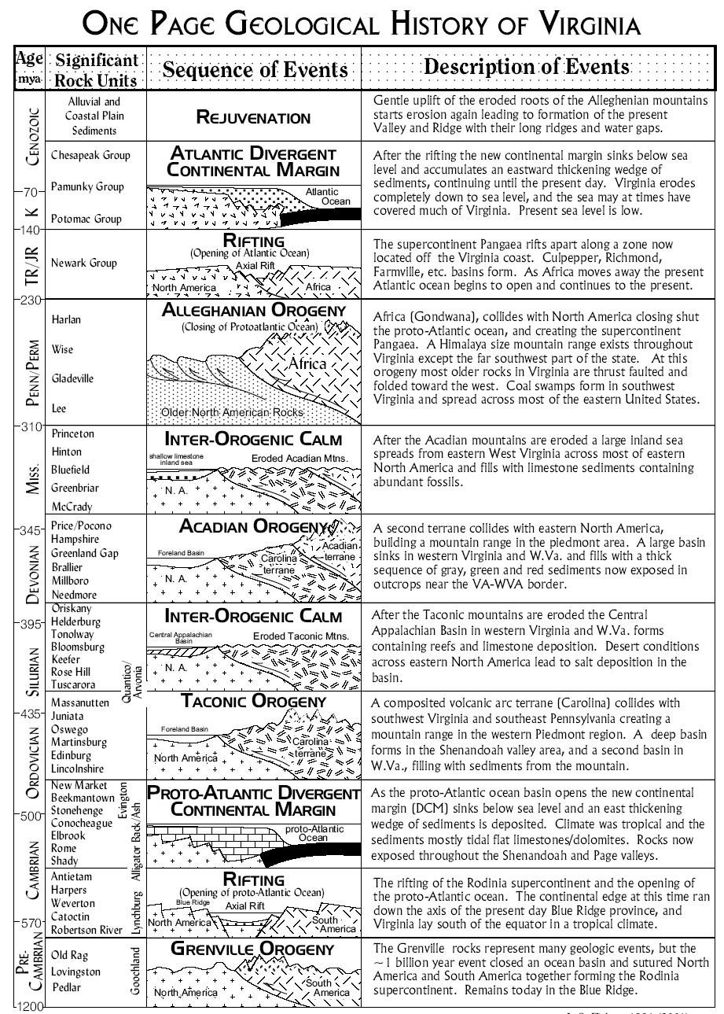
The Tectonic Theory of Lecture
Wilson Cycles and Mid-Atlantic History
Rejuvenation
Atlantic DCM
Rifting
Alleghanian Orogeny
Interorogenic Calm
Acadian Orogeny
Interorogenic Calm
Taconic Orogeny
Proto-Atlantic DCM
Rifting
Grenville Orogeny
Wilson
Opening
½ Wilson
Rifting Pangaea
“Rift to Drift”
Building Pangaea
Wilson
Closing
Full
Wilson
Wilson
Opening
Rifting Rodinia
“Rift to Drift”
Wilson
Closing
½ Wilson
Building Rodinia

Slide 10
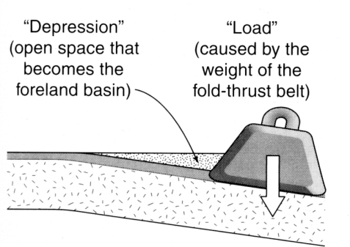
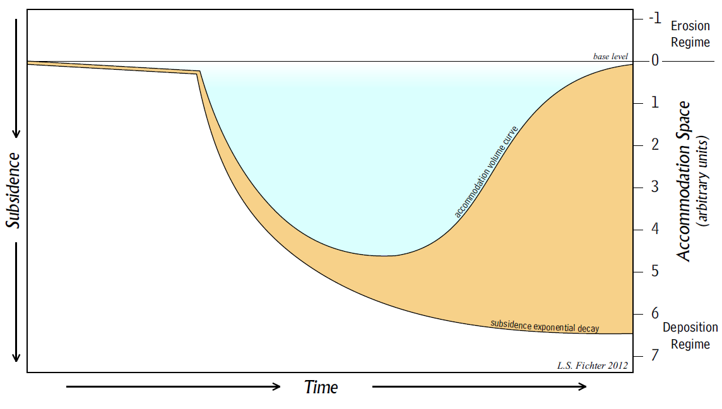
The Tectonic Theory of Lecture
Foreland Basin Theoretical Evolution
Effectively, the Hinterland Places a “Load” on the Foreland
Subsidence rate for tectonically stable places like cratons and mature DCMs.
Onset of tectonic activity; e.g. arc-continent collision
Slow subsidence; slow sedimentation
Initiation of deposition:
Accommodation curve: area above is relative accommodation space
Basin filling; shallowing -water environments
Tectonic Subsidence Curve rapidly creates subsidence and subsequent accommodation space; i.e. Rapid subsidence; slow sedimentation
Basin floor: sediment-water interface
Sediment volume = space between subsidence curve and accommodation curve
Loading contributes progressively more to Tectonic Subsidence
Exponentially slowing subsidence; rapid sedimentation

Slide 11
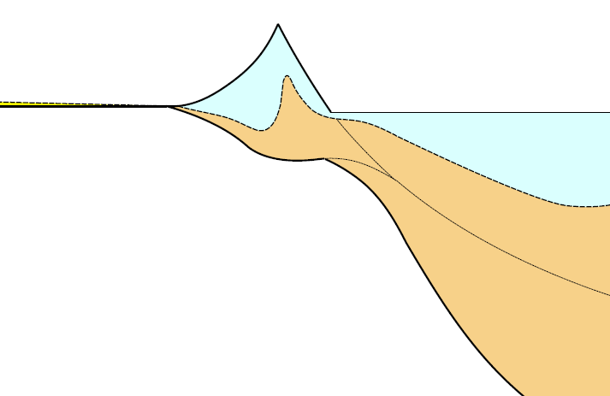
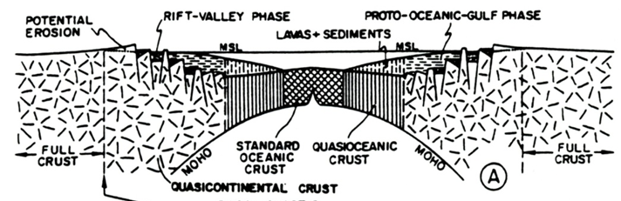
The Tectonic Theory of Lecture
Rift-to-Drift Basin Evolution
Horsts burying in own debris
Cratonic quartz arenites
Shallow evaporates
“Pre-rift “sediments (+ volcanics)
Drainage reversal
Early DCM
(slope rise)
Subareal clastic debris in alluvial fans, river valleys, and lakes
Late, mature DCM wedge

Slide 12
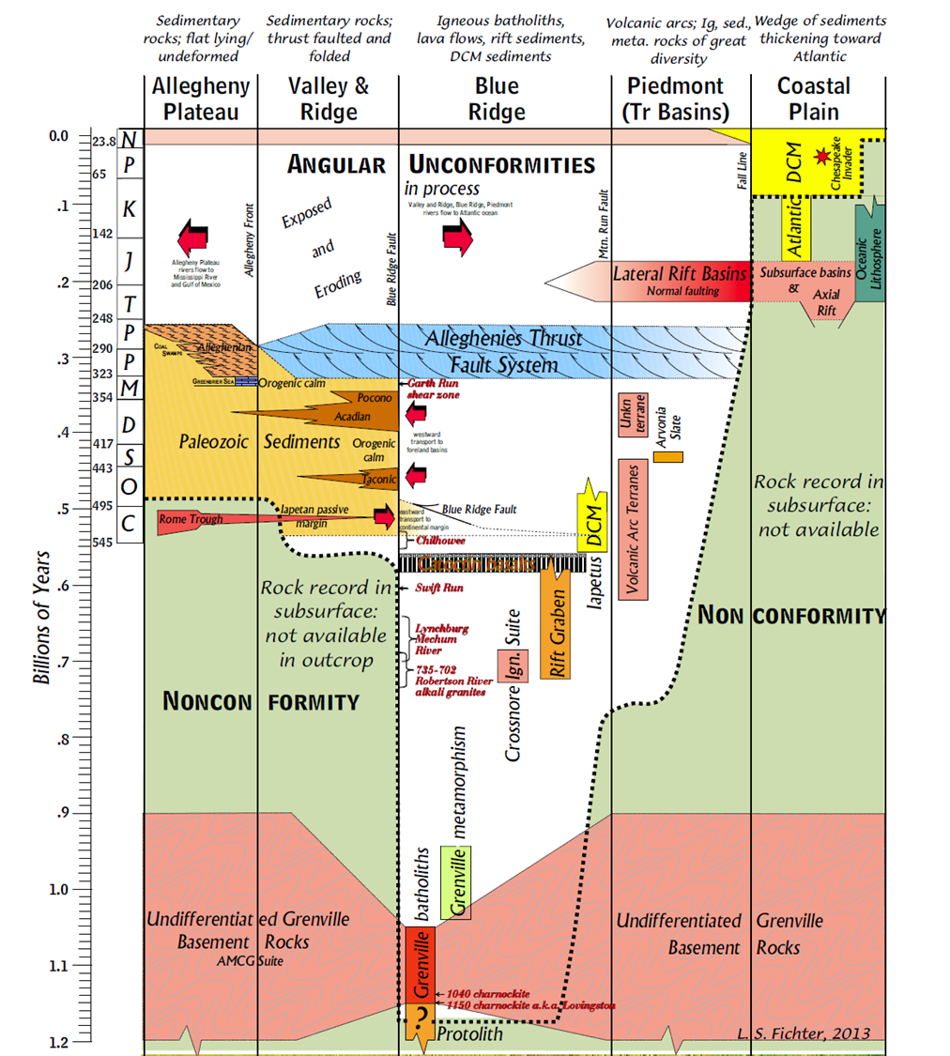
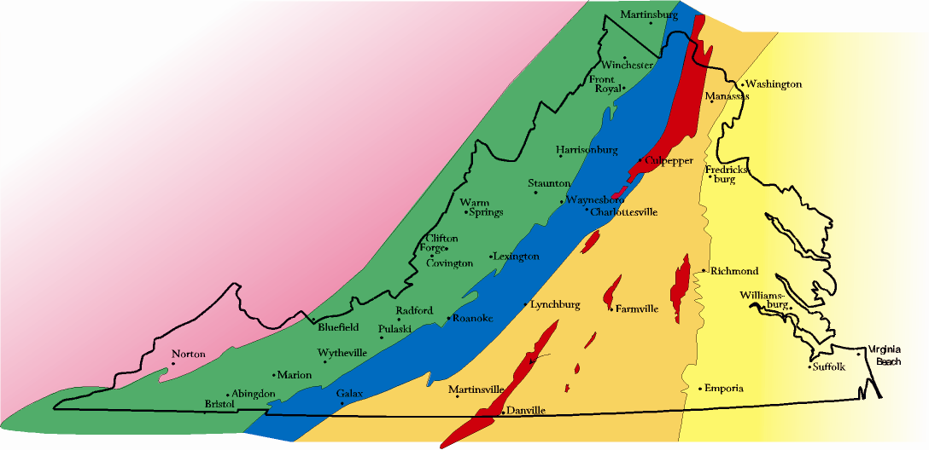
The Tectonic Theory of Lecture
Application of all this Theory to Mid-Atlantic Physiographic Provinces
Allegheny Plateau
Allegheny Front
Valley and Ridge
Blue Ridge Fault
Mountain Run Fault
Blue Ridge
Coastal Plain
Fall Line
Piedmont

Slide 13
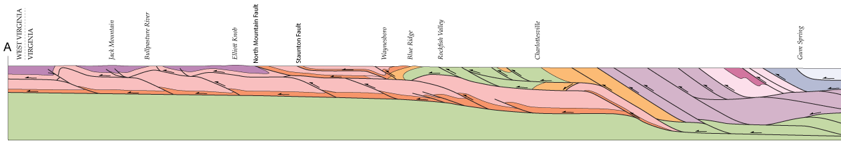
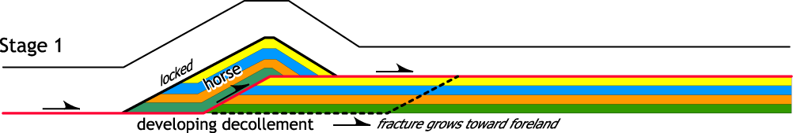
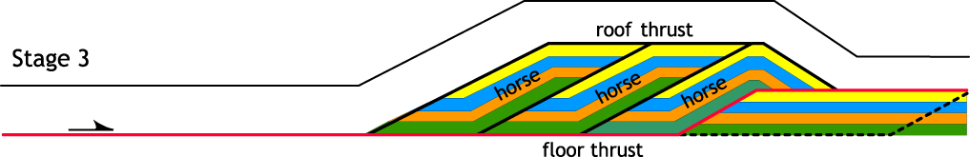
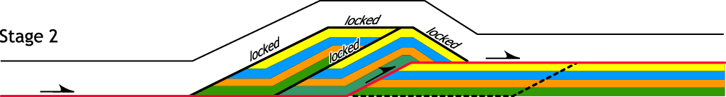
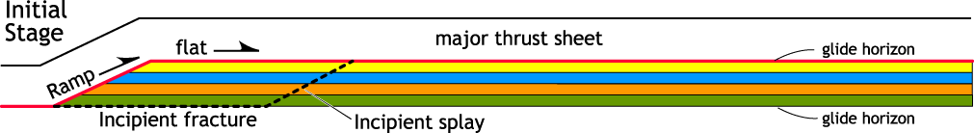
The Structural Theory of Lecture
Models of Deformation
Cross-section through western Virginia
10 km
Formation of a duplex system
Note: at any given time, the red line is the only active fault surface

Slide 14
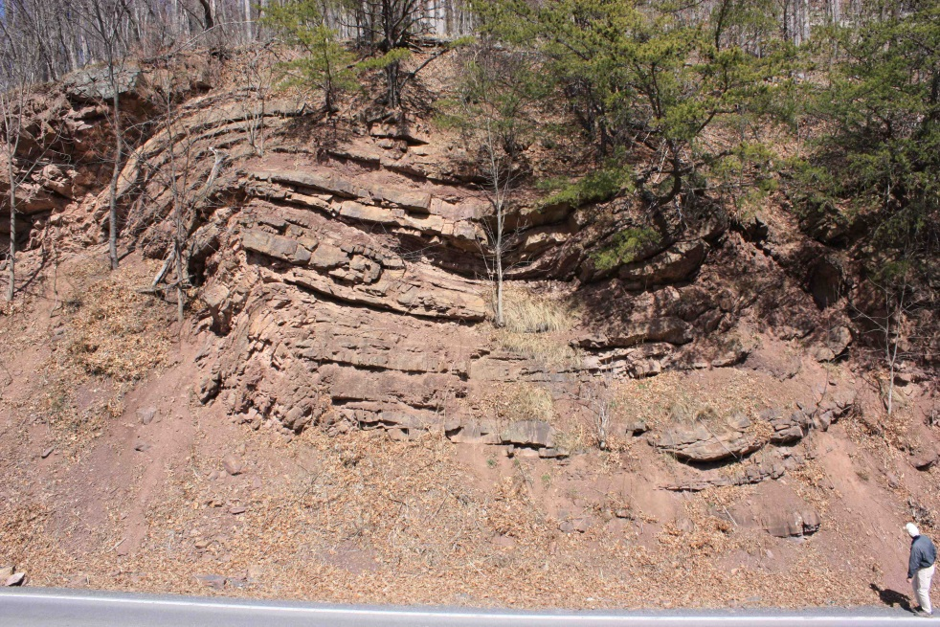
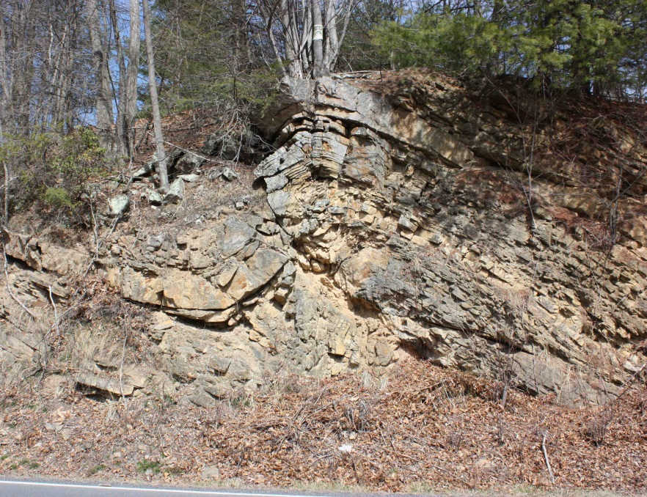
The Structural Theory of Lecture
. . . supported by field examples
Cross-section through western Virginia
10 km

Slide 15
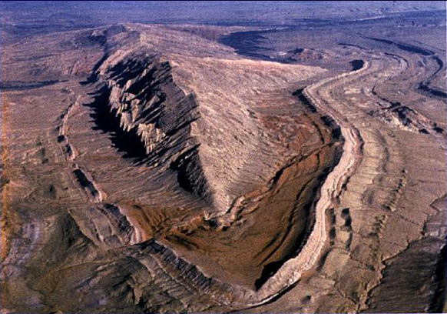
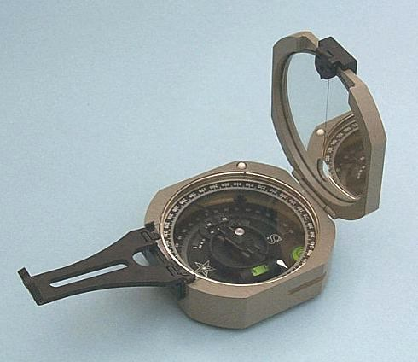
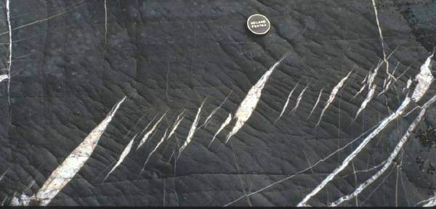
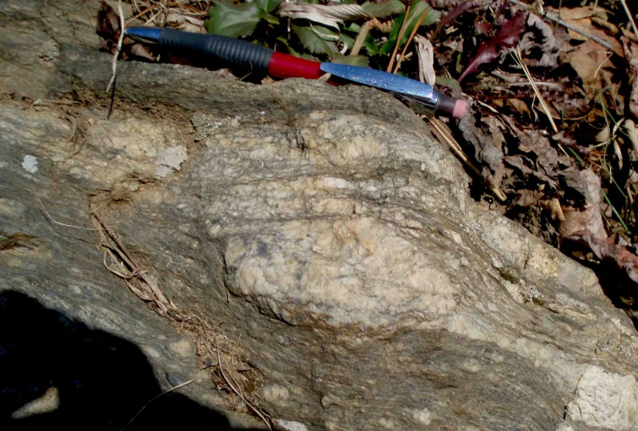
The Structural Theory of Lecture
Basic methods of Structural Analysis
Hillandale
Park data
2013
Hillandale
Park data
2013
Scale of observation
Tools
2 -> 223
sigma
porphyroclasts
en echelon veins
Interpreting structures

Slide 16
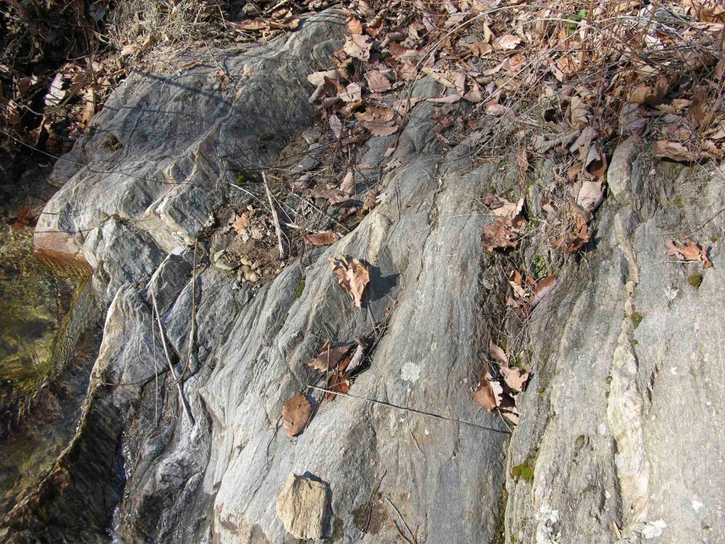
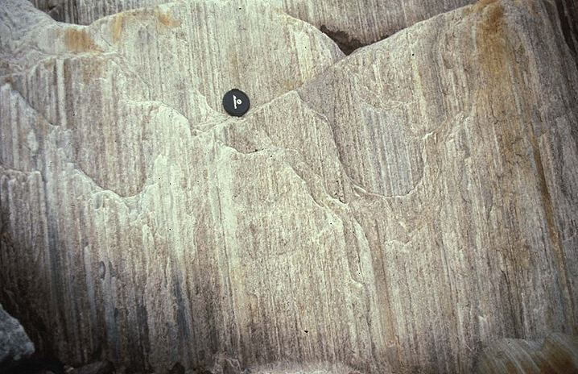
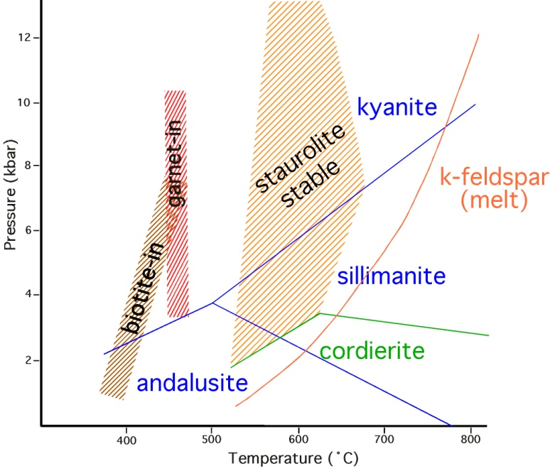
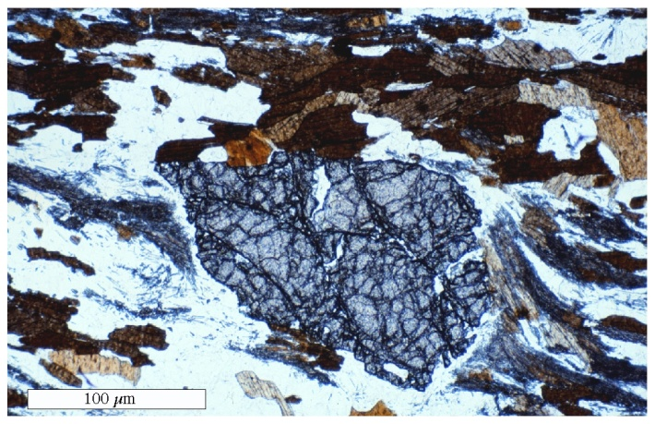
The Structural Theory of Lecture
Basic methods of Structural Analysis
slickenlines
mylonitic
foliations &
lineations
Fabric analysis
Deformation
conditions
Syntectonic growth of sillimanite,
with biotite and garnet stable

Slide 17
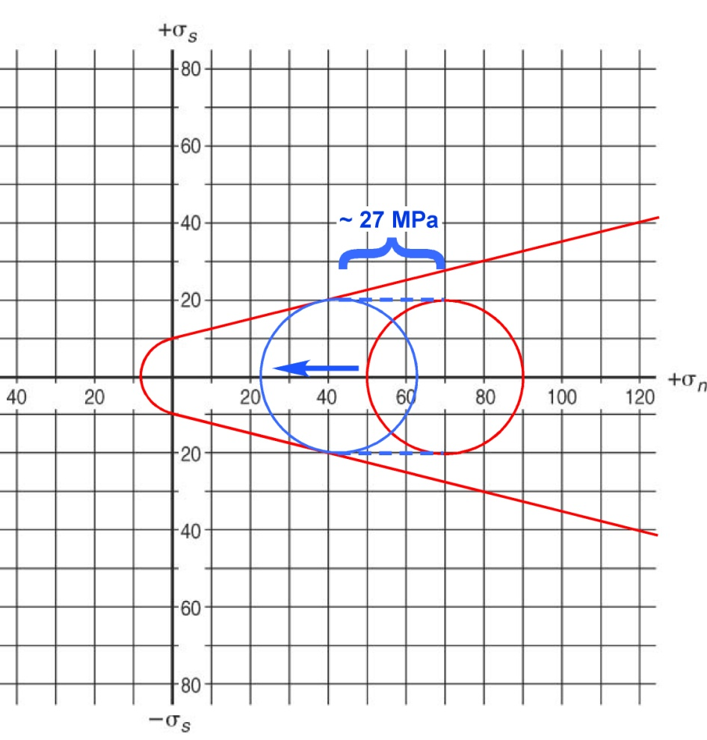
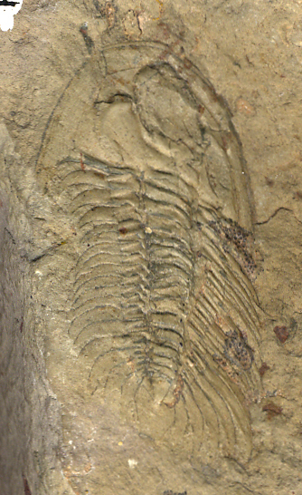
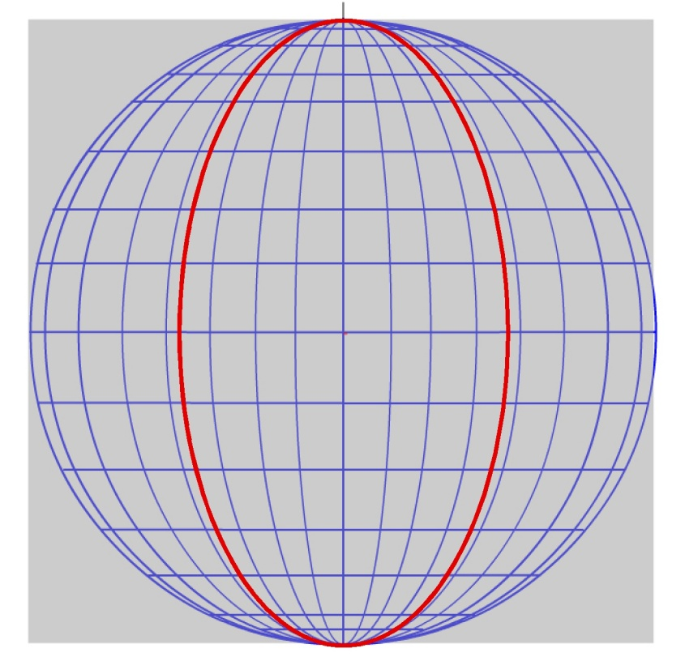
The Structural Theory of Lecture
Evaluating stress & strain
Quantifying strain
orthographic
net
Mohr-Coulomb failure envelope for stress
with effects of increased pore fluid pressure
90˚
R_{S} = 1.67

Slide 18

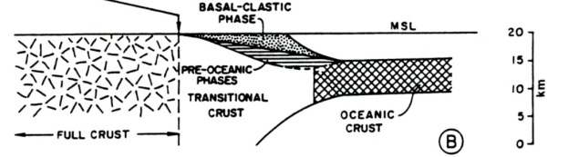
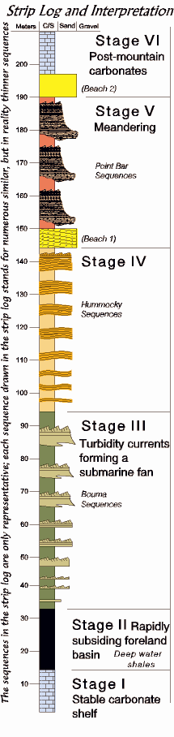
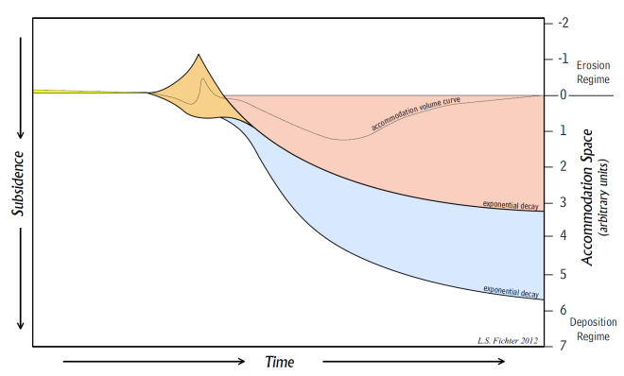
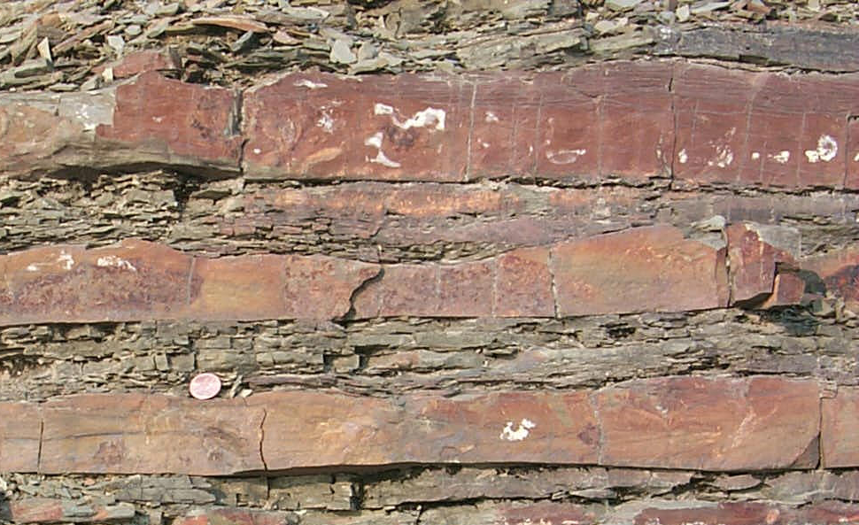
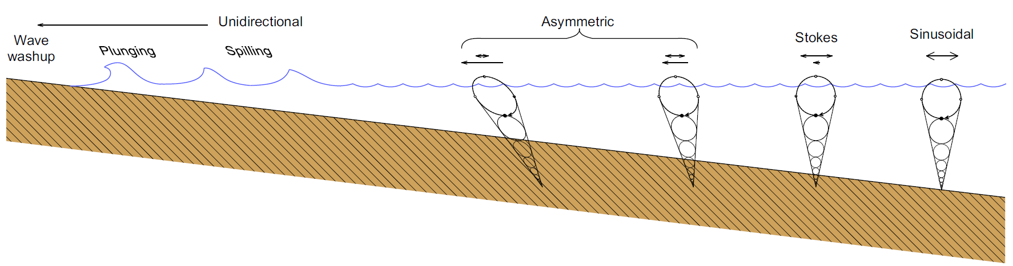
The Stratigraphic Theory of Lecture
Tectonics and Depositional Systems
Tectonic events produce basins:
Follow the energy.
Basins have histories:
Histories are recorded as sequences of depositional environments.
Which are accumulated as individual depositional events.
No rock is accidental.
Which reflect the energy passing through the environment.

Slide 19
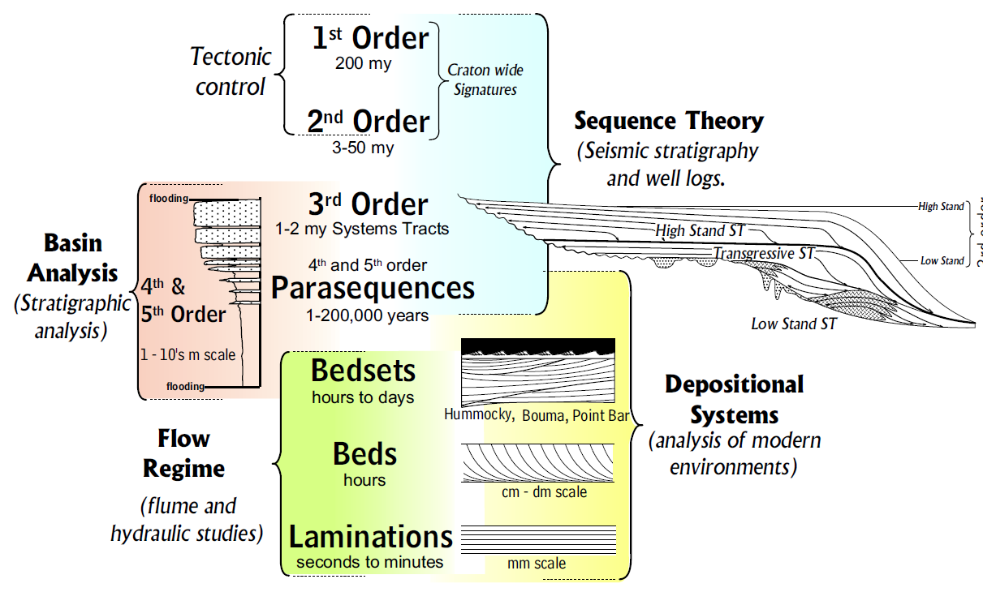
The Stratigraphic Theory of Lecture
Stratigraphic Signatures

Slide 20
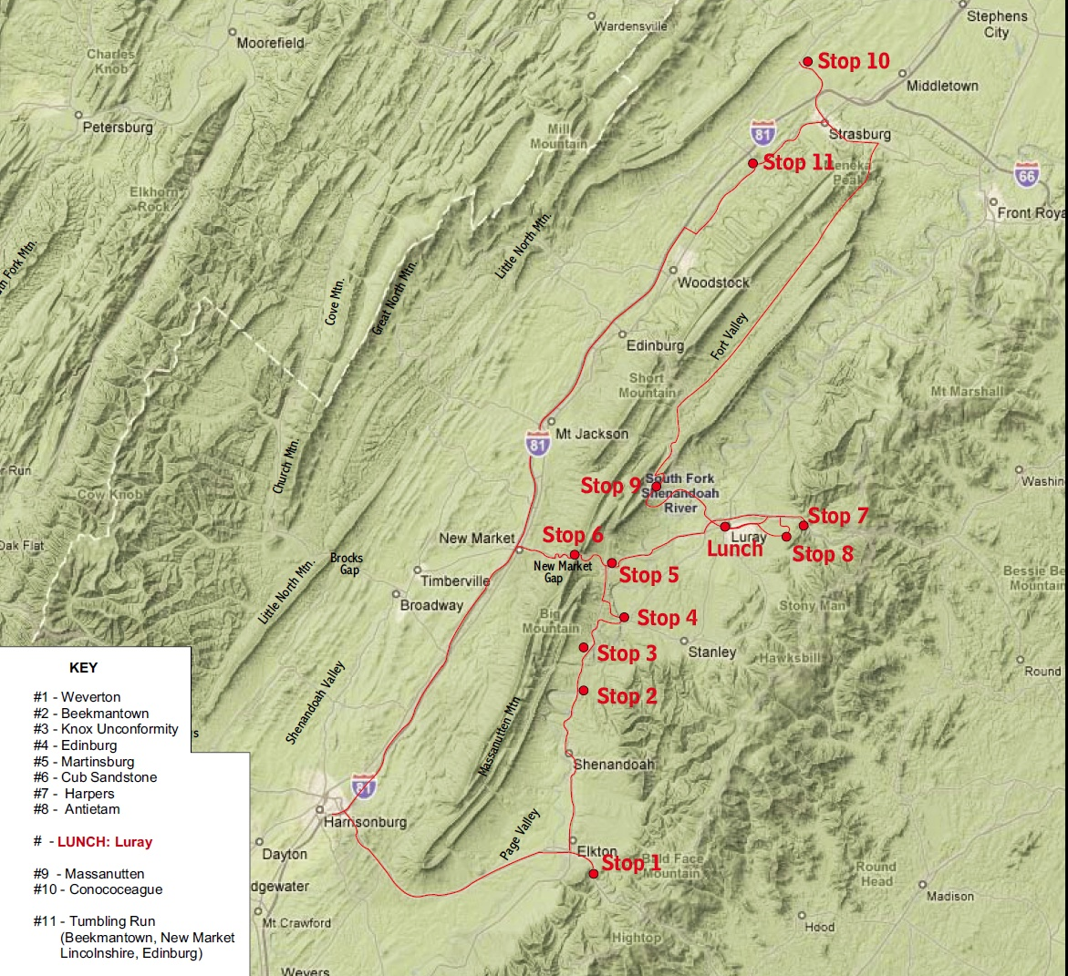
The Bottom-Up Empirical Practice of Field Trips
5 all day fieldtrips
1st trip Sedimentary Tectonics
We are well aware of the enormous advantage our location give us.

Slide 21
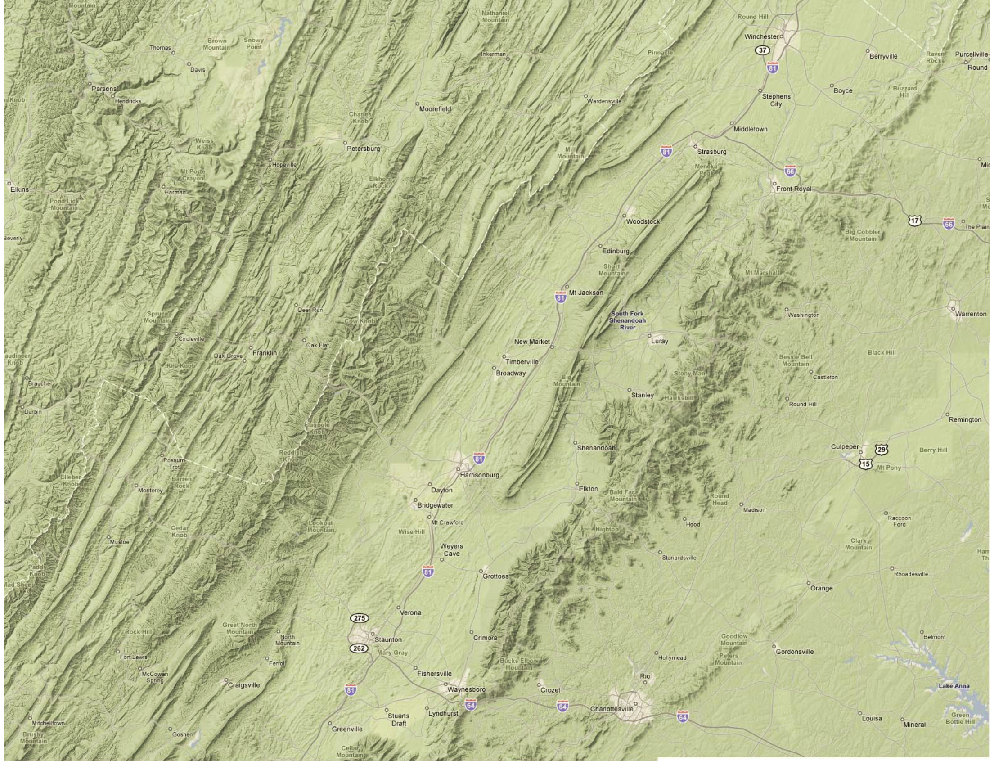
Great
Valley
Allegheny Plateau
Shenandoah Valley
Massanutten Mtn.
Allgeheny Front
Valley and Ridge
3rd
5th
4th
2nd trip petrology and structure
Page Valley
Blue Ridge Mtn.
Shenandoah Mtn.
Blue Ridge Province
Piedmont
Every outcrop is analyzed for stratigraphic/environmental interpretations, tectonics as structure, and tectonics as basin evolution. For example . . .

Slide 22
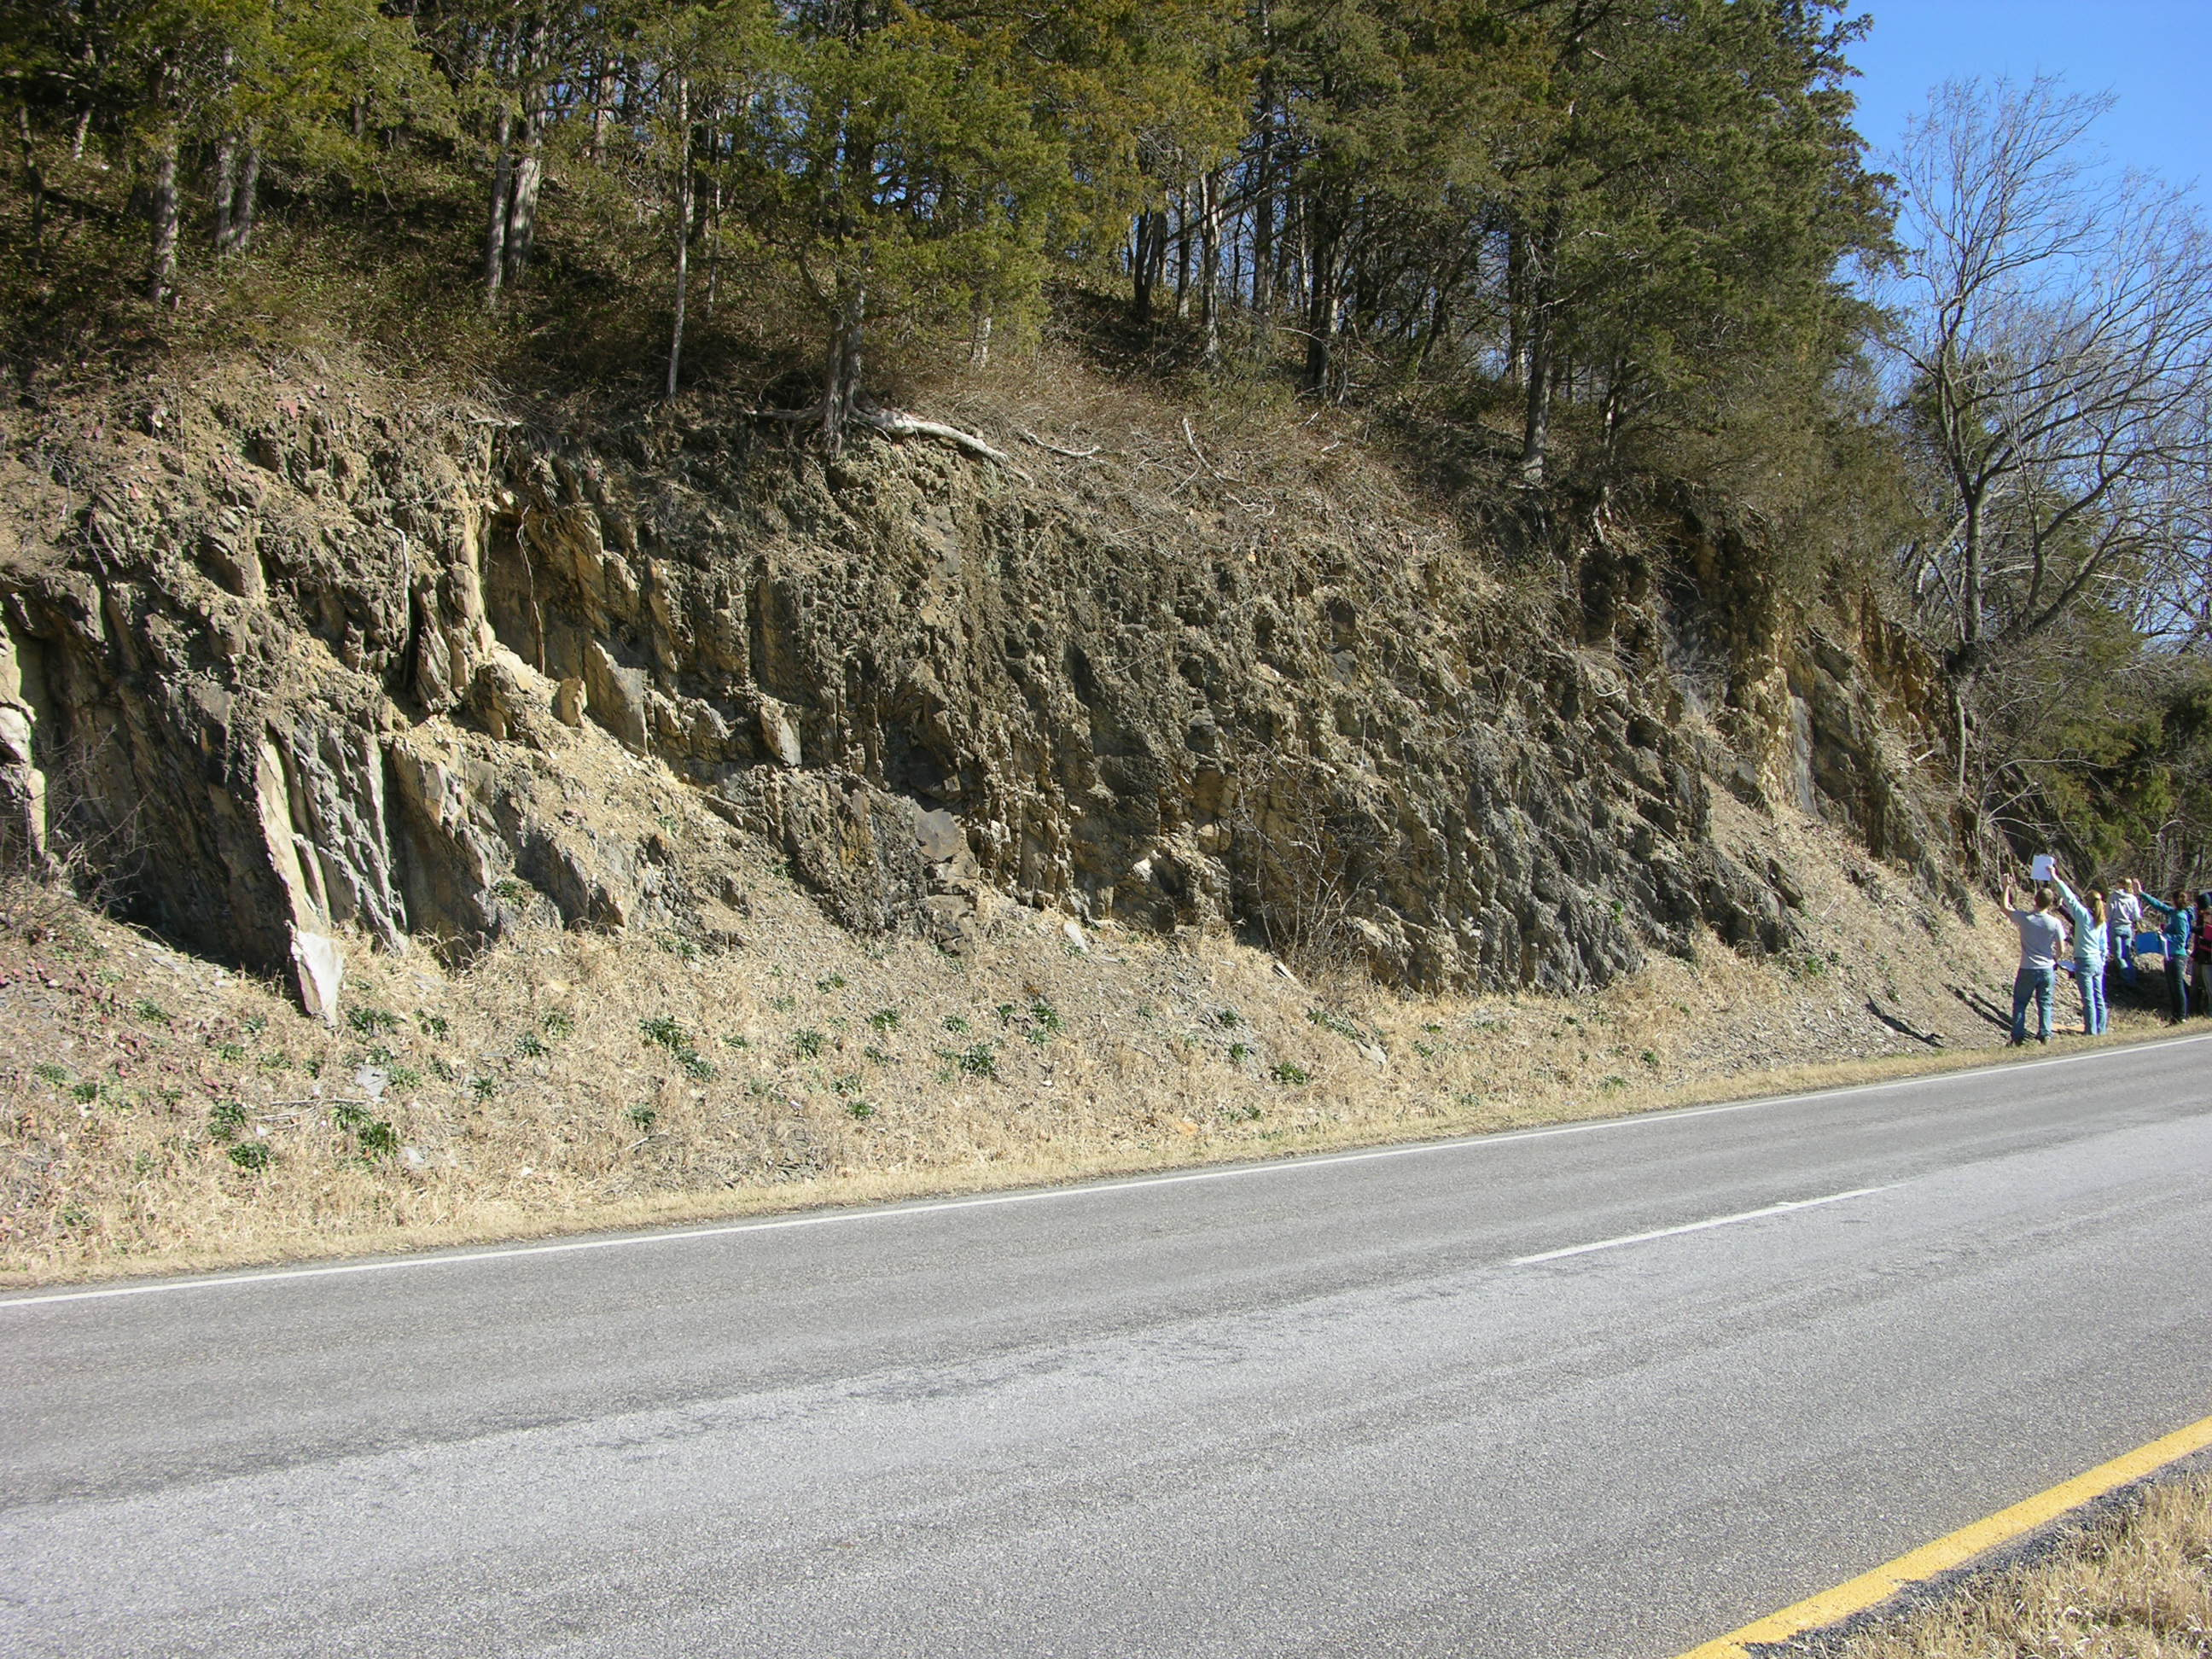
SST – Luray to Brocks Gap Field Trip:
Stop Three: Cub Sandstone
Badly weathered outcrop, but with good hummocky sequences, and a complex cleavage pattern

Slide 23
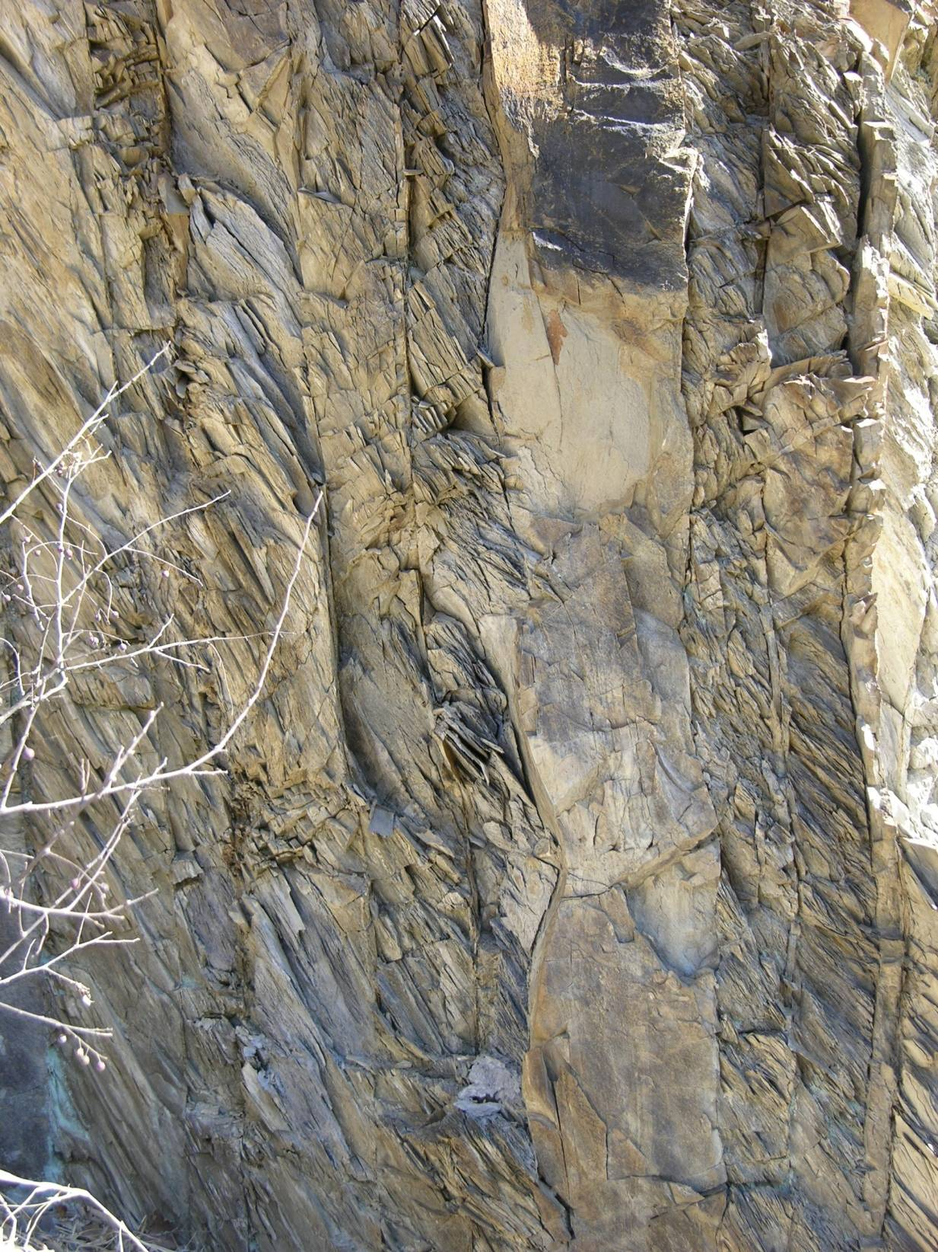
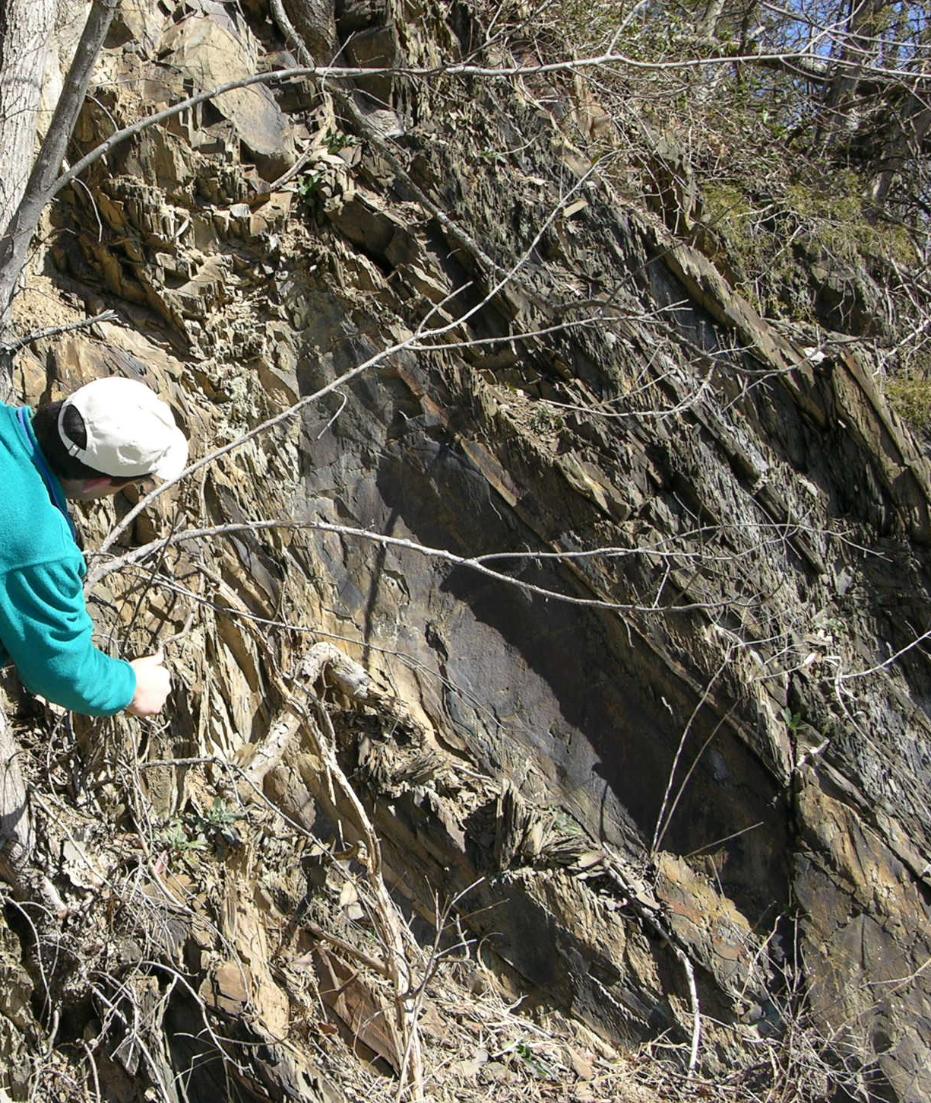
While cleavage on the east end goes like this
Note that the cleavage on the west end of the outcrop goes like this
Hummocky cross stratification
Do you know what to do with this information to build interpretations

Slide 24
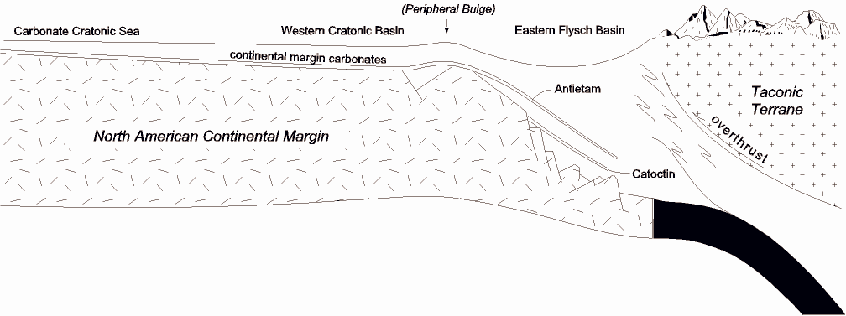
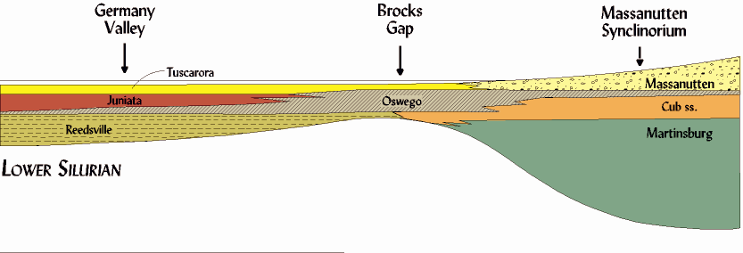
Edinburg

Slide 25
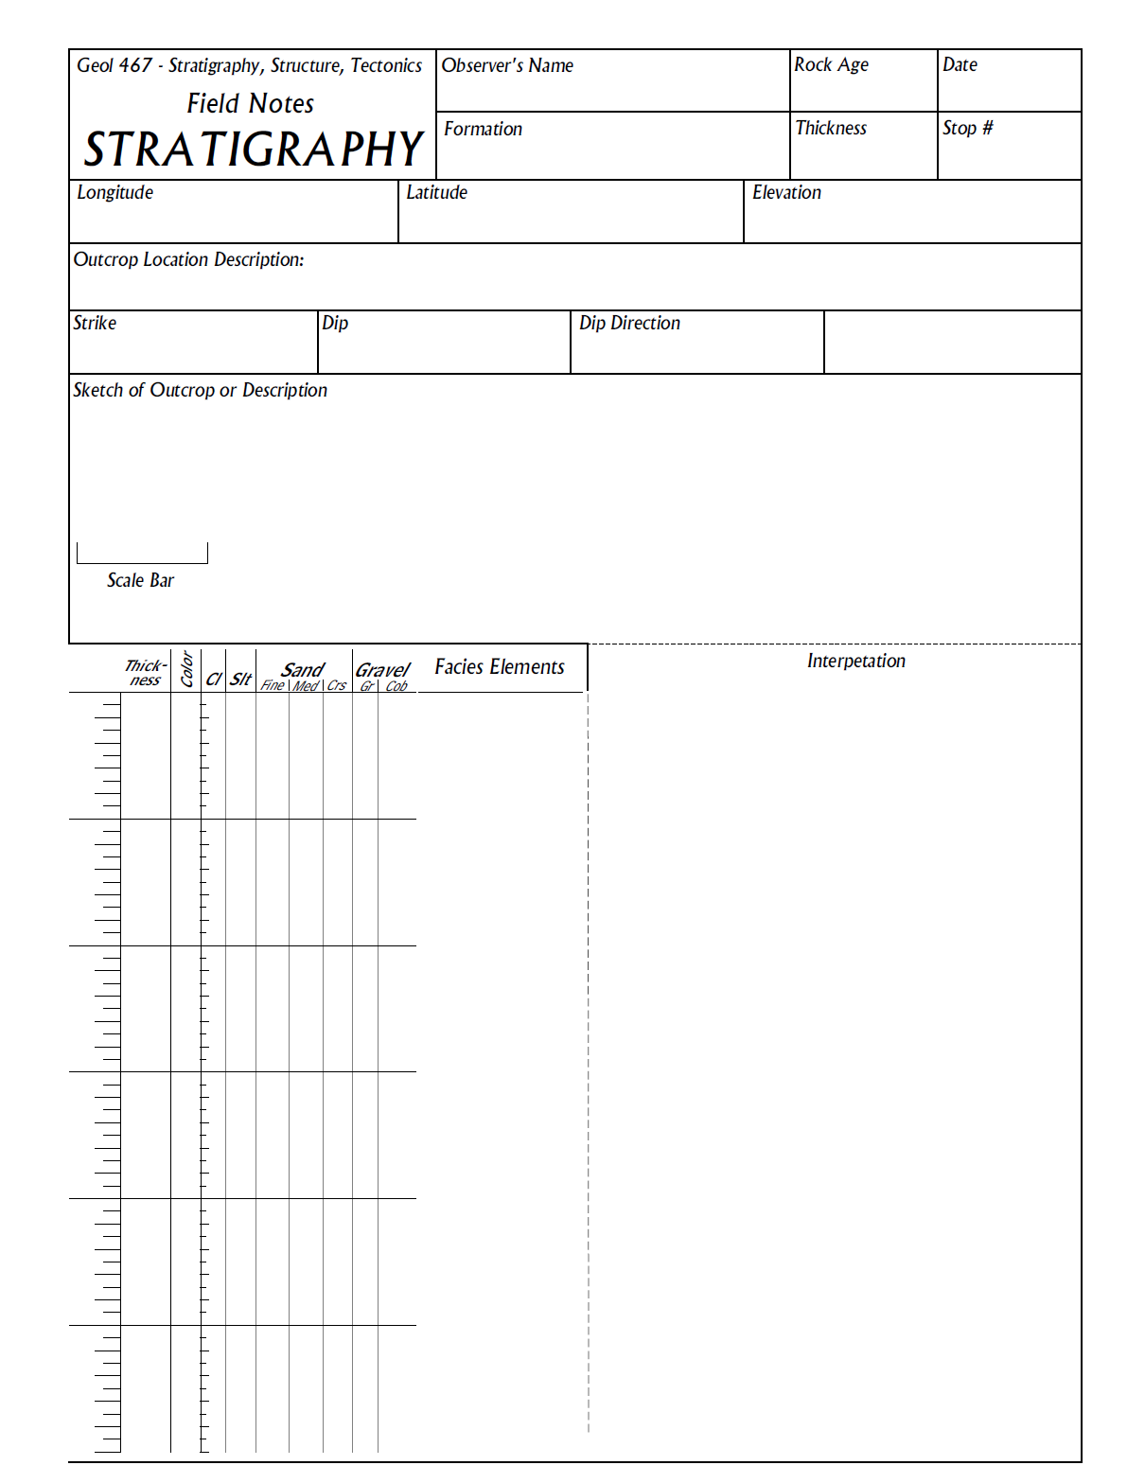
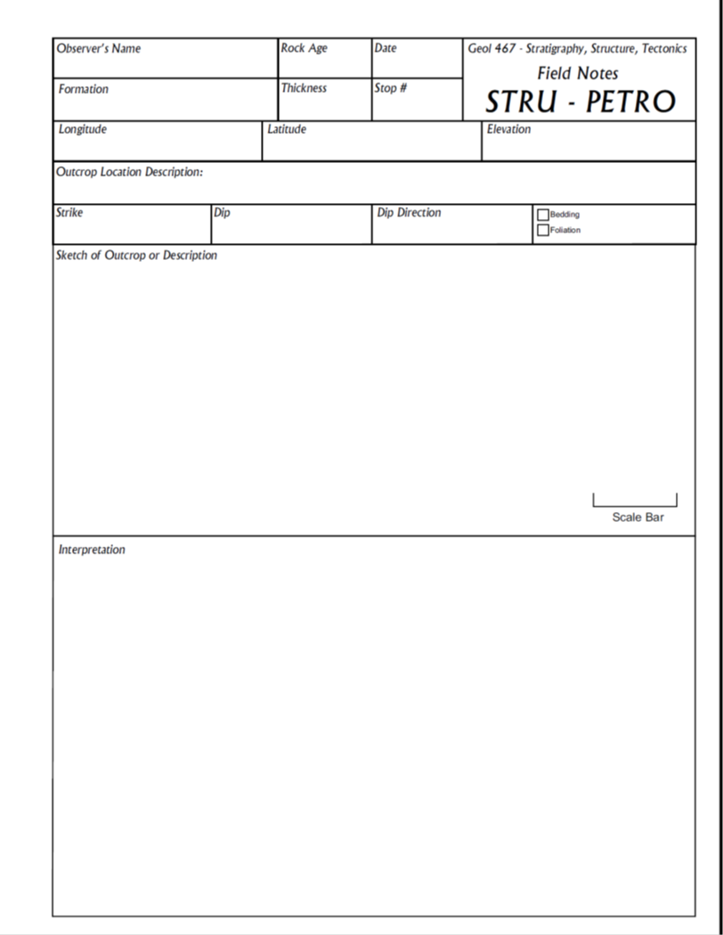
Field Trip Data Sheets

Slide 26
Final Deliverables:

Slide 27
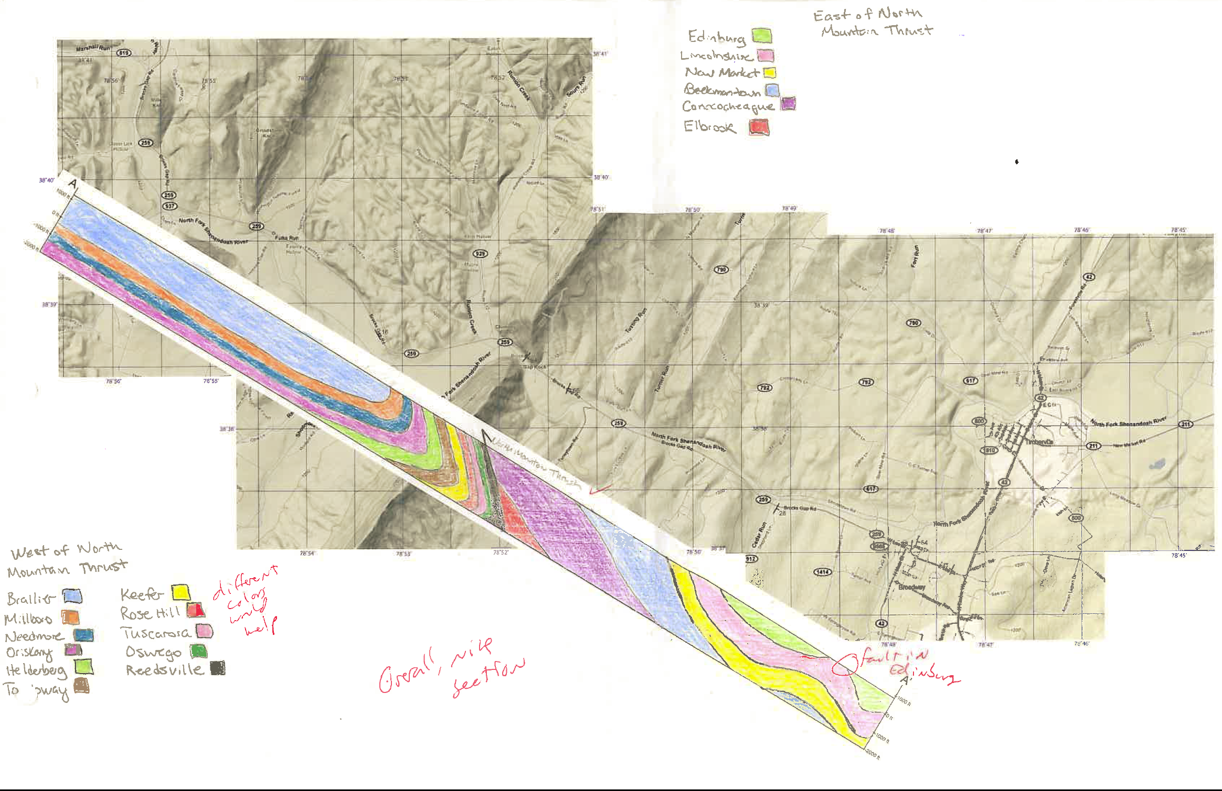

Slide 29
Future Plans
Great
Valley
Allegheny Plateau
Shenandoah Valley
Massanutten Mtn.
Allgeheny Front
Valley and Ridge
Thank you for your attention.
Questions?
Page Valley
Blue Ridge Mtn.
Shenandoah Mtn.
Blue Ridge Province
Piedmont

