Slide 1
NSTA’s Position Statement on the Teaching of Climate Science
A TOPICAL TOOL FOR SCIENCE TEACHER EDUCATION

Slide 2
Who completed this work?
Eric Pyle (Chair)
James Madison University
Judy Braus
North American Association for
Environmental Educators (NAEEE)
Don Duggan-Haas
The Paleontological Research
Institution
Chris Geerer
Parcells Middle School
Nancy Kellogg
Retired Science Teacher
Cheryl Manning
Evergreen High School
Frank Niepold
NOAA
Barney Peterson
Monroe Elementary School
Emily Schoerning (NSTA Board
Liaison)
The Joseph & Belle Braun Anshe
Emet Religious School
Lesley Smith
Cooperative Institute for Research
in Environmental Sciences (CIRES)
Nicole Vick (NSTA Council Liaison)
Galesburg High School North
Michael Wysession
Washington University-St. Louis

Slide 3
OverView of the Situation
As the national leader in science education, NSTA provides position statements for teachers and those that support them as guidance towards aiding all students to learn science;
NSTA has long provided resources on Climate Science and Climate Change consistent with national standards for science teaching and current science, but found a need to provide focused guidance at a critical time.

Slide 4
Importance of Position Statements
Summarizes the expertise of the organization around a particular issue;
Requires the expertise of a range of contributors within the organization that contribute to the statement on that issue;
As a collective statement, the potential for bias is minimized or mitigated;
Thoroughly vetted within the organization, potentially with external verification;
Provides guidance to members and to those that support the same mission;
They are, in effect, putting the reputation and credibility of the organization at stake.
(Craven, 2009, What’s the worst that could happen?)

Slide 5
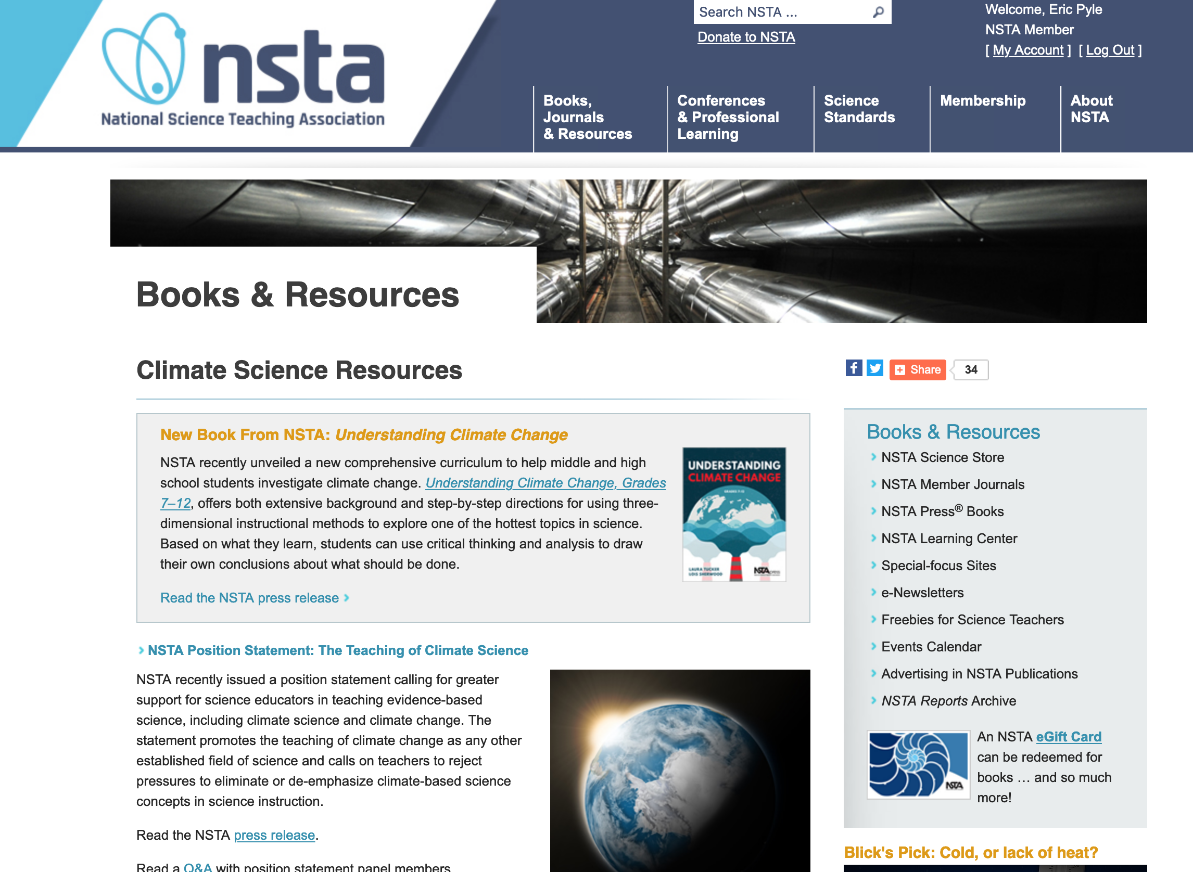
http://www.nsta.org/climate

Slide 6
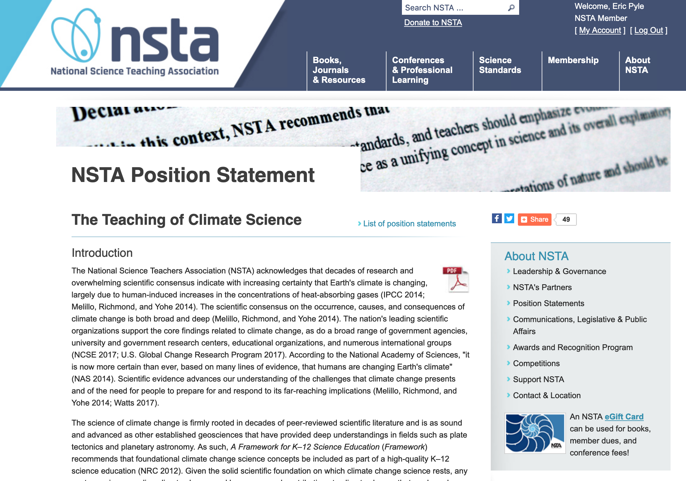
Text

Slide 7


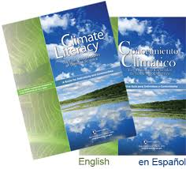
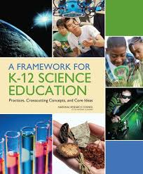
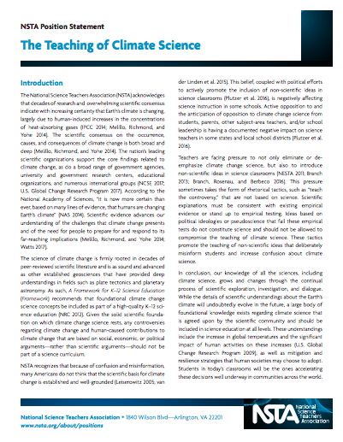
2007
2009
2012
2018
Timeline for Advancing Climate Literacy in the Education Systems

Slide 8
When was this statement developed?
March 2017 - NSTA Board voted to initiate the development of a position statement;
May 2017 - Committee empaneled;
Summer/Fall 2017 - Committee met by phone to organize and set priorities within document;
Fall/Winter 2018 - Draft statement organized;
February 2018 - NSTA reviewed and commented on 1st draft
Spring 2018 - Statement revised and sent for external scientific review;
May 2018 - Final draft completed and sent to NSTA Board for final revisions;
July 2018 - Second review by NSTA Board and sent to membership for comment;
August 2018 - Final approval of Statement and drafting of supplemental materials;
September 2018 - Final release of Statement and supplemental materials

Slide 9
Introduction
The nation’s leading scientific organizations support the core findings related to climate change, as do a broad range of government agencies, university and government research centers, educational organizations, and numerous international groups (NCSE 2017; U.S. Global Change Research Program 2017).
U.S. Global Change Research Program. 2017. Climate science special report: Fourth national climate assessment, Vol. 1 [Wuebbles, D.J., D.W. Fahey, K.A. Hibbard, D.J. Dokken, B.C. Stewart, and T.K. Maycock (eds.)]. Washington, CC: U.S. Global Change Research Program.

Slide 10
Introduction
Establishes that there is an overwhelming scientific consensus the climate system is changing, driven by human-induced increases in heat-trapping gases;
Any controversies that exist with respect to climate change that are based on social, economic, or political arguments should not be part of the science curriculum;
There is misinformation about climate change concepts, and active opposition in some quarters that opposes the teaching of climate change concepts;
Calls to “teach the controversy” are rhetorical tactics that are not based on science and can promote the teaching of non-scientific concepts;
Confirms the solid scientific foundation on which climate science is based, and advocates for its teaching in K-12 and higher education.

Slide 11
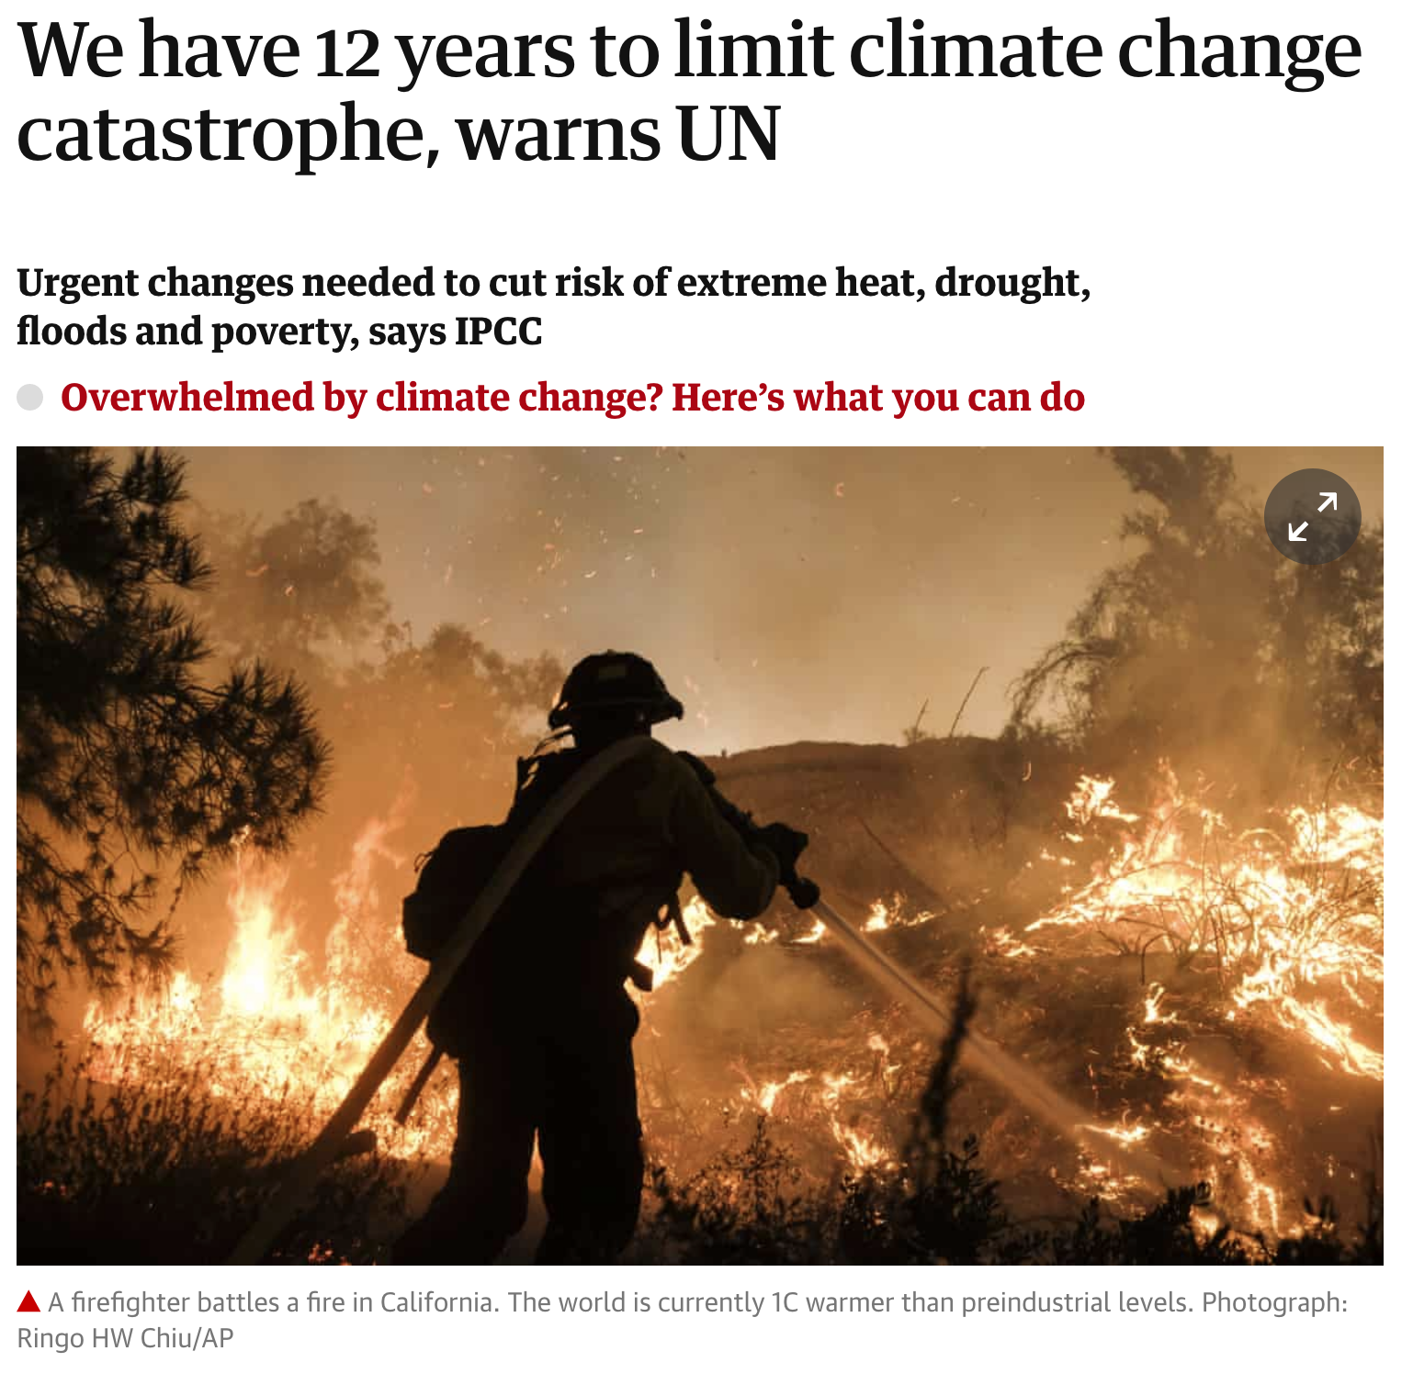
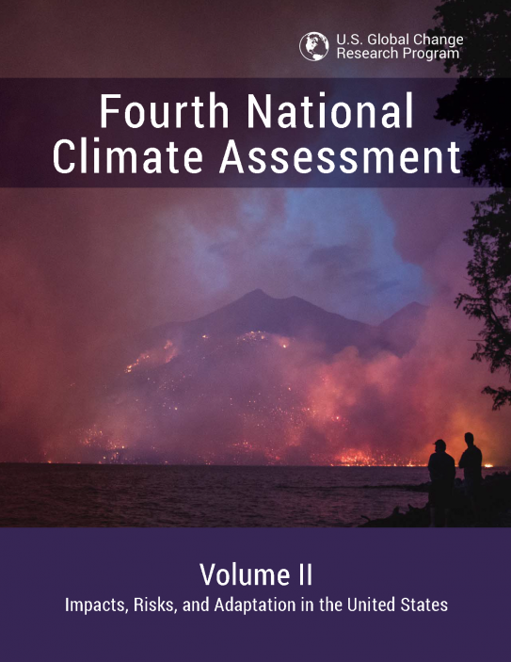
Why Now?

Slide 12
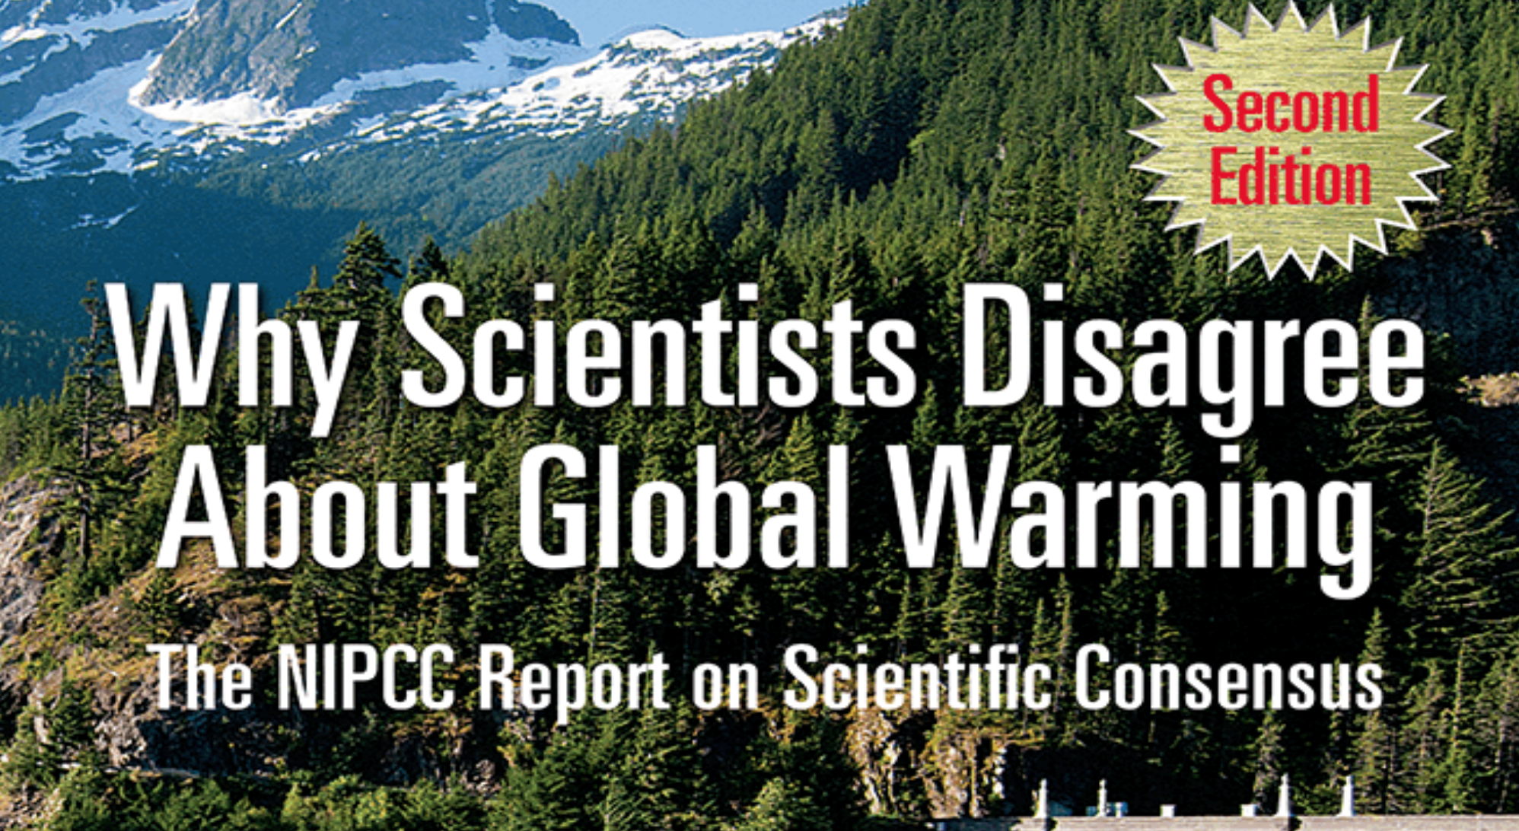
So how many of you receiveD this document? Thoughts?

Slide 13
Why Now?
Now more than ever, we need to give educators the support they need to stand up against pressures from special interests, parents, or their state leaders to teach ideas not based on scientific evidence.
Teachers need ongoing professional learning opportunities to strengthen their content knowledge, enhance their teaching practices, and help build their confidence to address socially controversial topics in the classroom.
The NSTA position statement acknowledges the solid scientific foundation on which climate change science rests and advocates for quality, evidence-based science to be taught in science classrooms.

Slide 14
Why Now?
The consequences of mitigating the effects of climate change and or the social and political implications could be explored in other areas of school, such as social studies, but they do not belong in science. Allowing non-scientific ideas in the science classroom take s away from valuable instruction time.
Many teachers, especially those at the elementary level, don’t receive specialized training on climate science. It’s critical that they be provided with professional learning to build stronger content knowledge and confidence to teach it.
Climate science is a framework that integrates all earth systems and allows us to apply science concepts in physics and life science.

Slide 15
What is important?
Q: What are the key points of the climate change position statement?
A: Acknowledging the solid scientific foundation on which climate change science rests, the statement calls for greater support for science educators in teaching evidence-based science, including the science of climate change. It promotes the teaching of climate change as any other established field of science and calls on teachers to reject pressures to eliminate or de-emphasize climate-based science concepts in science instruction.
Q: Why did NSTA decide to issue this statement?
A: NSTA has long supported the teaching of climate science by providing teachers with books, vetted resources, and other professional learning opportunities on the topic. But there is a significant effort to undermine science education and misinform the public about climate change. To address this, teachers need more professional learning opportunities to strengthen their content knowledge, enhance their teaching practices, and help build their confidence to address socially controversial topics in the classroom.

Slide 16
What is important?
Q: Why now? Why wasn’t this done years’ ago?
A: While we have long supported the teaching of climate science and support the Framework which advocates for it, we felt we wanted to add our voice in support of teachers and call on stakeholders to be involved.
Q: What do NGSS say about climate change?
A: The Next Generation Science Standards and the Framework on which they were built provided a large amount of clarity to teachers about the role of climate change and what should be taught. Climate change, and the fact that humans contribute, is included in the NGSS, which was released in 2013 and has been adopted by 20 states and DC. In fact, NSTA was a partner in the development of the standards that include key concepts of climate science.
Q: Are teachers facing extraordinary pressures to not teach climate science?
A: There is evidence that some teachers are feeling pressure to teach an apparent “controversy” around climate change, or to teach “both sides” of the issue. We hope this statement clarifies that there is no scientific controversy and gives them another layer of support to keep evidence-based science in the science classroom.

Slide 17
Declarations
For teachers:
  recognize the cumulative weight of scientific evidence that the Earth’s climate is changing and driven by human release of heat-heat-absorbing gases;
  there is no scientific controversy regarding the basic facts of climate change
  teach climate change as any other established field of science;
  analyze different climate change mitigation strategies with students

Slide 18
Declarations
For administrators and school boards:
  provide teachers with ongoing professional development to increase their content knowledge and develop their confidence in addressing socially controversial topics in the classroom;
  ensure that teachers have adequate time, guidance, and resources to learn about climate science;
  resist pressures to promote non-scientific views that seek to deemphasize or eliminate the scientific study of climate change.

Slide 19
Declarations
For policy makers and the community:
  ensure that licensure standards include climate change science content;
  preserve the quality of science education by rejecting censorship, pseudoscience, and narrow political agendas
  augment the work of science teachers by supporting students science learning at home;
  help students to understand the contributions that STEM professionals, policy makers, and educators can make to mitigate the effects of climate change.

Slide 20
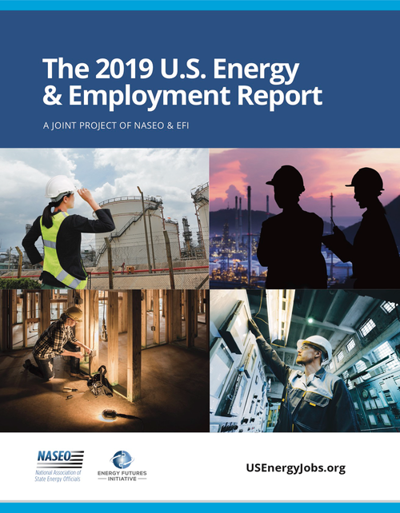
Energy Jobs Trends
The U.S. Energy & Employment Report provides a unique window on the people who meet the nation’s energy needs, and identifies important trends and skill sets for the 21st Century energy workforce.
• 2018 Job Loss. In 2018, the Electric Power Generation sector dropped 8,258 jobs, declining by almost 1 percent to a total of 875,585 jobs.
• Technology Shifts. Advanced natural gas added the most new jobs, 4,500, while solar contracted, losing 8,000 jobs. Other technologies that grew included wind, combined heat and power, and geothermal. Nuclear and coal declined.
• 2019 Expectations. Electric Power Generation employers anticipated 7.1 percent job growth in 2019, with most of the increase expected in renewable construction.
Notes:
https://www.usenergyjobs.org/

Slide 21
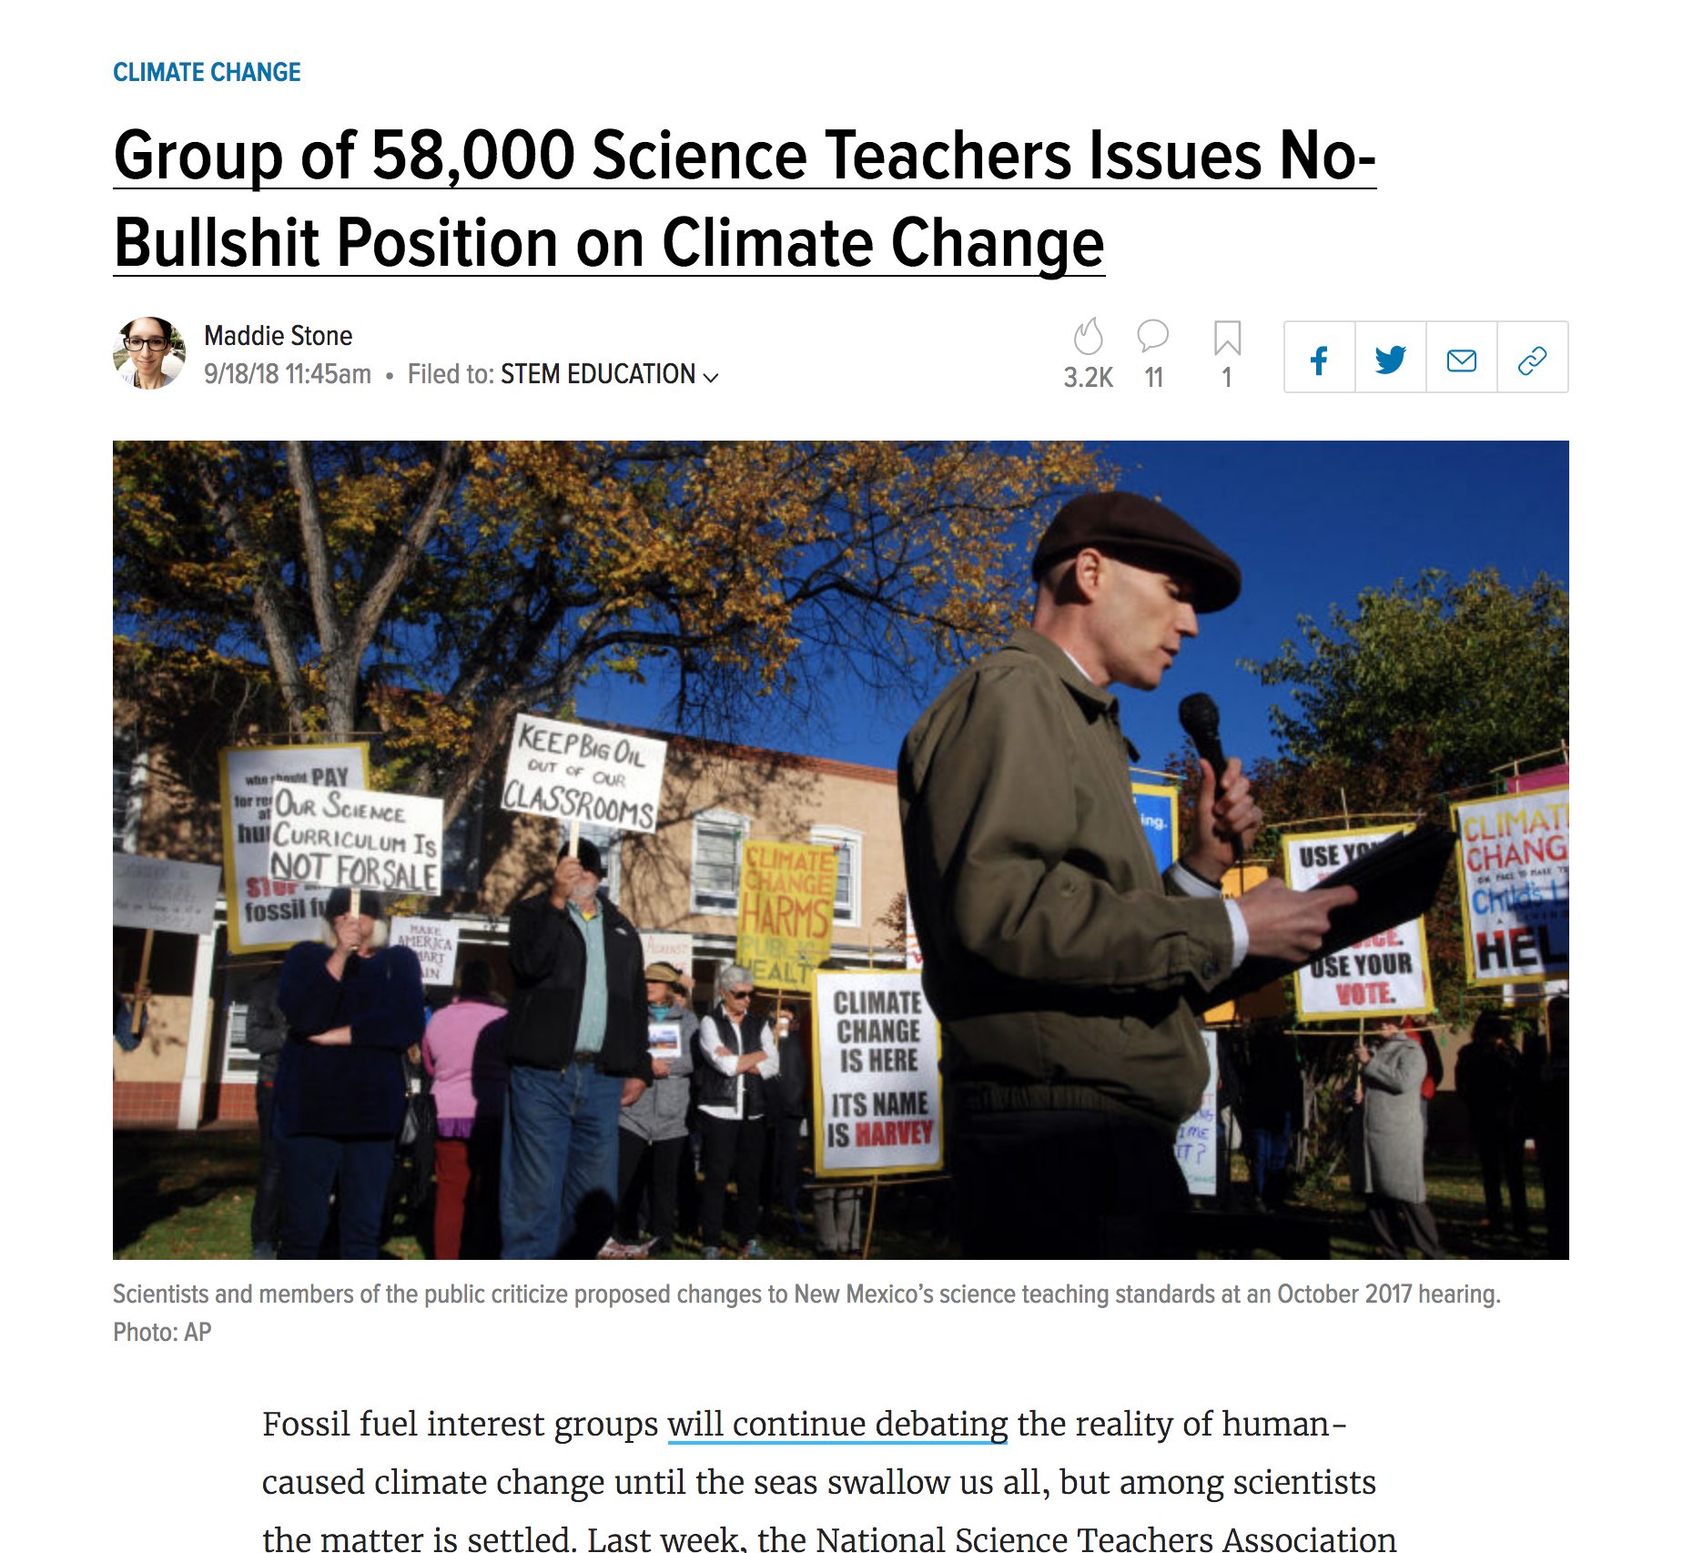
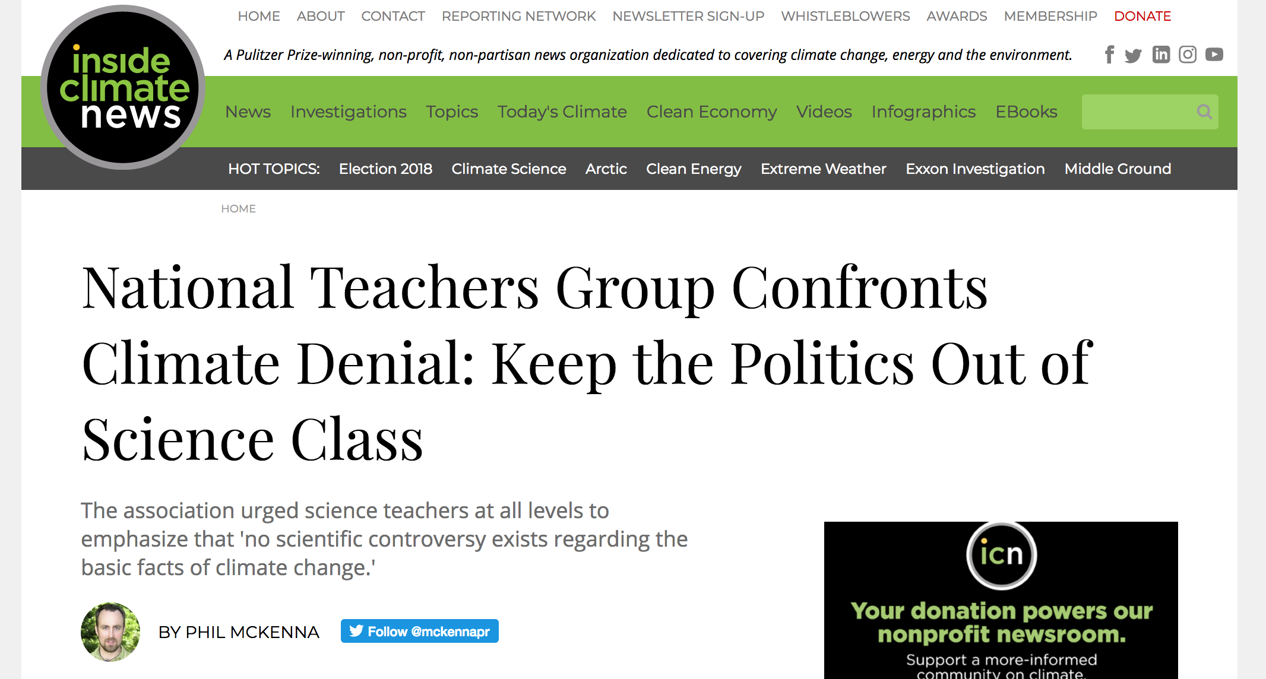
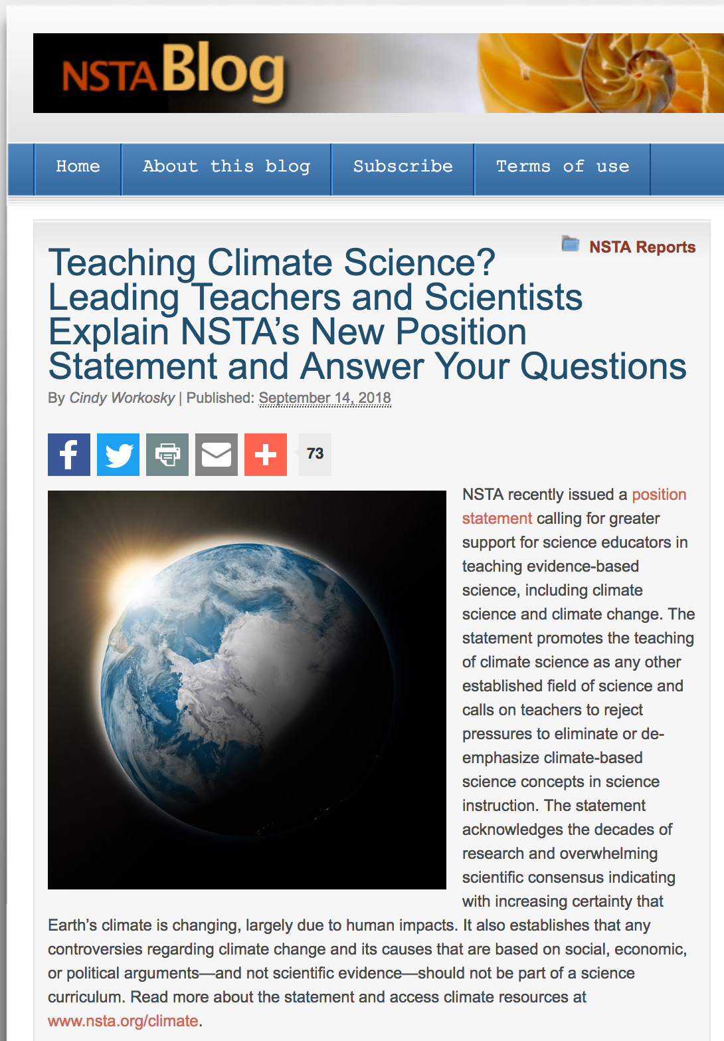
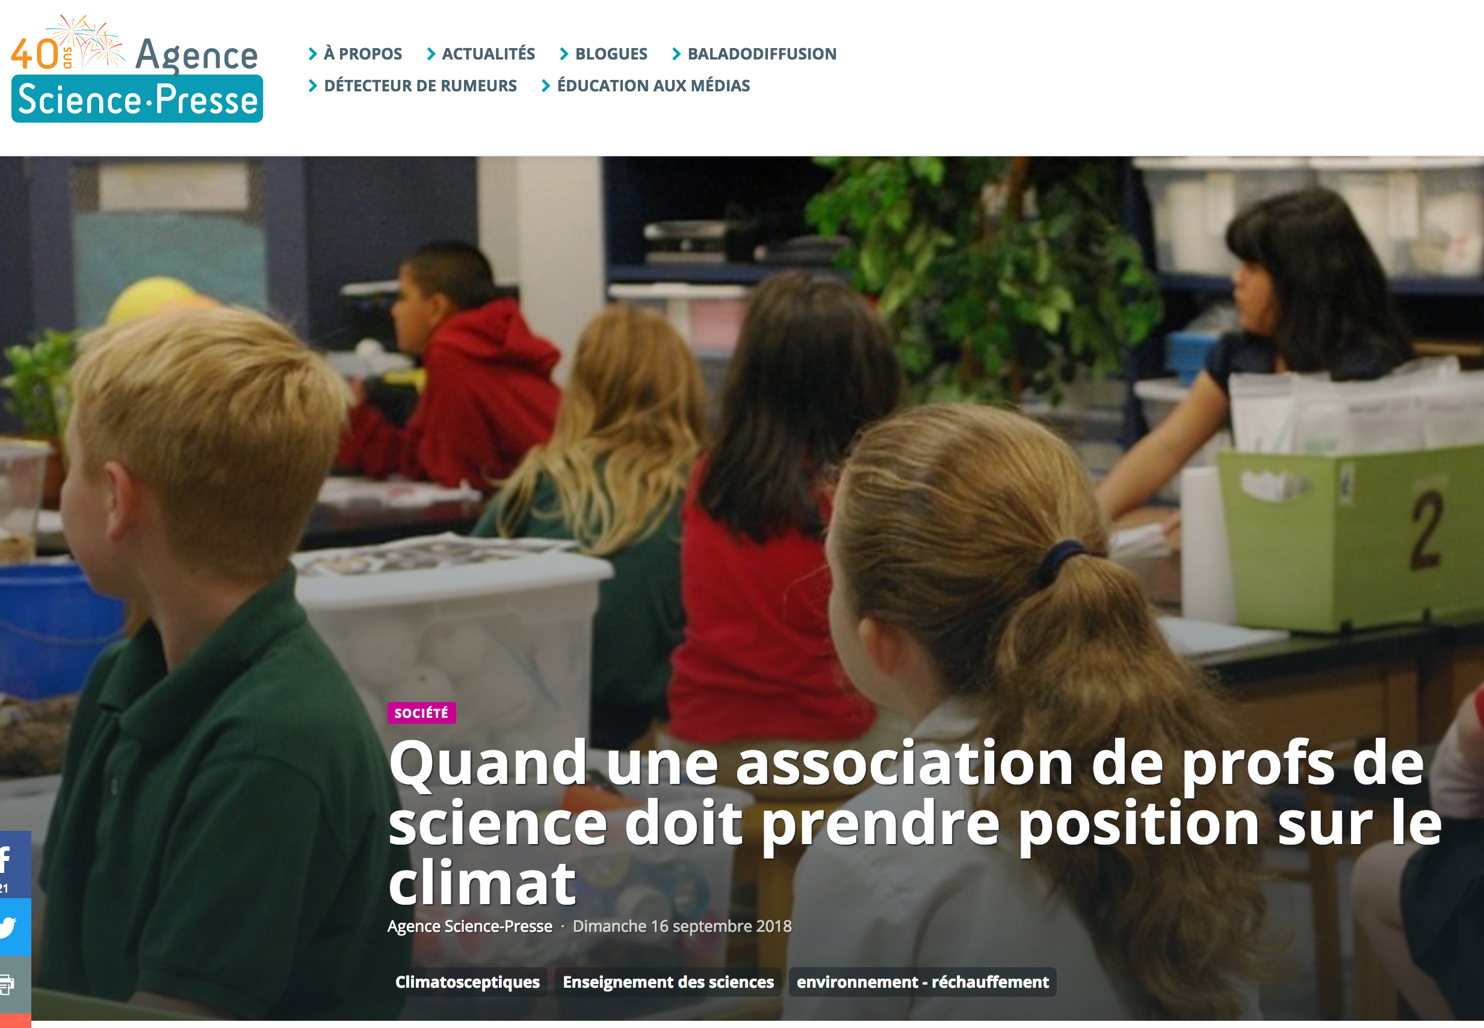
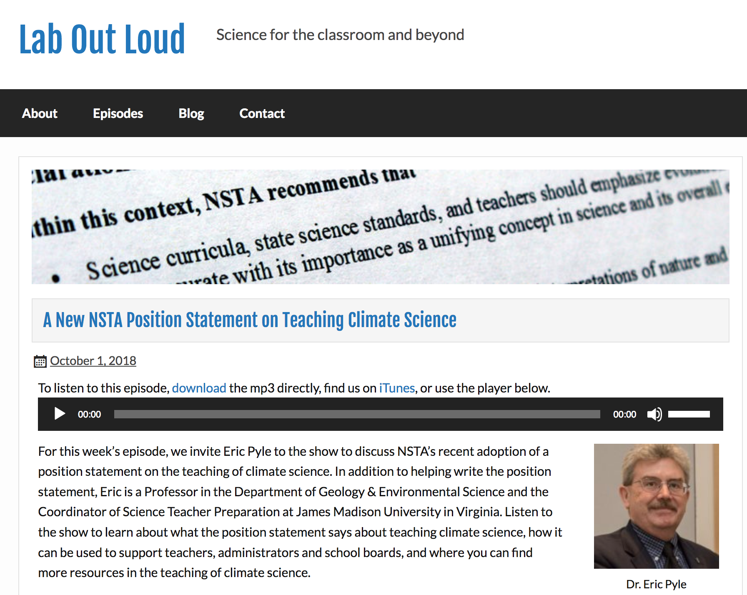
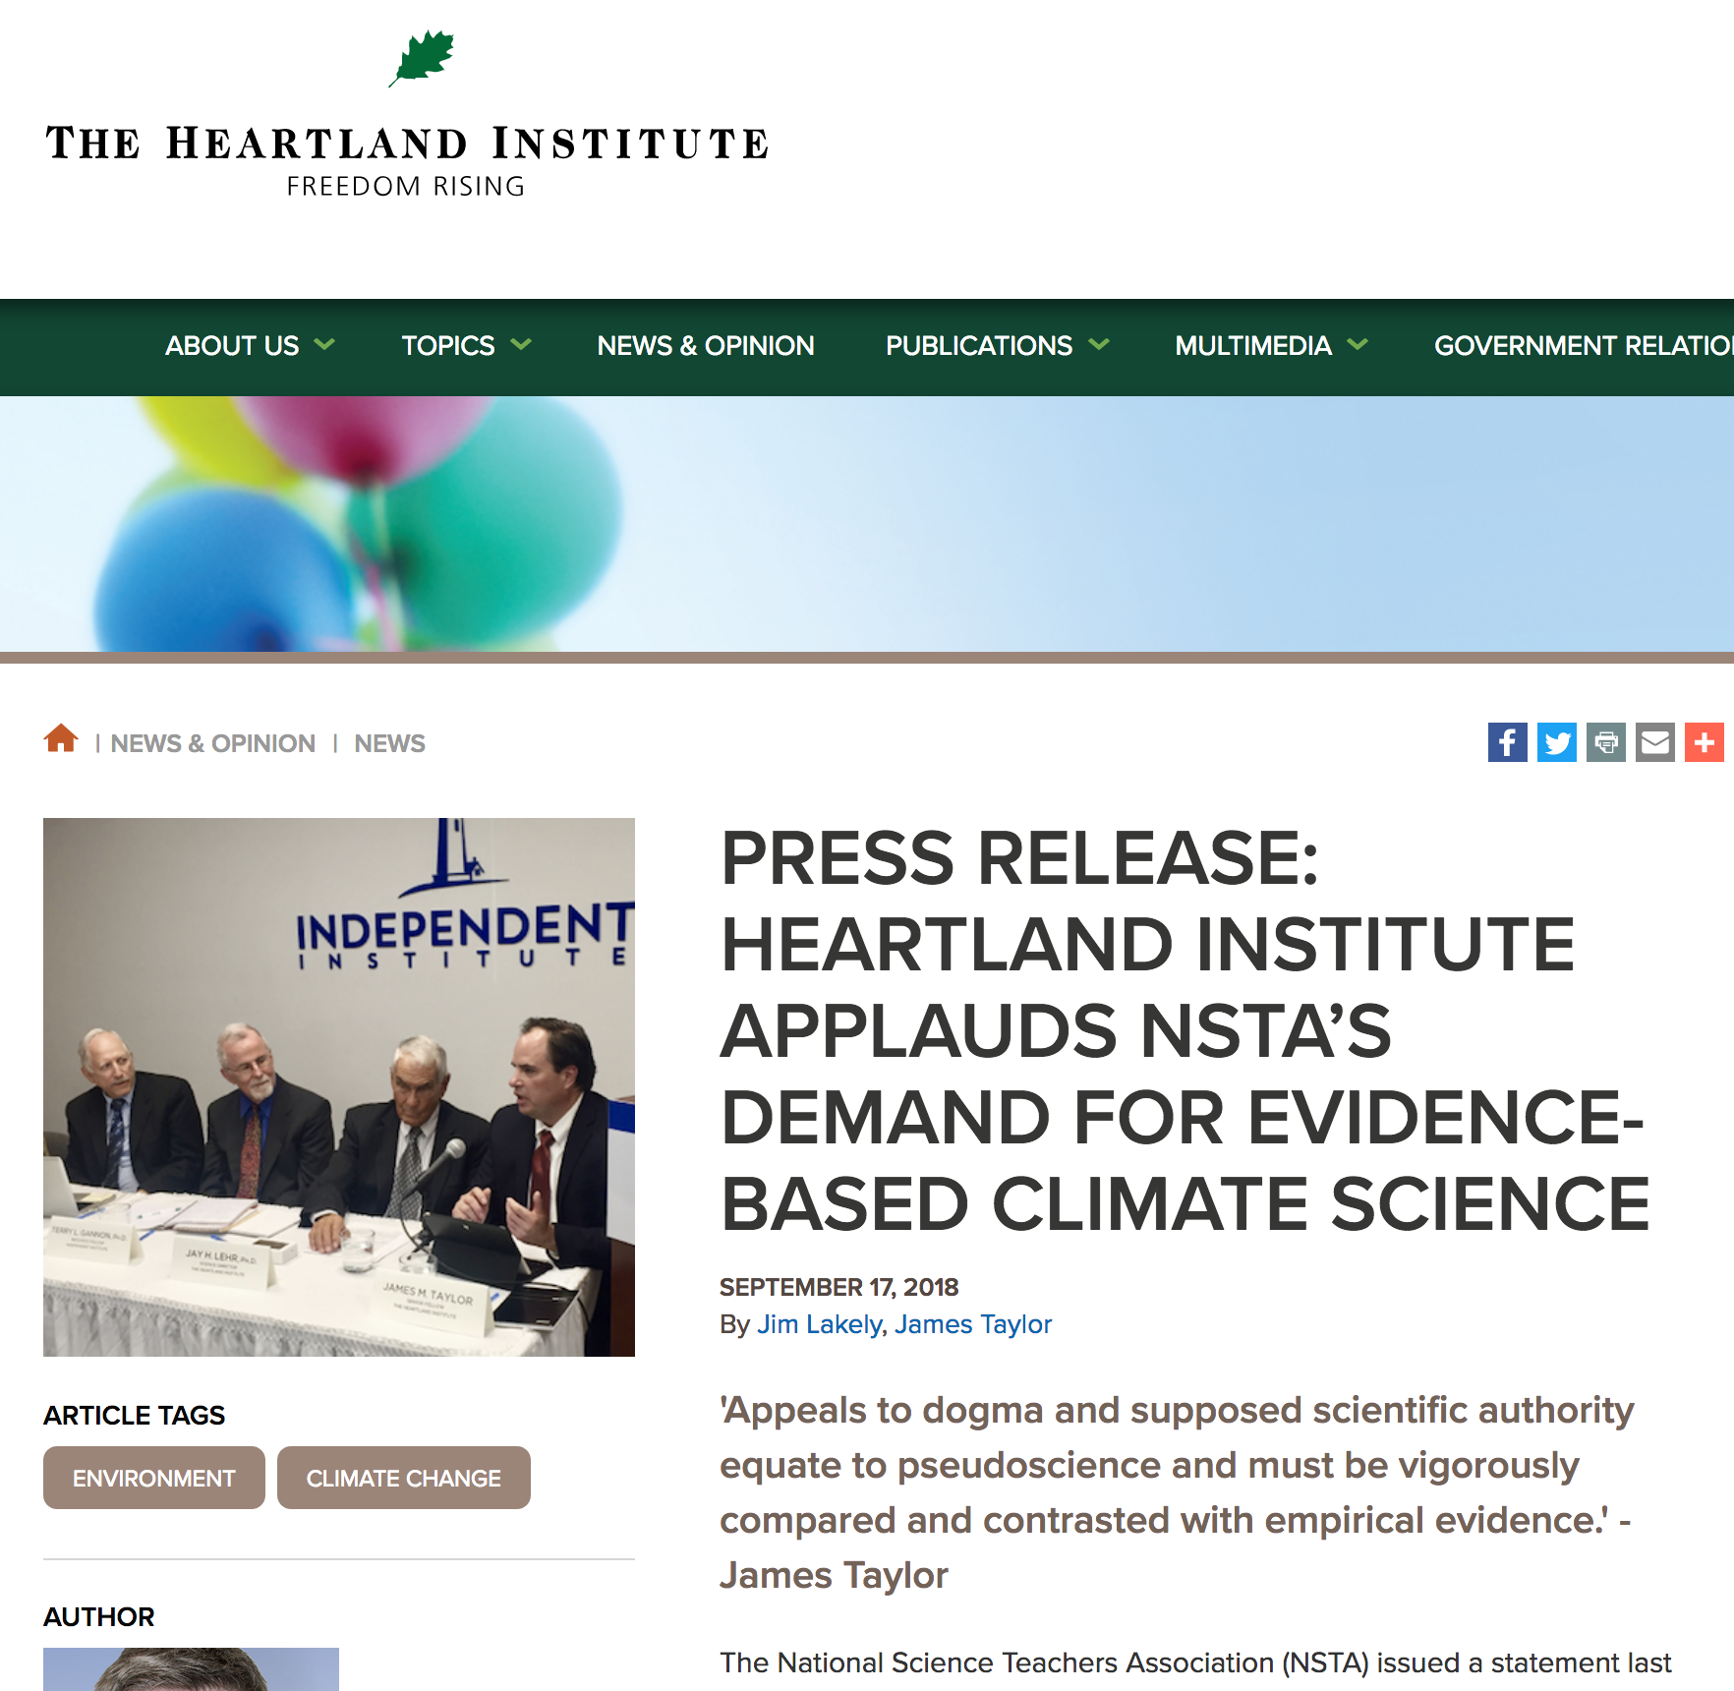
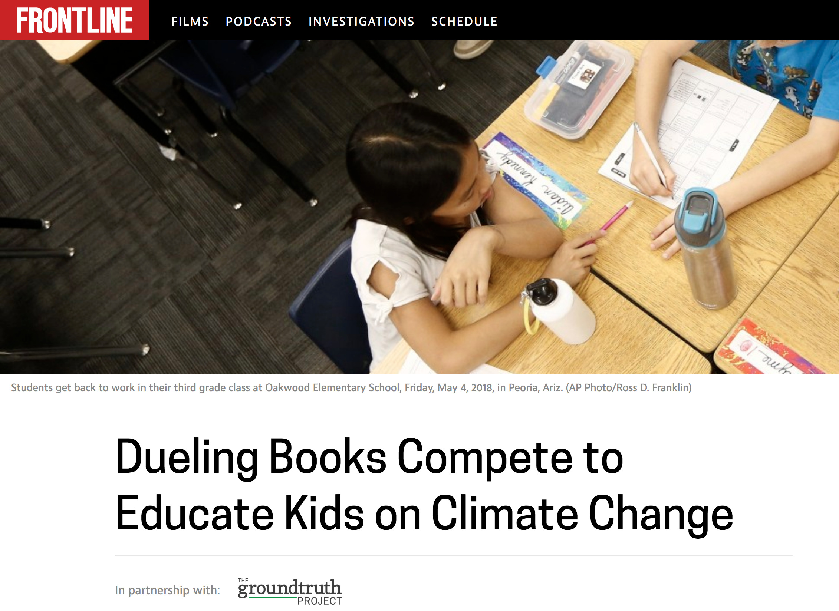
Reception of the Statement

Slide 22
What can you do?
It would be easy to sink into despair, gloom, and doom when presenting climate science and climate change. Instead, work with your students through STEM skills for positive actions on mitigation and resilience strategies;
Seek the collaboration of your fellow teachers, working for cross-disciplinary opportunities to reach students across the curriculum as well as longitudinally;
Expect (demand?) of your administrators the professional development and curricular support necessary to represent climate science to your students and build your personal professional confidence and competence on the subject;
Do not limit your voice to the classroom, but communicate clearly to the community and the media what you are doing to impact the future of society through the thorough teaching of climate science, climate change, and climate resilience.

Slide 23
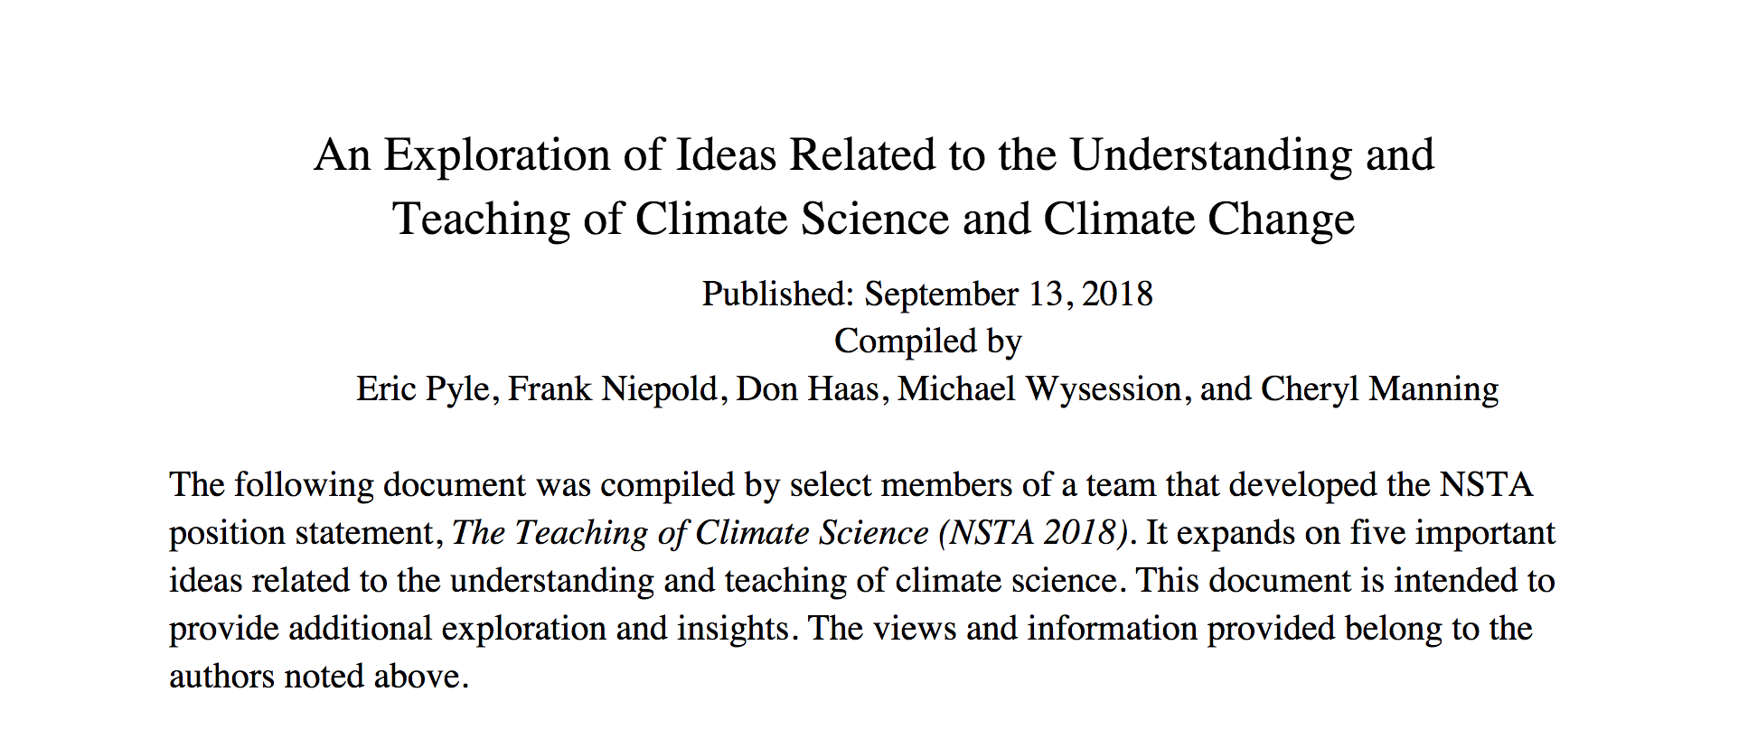
Supplemental Resources
The Nature of Science and Scientific Decision-Making;
Controversy and Personal Beliefs;
The Nature of Deep-Seated Beliefs;
The Time Needed for Learning;
Responses to Climate Change
  http://static.nsta.org/pdfs/AnExplorationOfIdeasRelatedToTheUnderstandingAndTeachingOfClimateScienceAndClimateChange.pdf

Slide 24
THE NATURE OF SCIENCE AND SCIENTIFIC DECISION-MAKING
Science educators need to focus on presenting concepts, including climate change, that are supported by empirically-based evidence collected from the natural world. The existence of uncertainty does not undermine the scientific validity of climate change science: To the contrary, it provides a sound example for broader instruction of science practices. The empirical evidence that science provides and the way that science both explains past events and offers possible future outcomes have roles in many academic disciplines including social studies, history, mathematics, economics, and literature classes.

Slide 25
CONTROVERSY AND PERSONAL BELIEFS
One of the central components of the Science and Engineering Practices (SEPs) in both the Framework and NGSS is the expectation that students should argue from evidence. Specifically, Appendix F of the NGSS states that “Argumentation is a process for reaching agreements about explanations and design solutions.” This requires individuals to distinguish between opinions and evidence and be prepared to “respectfully provide and receive critiques” about evidence and scientific reasoning.
There have been widely-publicized calls from non-scientists to use constitutionally-guaranteed free speech and the tradition of academic freedom as a reason to “teach the controversy” and “let the students decide” based on rhetorical arguments. These are political and academic philosophies and are not equivalent to scientific philosophy of argumentation and dialogue based on empirical evidence….The employment of “free speech” and “academic freedom” lacking data and empirical analysis is an abuse of the terminology to support a particular non-scientific political or economic endpoint.

Slide 26
The Nature of Deep-Seated Beliefs
Some of the psychological obstacles related to understanding climate change science are the result of temporal and spatial scales. Individuals carry a personal bias to view natural events within the span of a human lifetime, so understanding the temporal scales of past changes are difficult.
Spatial scale perception is another barrier. “Social math” uses familiar examples to show mass, volume, or relative number (NCIPC 2008). Individuals can perceive the square-footage of a house, the average volume of a tank of gas in a car, or the size of a science class, but the amount of annual human carbon emissions, presented in megatons, is more difficult.
Learning about climate change can be a more emotional experience than learning about other scientific topics, which is an indicator of climate change’s interdisciplinary nature. Climate change is an emotional topic because it is connected to issues of ideology and political identity.
Belief systems do not necessarily arise from logic and evidence, which are the bases of scientific understanding. Belief systems are founded in one’s faith, family, and personal emotional experiences unique to the individual

Slide 27
Responses to Climate Change
The rise of civilizations, the alteration of atmospheric chemistry, and the changes of climate intertwine. Indeed, the potential effects of increased greenhouse gases in the atmosphere, most notably from carbon dioxide, have been recognized since the work of John Tyndall in 1859 (Hulme 2009)
Climate research has shown that once carbon dioxide is in both the atmosphere and ocean at the enormous quantities now existing, removing it or countering its effects will require climate intervention actions at unrealistically enormous scales, and these actions would not only be exorbitantly expensive, but would create unintended environmental impact problems.
Climate change science offers an opportunity to learn from projections of different carbon emission pathways and their various climate impacts before we experience them, while also providing insights into how we can avoid those impacts. Taken together, scientific understanding of the causes and potential consequences of climate change provide a clear imperative for a rapid transition to a low-carbon economy.

Slide 28
The Time Needed for Learning
Teaching about any form of human impact on Earth systems is most effective when encouraging students to approach the topic from the perspective of designing and revising mitigation strategies and solutions to problems, not just focusing on the problems themselves. Teachers require sufficient time to adequately plan instruction that supports student engagement with the complexity of climate change science, as well as adequate time for student understanding to progress from basic concepts to complex interactions.

Slide 29
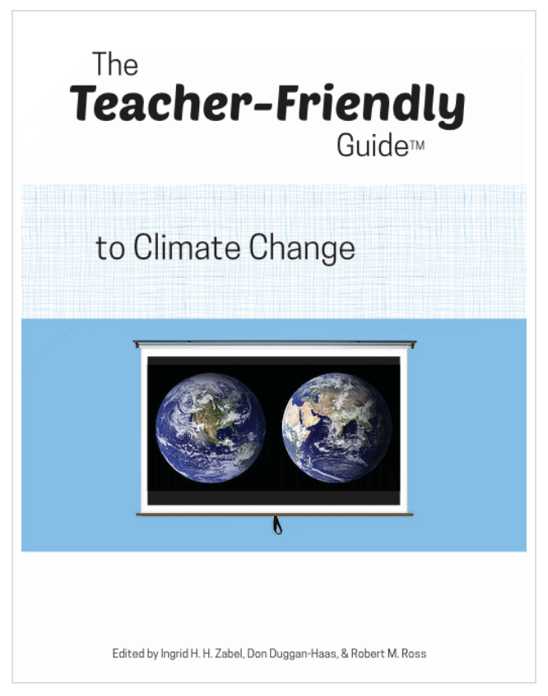
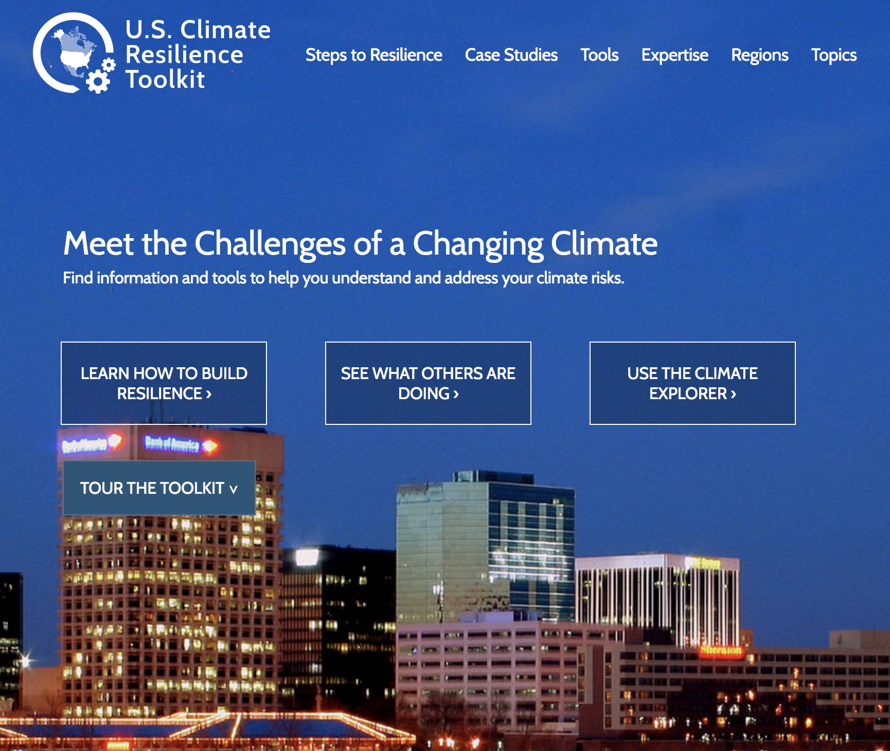
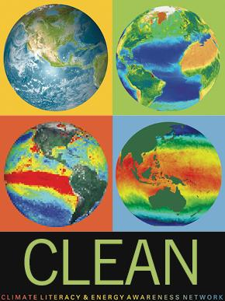
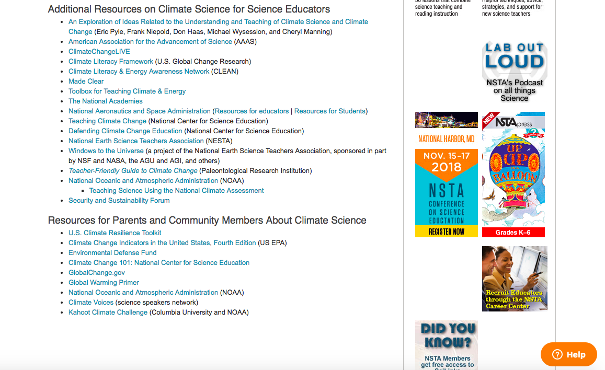
Supplemental Resources

Slide 30





Climate Literacy & Energy Awareness Network
CLEAN Collection: an online database of over 700 free, peer-reviewed, and ready-to-use educational resources, including learning activities, visualizations, videos, and short demonstrations/ experiments, for teaching about climate and energy.
CLEAN Network: a professionally diverse and active community of over 678 members committed to improving climate and energy literacy since 2008.
Join us! www.cleanet.org
Notes:
Please apply your own slide template to this slide!

Slide 31
The Framework, NGSS, and Climate Change
LS2.C: ECOSYSTEM DYNAMICS, FUNCTIONING, AND RESILIENCE
    What happens to ecosystems when the environment changes?
LS4.D: BIODIVERSITY AND HUMANS
  What is biodiversity, how do humans affect it, and how does it affect humans?
ESS1.B: EARTH AND THE SOLAR SYSTEM
What are the predictable patterns caused by Earth’s movement in the solar system?
ESS2.A: EARTH MATERIALS AND SYSTEMS
How do Earth’s major systems interact?
ESS2.D: WEATHER AND CLIMATE
What regulates weather and climate?
ESS2.E: BIOGEOLOGY
How do living organisms alter Earth’s processes and structures?
ESS3.D: GLOBAL CLIMATE CHANGE
How do people model and predict the effects of human activities on Earth’s climate?
ETS2.B: INFLUENCE OF ENGINEERING, TECHNOLOGY, AND SCIENCE ON
SOCIETY AND THE NATURAL WORLD
How do science, engineering, and the technologies that result from them affect the ways in which people live? How
do they affect the natural world?

Slide 32
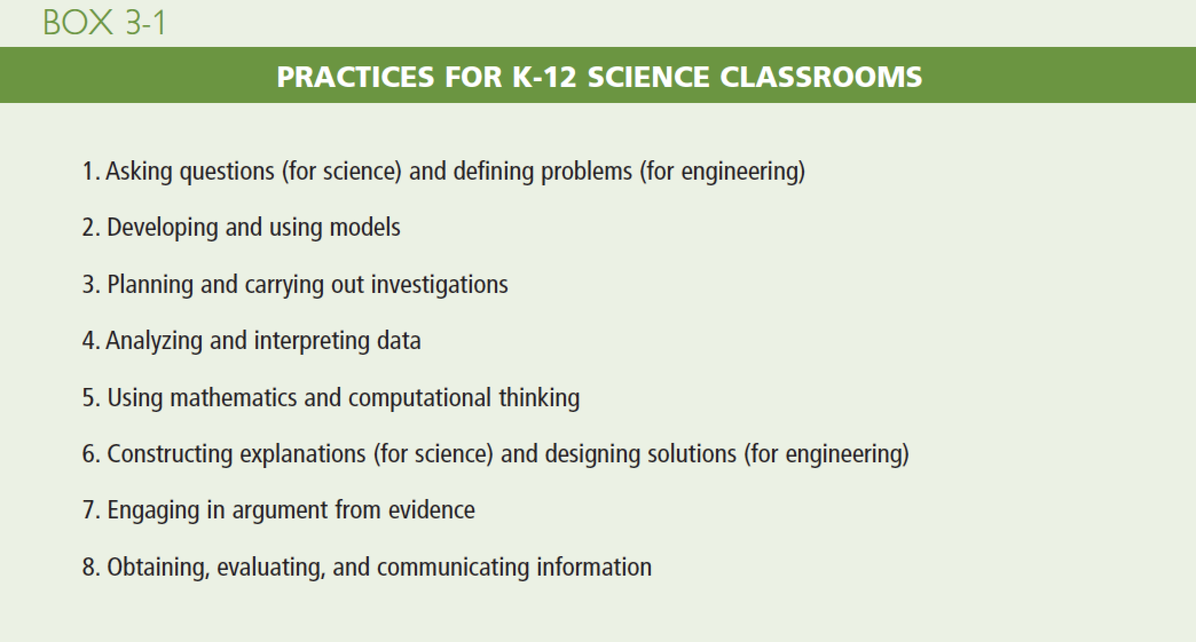
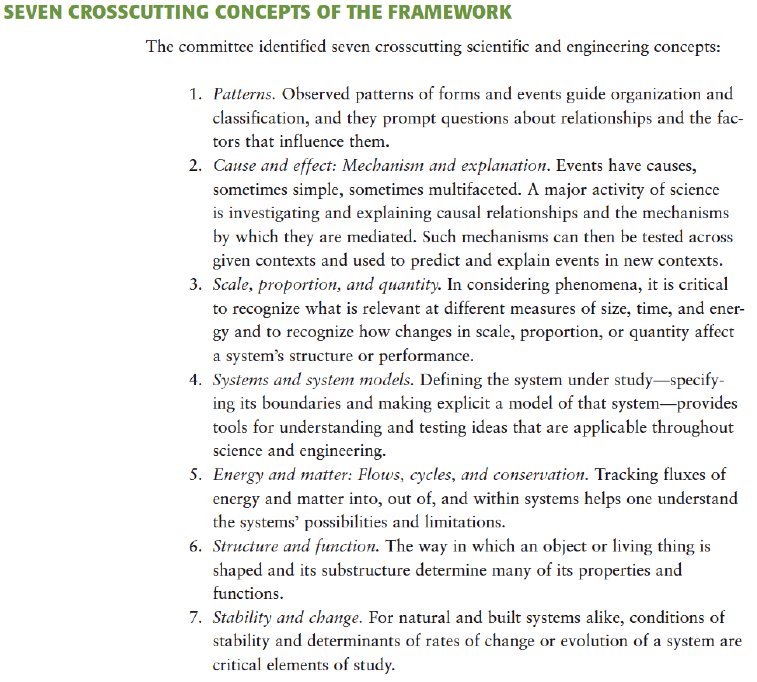
Text

Slide 33
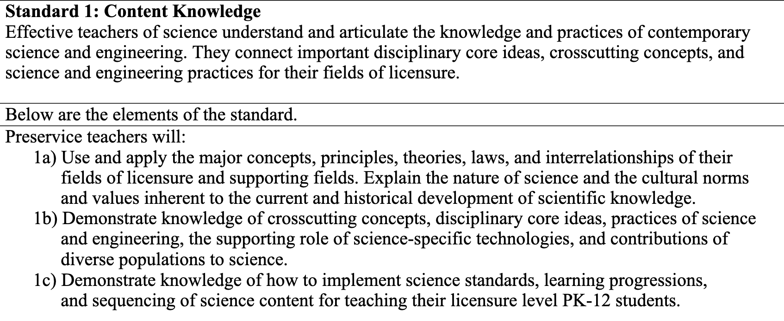
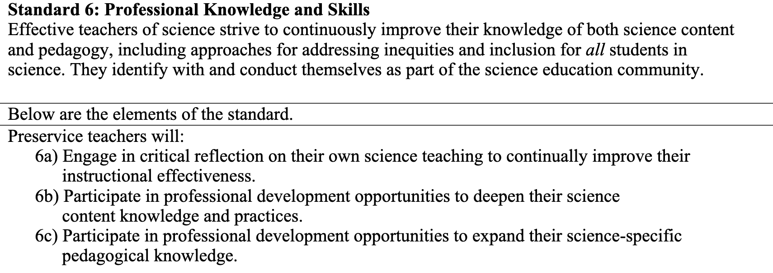
NSTA/ASTE Standards for Science Teacher Preparation
http://www.nsta.org/preservice or at
https://theaste.org/2020-nsta-aste-standards-for-science-teacher-preparation/

Slide 34
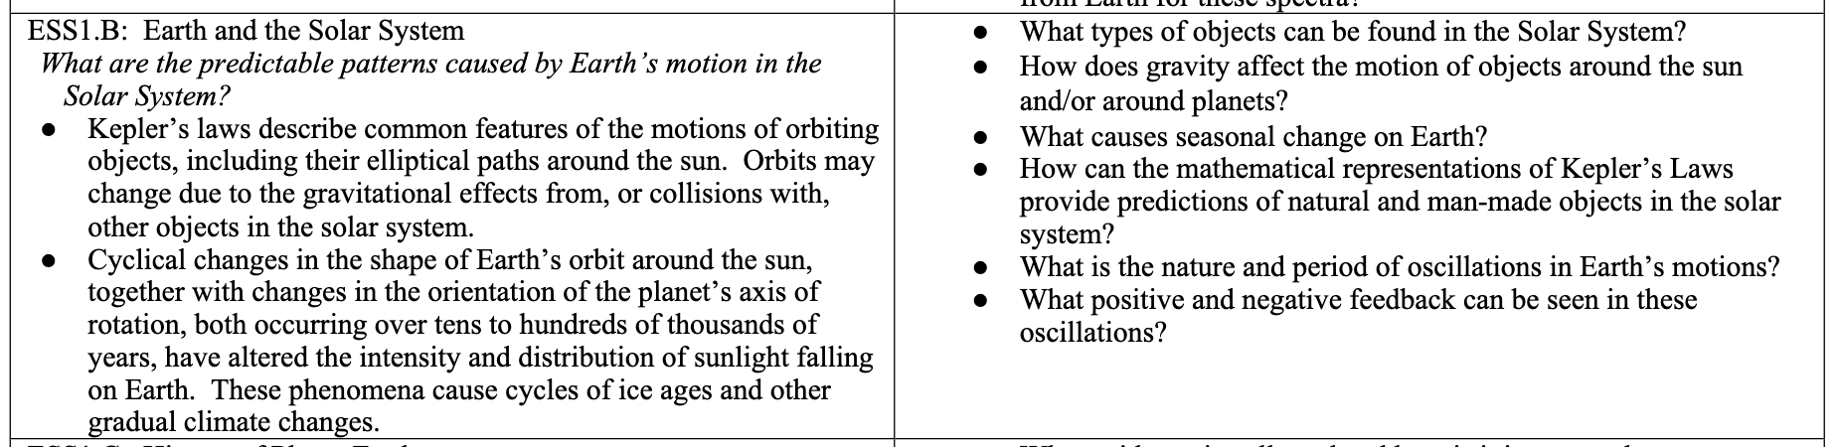
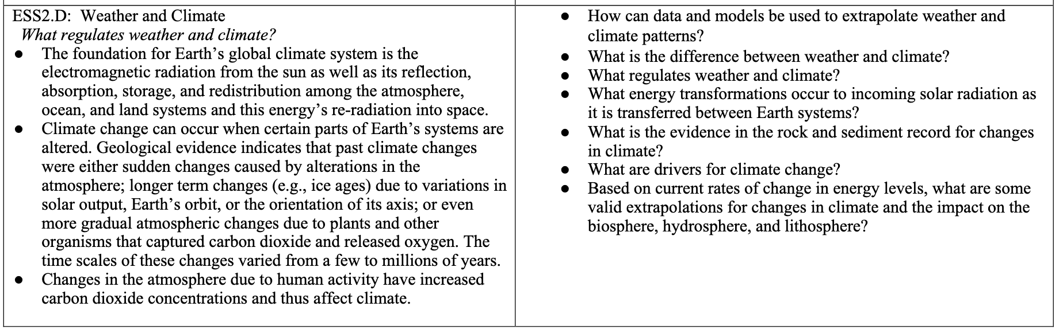
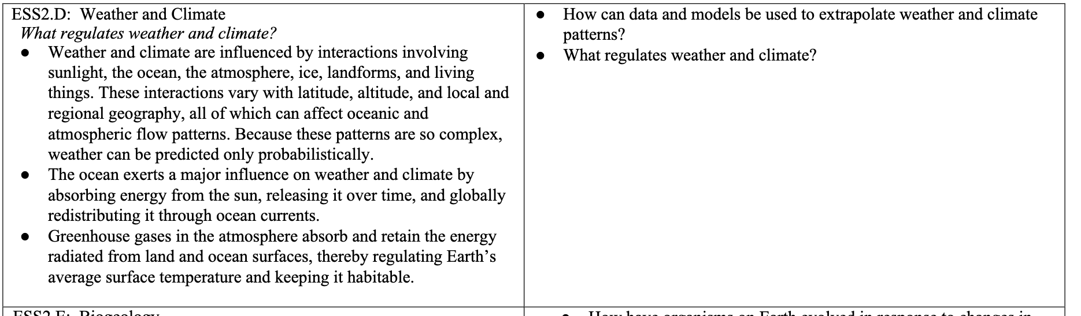
NSTA/ASTE Standards for Science Teacher Preparation
http://www.nsta.org/preservice or at
https://theaste.org/2020-nsta-aste-standards-for-science-teacher-preparation/

Slide 35
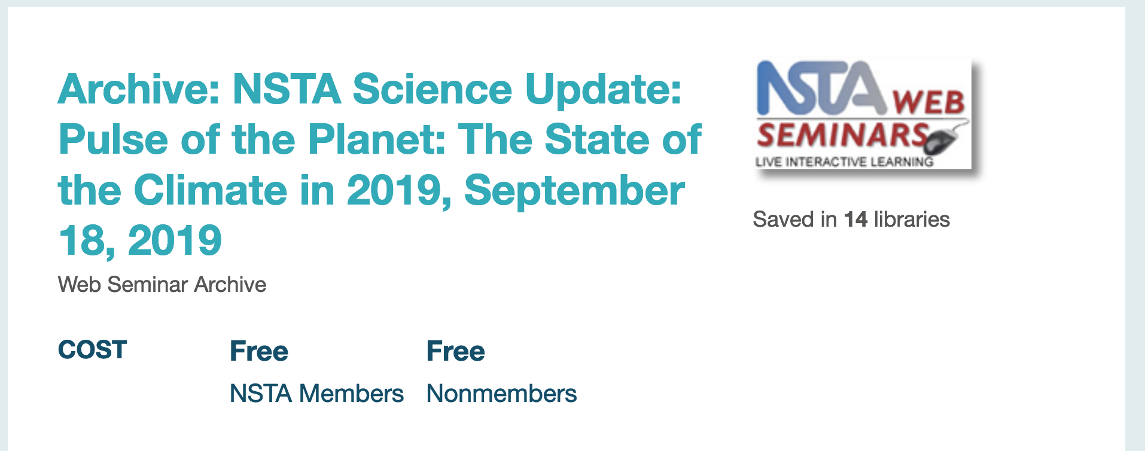
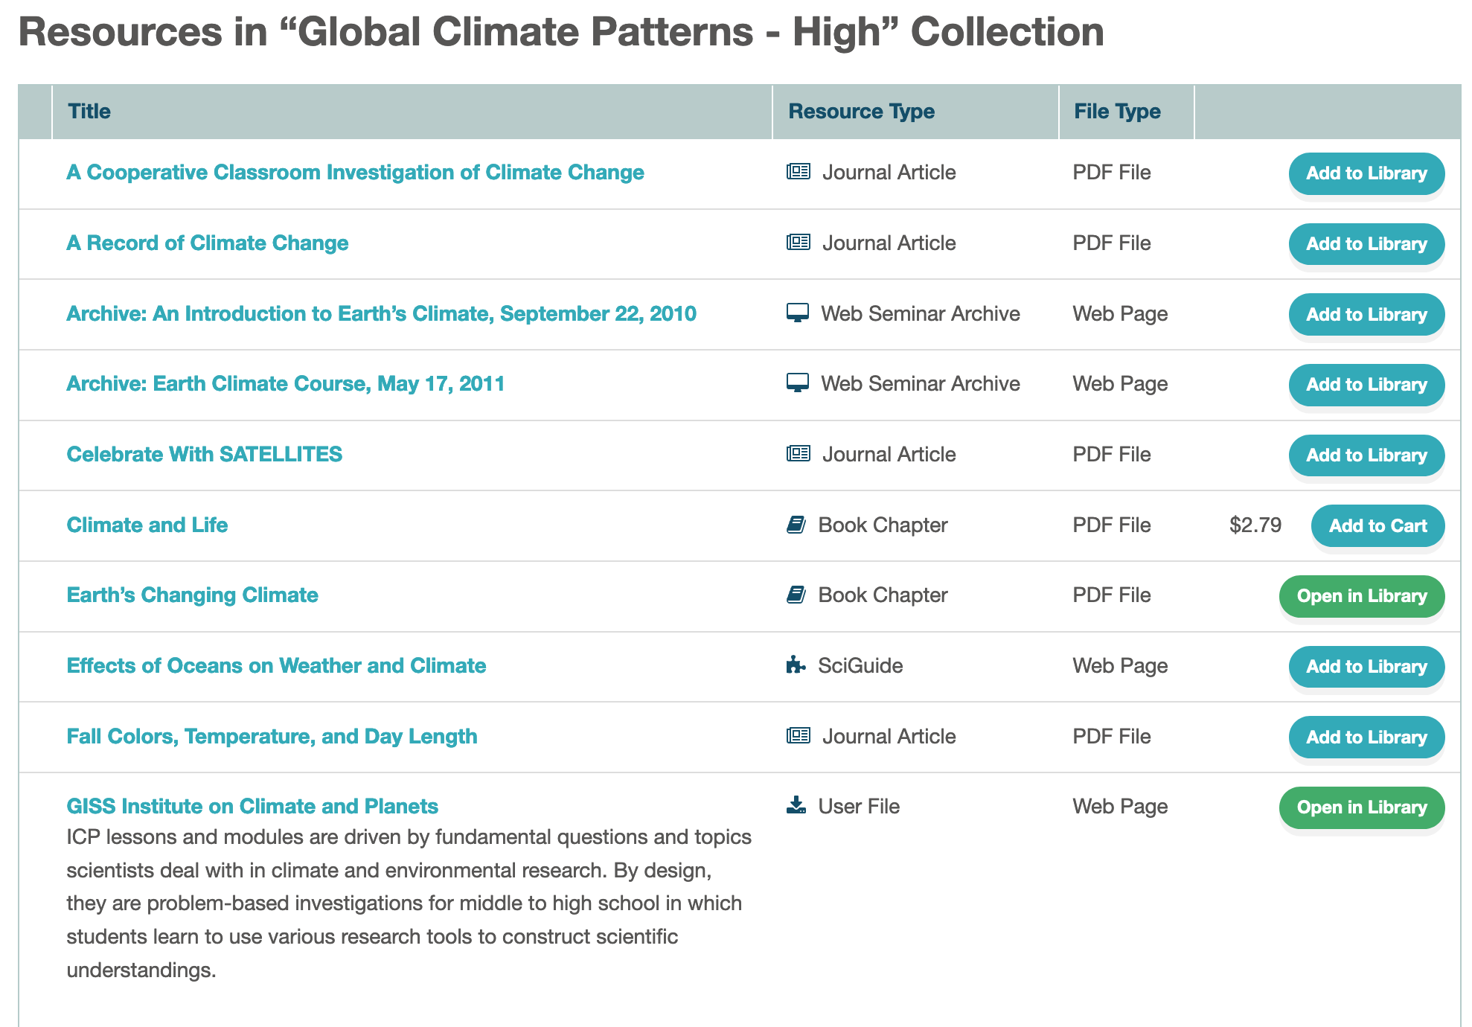
NSTA LEarning Center Resources
A simple search for “climate” at the NSTA Learning Center yields over 2600 hits, but filtering by “webinars” and “collections” makes the task much more manageable:
https://common.nsta.org/resource/?id=10.2505/9/WSNSTA190918
https://learningcenter.nsta.org/mylibrary/collection.aspx?id=pm5o5oxa2FM_E

Slide 37
Climate Resilience Toolkit (toolkit.climate.gov)
https://toolkit.climate.gov/#steps
  https://vimeo.com/211553976
https://toolkit.climate.gov/case-studies
  https://toolkit.climate.gov/case-studies/when-weather-becomes-problem-motivating-resilience-action-texas
https://toolkit.climate.gov/tools
  https://toolkit.climate.gov/tool/carbontracker

Slide 38
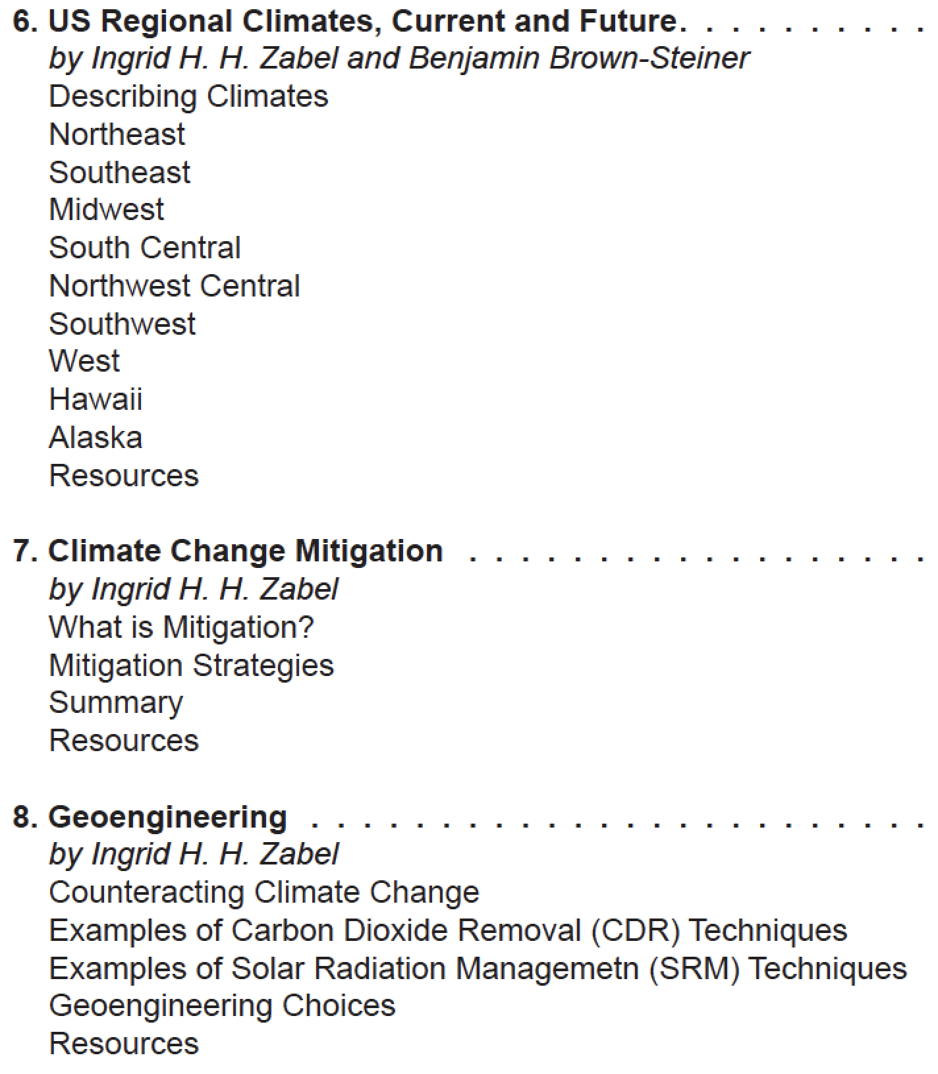
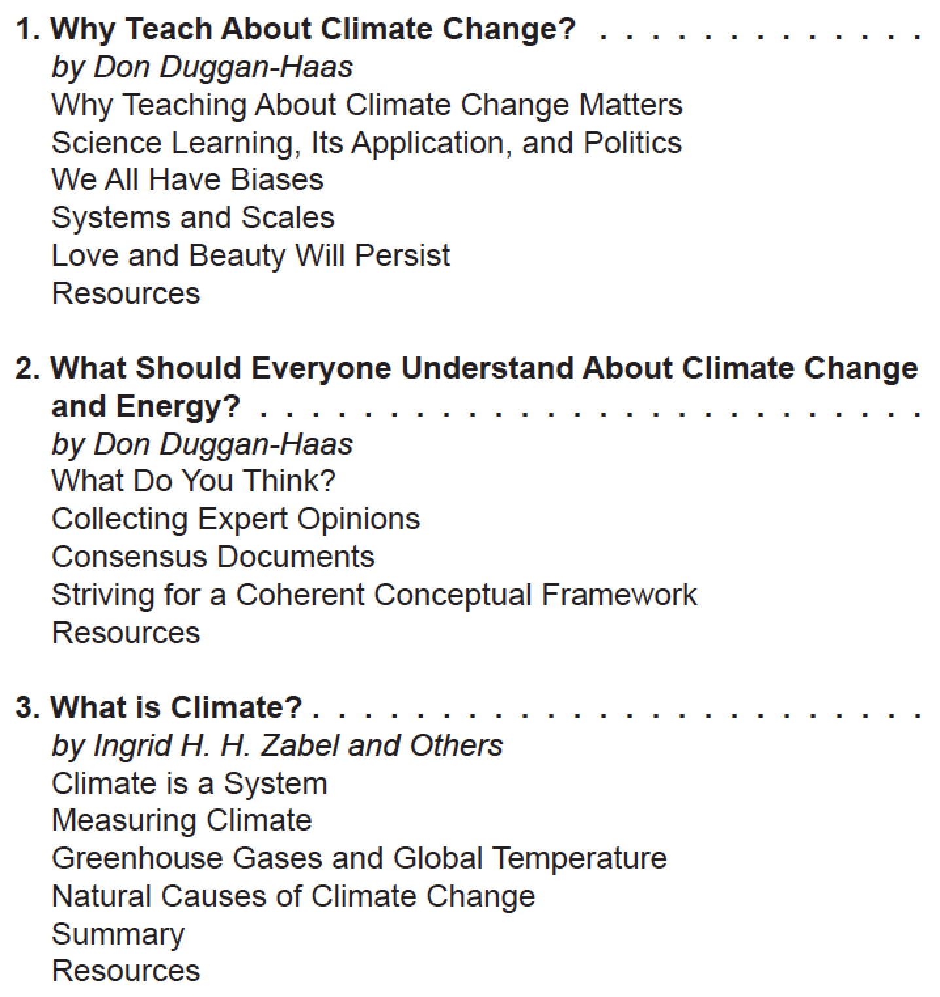
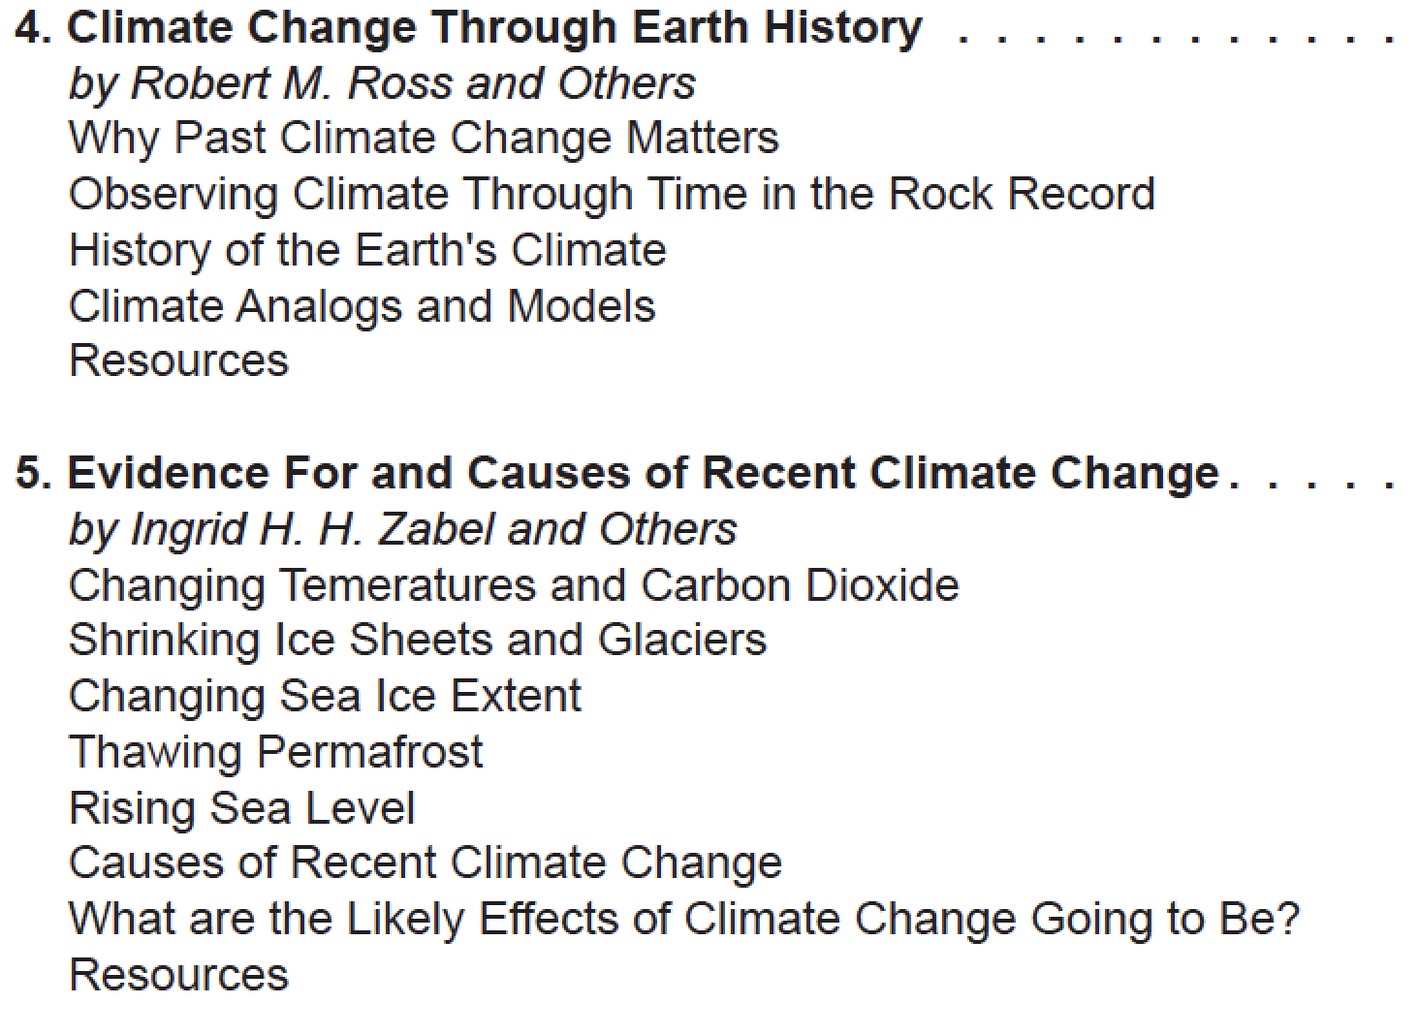
Teacher Friendly Guide to Climate Change
It would be easy to sink into despair, gloom, and doom when presenting climate science and climate change. Instead, work with your students through STEM skills for positive actions on mitigation and resilience strategies;

Slide 39



Carbon equivalence scales
About 5.5 pounds of that is carbon.
Wood is 45% - 50% carbon, so…
11 pounds of wood needs to be grown to sequester each gallon of gasoline we burn.
1 gallon weighs ~ 6 pounds

Slide 40
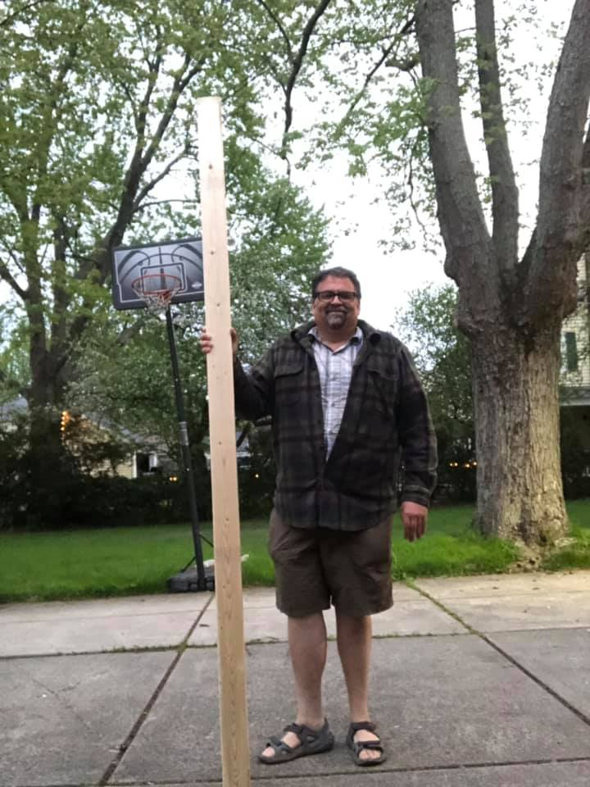

Q: How much wood do you need to grow to offset burning a gallon of gasoline?
A: 11 pounds.
The weight of a standard 8 foot 2 x 4.
We burn over 390 million gallons of gasoline in the US everyday.

Slide 41
How much do you have to plant or grow to take that carbon back out of the air?
11 pounds of wood needs to be grown to sequester each gallon of gasoline we burn.
A standard 8 foot 2x4 weighs 11 pounds.

Slide 42
How much do you have to plant or grow to take that carbon back out of the air?
We need to grow a 2x4’s worth of wood for each of the 390 million gallons of gas we burn everyday.
390 million 2x4s a day.
11 pounds x 390 million = 4,290,000,000 pounds of wood, every day.
That’s more than 1.5 trillion pounds a year.

Slide 43
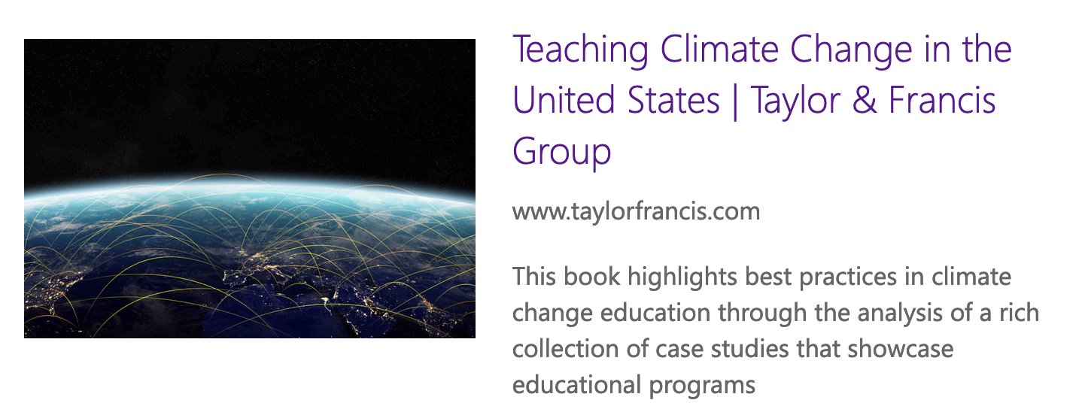
YOUR FAVORITE ACTIVITIES IN SCIENCE TEACHER EDUCATION?
http://bit.ly/InterdisciplinaryClimate
What are your favorite ideas or activities in science teacher education?

