Slide 1
Virginia’s Geologic Diversity
Eric J. Pyle
Department of Geology
& Environmental Science
James Madison University
With graphic design work by Drs. Lynn Fichter and Steve Whitmeyer, JMU

Slide 2
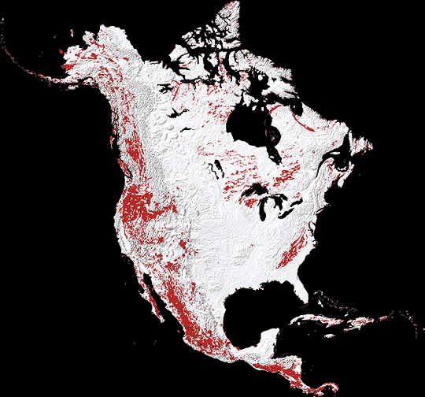
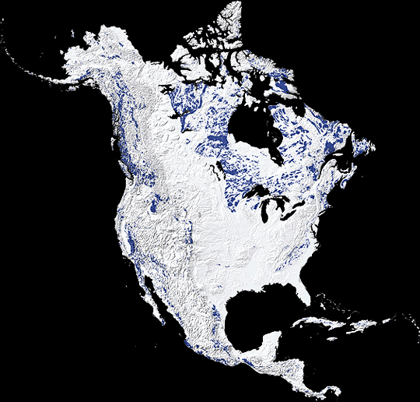
Igneous Rocks

Slide 3
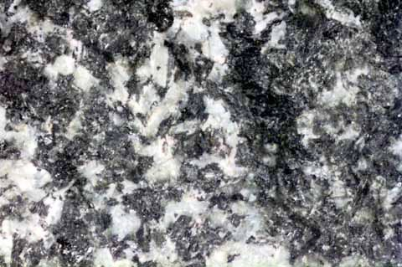
Gabbro:
No quartz,
Ca/Na to Ca plagioclase and pyroxene in about equal amounts

Slide 4
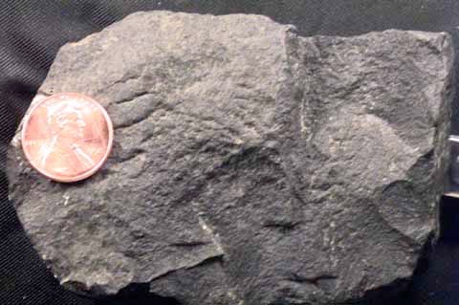
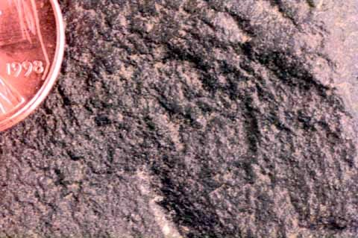
Basalt
Minerals cannot be identified in hand specimen, but come from the top of Bowen’s Reaction Series

Slide 5
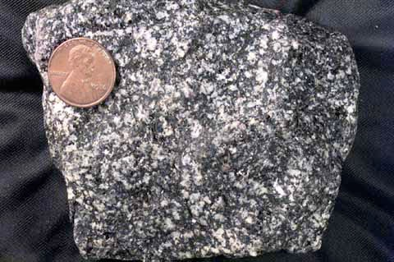
Diorite:
0% quartz,
Na plagioclase and amphibole in about equal amounts; this is a darker version but light and dark colors are still about equal.

Slide 6
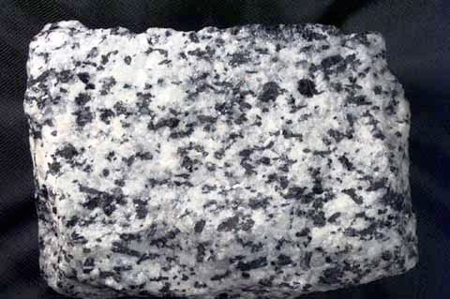
Diorite:
0 - 5% quartz,
Na plagioclase and amphibole in about equal amounts

Slide 7
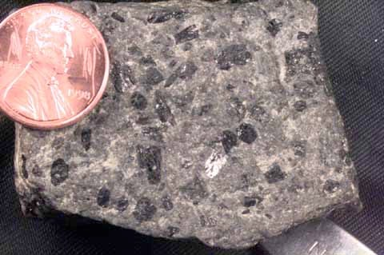
Andesite porphyry
Minerals cannot be identified in fine grained groundmass, but phenocrysts of amphibole are visible

Slide 8
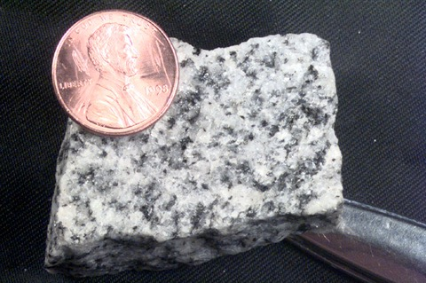
Granite:
>20% quartz,
Na plagioclase dominates; orthoclase possible but may be absent;
Mafics (biotite/amphibole) <5%

Slide 9
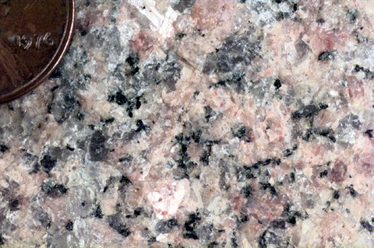
Granite:
>20% quartz,
Orthoclasse dominates; plagioclase possible;
Mafics (biotite/amphibole) <5%

Slide 10
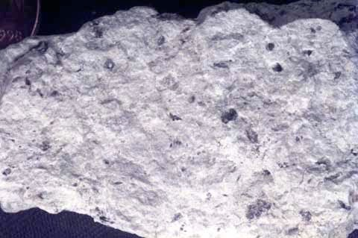
Rhyolite:
Minerals cannot be identified in hand specimen

Slide 11
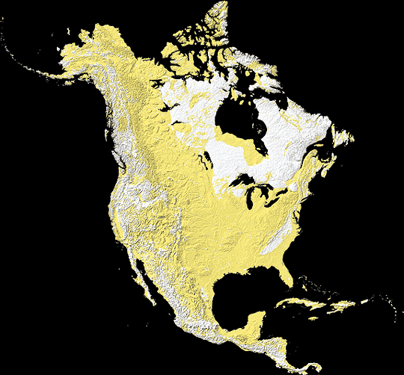
Sedimentary Rocks

Slide 12
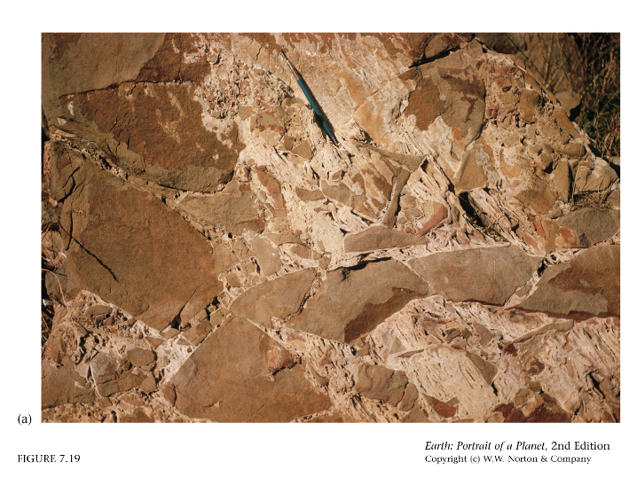
Breccia
Poorly sorted, angular clasts, matrix-supported

Slide 13
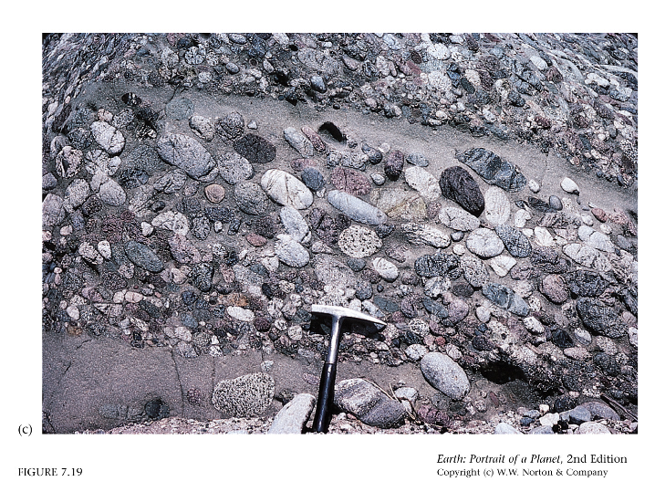
Conglomerate
Poorly sorted, rounded clasts, matrix-supported

Slide 14
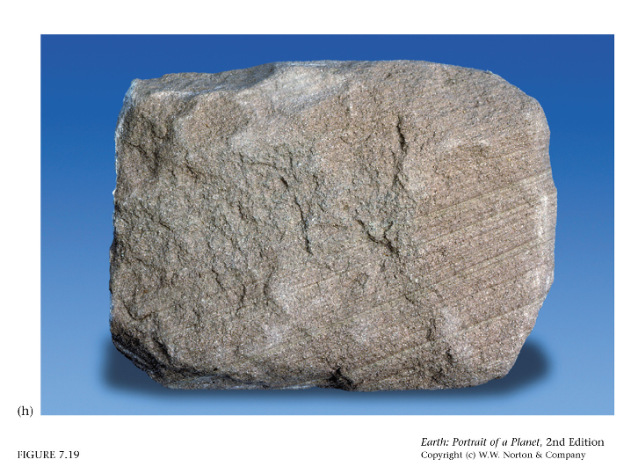
Arenite
Well sorted, subangular to rounded clasts, grain-supported

Slide 15
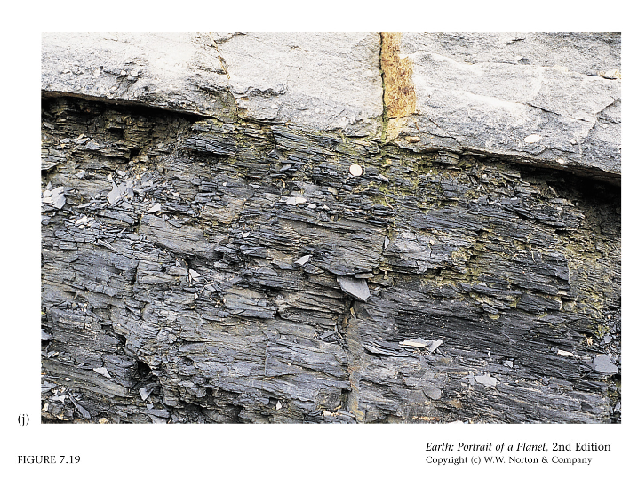
Shale
Well sorted, no clasts, predominantly matrix

Slide 16
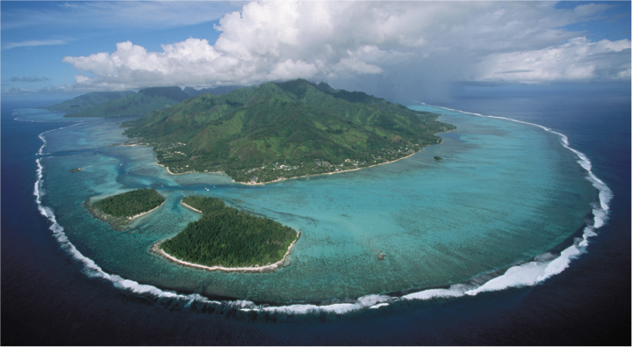
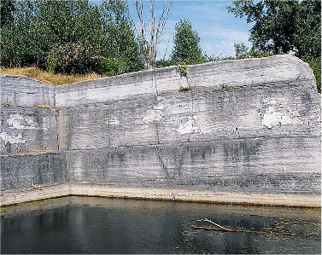
Tidal inlets are sites for ooid formation
Whereas the fringing reef produced coral fragments, the lagoon produces micrite and is a repository for fecal pellets.

Slide 17
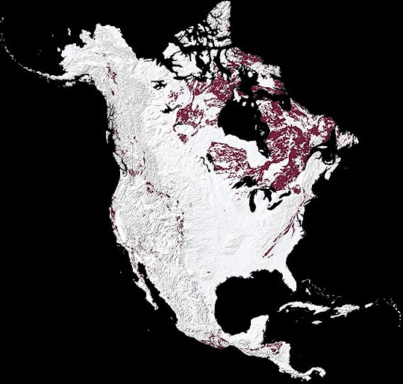
Metamorphic Rocks

Slide 18

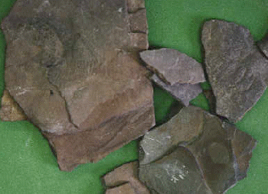
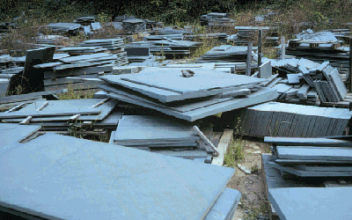
Barrovian Metamorphism
Shale
Slate
Metamorphoses
Into
Clay
Silica
Iron oxides
Sedimentary
Bedding
Small chlorite
crystals
Slaty cleavage
Dull “thunk” sound when struck
Rings like a bell when struck

Slide 19
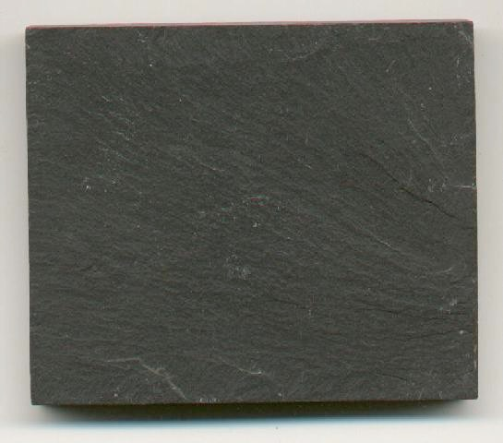
Foliated
Textures
Slaty Cleavage
http://www.env.duke.edu/eos/geo41/ims2.htm
http://www.accd.edu/sac/EARTHSCI/1301.090/Lecture%202.htm

Slide 20
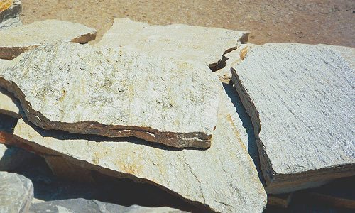
Barrovian Metamorphism
Slate
Phyllite
Metamorphoses
Into
http://geology.about.com/library/bl/images/blphyllite.htm
Small chlorite
crystals
Large chlorite
crystals
Slaty cleavage – coarser grained foliation
Slaty cleavage
Rings like a bell when struck
Has a definite sheen in reflected light; back to dull “thunk” sound

Slide 21
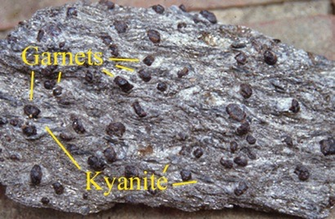
Barrovian Metamorphism
Phyllite
Schist
Metamorphoses
Into
http://geology.about.com/library/bl/images/blphyllite.htm
Chlorite gone. Quartz, feldspar, mica, and many new minerals
Large chlorite
crystals
Slaty cleavage – coarser grained foliation
Schistosity; minerals completely intermixed
Has a definite sheen in reflected light; back to dull “thunk” sound
Minerals large enough to be easily identified

Slide 22
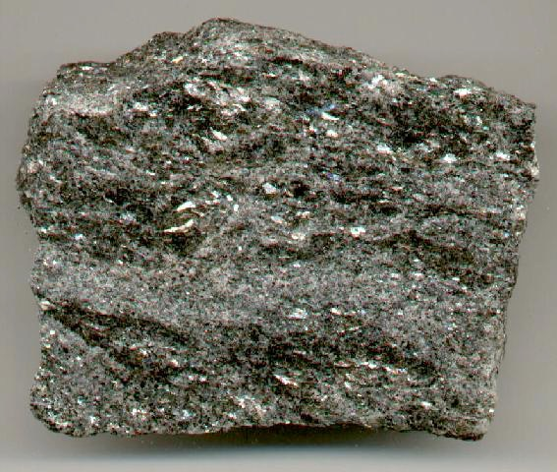
Foliated Textures - Schistosity
Schist
http://www.accd.edu/sac/EARTHSCI/1301.090/Lecture%202.htm

Slide 23
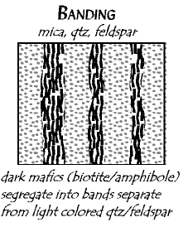
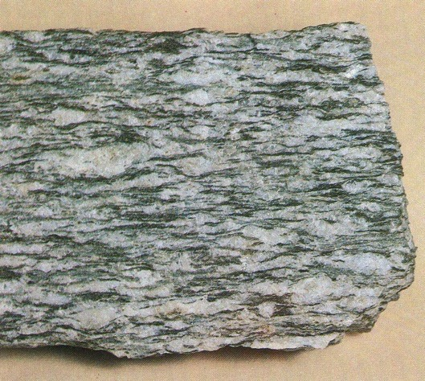
Foliated Textures – Mineral Banding
Gneiss
http://www.uwlax.edu/faculty/stoelting/Intro/Guides/Images2/gneiss_8X6.jpg

Slide 24
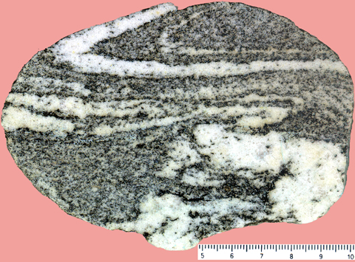
Foliated Textures – Mineral Banding
Gneiss
http://www.ut.ee/BGGM/miner/para_gneiss1.jpg

Slide 25
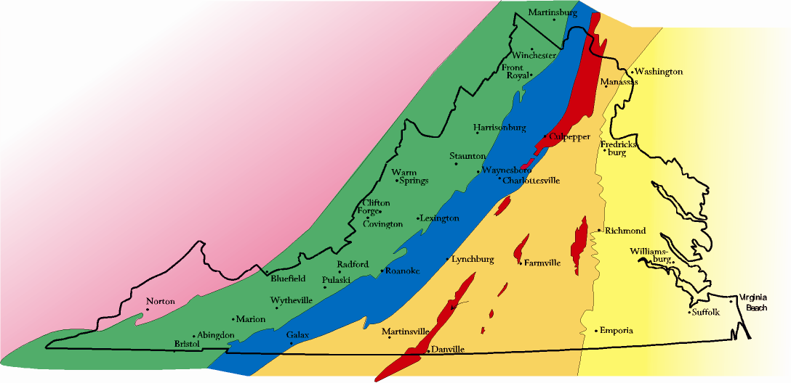
“Physiographic”
n : the study of physical features of the earth's surface
Allegheny Plateau
Allegheny Front
Valley and Ridge
Blue Ridge Fault
Mountain Run Fault
Blue Ridge
Coastal Plain
Fall Line
Piedmont

Slide 26
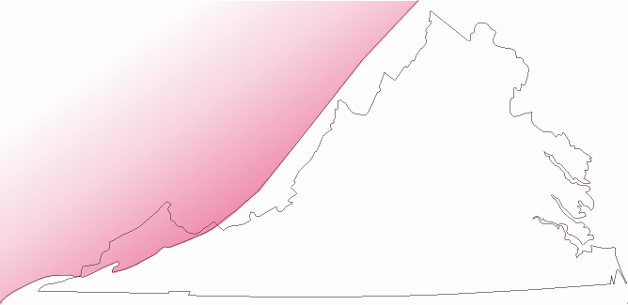
Allegheny Plateau
Allegheny Front
Flat laying sedimentary rocks in a complete stratigraphic section (Cambrian – Permian).
Underlie most of Kentucky, West Virginia, and western Maryland and Pennsylvania. Topographically high above sea level.
Dendritic drainage.

Slide 27
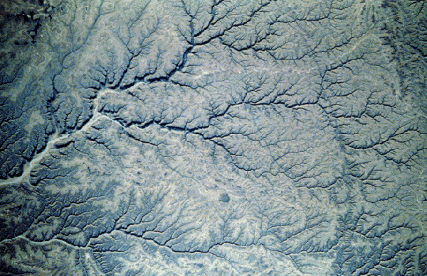
Dendritic Drainage
dendritic ("treelike"), resembles the pattern of branches and twigs
http://www.ge-at.iastate.edu/courses/Geol_100/old_files/dendritic.html

Slide 28
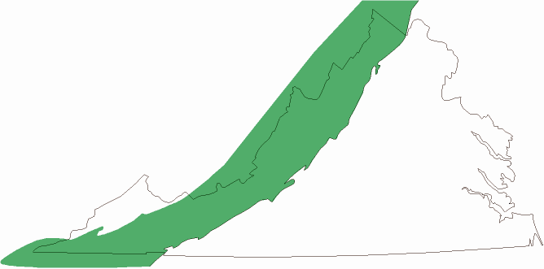
Valley and Ridge
Allegheny Front
Blue Ridge Fault
Sedimentary Rocks, largely of same age as those in Allegheny plateau (through Lower Mississippian, sans Penn. and Permian )
But, thrust faulted and folded. Major deformation.
Thus, forming a trellis drainage pattern.

Slide 29
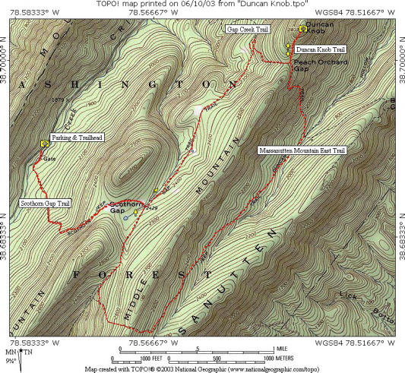
Valley and Ridge Trellis Drainage
http://www.localhikes.com/HikeData.ASP?DispType=1&ActiveHike=0&GetHikesStateID=&ID=4297

Slide 30
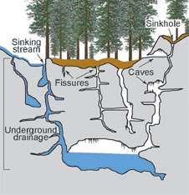
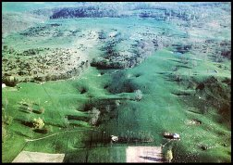
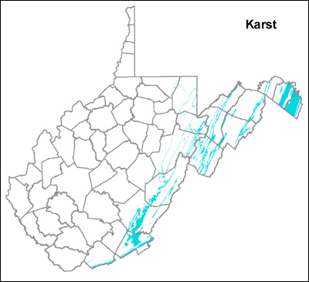
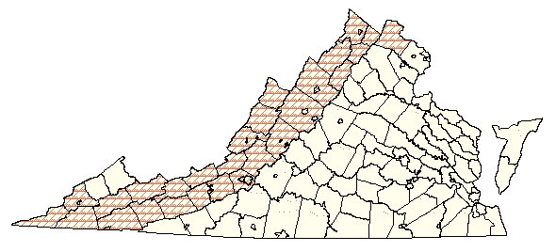

Slide 31
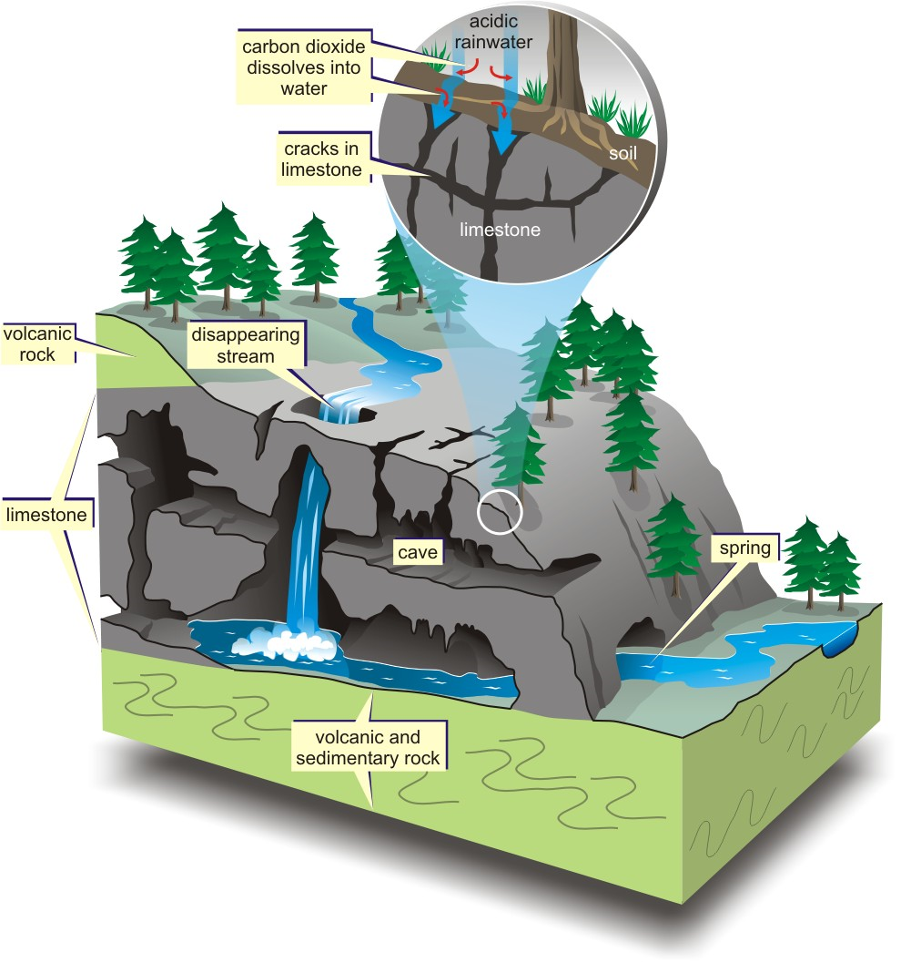

Slide 32
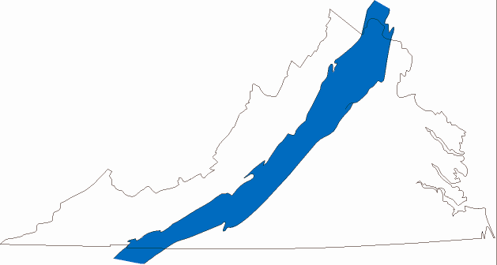
Blue Ridge
Blue Ridge Fault
Mountain Run Fault
Igneous batholiths, lava flows, and rift clastic sedimentary rocks, all low grade metamorphosed (Middle Proterozoic - Early Cambrian).
Blue Ridge province includes both the Blue Ridge mountains (Skyline Drive/Blue Ridge Parkway), and the strip of land to the east running through Galax, Charlottesville, Culpepper, and Warrenton.

Slide 33
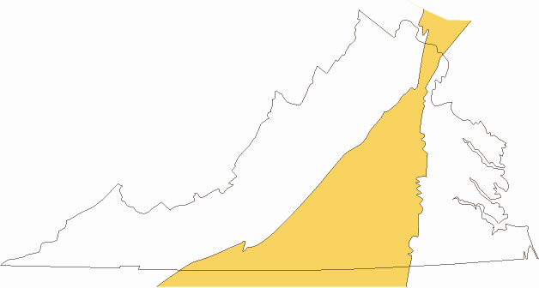
Piedmont
Mountain Run Fault
Fall Line
Great complex of igneous/sedimentary/metamorphic rocks generated mostly in volcanic arcs transported to North America from distant places; Later Proterozoic to Mississippian.
Low, rolling countryside with dendritic drainage.

Slide 34
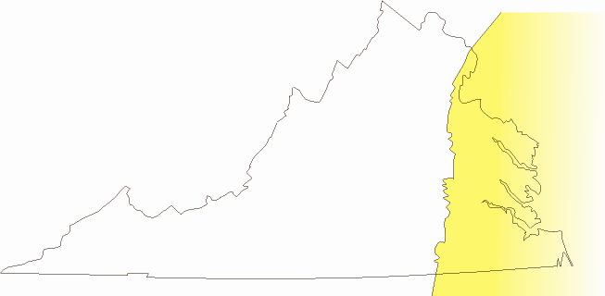
Coastal Plain
Eastward thickening wedge of sediments mostly deposited in shoreline and shallow shelf environments. Extends out to continental margin (Jurassic to Present).

Slide 35
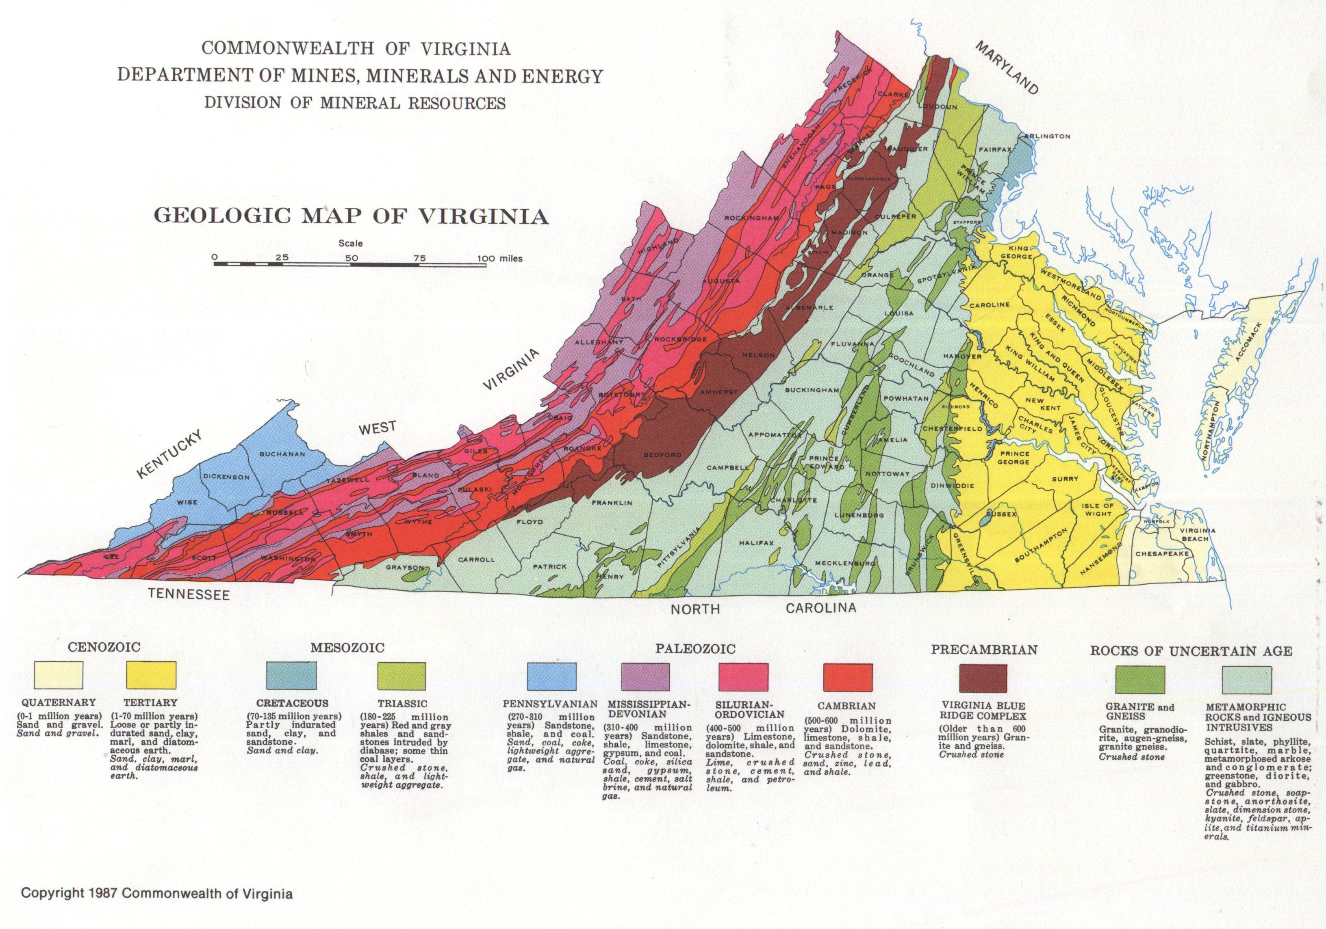
Youngest
Oldest

Slide 36
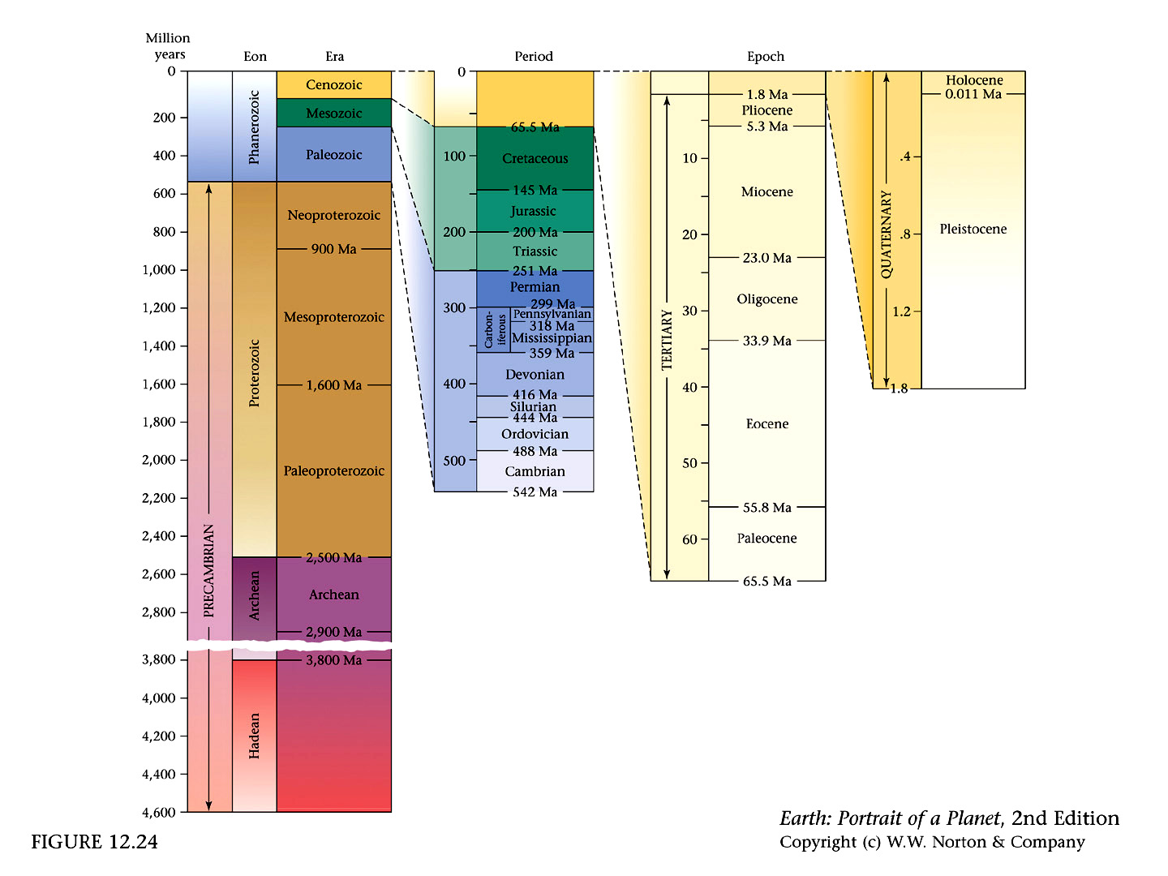
12_24.jpg

Slide 37
What would account for the ages and arrangements of Virginia’s geology?
Why are the oldest rocks in the middle?
Why are there gaps in the timeline?

Slide 38
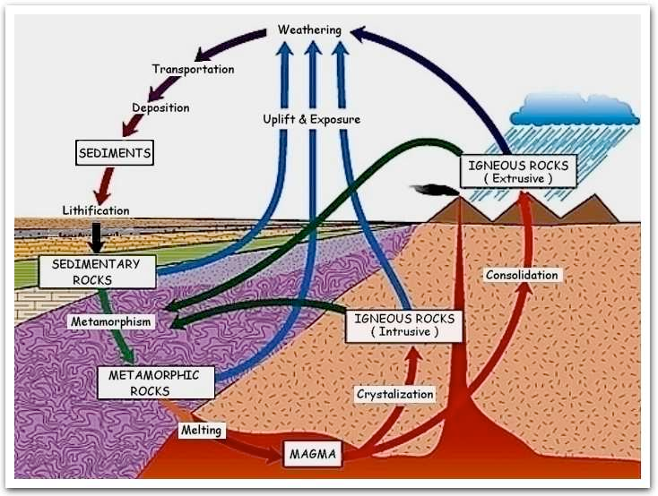
A cartoon rock cycle

Slide 39
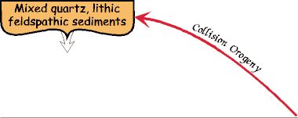
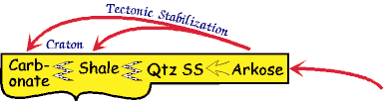
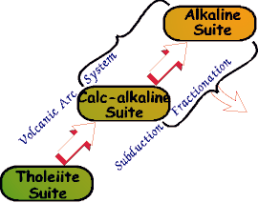
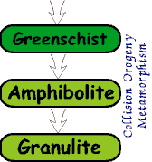
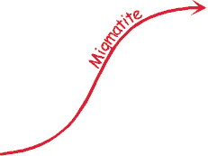
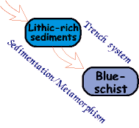


Greywacke
Greywacke
Breccia, Conglomerate,
Arkosic sand
A Tectonic Rock Cycle
Sandstone, Shale,
Siltstone, Limestone
Rhyolite/Granite
Greywacke
Andesite/Diorite
Basalt/Gabbro

Slide 40

Stage A. Stable Craton of granodiorite average composition
Stage B. Early Rifting
Early rhyolite volcanoes
basaltic ponding

Slide 41
Stage A. Stable Craton of granodiorite average composition
Stage B. Early Rifting
breccias, conglomerates
felsic tuffs

Slide 42
Stage A. Stable Craton of granodiorite average composition
Stage B. Early Rifting
Partial melting, contact metamorphism

Slide 43

Stage C - basin formation
New basalts, with gabbros and peridotites beneath
Buried rhyolite volcanoes, ash, and lava
Basaltic magma

Slide 44
Stage C - basin formation
near shore sediments - sand and mud - if undisturbed, these become sandstones, siltstones, and shales
Buried breccias, conglomerates, and tuffs

Slide 45
Stage C - basin formation
Hydrothermal alteration by seawater infiltration
Hydrothermal alteration by infiltrating seawater

Slide 46



Proto-Atlantic Tension
Opening phase of Paleozoic Wilson cycle
Proto-Atlantic
Tension

Slide 47

Post Grenville – Erosion to a Peneplain

Slide 48

Proto-Atlantic Tension

Slide 49

Proto-Atlantic Tension

Slide 50


Atlantic Tension
Opening phase of Atlantic Wilson cycle
Atlantic
Tension

Slide 51

Triassic Basins
Exposed
Basins
Subsurface
Basins

Slide 52



Slide 53

Stage D - Divergent Continental Margin (DCM)
transgressive sequence of sand, mud, and lime
deep marine muds
Almost no igneous or metamorphic activity here

Slide 54

Sedimentary Protolith

Slide 55
The Ordovician World
You are here (think Bahamas)

Slide 56


Slide 57

Natural Bridge exists because
of a dolomite cap on a thick limestone base

Slide 58

Lincolnshire
Lincolnshire
Edinburg
Lincolnshire

Slide 59


Slide 60



Slide 61

Stage E - Island Arc formation
Basalt and andesitic lavas and pyroclastics
Partial melting of underside of plate,
with dioritic magmas
Partial melting of cold, wet basalt and mud

Slide 62
Stage E - Island Arc formation
mafic to intermediate pyroclastics and ash
DCM sediments thickening
mix of mud and eroded pyroclastics

Slide 63
Stage E - Island Arc formation
Greenschist
Amphibolite
Granulite
Blueschist
Eclogite
Contact
Metamorphism

Slide 64

Assemblage of the Carolina Amalgamated Terrane

Slide 65

Assemblage of the Carolina Amalgamated Terrane

Slide 66

Assemblage of the Carolina Amalgamated Terrane

Slide 67


Foreland Basin Development
Acadian Orogeny

Slide 68

Willis Mountain Kyanite

Slide 69

Stage F - Arc-continent collision
Foreland basin filling with re-worked sediments and pyroclastics
DCM Sediments uplifted and exposed to weathering and erosion.

Slide 70
Stage F - Arc-continent collision
Arc sediments and metamorphics ground by cataclastic metamorphism
Little or no igneous activity is observed in this stage.

Slide 71


Slide 72

Stage G - Cordilleran formation
Little or no igneous or metamorphic activity here
Andesitic and rhyolitic lavas and pyroclastics
Partial melting of underside of plate,
with granitic magmas
Partial melting of cold, wet basalt and mud

Slide 73
Stage G - Cordilleran formation
Foreland basin filled with re-worked sediments
all the material that can be weathered has been, leaving a veneer of quartz sand
Intermediate to felsic pyroclastics and ash
mix of mud and eroded pyroclastics

Slide 74
Stage G - Cordilleran formation
Slate
Phyllite
Schist
Gneiss
Little or no igneous or metamorphic activity here
Blueschist
Eclogite
Contact
Metamorphism

Slide 75


Later Grenville – Collision and Metamorphism

Slide 76

Haysville-Fries-Rockfish
Valley Fault

Slide 77


Slide 78

Stage H - Continental collision
Little or no new igneous activity is observed here

Slide 79
Stage H - Continental collision
Foreland basin filling with re-re-worked sediments and exposed crystalline rocks

Slide 80


Slide 81


Slide 82
Stage H - Continental collision
Obduction of deep material, complex folding, cataclasis
Potential for retrograde metamorphism

Slide 83

Virginia ~ 1 Billion Years Ago
Grenville Mountains Would Have Looked Like These Modern Andes Mountains
http://www.astro.uni-bonn.de/~maltmann/photgal_cz.html

Slide 84



Grenville Compression
Closing phase of Rodinia Wilson cycle
Grenville
Compression

Slide 85
Early Grenville – Subduction Orogeny

Slide 86


279
Continent-Continent Collision Orogeny
Alleghanian Orogeny
A mountain range that
Existed in eastern North
America about 250 million years ago
When Africa collided with eastern North America.

Slide 87

Valley and Ridge Carbonate Rocks
Sandstones
and Shales
North Mountain Fault
Blue Ridge Fault
Limestones
Sandstones and Shales
Limestones
Blue Ridge Mountains
http://www.localhikes.com/HikeData.ASP?DispType=1&ActiveHike=0&GetHikesStateID=&ID=4297

Slide 88



The trouble with Mid-Atlantic Geology
Is that most of it has been
Shuffled Like a Deck of Cards
Grenville Basement
autochthonous

Slide 89


Compression with rapid erosion
Compression with slow erosion

Slide 90

Alleghanian Compression
Shuffling the Deck
Blue
Ridge
Piedmont
Valley and Ridge
Allegheny Front
Blue Ridge Fault
Mtn. Run Fault
Piedmont
Coastal Plain
Fall Line

Slide 91

Paleozoic Compression Events
Shuffling the Deck

Slide 92

Grenville Compression

Slide 93

Rockfish Gap
Lovingston Gneiss
http://www.vanaturally.com/mineralsandenergy.html

Slide 94

Stage I - Erosion to peneplain
all the material that can be weathered has been, leaving a veneer of quartz sand
Little or no new igneous or metamorphic activity is observed here.

Slide 95


Slide 96
What would account for the ages and arrangements of Virginia’s geology?
Why are the oldest rocks in the middle?
Why are there gaps in the timeline?

Slide 97


Slide 98
12_24.jpg

Slide 99

1950-1920 Ma
Rae Province
Hearne Province
Assembly of
Laurentian
craton
Slave-Rae collision,
Arc accretion: Rimbey,
Taltson, Thelon, etc.

Slide 100

1880-1860 Ma
Rae Province
Hearne Province
Assembly of
Laurentian
craton
Arc accretion:
Great Bear, La Ronge,
Torngat arcs, etc.

Slide 101

1860-1840 Ma
Rae Province
Hearne Province
Assembly of
Laurentian
craton
Arc accretion: Narsajuaq,
Pembine-Wausau, etc.
Wopmay orogen,
Southeast thrusting along
Snowbird tectonic zone

Slide 102

1840-1820 Ma
Rae Province
Hearne Province
Assembly of
Laurentian
craton
Trans Hudson / Penokean orogens:
accretion of Sask Block, Superior
Province, and Marshfield terrane

Slide 103

1820-1800 Ma
Rae Province
Hearne Province
Assembly of
Laurentian
craton
Trans Hudson / Penokean orogens:
accretion of Medicine Hat Block,
and Wyoming Province;
Makkovik orogen in northeast

Slide 104

1790-1770 Ma
Juvenile
terrane
accretion
Accretion of Archean
Grouse Creek Block,
Selway Terrane, and
Mojave Province;
Yavapai arcs outboard
T_{DM} = 2.5 - 2.3 Ga

Slide 105

1750-1720 Ma
Juvenile
terrane
accretion
Yavapai Province:
A Banda Sea-style
assembly of arcs

Slide 106

1550-1350 Ma
Juvenile
terrane
accretion
Granite-Rhyolite Province:
includes Elzevir Block &
Pinware Terrane;
Note Appalachian outliers

Slide 107

1550-1350 Ma
Granitoid
intrusion
Granite-Rhyolite granitoids:
A-type plutons stitch much
of southern Laurentia

Slide 108

1300-1000 Ma
Continent-
continent
collisions
Grenville Province:
includes Llano Province
& Frontenac Block;
transfer of Caborca Block

Slide 109

1300-950 Ma
Granitoid
intrusion
Grenville granitoids:
intrude older terranes
as far west as Colorado

Slide 110


Slide 111

Late Precambrian - 550
JMU
http://jan.ucc.nau.edu/~rcb7/nam.html

Slide 112

Middle Cambrian - 510
JMU
http://jan.ucc.nau.edu/~rcb7/nam.html

Slide 113

Late Cambrian - 500
JMU
http://jan.ucc.nau.edu/~rcb7/nam.html

Slide 114

Early Ordovician - 485
JMU
http://jan.ucc.nau.edu/~rcb7/nam.html

Slide 115

Middle Ordovician - 470
JMU
http://jan.ucc.nau.edu/~rcb7/nam.html

Slide 116

Late Ordovician - 450
JMU
http://jan.ucc.nau.edu/~rcb7/nam.html

Slide 117

Early Silurian - 430
JMU
http://jan.ucc.nau.edu/~rcb7/nam.html

Slide 118

Late Silurian - 420
JMU
Central Appalachian Basin
http://jan.ucc.nau.edu/~rcb7/nam.html

Slide 119

Early Devonian - 400
http://jan.ucc.nau.edu/~rcb7/nam.html

Slide 120

Middle Devonian - 385
http://jan.ucc.nau.edu/~rcb7/nam.html

Slide 121

Early Mississippian - 345
http://jan.ucc.nau.edu/~rcb7/nam.html

Slide 122

Late Pennsylvanian – 300
http://jan.ucc.nau.edu/~rcb7/nam.html

Slide 123

Middle Permian - 275
http://jan.ucc.nau.edu/~rcb7/nam.html

Slide 124

Late Permian - 260
http://jan.ucc.nau.edu/~rcb7/nam.html

Slide 125

Early Triassic - 245
http://jan.ucc.nau.edu/~rcb7/nam.html

Slide 126

Late Triassic - 210
http://jan.ucc.nau.edu/~rcb7/nam.html

Slide 127

Early Jurassic - 195
http://jan.ucc.nau.edu/~rcb7/nam.html

Slide 128

Early Jurassic - 180
http://jan.ucc.nau.edu/~rcb7/nam.html

Slide 129

Middle Jurassic - 170
http://jan.ucc.nau.edu/~rcb7/nam.html

Slide 130

Late Jurassic - 150
http://jan.ucc.nau.edu/~rcb7/nam.html

Slide 131


Slide 132


Slide 133


Slide 134


Slide 135

http://geology.rutgers.edu/103web/NJcontext/ENAhistory.html

Slide 136

Rejuvenation

Slide 137
Atlantic DCM

Slide 138
Atlantic Rifting

Slide 139
Alleghanian Orogeny

Slide 140
Interorogenic Calm

Slide 141

Acadian Orogeny

Slide 142
Interorogenic Calm

Slide 143
Taconic Orogeny

Slide 144
ProtoAtlantic DCM

Slide 145
Proto-Atlantic Rifting

Slide 146
Atlantic Rifting
Tension
The Influence of Wilson Cycles on Mid-Atlantic Geology
Alleghenian
Orogeny
Compression
Proto-Atlantic
Rifting
Tension
Grenville
Orogeny
Compression

Slide 148

Rejuvenation
Atlantic DCM
Rifting
Alleghanian Orogeny
Interorogenic Calm
Acadian Orogeny
Interorogenic Calm
Taconic Orogeny
Proto-Atlantic DCM
Rifting
Grenville Orogeny
Wilson
Opening
½ Wilson
“Rift to Drift”
Wilson
Closing
Full
Wilson
Wilson
Opening
“Rift to Drift”
Wilson
Closing
½ Wilson

Slide 149





