Slide 1
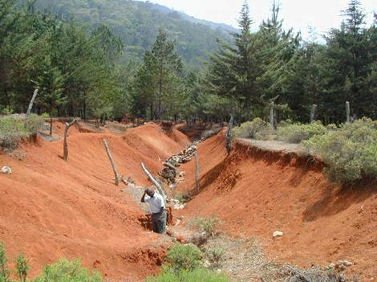
Soil Erosion and Erosion Control

Slide 2
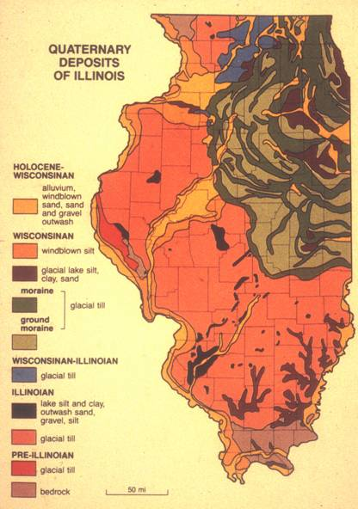
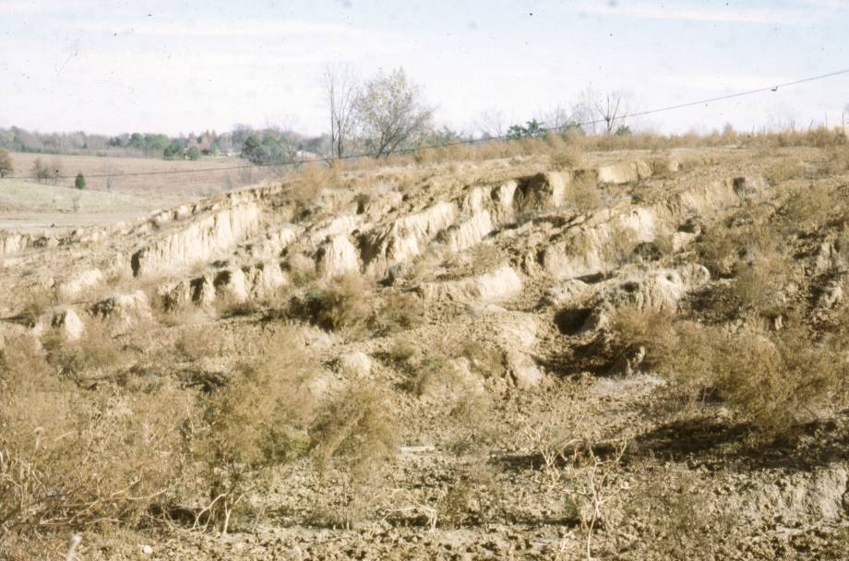
southern Illinois

Slide 3
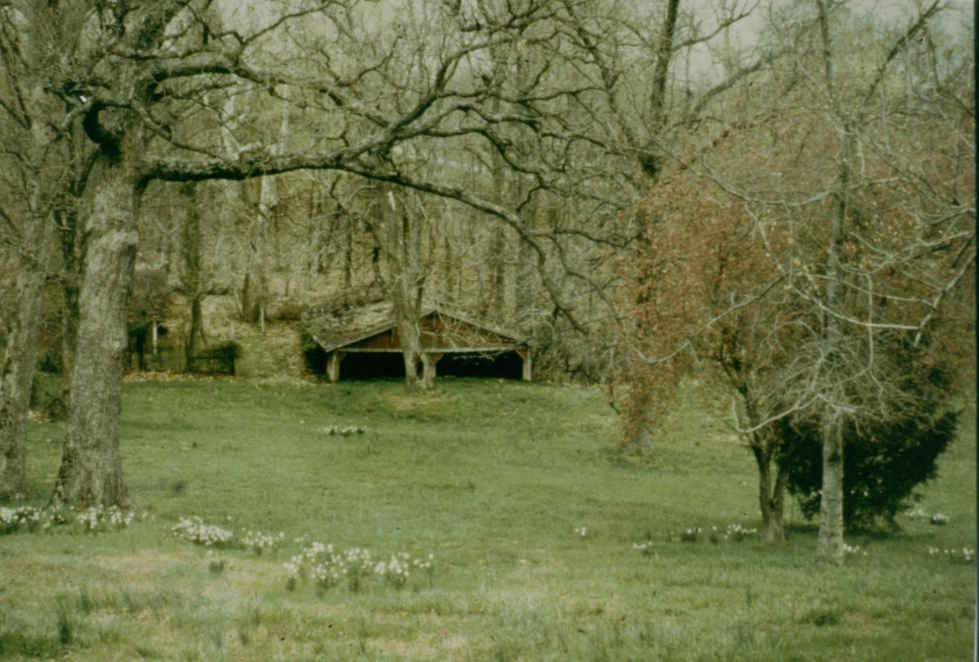

~3 ft high

Slide 4
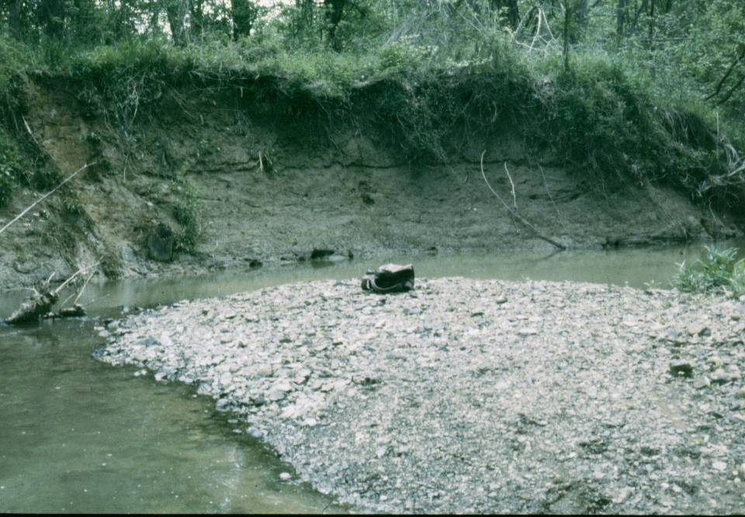

Slide 5
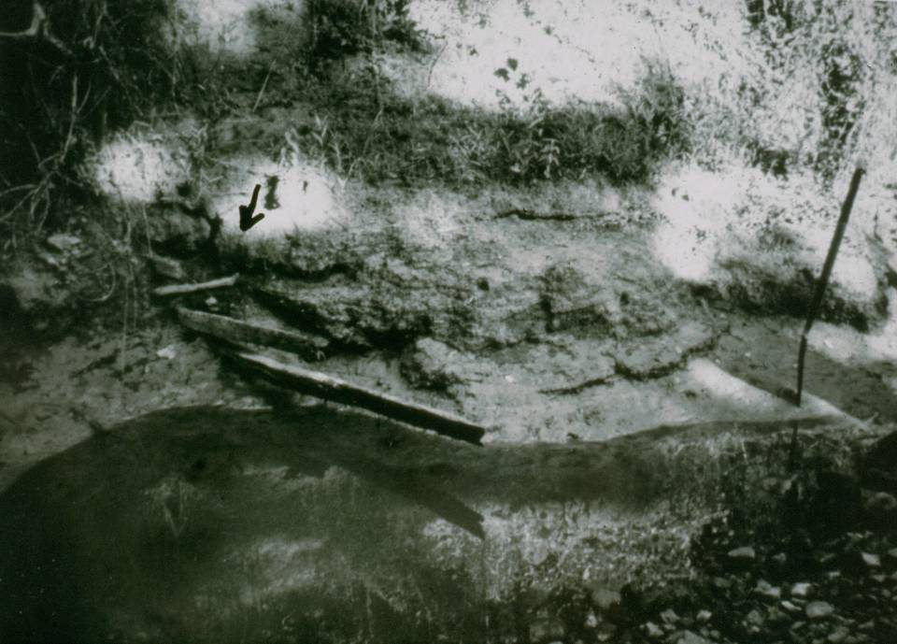

Slide 6
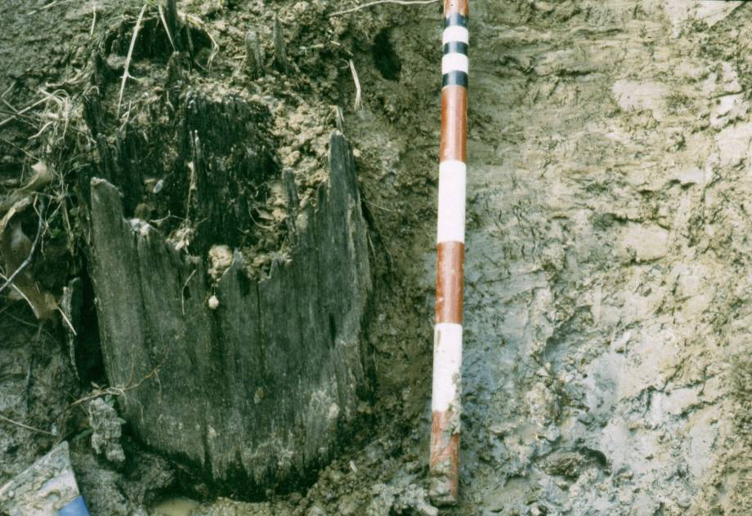

Slide 7
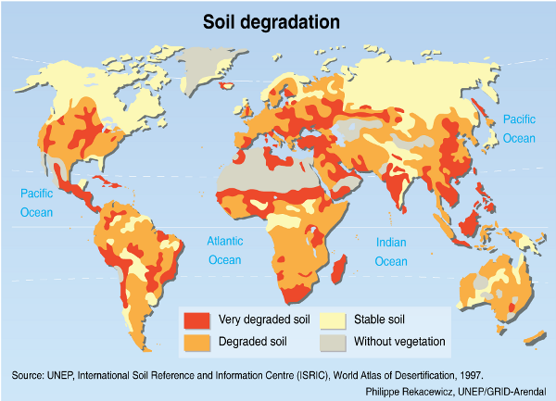
Overview
A. One of the most destructive human events on world’s soil resources

Slide 8
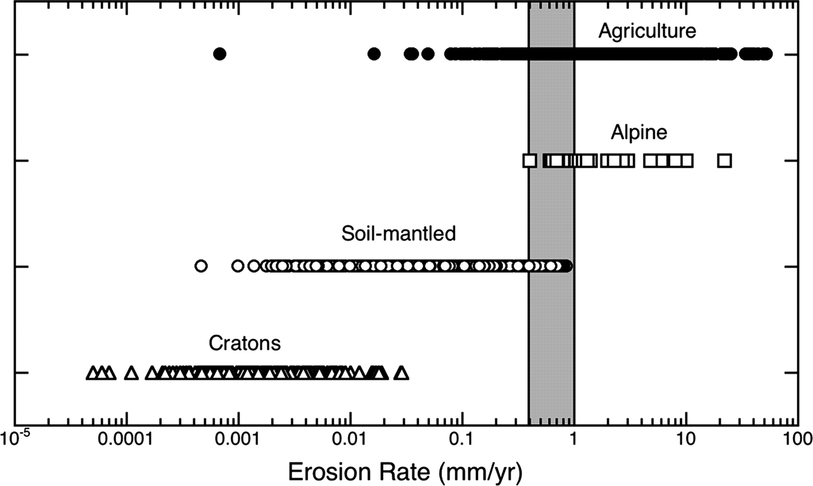

Slide 9
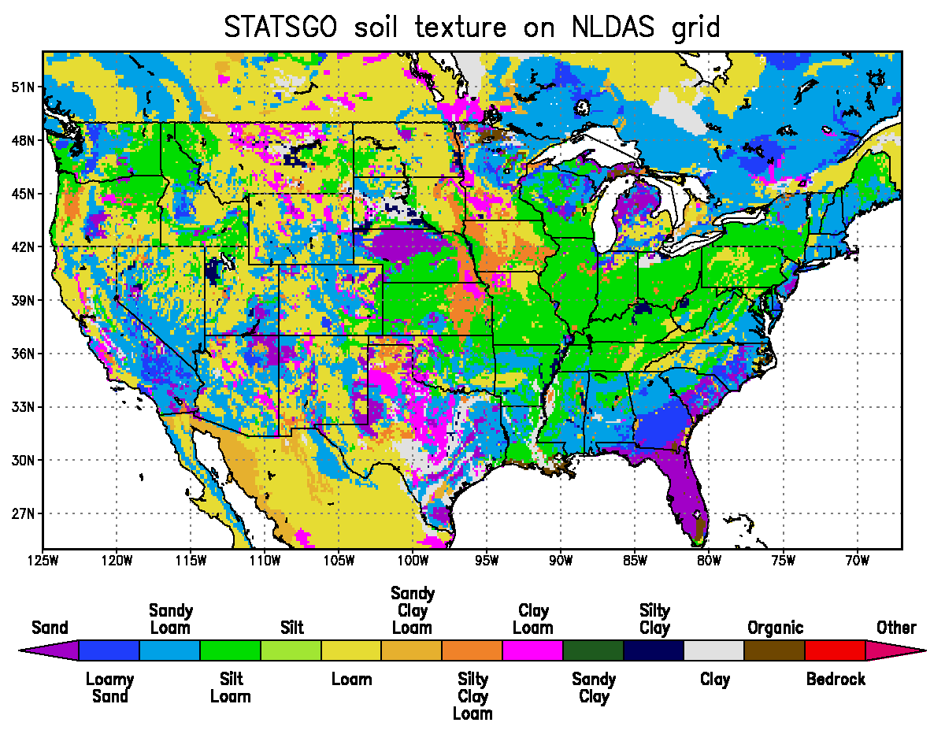
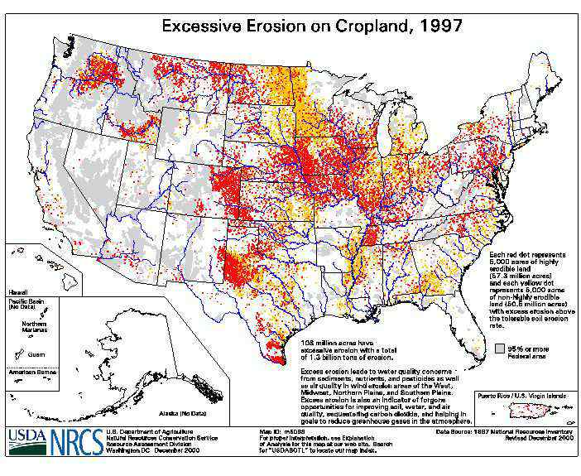
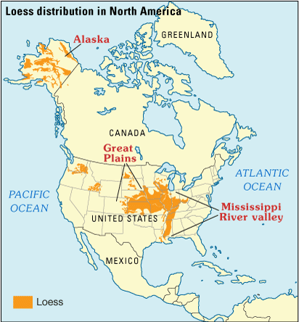
Overview
A. One of the most destructive human events on world’s soil resources

Slide 10
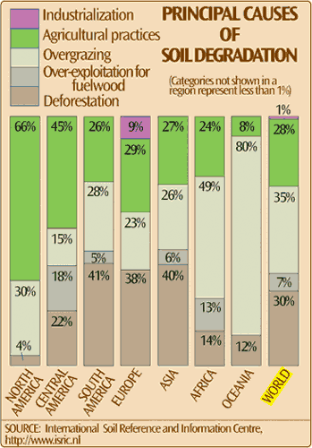
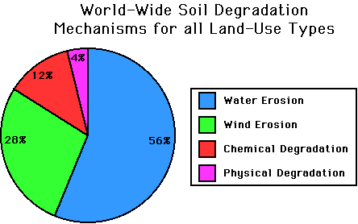
Overview
A. One of the most destructive human events on world’s soil resources

Slide 11
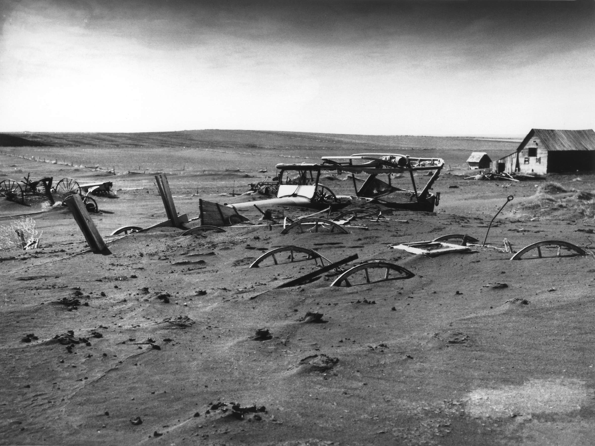
The Dust Bowl (1931-1939)

Slide 12
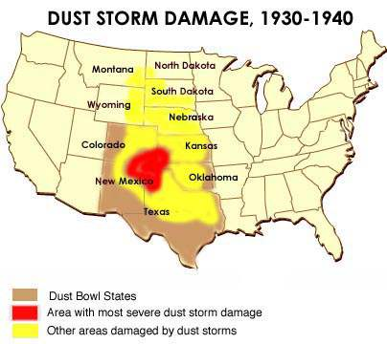
The Dust Bowl (1931-1939)

Slide 13
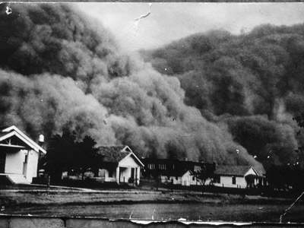
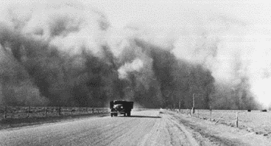
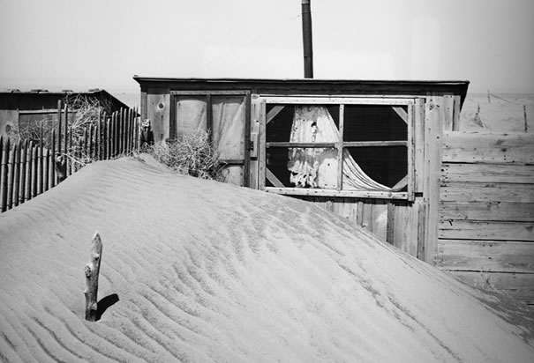
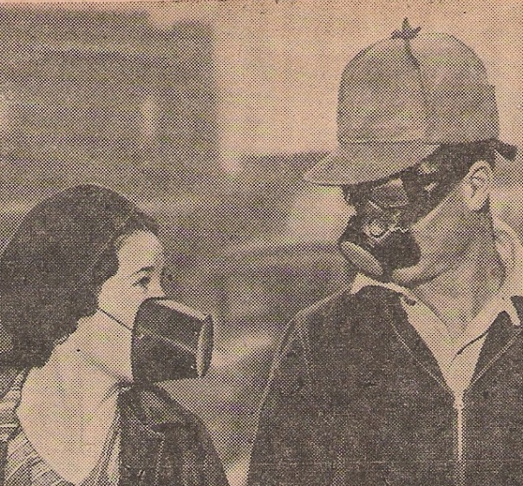


Slide 14
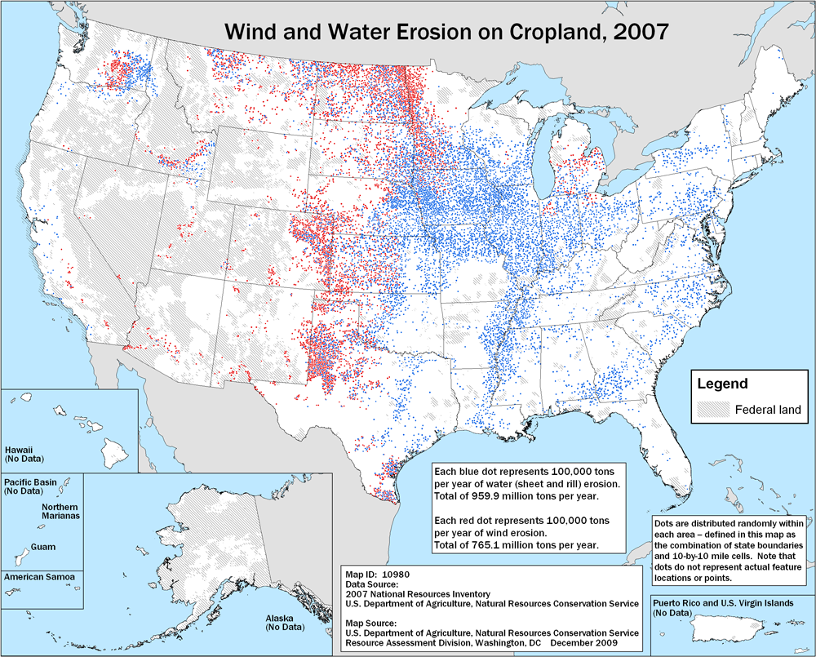

Slide 15
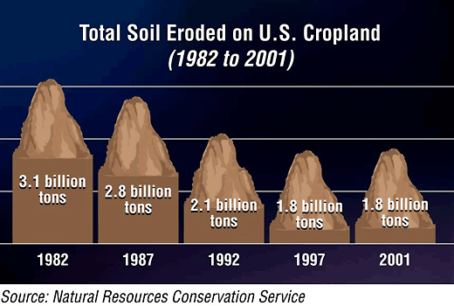
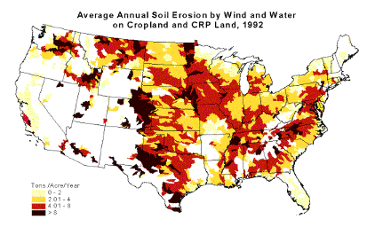

Slide 16
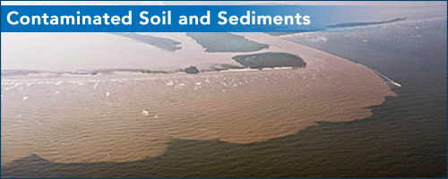
Overview
B. Labeled as a pollutant by EPA

Slide 17
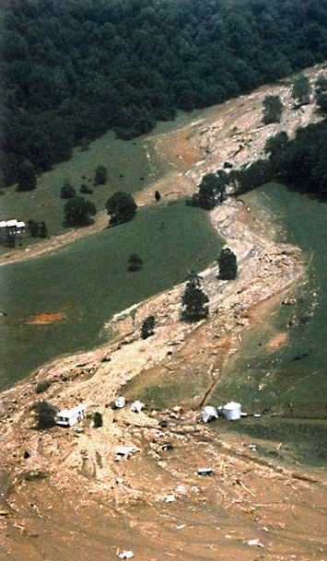
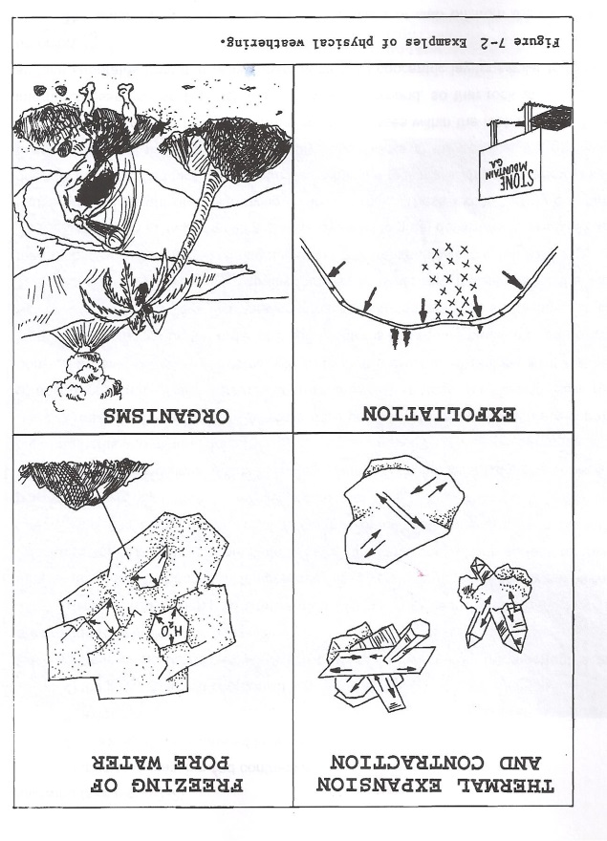
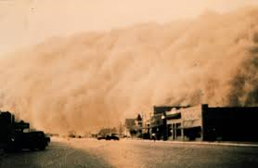
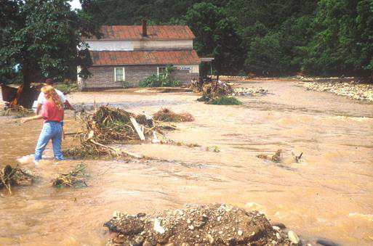
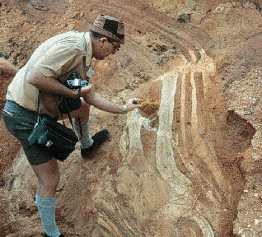
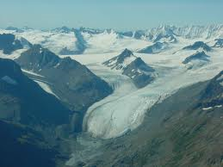
II. The Erosion Process
A. Agents of erosion

Slide 18
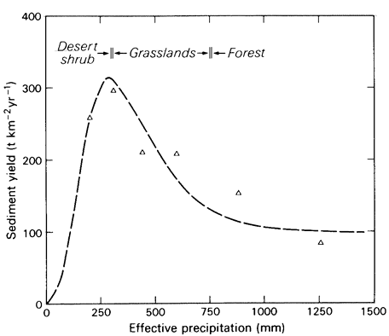
Effective rainfall refers to the percentage of rainfall which becomes available to plants and crops.
II. The Erosion Process
B. Natural soil loss as a function of ppt.
Langbein and Schumm, 1958

Slide 19
II. The Erosion Process
B. Natural soil loss as a function of ppt.
Langbein and Schumm, 1958

Slide 20
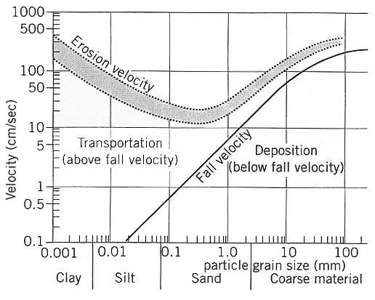
II. The Erosion Process
C. Effects of Particle Size on Erosion
Hjulstrom,
1939

Slide 21
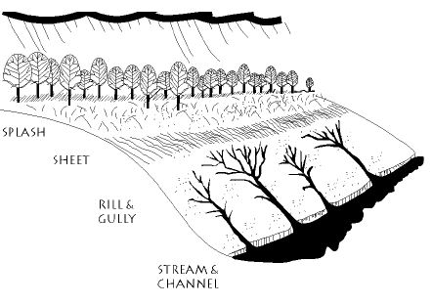
II. The Erosion Process
D. Water

Slide 22
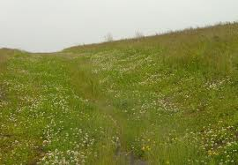
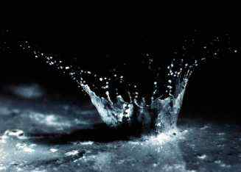
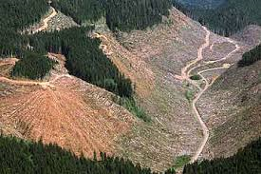
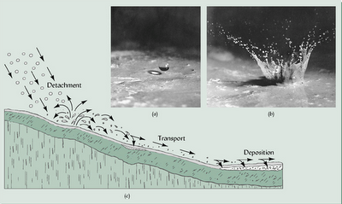
II. The Erosion Process
D. Water
Rainsplash

Slide 23
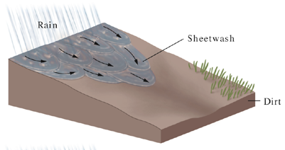

Slide 24
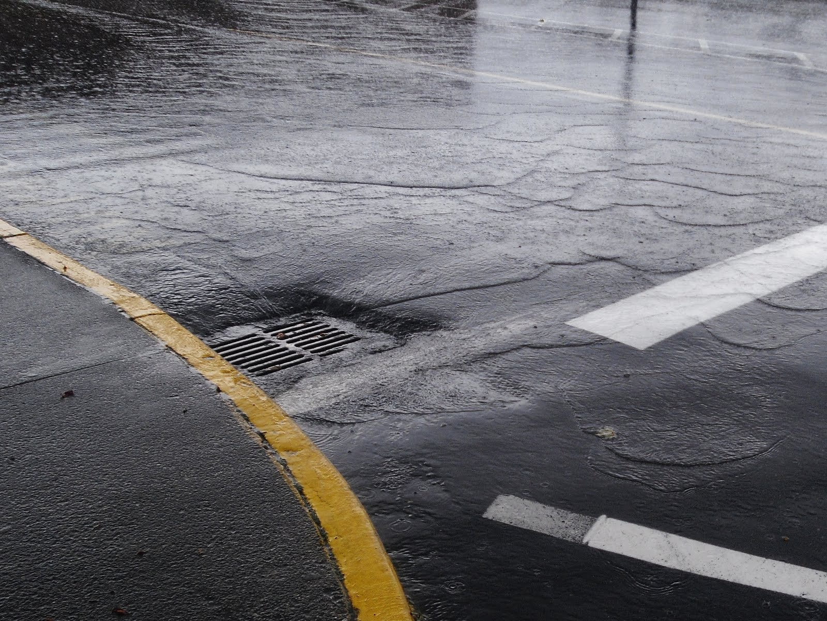
II. The Erosion Process
D. Water
Sheet Wash

Slide 25
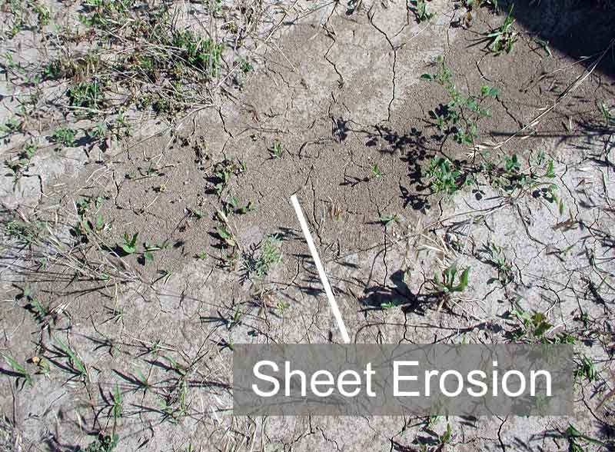

Slide 26
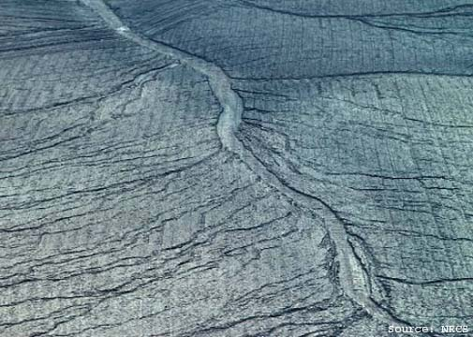
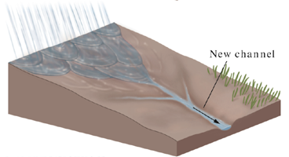
Rill Erosion
A. Erosion

Slide 27
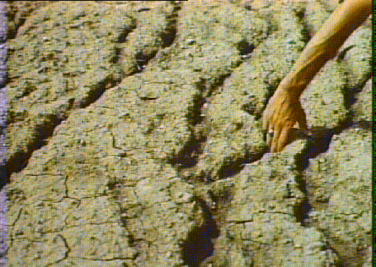
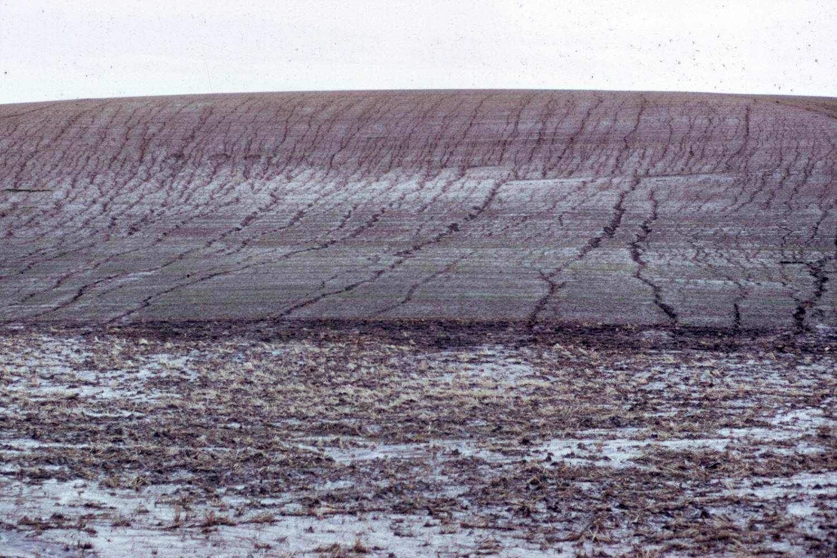
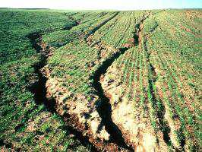
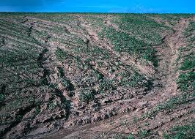
Rill Erosion

Slide 28
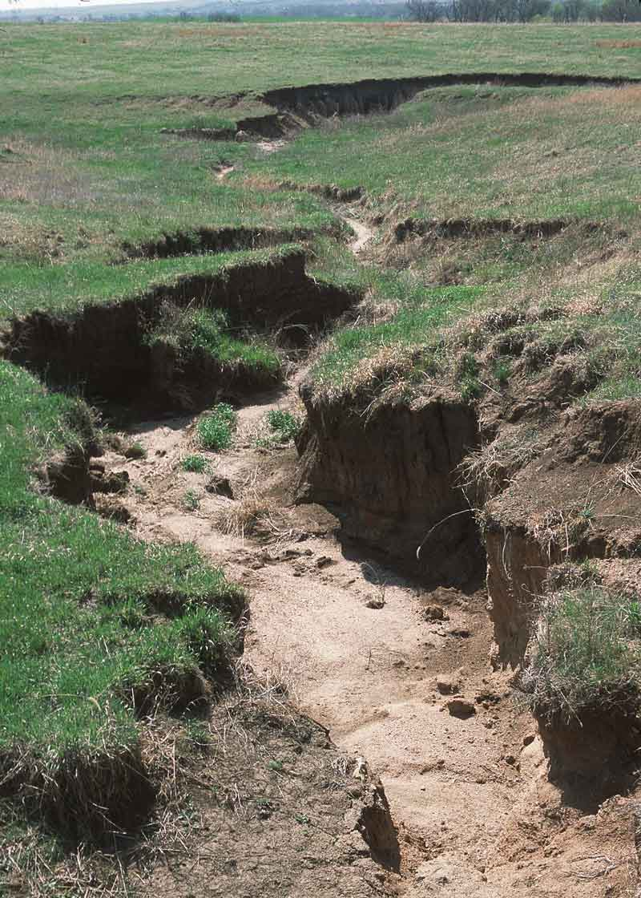
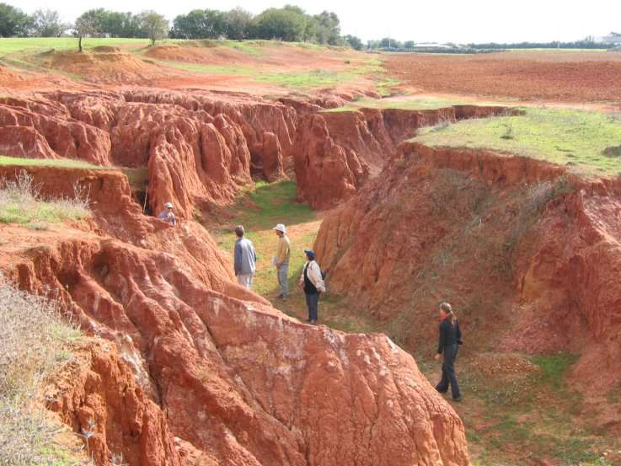
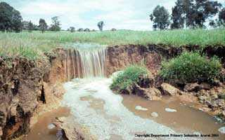
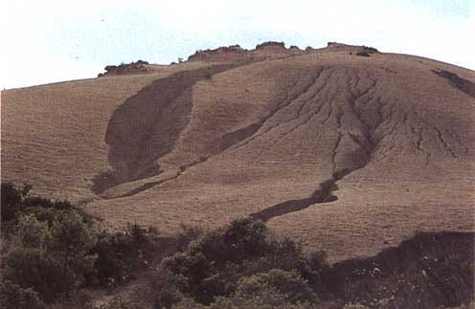
Gully Erosion

Slide 29




Slide 30


Slide 31

II. The Erosion Process
E. Wind

Slide 32


II. The Erosion Process
E. Wind

Slide 33

II. The Erosion Process
E. Wind
Most common in arid and semi-arid environments

Slide 34
III. Erosion and Land Use
A. Agriculture

Slide 35

III. Erosion and Land Use
A. Agriculture

Slide 36


III. Erosion and Land Use
A. Agriculture

Slide 37






Slide 38
Sediment Supply

Slide 43

Mill Pond Dams

Slide 44

Mill Pond Dams

Slide 45

Mill Pond Dams

Slide 46


Slide 47

Mill Pond Dams

Slide 48
Rates of Denudation (Erosion)
Long Term: ~4 cm/1000 yr
Historic: 200 – 1600 cm/1000 yr
Soil production: ~11 cm/1000 yrs

Slide 49


Logging
III. Erosion and Land Use
B. Land Development

Slide 50

Vice and others, 1069
III. Erosion and Land Use
B. Land Development

Slide 51

Wolman and Schick
III. Erosion and Land Use
B. Land Development

Slide 52

Table 10-2
III. Erosion and Land Use
B. Land Development

Slide 53

Wolman, 1967
III. Erosion and Land Use
B. Land Development

Slide 54
IV. Universal Soil Loss Equation
A. Overview
Hailed as one of the most significant developments in soil and water conservation in the 20th century.
Empirically-derived to estimate soil erosion by raindrop impact and surface runoff.
Culmination of decades of soil erosion experimentation conducted by university faculty and federal scientists across the United States.
In use world-wide

Slide 55
IV. Universal Soil Loss Equation
B. The Equation
A = RKLSCP

Slide 56
IV. Universal Soil Loss Equation
A = RKLSCP
A: Estimated soil loss (tons/acre/yr)
R: Rainfall Factor:
A statistic calculated from the annual summation of rainfall energy in every storm (correlates with raindrop size) times its maximum 30 - minute intensity.

Slide 57


Slide 58


Slide 59
IV. Universal Soil Loss Equation
A = RKLSCP
A: Estimated soil loss (tons/acre/yr)
R: Rainfall Factor
K: Soil Erodibility Factor
Quantifies the cohesive, or bonding character of a soil type and its resistance to dislodging and transport due to raindrop impact and overland flow.

Slide 60

A = RKLSCP
L: Slope-Length Factor
S: Slope Steepness Factor
Steeper slopes produce higher overland flow velocities. Longer slopes accumulate runoff from larger areas and also result in higher flow velocities. Thus, both result in increased erosion potential, but in a non - linear manner. For convenience L and S are frequently lumped into a single term.
“The Topographic Factor”

Slide 61


Slide 62


Slide 63
A = RKLSCP
C: Cover Factor
This factor is the ratio of soil loss from land cropped under specified conditions to corresponding loss under tilled, continuous fallow conditions.

Slide 64

A = RKLSCP

Slide 65



Slide 66



Slide 67



Slide 68



Goal: limit to 5 tons/acre/year
1 Ton of
Gravel

Slide 69
IV. Universal Soil Loss Equation
A = RKLSCP
P: Control Practice Factor
Practices included in this term are contouring, strip cropping (alternate crops on a given slope established on the contour), and terracing.

Slide 70



Default Value: set to “1”

Slide 71
IV. Universal Soil Loss Equation
A = RKLSCP
A: Estimated soil loss (tons/acre/yr)
R: Rainfall Factor
K: Soil Erodibility Factor
L: Slope-Length Factor
S: Slope Steepness Factor
C: Cover Factor
P: Control Practice Factor
“The Topographic Factor”

Slide 72


LS Factor = ????

Slide 73

R Factor = 125
K Factor = 0.19
A = RKLSCP
A = RKLSC
LS Factor = ????

Slide 74
LS Factor = ????
L: Slope-Length Factor
S: Slope Steepness Factor

Slide 77


Slide 78


Slide 79
= 43.46 tons/acre/yr

Slide 80


Slide 81


Slide 82
C = 0.11
Choosing between Idealism vs. Pragmatism……

Slide 83


V. Estimating “Q” (Discharge)
A. The Concept:

Slide 84
V. Estimating “Q” (Discharge)
The Concept:
The Rational Equation
Qp=CIA
Where Qp=peak flow rate (ft3/s)
C= runoff coeffic.
I = ave ppt intensity (in/hr)
A = drainage area (acres)
Best for small basins of under 10,000 acres

Slide 85

Qp=CIA
Where Qp=peak flow rate (ft3/s)
C= runoff coeffic.
I = ave ppt intensity (in/hr)
A = drainage area (acres)

Slide 86
Qp=CIA
Where Qp=peak flow rate (ft3/s)
C= runoff coeffic.
I = ave ppt intensity (in/hr)
A = drainage area (acres)
“Need to solve “I” using ‘Time of Concentration calculations, and
the recurrence interval of the rain storm in question.”

Slide 87

“Kirpick Eq.”
Where K and b
are constants for
an individual basin

Slide 88

First: solve for time
of concentration (“Duration”);
THEN: solve for
rainfall intensity for
a given X year storm.
“Time of concentration”

Slide 89


Slide 90


First: solve for time
of concentration;
THEN: solve for
rainfall intensity for
a given X year storm.

Slide 91
First: solve for time
of concentration;
THEN: solve for
rainfall intensity for
a given X year storm.

Slide 92
First: solve for time
of concentration;
THEN: solve for
rainfall intensity for
a given X year storm.

Slide 93
Tc = 14.28 min
10 yr. storm
“Time of concentration”

Slide 94
First: solve for time
of concentration;
THEN: solve for
rainfall intensity for
a given X year storm.
Or….

Slide 95


i = 4.56 in/hr

Slide 96

VI

Slide 97


Slide 98



Q = CiA

Slide 99


Slide 100


Determine Average Slope:
First: Determine the
parcel areas…….
= Y factor

Slide 101




= ave CN factor

Slide 102
= ave CN factor

Slide 103


Slide 104


L = 4500 ft
Y = 6.05%

Slide 105
L = 4500 ft
Y = 6.05%

Slide 107
Determine i for a 10 year storm for the Richmond Area,
where tc = 56 minutes:
“Time of concentration”

Slide 108
Determine i for a 10 year storm for the Richmond Area,
where tc = 56 minutes:
i = 2.43”/hr for 56 minutes

Slide 109

OR….

Slide 110


Slide 111


Slide 112


Slide 113



Slide 114



“NEW”
C

Slide 115



Slide 116


Slide 117


Slide 118


