Slide 1
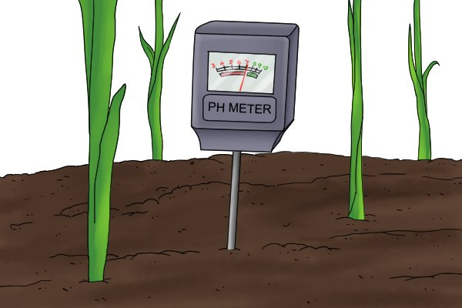
Determination of Soil Acidity

Slide 2
Cation Exchange Capacity (CEC)
Total negative charge on soil particles
Expressed in units of charge per mass
Centimoles of (positive) charge per kilogram
cmol_{c}/kg
Milliequivalents per 100 grams soil
meq/100 g
Older unit used in literature
These two units are equivalent

Slide 3
CEC cont.
Cation exchange sites hold both acidic and basic cations
Dynamic equilibrium between ions on colloid surface and in soil solution
Depending on the composition of the ions occupying the sites, the soil chemistry will change
Total CEC = %base saturation + %acid saturation

Slide 4
Acidic and Basic Cations
Acid cations
H⁺
Al³⁺
Basic cations
Mg²⁺
Ca²⁺
K⁺
Na⁺
Total CEC = % base cation saturation + % acid cation saturation

Slide 5
Soil Acidity and Alkalinity
pH scale from 0-14
Basic (greater than 7)
7 is neutral
Acidic (less than 7)
Controlled by the ion composition that occupies the exchange sites
Fig. 9.7 from Nature and Properties of Soils. Brady and Weil.

Slide 6
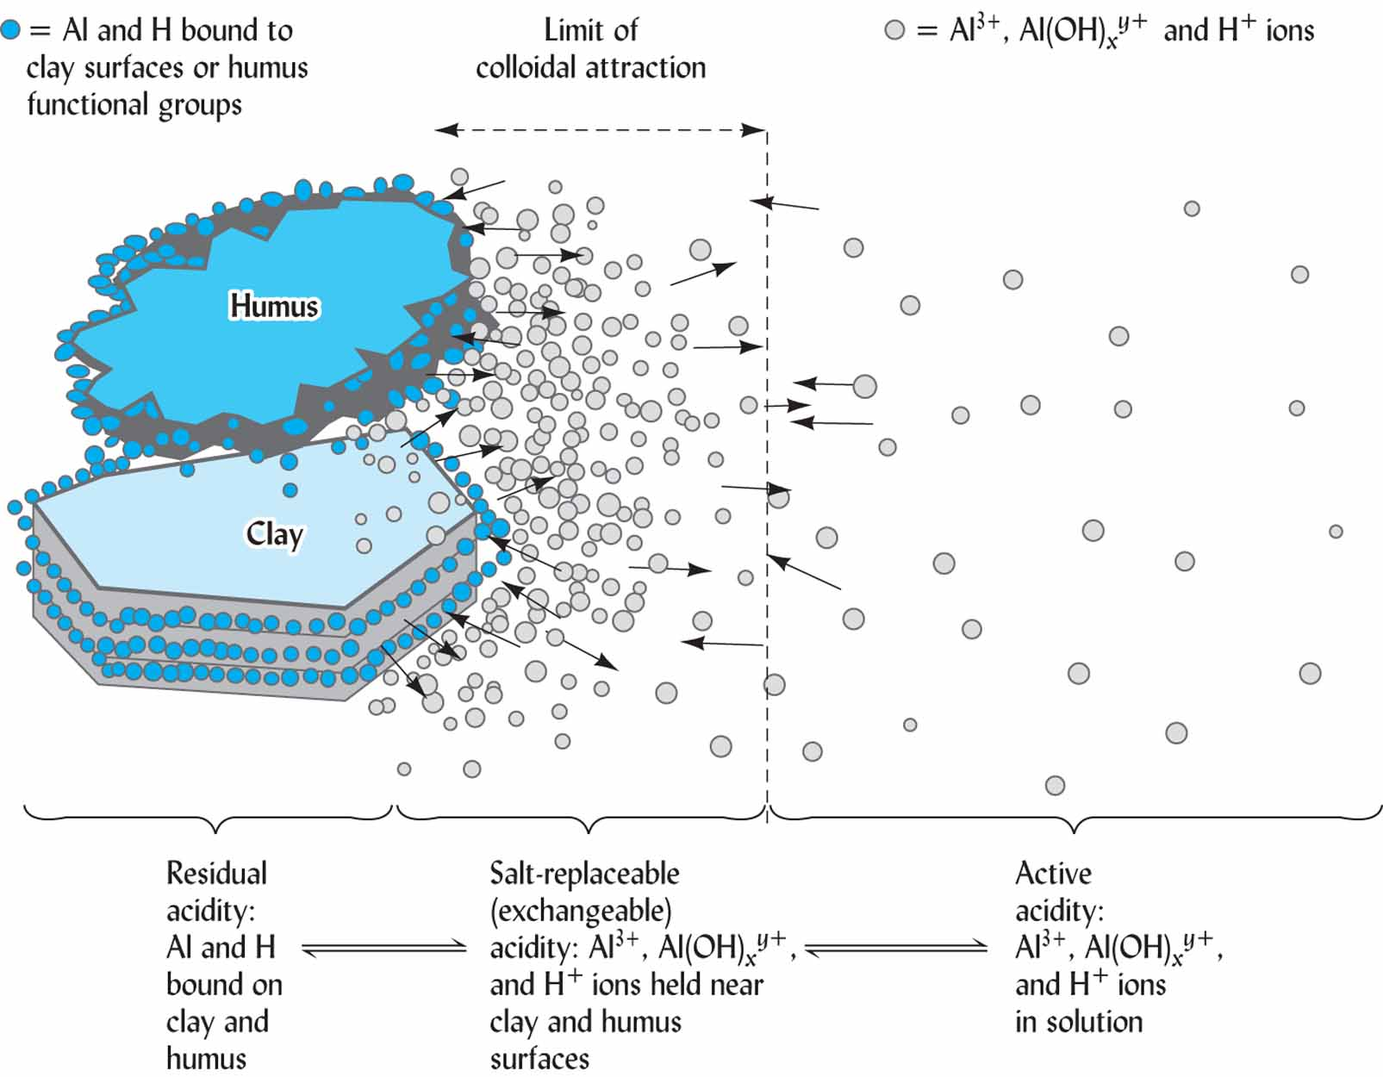
Major Types of Acidity
Exchangeable Acidity
Active Acidity
Fig. 9.9 from Nature and Properties of Soils. Brady and Weil.

Slide 7
Exchangeable & active acidity
p. 1
1. Exchangeable
Cations stored on sites & replaceable by washing with a salt solution
2. Active
Controlled entirely by the [H⁺] in soil solution
Exchangeable acidity is always many times larger than the active acidity

Slide 8
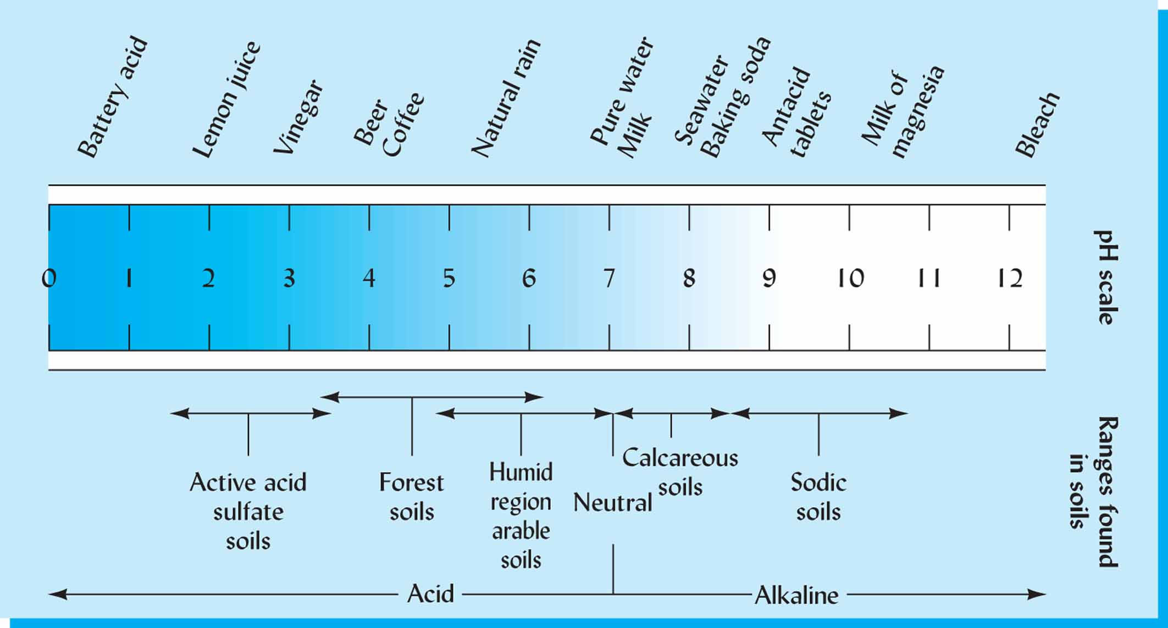
Soil pH
System = log (base 10)
pH = -log [H⁺]
pOH = -log [OH⁻]
Fig. 9.2 from Nature and Properties of Soils. Brady & Weil. P 366

Slide 9
Sample Calculation
What is the pH of a solution with a [H⁺] concentration of 0.01?
[H⁺] = 0.01M (mol/L)
Write 0.01 in scientific notation.
0.01 = 1x10⁻²
pH = - log [H⁺] = - log [1x10⁻²]
pH = - (-2)
pH = 2

Slide 10
How soils become acidic?
Soils become acidic through weathering and leaching
Warm, humid climates speed up weathering
Ultisols → “ultimate”, most weathered after Oxisols
Calcium and other basic cations are replaced on soil colloid by protons/H⁺ and the basic elements leach away.
Lime can replenish these ions

Slide 11
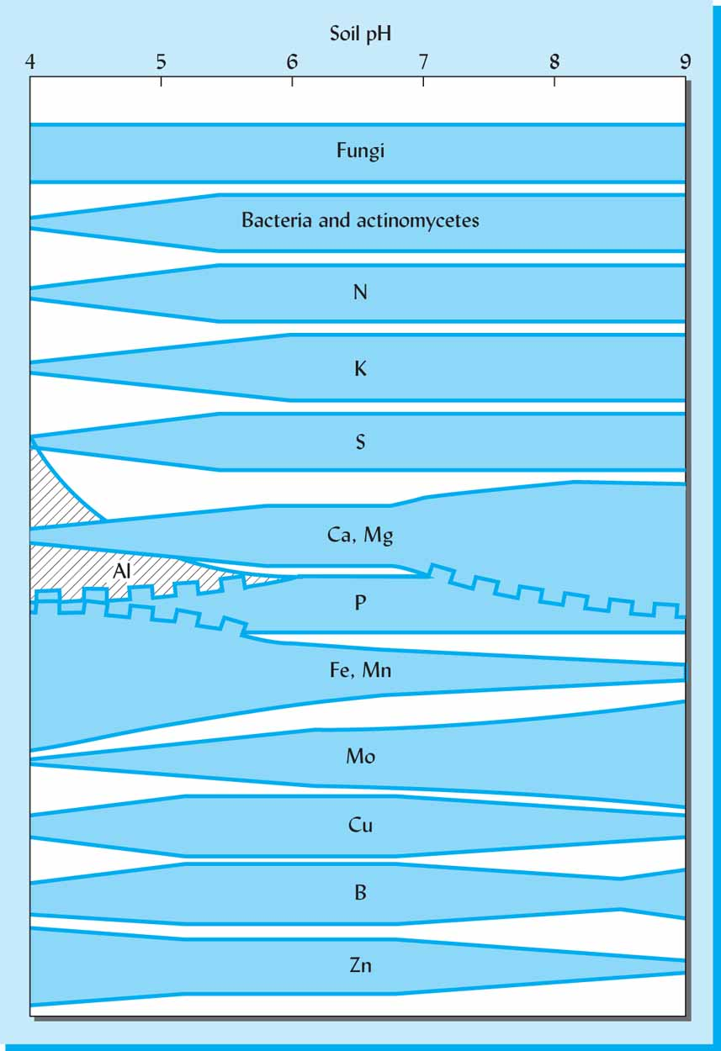
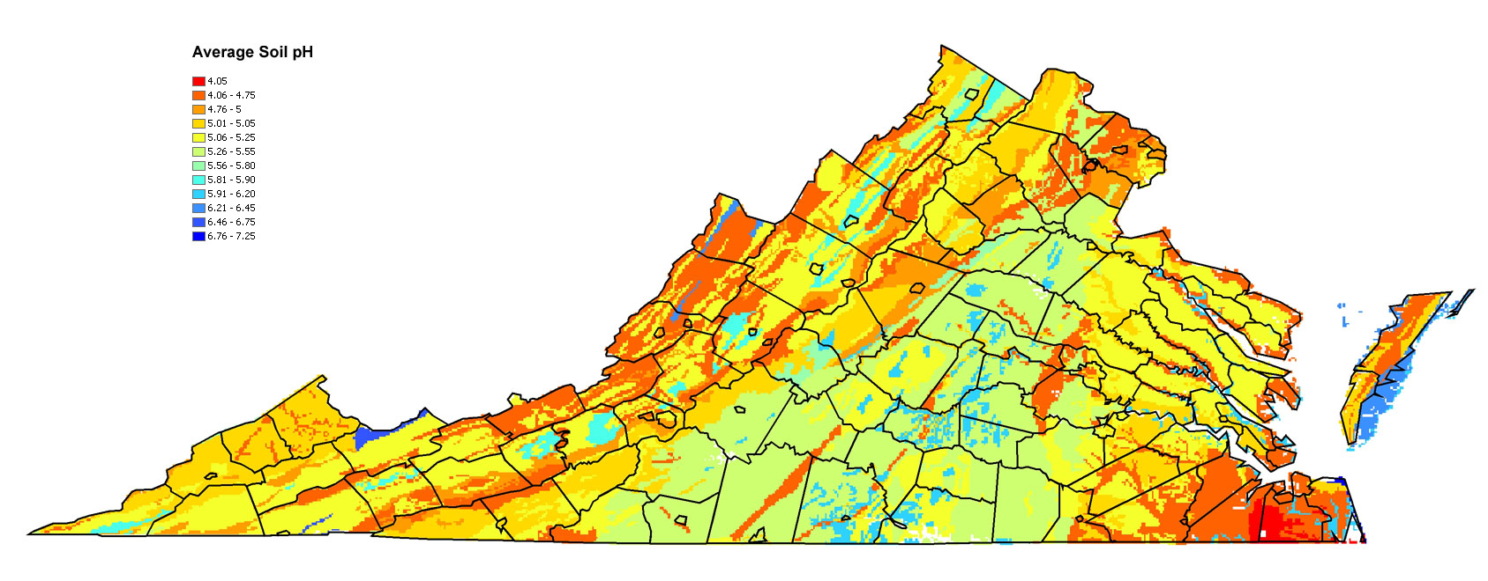
Importance of pH
p. 3
Optimal pH 5.8 – 6.5
Nutrient availability
Ions include micro and macronutrients
Essential for plant growth
Toxic at high levels
Availability varies based on pH
Source: Brady and Weil
Fig. 9.22 from Nature and Properties of Soils. Brady and Weil.
Source: oak.ppws.vt.edu

Slide 12
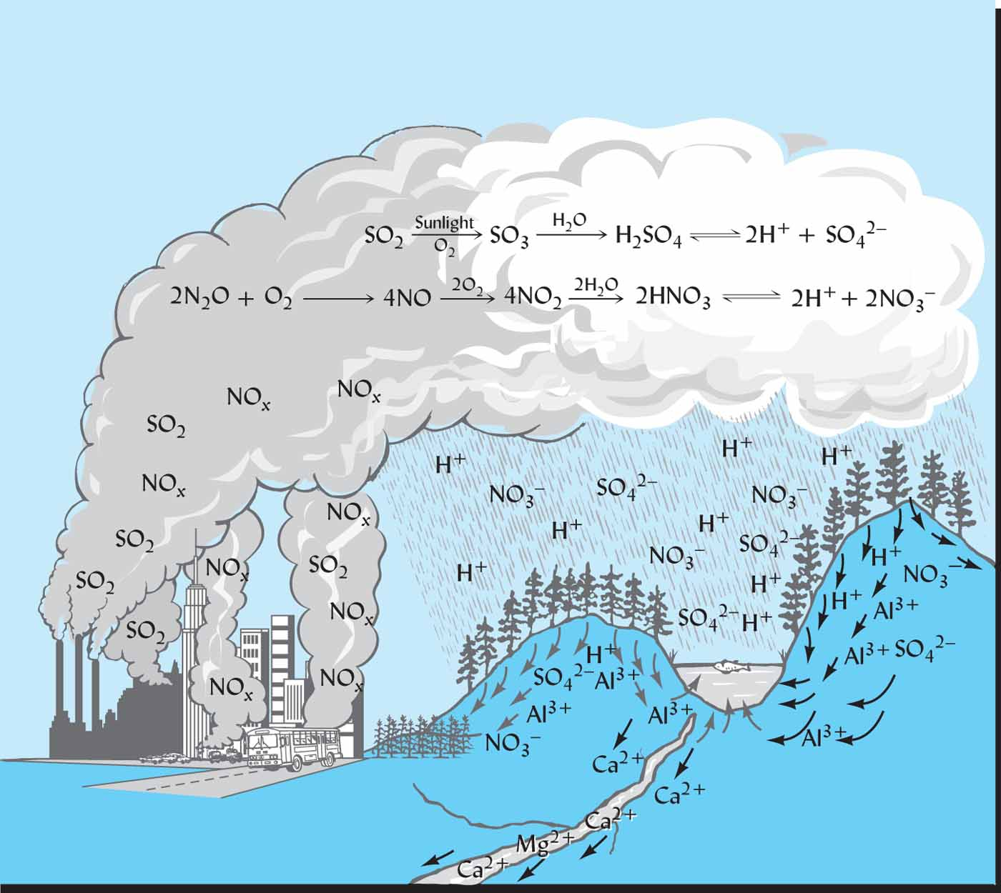
Buffering Capacity
p. 4
A well buffered soil will resist changes in pH if acid is introduced
Acid rain
Soil amendments
Directly related to the CEC
Large CEC, high buffering capacity
Small CEC, small buffering capacity
Fig. 9.16 from Nature and Properties of Soils. Brady and Weil.

Slide 13
Four types of aluminum
p. 3-4
Structural Al : within mineral structure; not exchangeable
Exchangeable Al : ions in dynamic equilibrium between soil colloid fraction and soil solution
Precipitate and polymer Al: found in inner layer of clays; not exchangeable
Chelated Al : bound to functional groups like OH⁻; not exchangeable

Slide 14
Determination of acidity of a soil sample
Step 01: Soil extraction and filtration
Add 10 g of air-dry soil to 250 ml plastic screw top bottle
Add 100 ml of 1M KCl to the bottle (Note: leave the sample for an overnight for saturation and then go to the next step).
Shake the bottle at 220 rpm for 5 minutes
Set up the filtration funnel while allowing soil particles to settle
Use transfer pipette to slowly drip the soil extract in to the filter paper and
Collect 10 ml to a 25 ml volumetric flask

Slide 15
Step 02: Titrations
To determine the acidity of a solution, using a known concentration of strong base.
Turn stopper slowly and add titrant dropwise.
At the end point (equivalence point) the [H⁺] = [OH⁻]
Record initial and final volumes from the burette to determine how many mL were added
Photo credit: www.oocities.org Accessed: 1/13/14

Slide 16
Step 02: Titrations
Determining exchangeable hydrogen
Total Exchangeable acidity = Exchangeable Al³⁺ + Exchangeable H⁺
Forward titration with base (NaOH)
Backward titration with acid (HCl)
Total Exchangeable acidity – Exchangeable Al³⁺ = Exchangeable H⁺

Slide 17
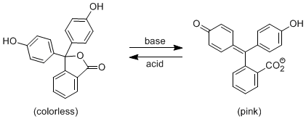
Step 02 A: Forward titration with NaOH
Forward titration with NaOH (strong base) to find total exchangeable acidity
Add phenolphthalein first as indicator
Any H⁺ in solution will be neutralized by the OH⁻
Phenolphthalein

Slide 18
Step 02 B: Prepare for backwards titration – To determine the exchangeable Al
Prepare for backwards titration with HCl (strong acid) to find exchangeable aluminum
First, add 1-2 drops HCl to bring solution back to clear
Add 5mL 4% NaF with a transfer pipette which will react to produce OH⁻
NaF react with any Al(OH)₃ aluminum that is present solution and the solution will turn pink again

Slide 19
Example calculation
To determine the acidity of a sample 10 grams of soil was added into a screw top bottle and saturated with 100 ml of 1M KCl solution. Sample was shaken for 4 minutes and leave for 24 hours for saturation. On the following day the sample was filtered and 10 ml of the filtrate was transferred in to a Erlenmeyer flask. Using the following, calculate the total exchangeable acidity, exchangeable Al³⁺ and exchangeable H+ of the sample.
Initial NaOH volume: 50 ml
Final NaOH volume: 49.05 ml
Initial HCl volume: 50 ml
Final HCl volume: 49.35 ml

Slide 20
Step 01: Determination of Total Exchangeable Acidity
NaOH volume used for titration: 50 – 49.05 = 1.95 ml
Convert Moles of NaOH to cmol_{c}/kg of TEA
10 ml of this solution “represents” about 1 g of soil
0.025 mol_{c} NaOH x 1.95 mL x 1000 g soil x 1 L x 100 cmol_{c}
L 1 gram soil 1 kg soil 1000 mL 1 mol_{c}
= 4.875 cmol_{c}/kg

Slide 21
Step 02: determination of exchangeable aluminum
HCl volume used for titration: 50 – 49.35 = 1.65 ml
0.025 mol_{c} HCl x 1.65 mL x 1000 g soil x 1 L x 100 cmol_{c}
L 1 gram soil 1 kg soil 1000 mL 1 mol_{c}
Exchangeable acidity – Exchangeable Al³⁺ = Exchangeable H⁺
-
=
4.875 cmol_{c}/kg
4.125 cmol_{c}/kg

Slide 22
Step 03: Determining exchangeable hydrogen
Exchangeable acidity – Exchangeable Al³⁺ = Exchangeable H⁺
4.875 cmol_{c}/kg
-
4.125 cmol_{c}/kg
=
0.75 cmol_{c}/kg

