Slide 1
SOIL TAXONOMY

Slide 2
IV. Soil Taxonomy Hierarchy
Order
Suborder
Great Group
Subgroup
Family
Series

Slide 3
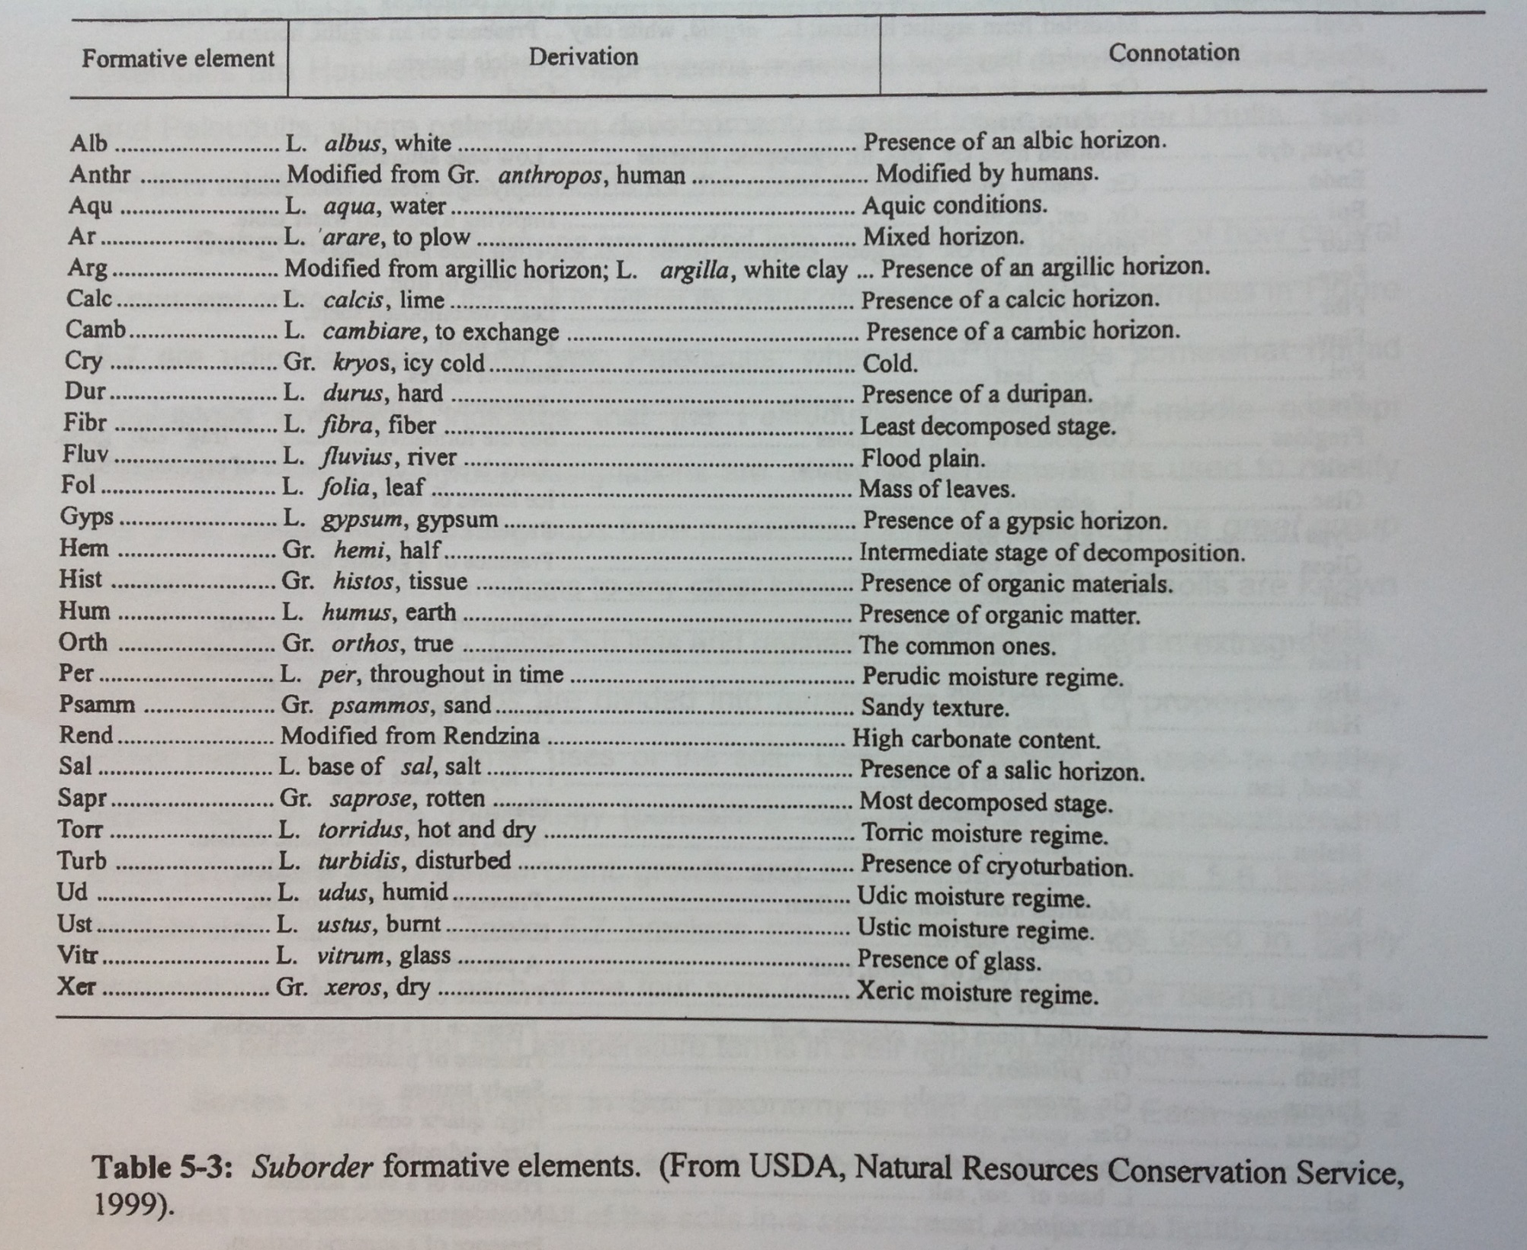

Slide 4
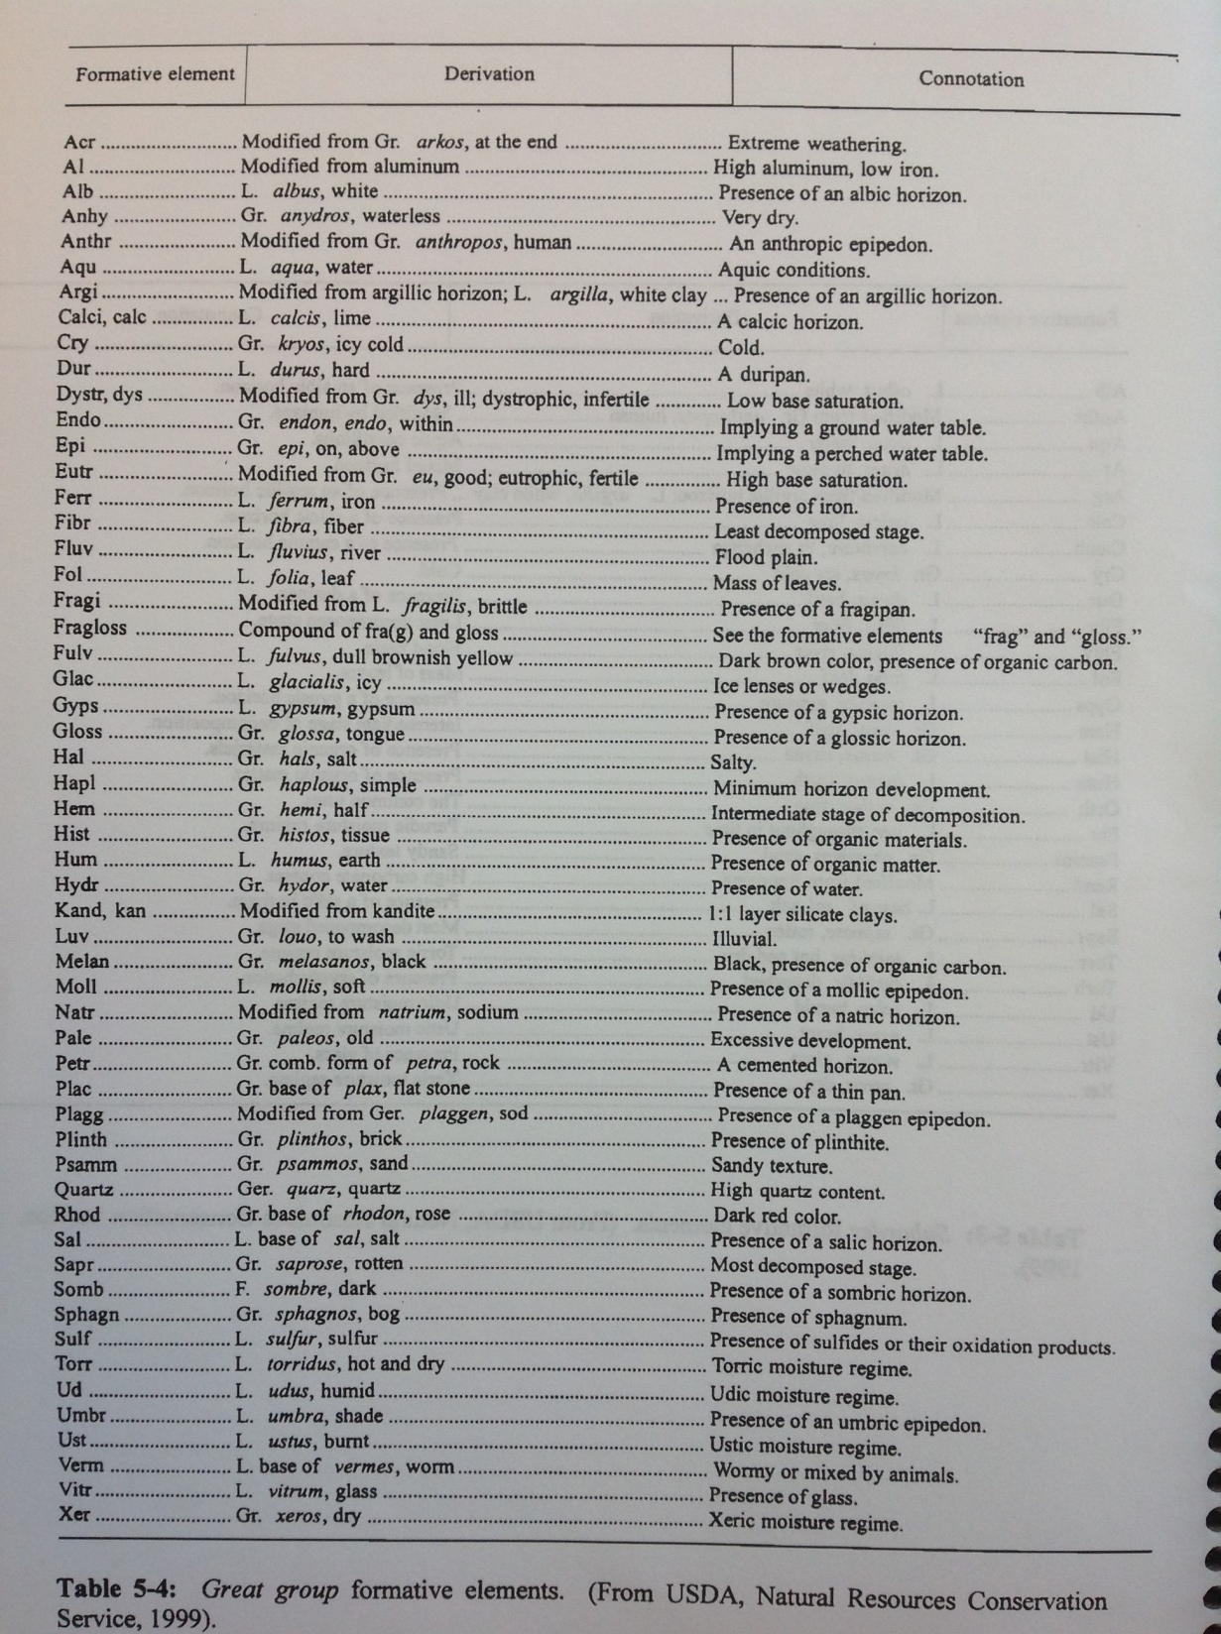

Slide 5
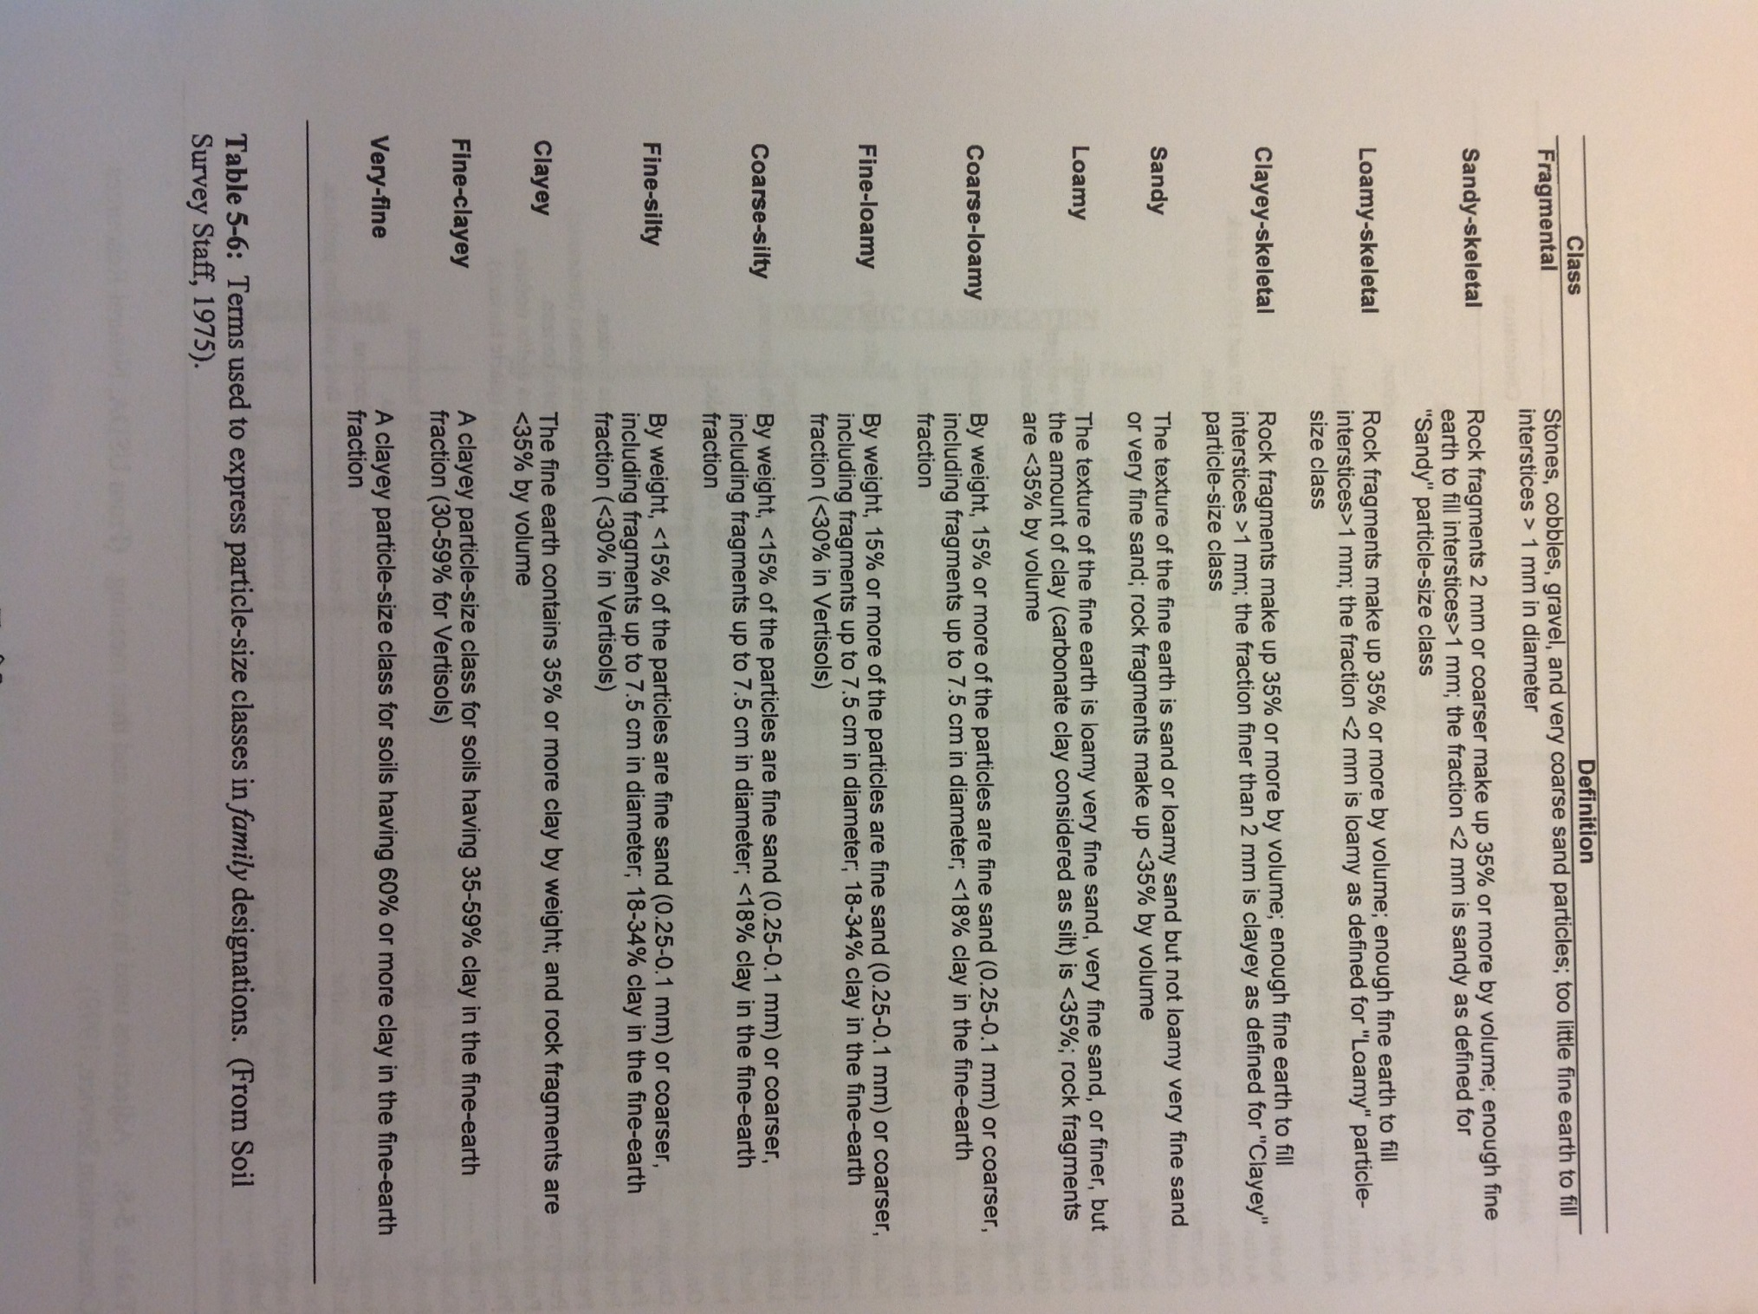

Slide 6
IV. Soil Taxonomy Hierarchy (Frederick Series)
Order (Ultisols)
Suborder (Udults)
Great Group (Paleudults)
Subgroup (Typic Paleudults)
Family (Clayey, Kaolinitic, Mesic)
Series (Frederick)
Clayey = > 35% clay
Kaolinitic = clay > 50% Kaolinite
Mesic Temperature = 47 -59 degrees F
Clayey, Kaolinitic, Mesic, Typic, Paleudults
Ultimate development
Moist climate
Thick solum and heavily weathered, old
Central

Slide 7
IV. Soil Taxonomy Hierarchy (Lodi Series)
Order (Ultisols)
Suborder (Udults)
Great Group (Hapludults)
Subgroup (Typic Hapludults)
Family (Clayey, Kaolinitic, Mesic)
Series (Lodi)
Clayey = > 35% clay
Kaolinitic = clay > 50% Kaolinite
Mesic Temperature = 47 -59 degrees F
Clayey, Kaolinitic, Mesic, Typic, Hapludults

Slide 9
IV. Soil Taxonomy Hierarchy (Endcav Series)
Order (Alfisol)
Very Fine, mixed, mesic, Typic Hapludalf

Slide 10
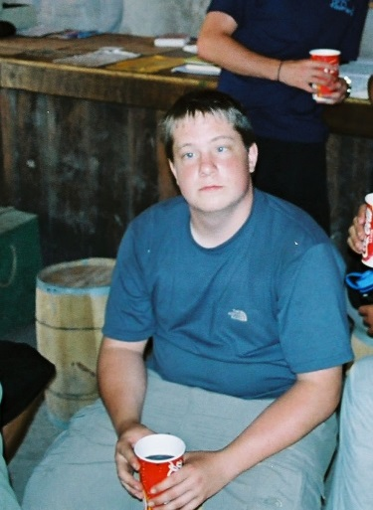
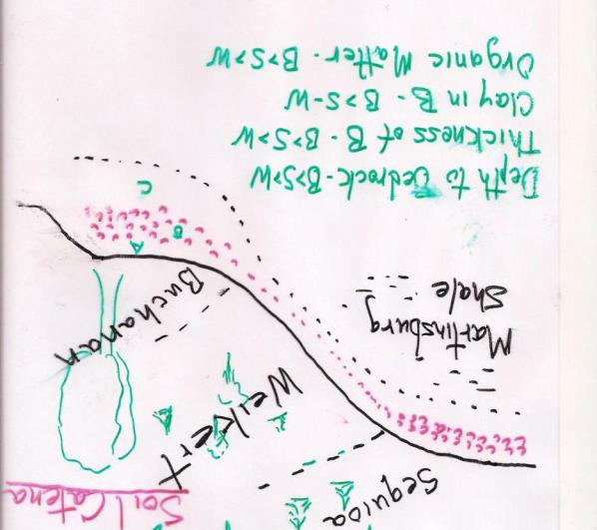
Cantina

Slide 11
IV. Soil Taxonomy Hierarchy (Sequoia Series)
Order (Ultisols)
Clayey, Mixed, Mesic, Typic, Hapludults

Slide 12
IV. Soil Taxonomy Hierarchy (Weikert Series)
Order (Inceptisols)
Suborder (Inceptisols)
Loamy-skeletal, mixed, active, mesic Lithic Dystrudepts
Degree of activity
of CEC
Presence
Of stones
Humid
Loam texture
w/ coarser fragments
Mixed clay
mineralogy
47 -59
degrees F
Low
Base
Satur.
Inceptisols

Slide 13
Superactive
Active
Semiactive
Subactive

Slide 15
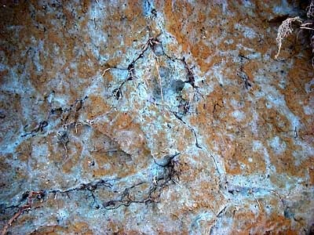
IV. Soil Taxonomy Hierarchy (Buchanan Series)
Order (Ultisols)
Fine-Loamy, mixed, mesic Aquic Fragiudults

Slide 16
IV. Soil Taxonomy Hierarchy (Shenval Series)
Order (Alfisols)
Fine, mixed, mesic typic Paleudalfs

Slide 17
IV. Soil Taxonomy Hierarchy (Monongahela Series)
Order (Ultisols)
Fine-loamy, mixed, mesic, Typic Fragiudults

Slide 20
IV. Soil Taxonomy Hierarchy (Mill Rock Series)
Order (Entisols)
Mixed, mesic, Alfic Udipsamment

Slide 22
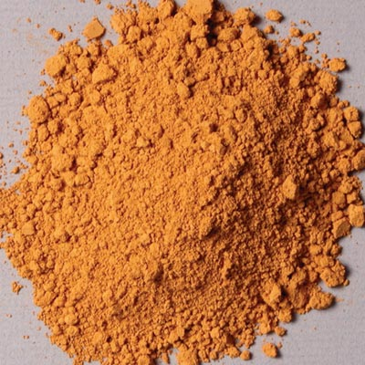
IV. Soil Taxonomy Hierarchy (Tioga Series)
Order (Inceptisols)
Coarse-loamy, mixed, mesic, Dystric, Fluventic Eutrochrept

Slide 24
IV. Soil Taxonomy Hierarchy (Massenetta Series)
Order (Mollisols)
Fine-Loamy, carbonatic, mesic, Fluvaqentic Hapludoll

Slide 25
IV. Soil Taxonomy Hierarchy (Edom Series)
Order (Alfisol)
Fine, illitic, mesic, Typic Hapludalfs

Slide 26
IV. Soil Taxonomy Hierarchy
Piedmont Soils
Davidson Series
fine, kaolinitic, thermic, Rhodic, Paleudults (Kandiudults)
Rabun Series
Fine, kaolinitic, mesic, typic, Rhodudults

Slide 27
IV. Soil Taxonomy Hierarchy
Piedmont Soils
Watt Series
Loamy-skeletal, mixed, mesic, umbric Dystrudepts

Slide 28
IV. Soil Taxonomy Hierarchy
Piedmont Soils
Penn Series
Fine-loamy, mixed, superactive, mesic, ultic Hapludalfs
Bucks Series
Fine-loamy, mixed, active, mesic, Typic Hapludults
Superactive
Active
Semiactive
Subactive

Slide 29
IV. Soil Taxonomy Hierarchy
Piedmont Soils
Tatum Series
Clayey, mixed, thermic, Typic Hapludults
Nason Series
Clayey, mixed, thermic, Typic Hapludults

Slide 30
IV. Soil Taxonomy Hierarchy
Piedmont Soils
Wehadkee Series
Fine-loamy, mixed, active, nonacid, thermic, Fluvaquentic Endoaquepts
Rowland Series
Fine-loamy, mixed, superactive, mesic Fluvaquentic Dystrudepts

Slide 32
IV. Soil Taxonomy Hierarchy
Piedmont Soils
Iredell Series
Fine, montmorillonitic, thermic, vertic Hapludalfs
or
Fine, mixed, active, thermic, oxyaquic vertic Hapludalfs
Oxyaquic: saturated soils, but are not reduced and do not contain redoximorphic features
Orange Series
Fine, smectitic, mesic, Albaquic Hapludalfs
Zion Series
Fine, mixed, thermic ultic Hapludalfs
ultic: “sufficiently leached that base saturation is lower than for a typical Hapludalf”

