Slide 1
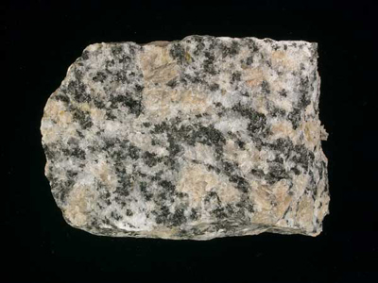
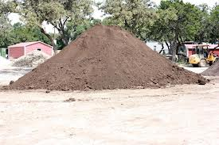
Rock Weathering and Soil Mineralogy

Slide 2
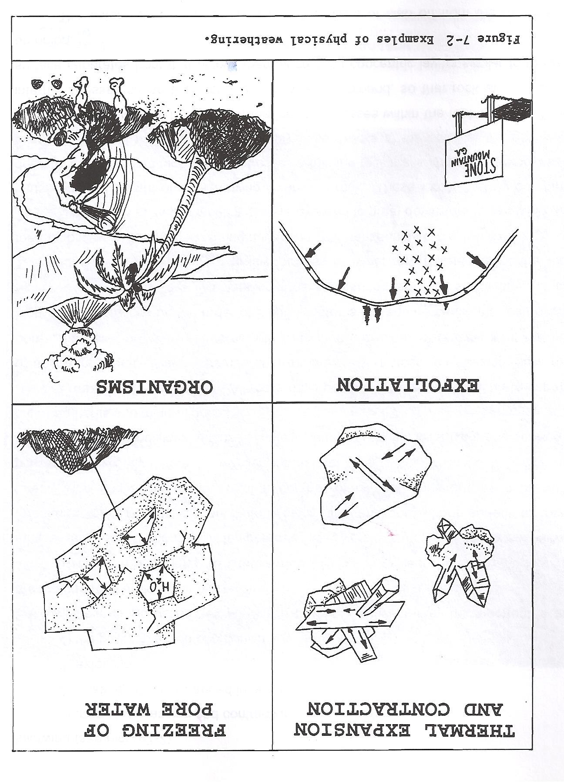
Physical Weathering……

Slide 3
Weathering
A . Chemical Weathering
Water is critical (and heat serves as a catalyst)
Complex Process (involves several reactions)
Biological Activity (helps accelerate weathering processes)

Slide 4
Complex Process
Solution
Hydrolysis
Oxidation
Hydration
Chelation
Dialysis
Chemical Reconstitution

Slide 5
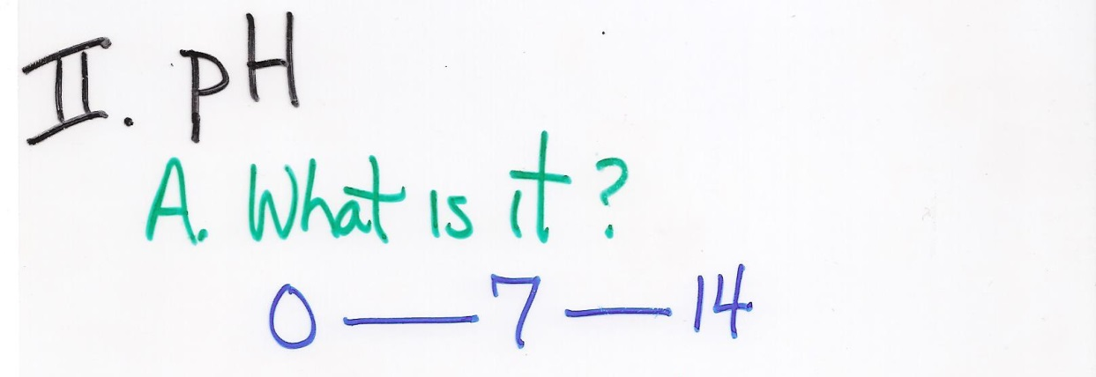
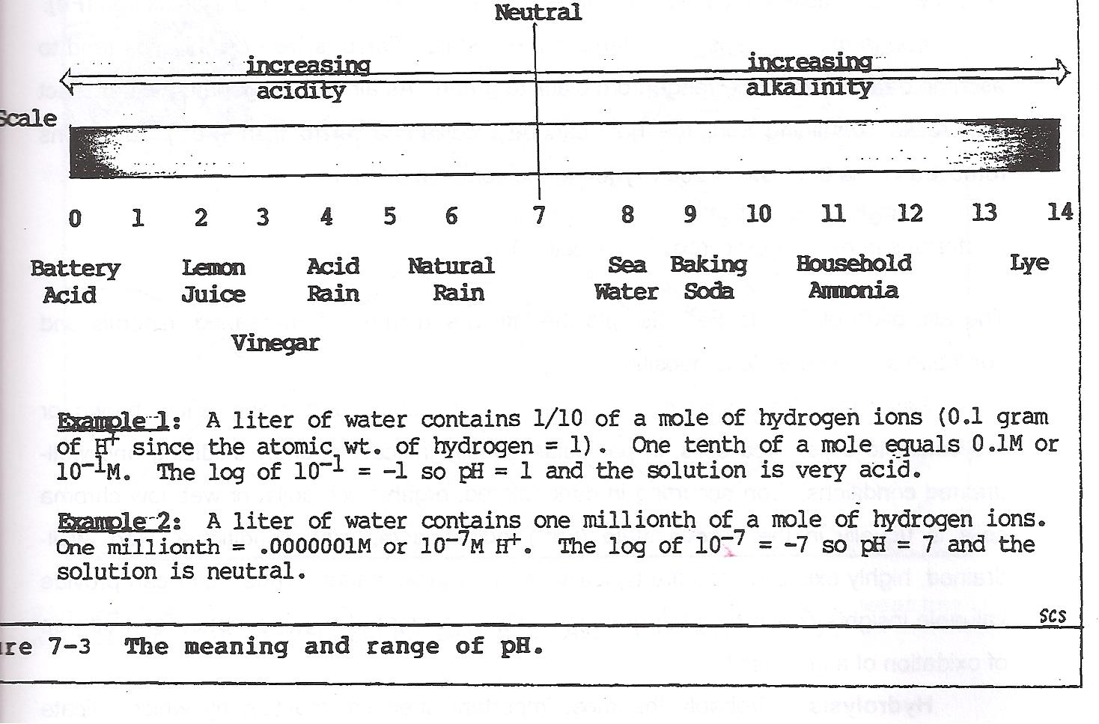
“The negative log of hydrogen
in concentration”
The negative log of hydrogen ion content

Slide 7
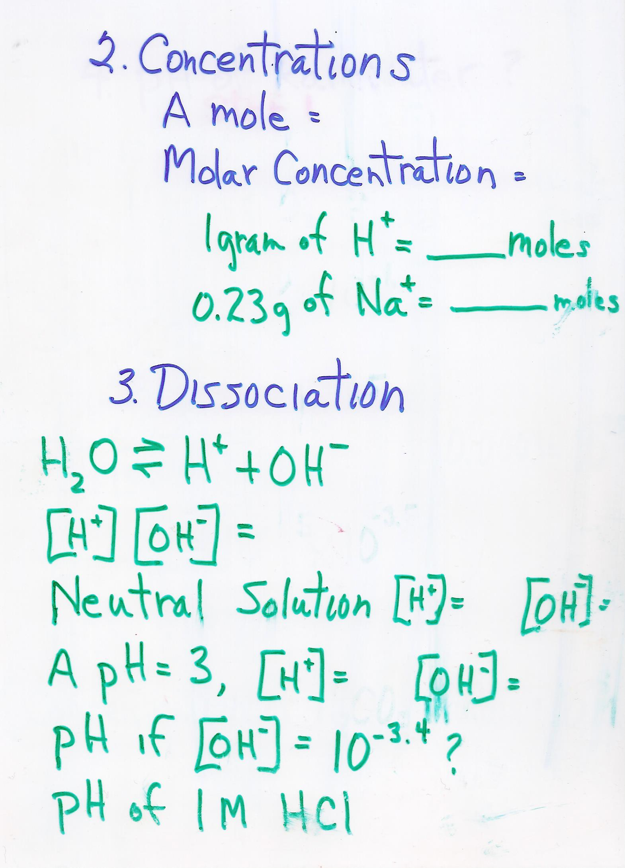
6.02214129(27)×10²³ atoms
Moles per liter
1 g H = 1 Mole
1.008 g H
0.23 g Na = 1 Mole
22.99 g Na

Slide 8
6.02214129(27)×10²³ atoms
Moles per liter
1 g H = 1 Mole = ~1 Mole H
1.008 g H
0.23 g Na = 1 Mole = 0.01 Mole Na
22.99 g Na

Slide 9
Concentration of H⁺ * Concentration of OH⁻ = 10⁻¹⁴
[10⁻⁷ ][10⁻⁷ ] = 10⁻¹⁴
“Always a constant for this
reaction”
“The negative log of hydrogen
in concentration”

Slide 10
Concentration of H⁺ * Concentration of OH⁻ = 10⁻¹⁴
[10⁻⁷ ][10⁻⁷ ] = 10⁻¹⁴
“Always a constant for this
reaction”
[10⁻³ ] [10⁻¹¹ ]
“The negative log of hydrogen
in concentration”

Slide 11
Concentration of H⁺ * Concentration of OH⁻ = 10⁻¹⁴
[10⁻⁷ ][10⁻⁷ ] = 10⁻¹⁴
“Always a constant for this
reaction”
[10⁻³ ] [10⁻¹¹ ]
[10 ^{x} ][10^{-3.4} ] = 10⁻¹⁴
“The negative log of hydrogen
in concentration”

Slide 12
Concentration of H⁺ * Concentration of OH⁻ = 10⁻¹⁴
[10⁻⁷ ][10⁻⁷ ] = 10⁻¹⁴
“Always a constant for this
reaction”
[10⁻³ ] [10⁻¹¹ ]
[10 ^{-10.6} ][10^{-3.4} ] = 10⁻¹⁴
“The negative log of hydrogen
in concentration”

Slide 13
Concentration of H⁺ * Concentration of OH⁻ = 10⁻¹⁴
[10⁻⁷ ][10⁻⁷ ] = 10⁻¹⁴
“Always a constant”
pH of 0.1 M HCl = 10⁻¹ M = log 10⁻¹ = -1 = pH is 1
pH of 1 M HCl = 10⁰ M = log 10⁰ = 0 = pH is 0
pH: “The negative log of hydrogen
in concentration”

Slide 14
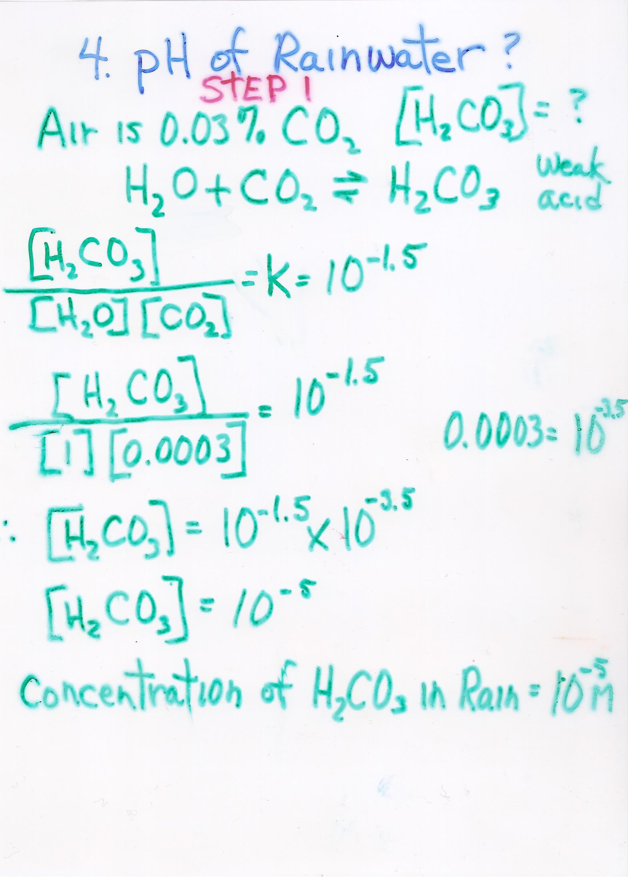
Question 1:
“How much carbonic acid is there in rainwater?”
pH: “The negative log of hydrogen
in concentration”

Slide 15
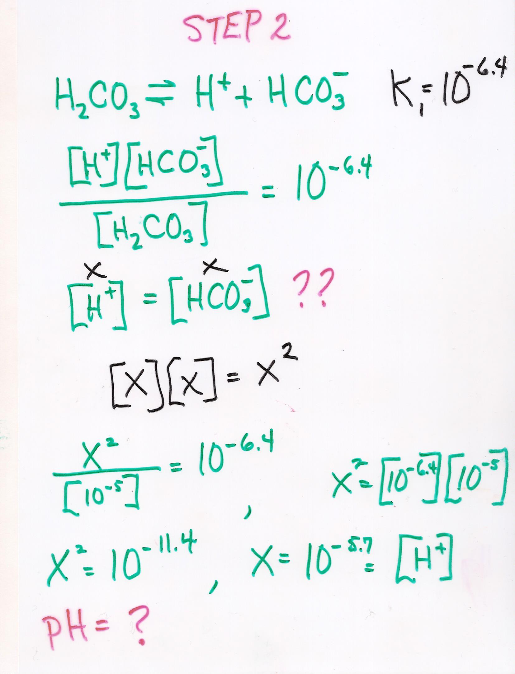
Question 2:
“What is the pH of this rainwater?”
pH: “The negative log of hydrogen
in concentration”

Slide 16
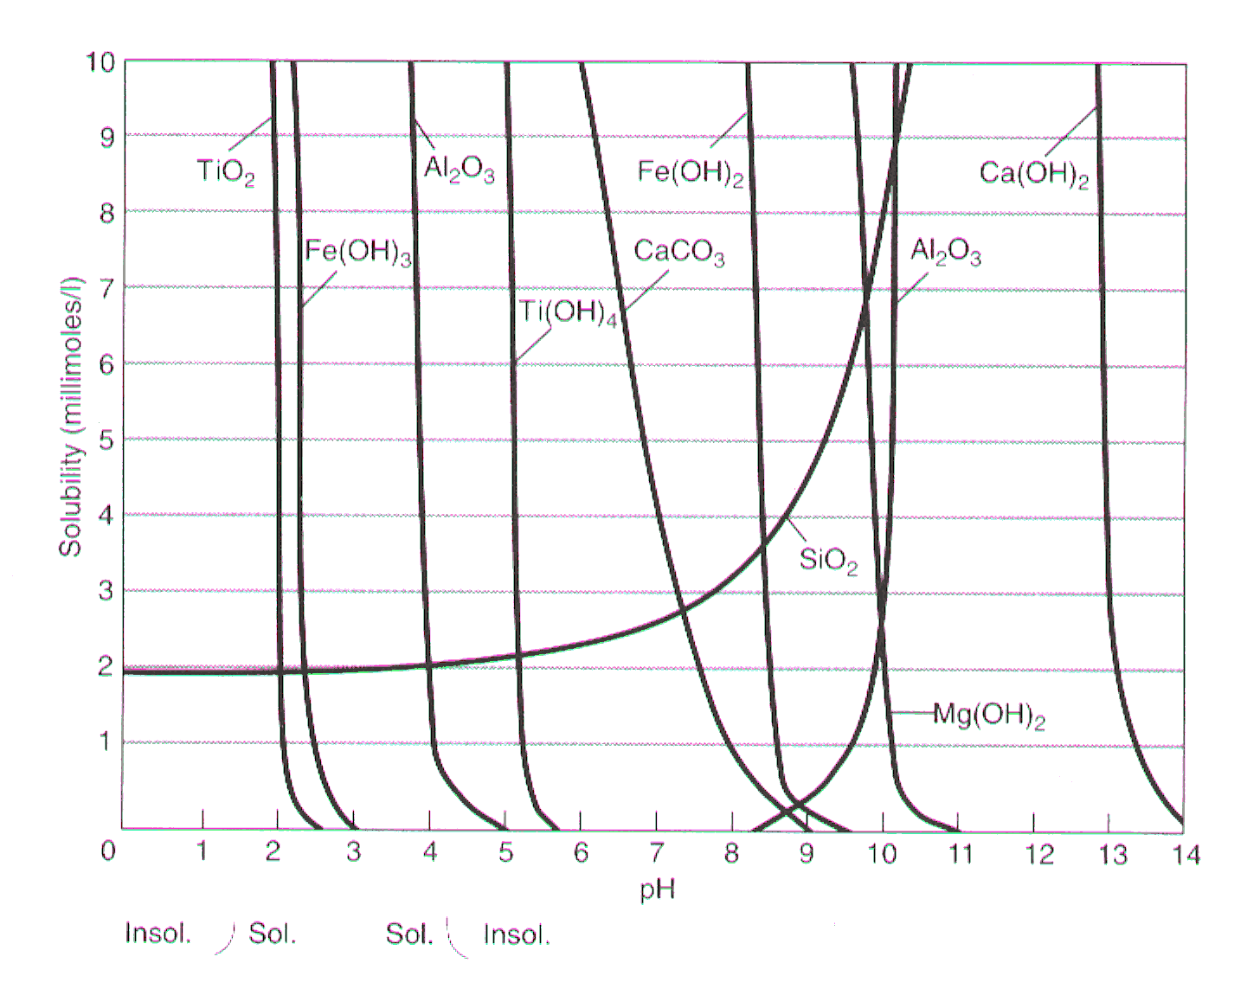
Why does it matter?

Slide 17
Why does it matter?
Ca²⁺ > Na⁺ > Mg²⁺ > K⁺ > Si⁴⁺ > Fe³⁺ > Al³⁺
Most
Mobile
Least
Mobile

Slide 18
Molar BA Ratio

Slide 19
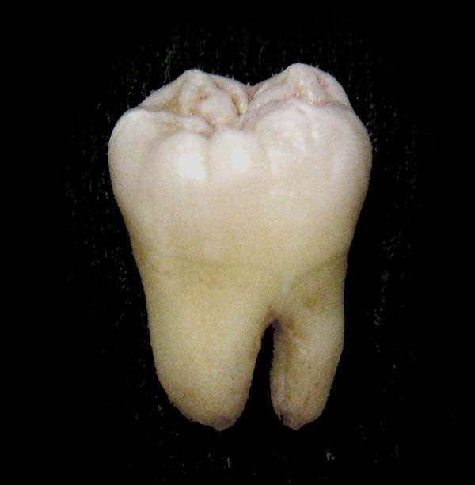
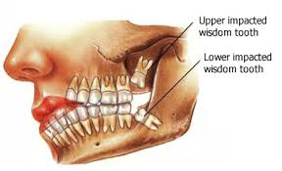
Molar BA Ratio ????
“Mineralogy made
me do this!”
Uncle
Festus
Cuzzin
Cletus

Slide 20
Molar BA Ratio
Moles of Na₂O + K₂O + CaO + MgO
Moles of Al₂O₃

Slide 21
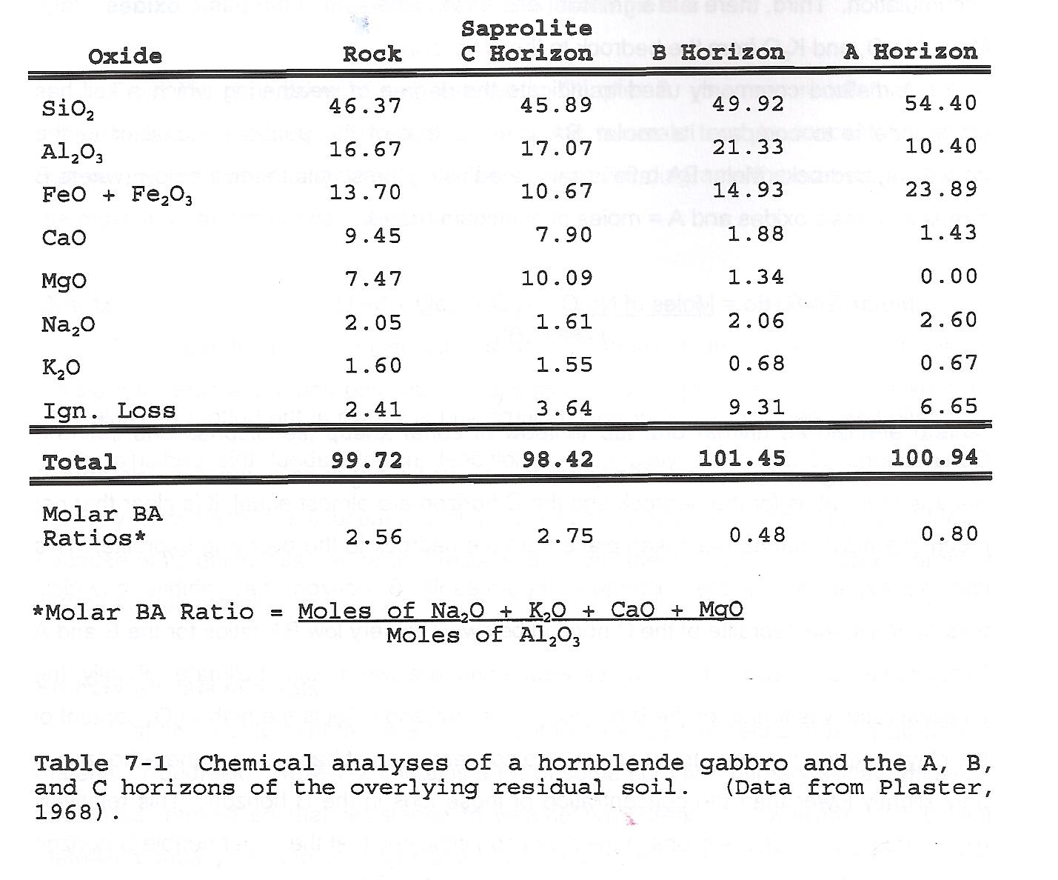

Slide 22
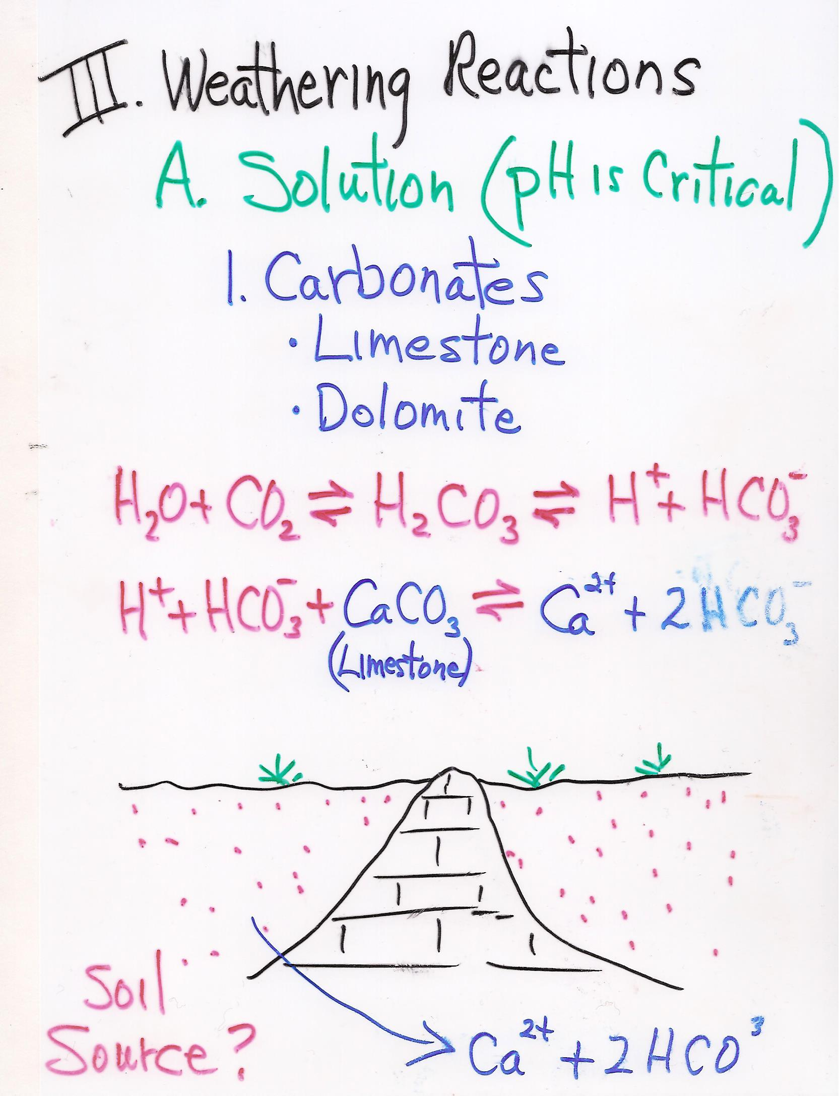

Slide 23
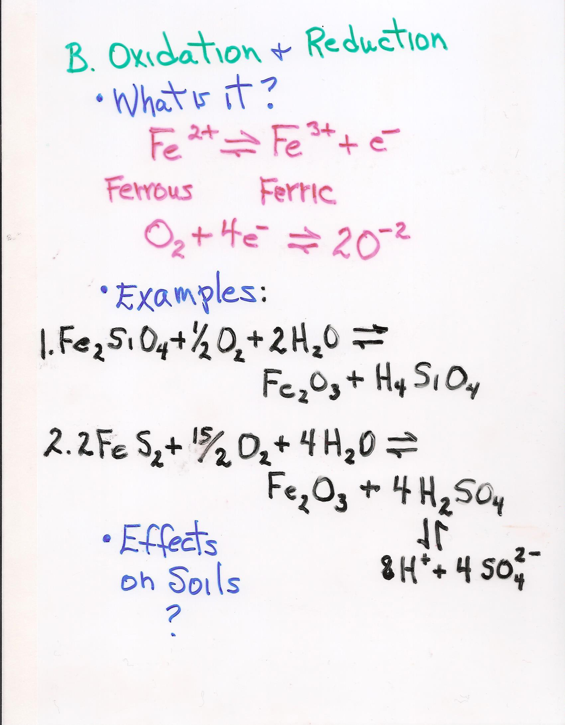

Slide 24
C. Hydrolysis “converting a silicate mineral into a clay via water”
2KAlSi₃O₈ + 2 H₂CO₃ + H₂0 =
Orthoclase Carbonic Acid Water
H₄Al₂Si₂O₉ + 2K⁺ + HCO₃⁻ + 4 H₄SiO₄ + OH⁻
Kaolinite Bicarbonate Silicic Acid

Slide 25
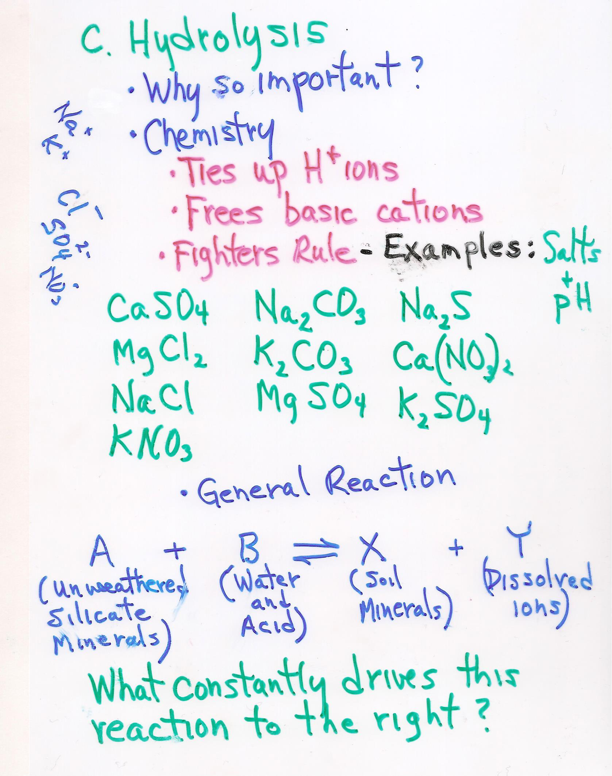

Slide 27
HCl - hydrochloric acid HNO₃ - nitric acid H₂SO₄ - sulfuric acid
LiOH - lithium hydroxide
NaOH - sodium hydroxide
KOH - potassium hydroxide

Slide 29
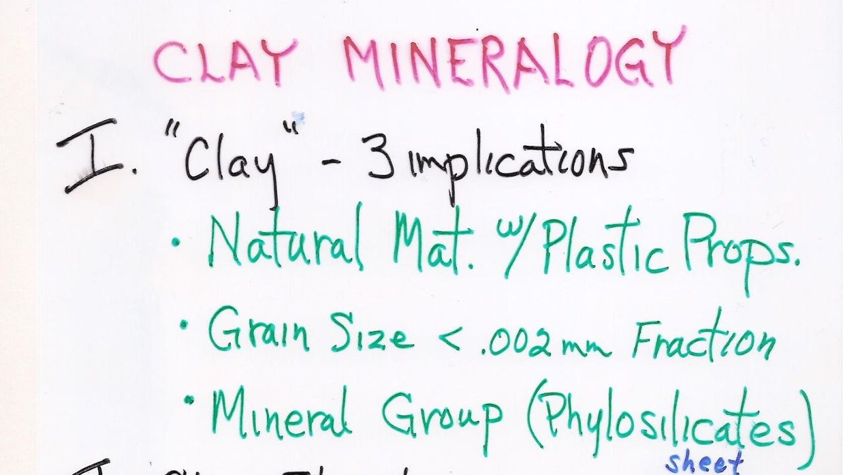

Slide 30
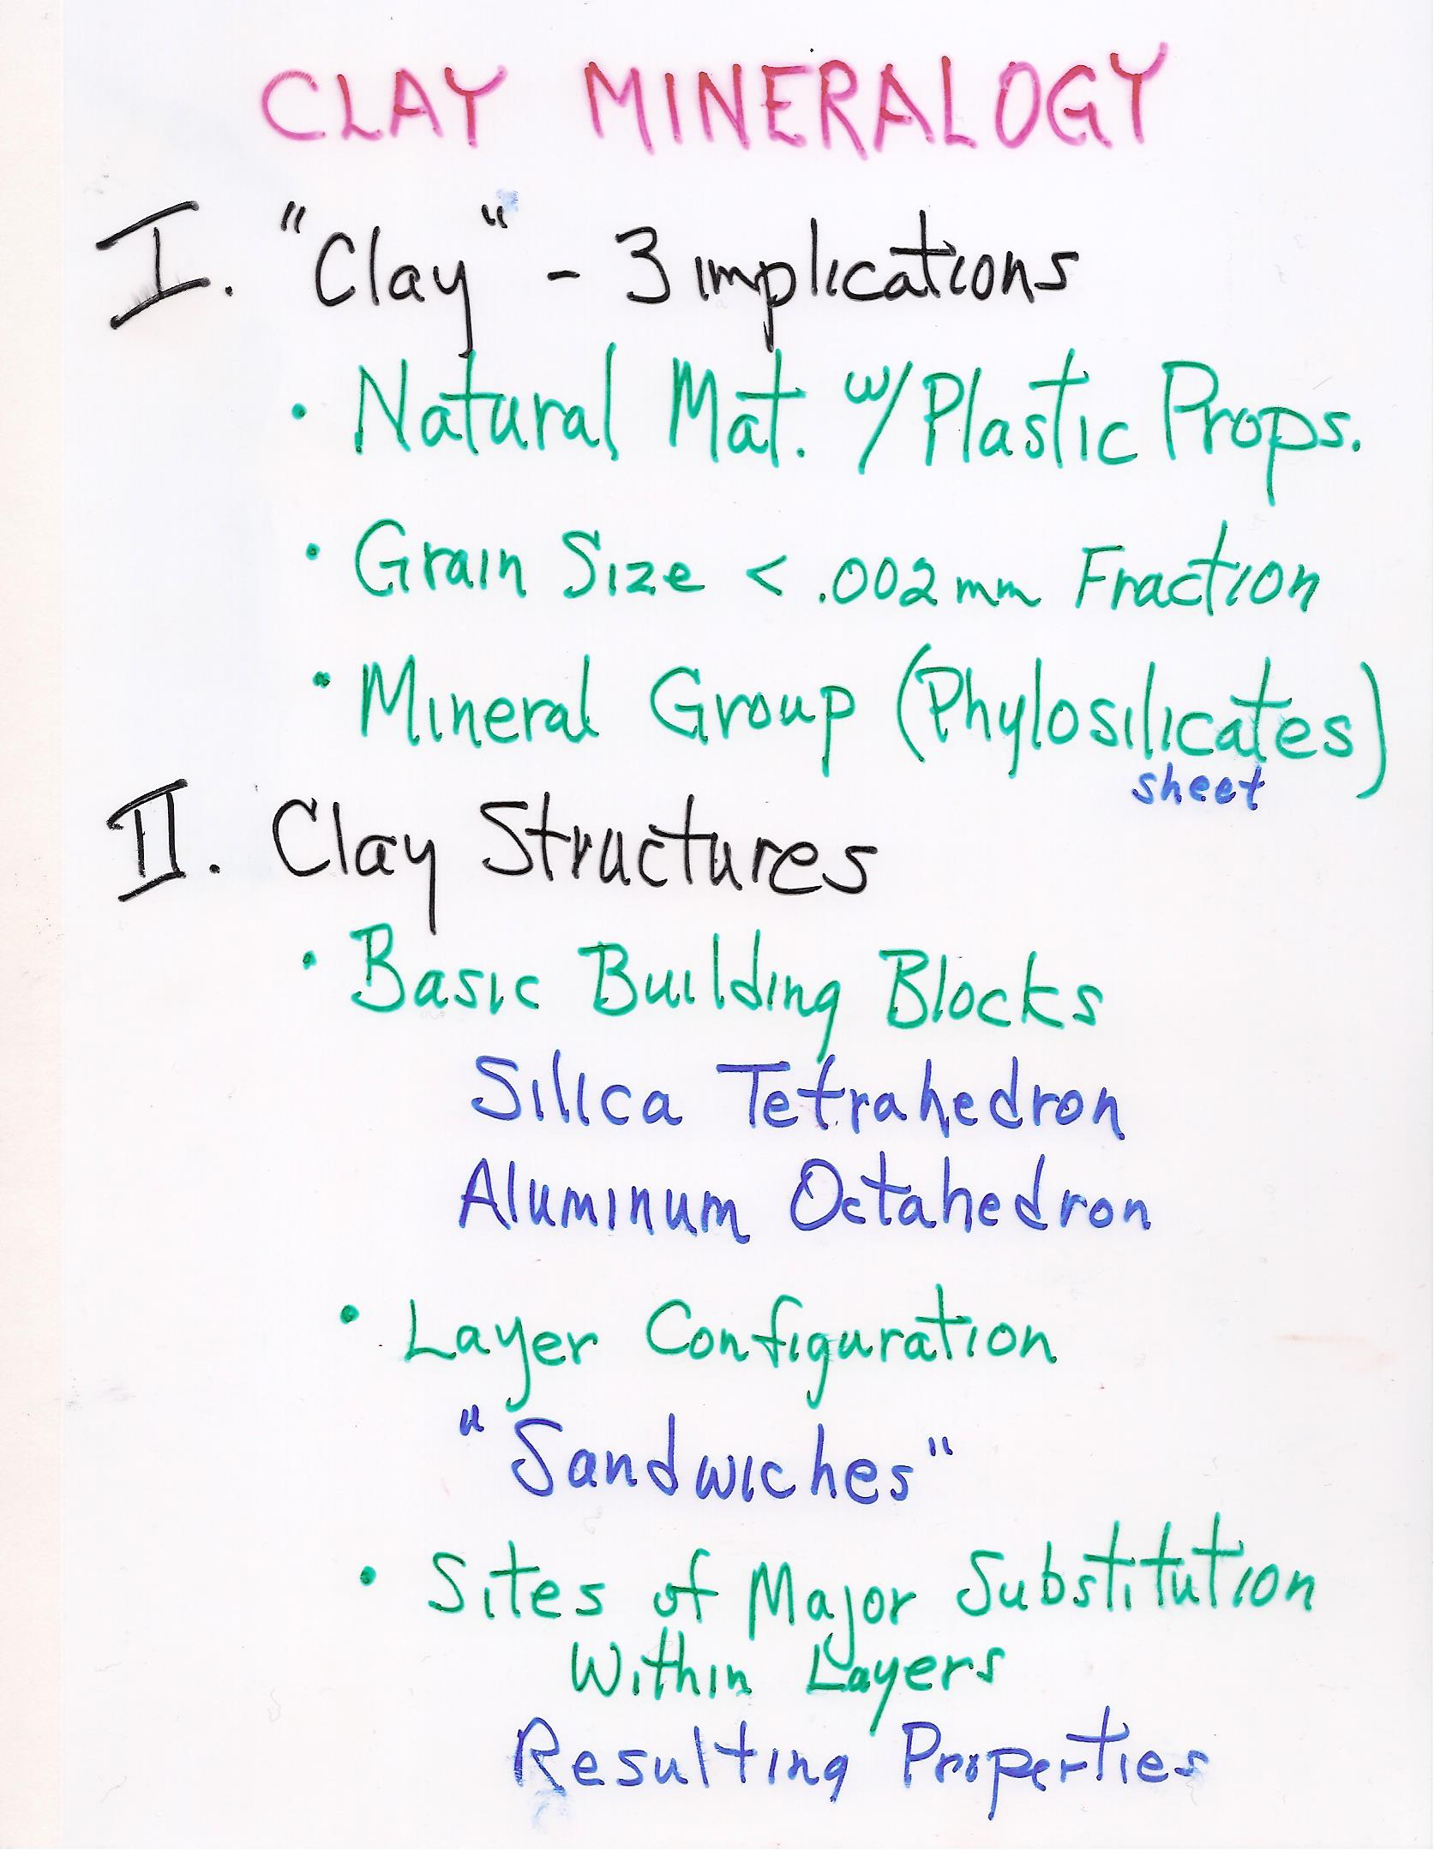
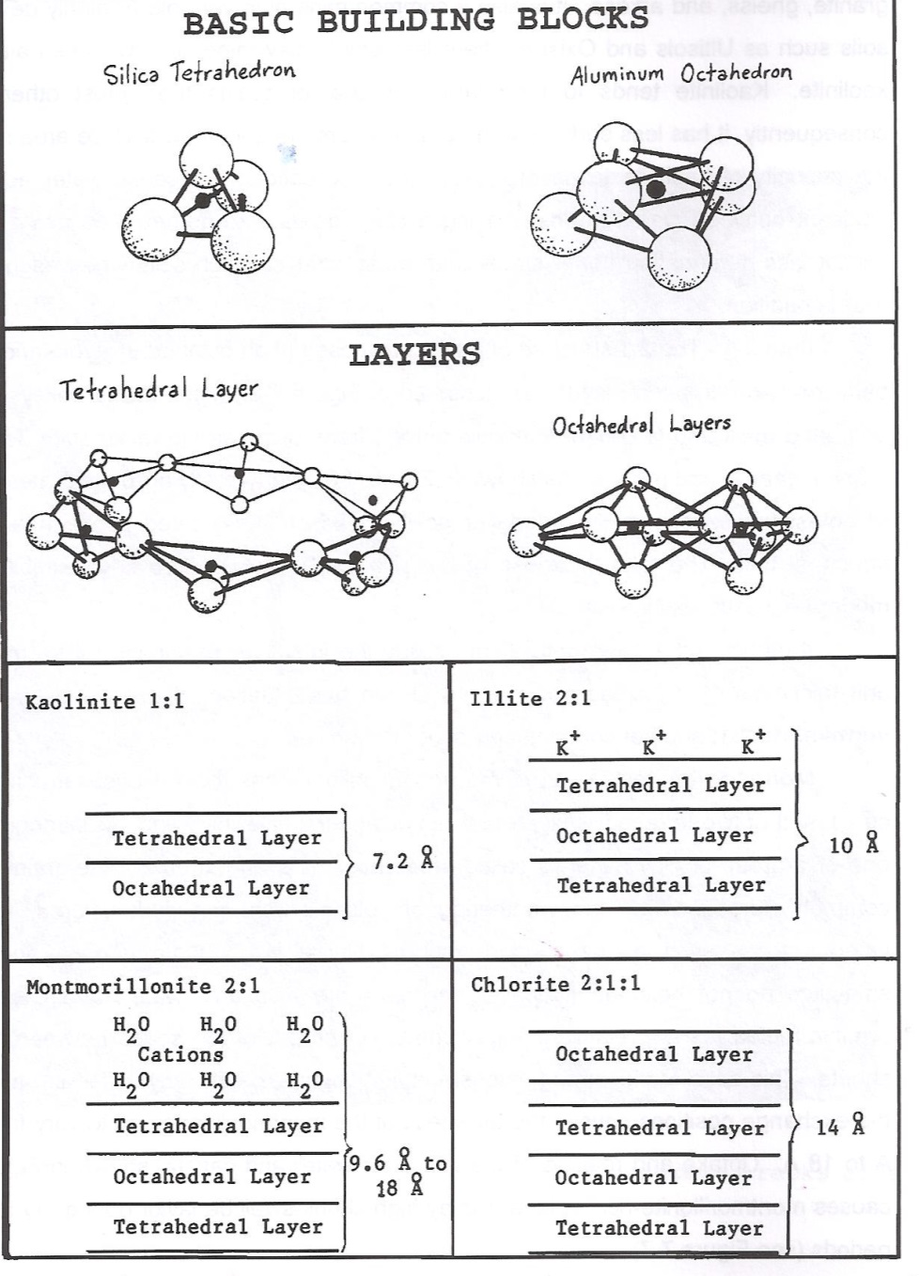
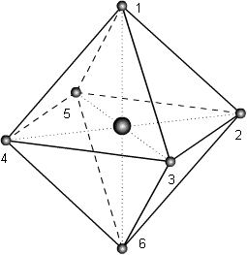

Slide 31
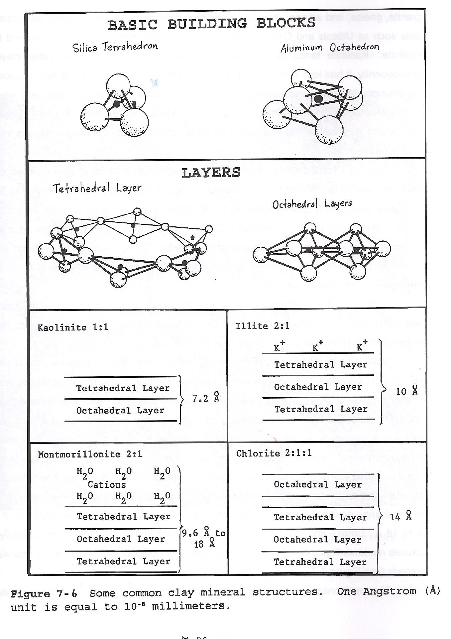

Slide 32
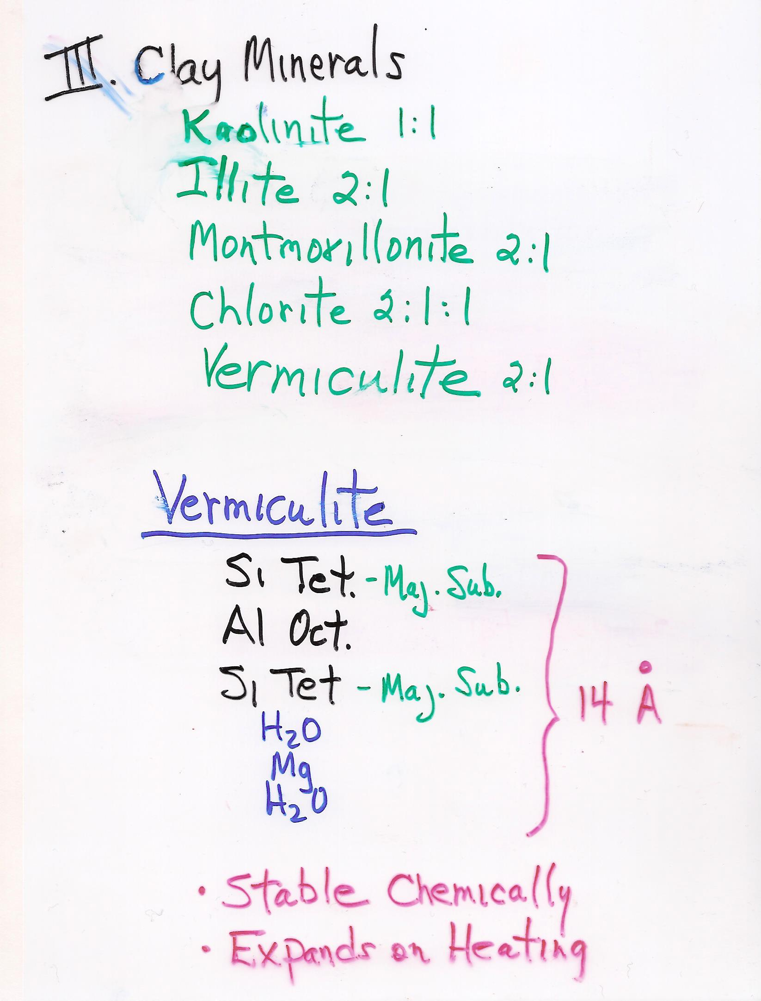
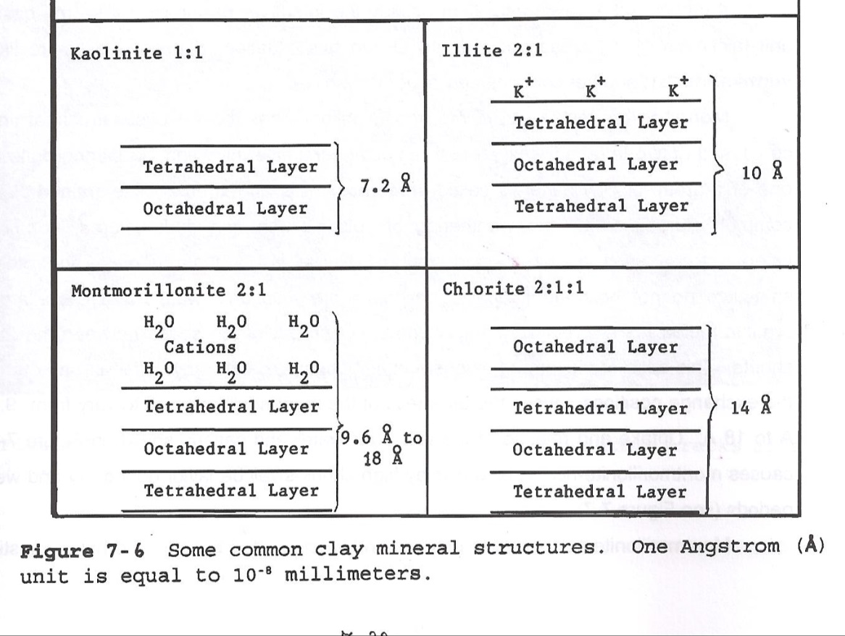

Slide 33
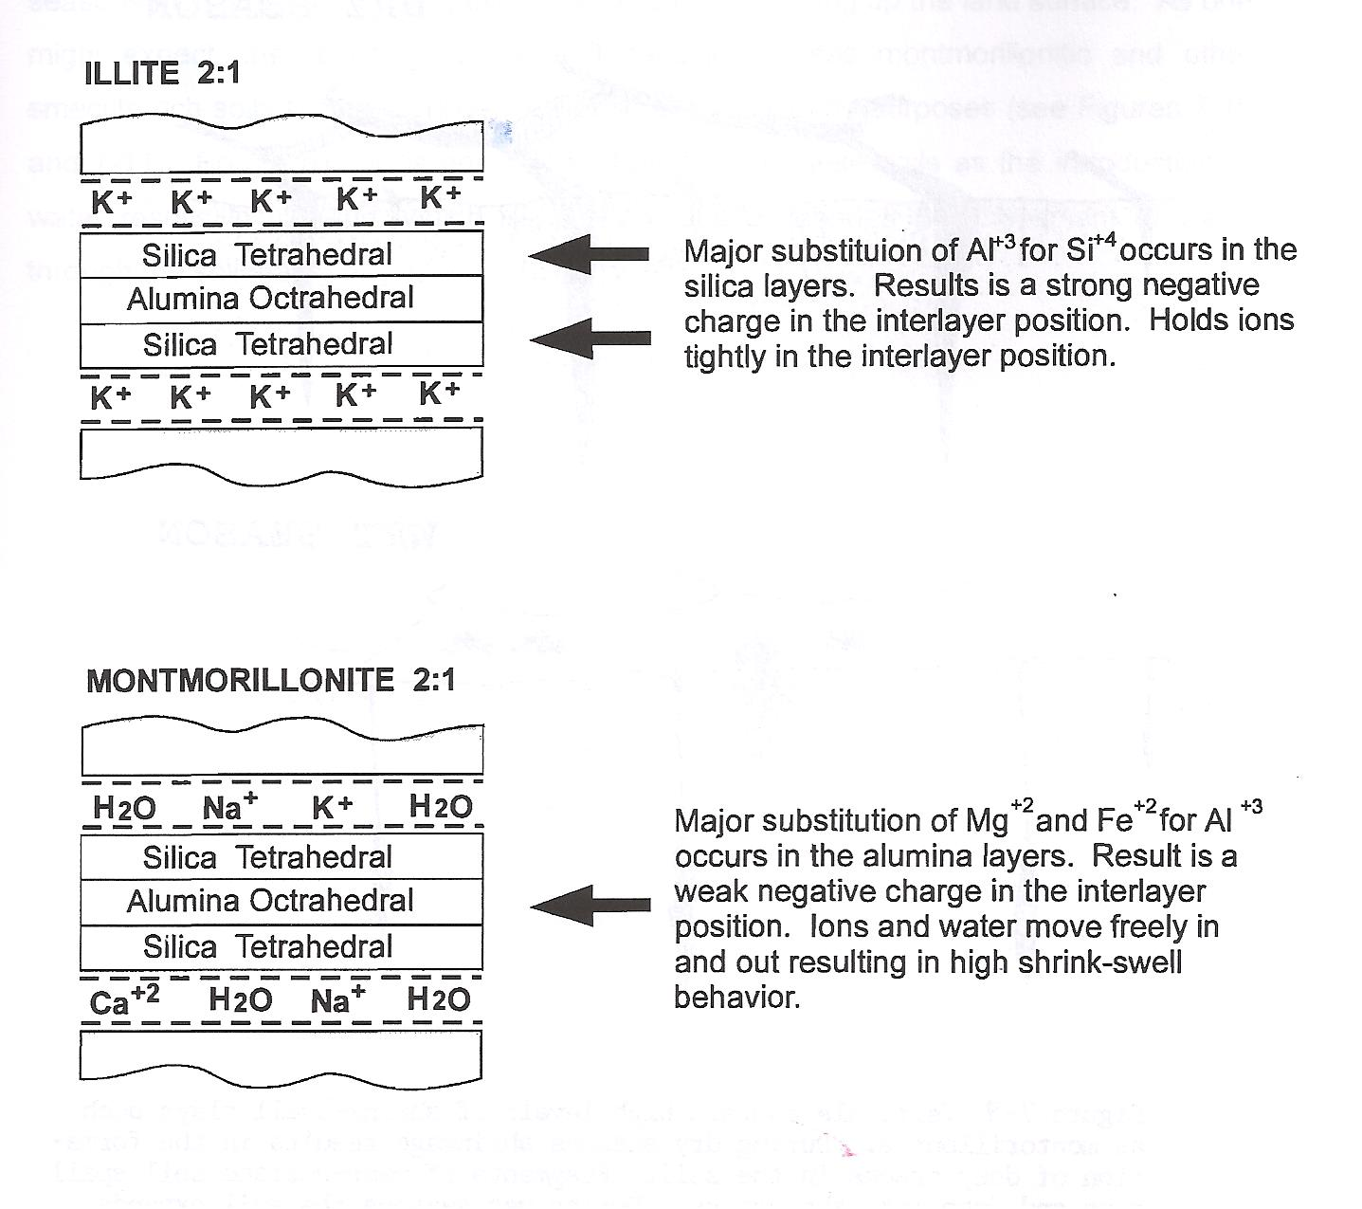

Slide 34
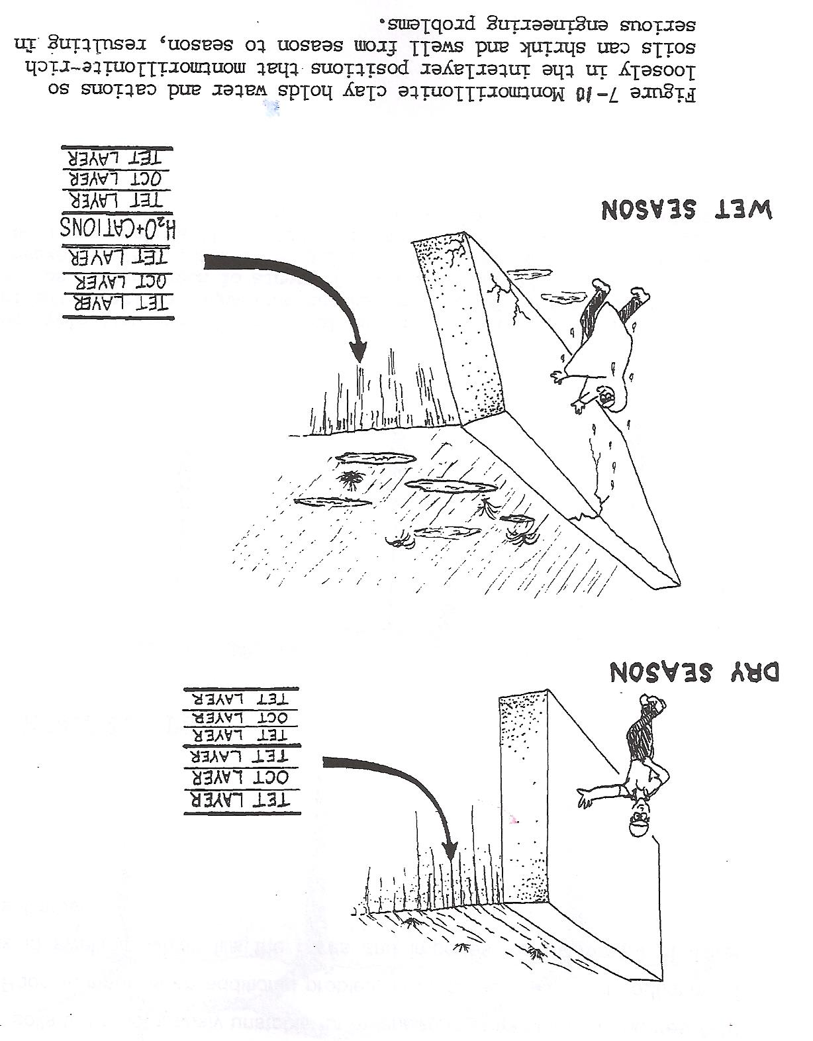

Slide 35
Cation Exchange Capacity (CEC):
The amount of exchangeable cations that a given weight of soil is capable of holding

Slide 36
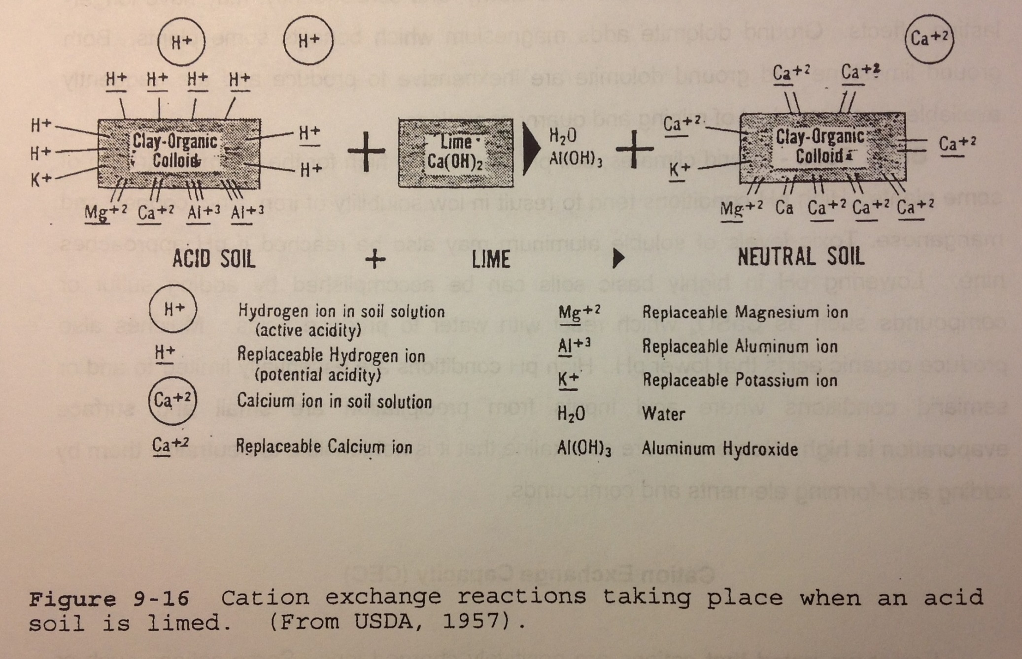

Slide 37
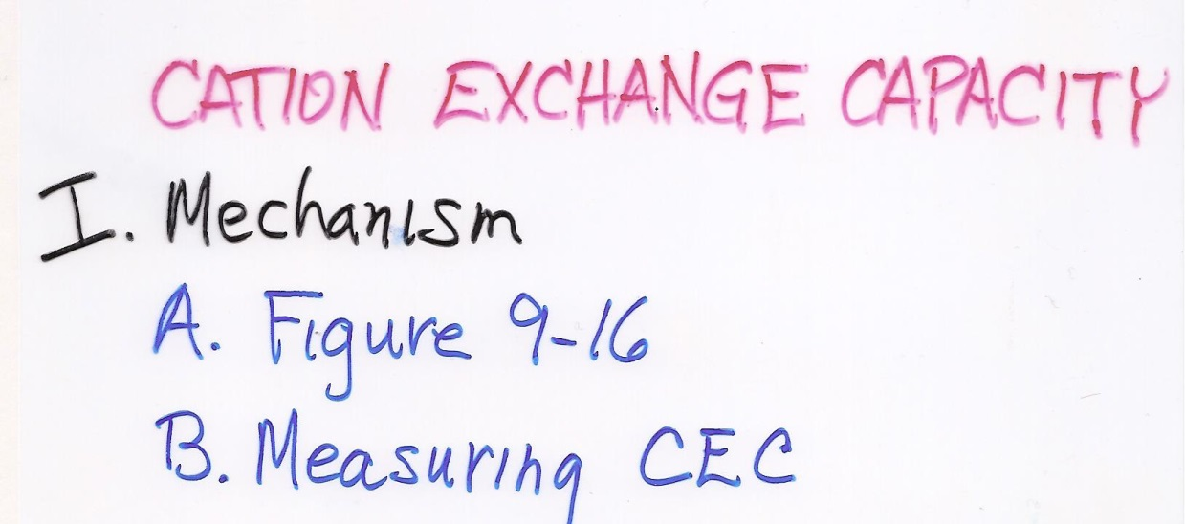
Cmol = ‘centimole’ 1/100 of a mole
CEC is measured in units of Cmol/kg, which replaces milliequivilents (meq)/100 g.
Cation Exchange Capacity (CEC): The amount of exchangeable cations that a given weight of soil is capable of holding.

Slide 38
CEC is measured in units of Cmol/kg, which replaces milliequivilents (meq)/100 g.
Wt. of 1 meq. = mole weight (g)
charge of ion * 1000
For example: the weight of 1 meq. of calcium is:
1 meq. Of Ca²⁺ = 40.08 g = 0.02 g
(2) * 1000

Slide 40
Ex: the weight of 1 meq. of calcium is:
1 meq. Of Ca²⁺ = 40.08 g = 0.02 g
(2) * 1000
So….the CEC of a soil containing 1.0316 g of exchangeable Ca²⁺ per 100 g of soil is:
(wt. of exchangeable Ca²⁺) = 1.0316 g
(wt. of 1 meq. of Ca²⁺) 0.02
1.0316 g Ca used
via Adhesion

Slide 41
Ex: the weight of 1 meq. of calcium is:
1 meq. Of Ca²⁺ = 40.08 g = 0.02 g
(2) * 1000
So….(for example) the CEC of a soil containing 1.0316 g of exchangeable Ca²⁺ per 100 g of soil is:
(wt. of exchangeable Ca²⁺) = 1.0316 g
(wt. of 1 meq. of Ca²⁺) 0.02
= 51.58 meq.
=51.58 meq. per 100 g, or 51.58 Cmol/kg

Slide 42
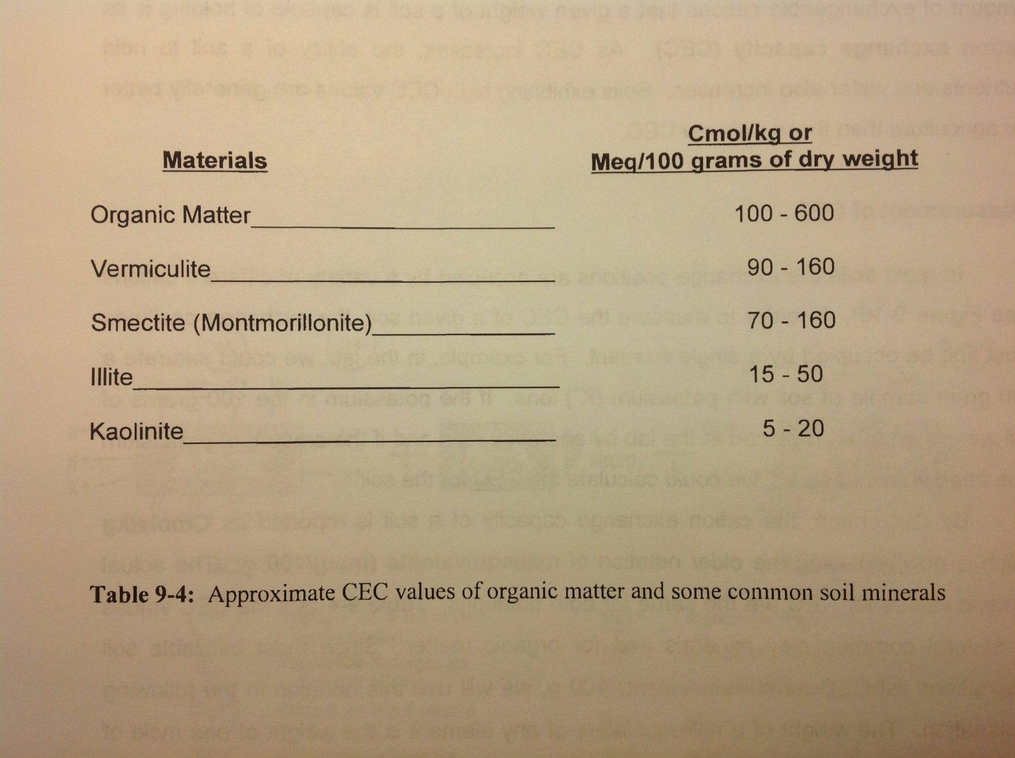
C. CEC Capacities

Slide 43
Base Saturation

Slide 44
Base Saturation: the percentage of cation exchange capacity of a soil occupied by basic cations (other than hydrogen and aluminum).
In general, the higher the base saturation, the higher the pH of the soil.
Why important?
Plant growth
Plant protection

Slide 45
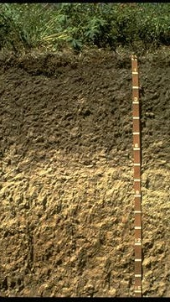
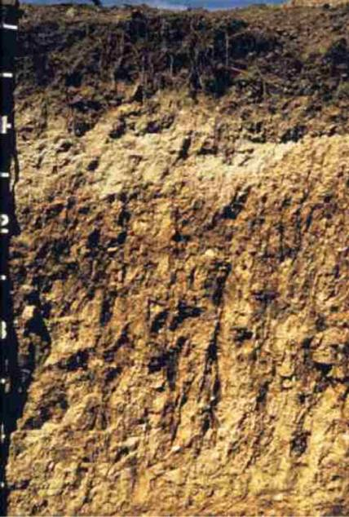
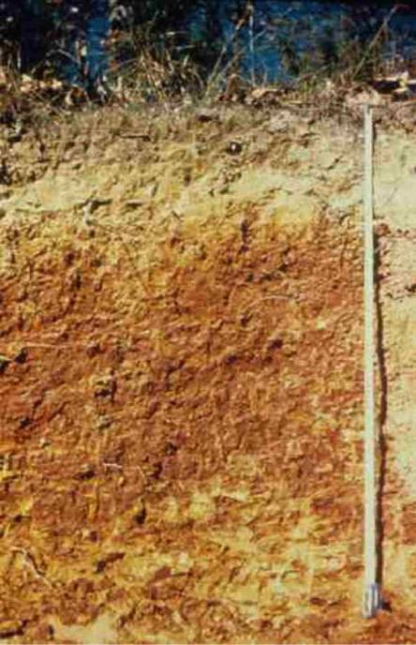
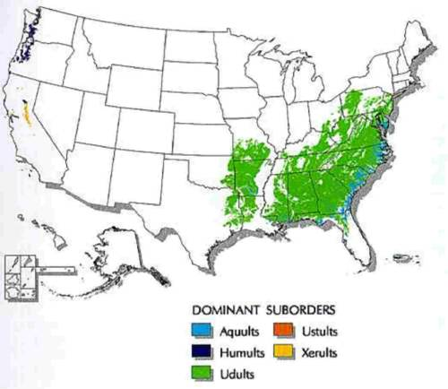
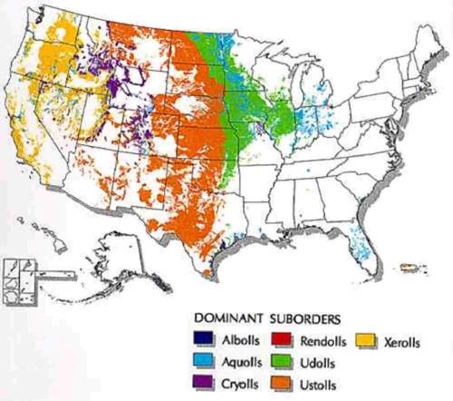
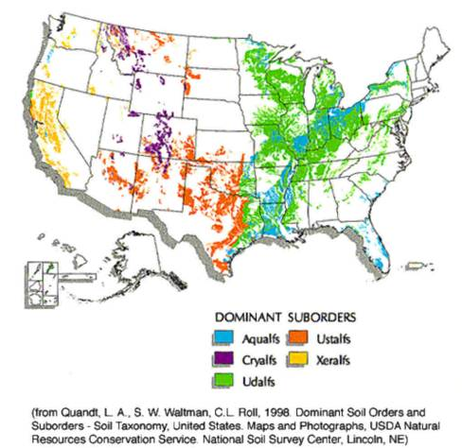
Mollisol
Alfisols
Ultisols

Slide 46
base saturation
greater than 50%
base saturation
between 35% - 50%
base saturation
less than 35%
Mollisol
Alfisols
Ultisols

Slide 47
End of material for
Exam II

