Slide 1
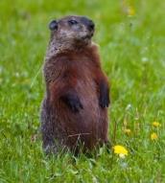
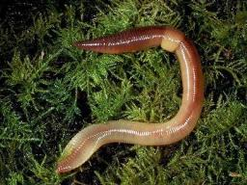
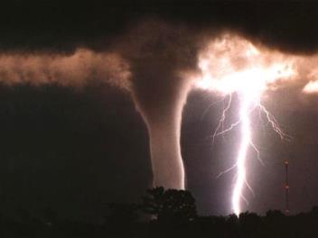
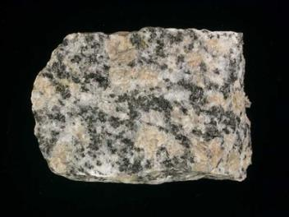
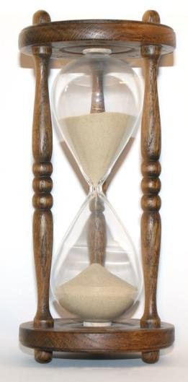
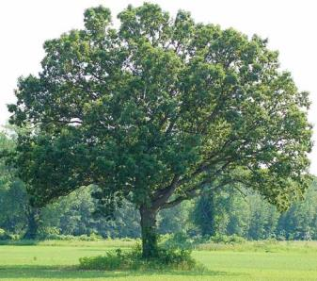
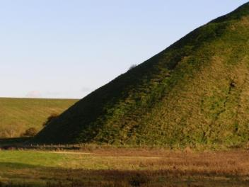
Major Factors of Soil Formation

Slide 2
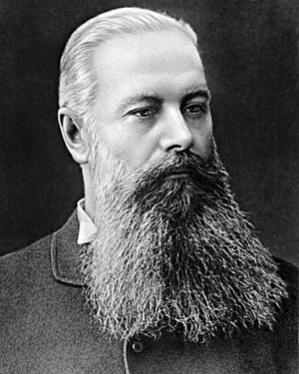
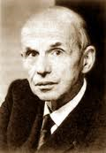
Vasily V. Dokuchaev
Hans Jenny

Slide 3
S = f(cl, o, r, p, t, ….)
S = soil
cl = (sometimes c) climate
o = organic activity
r = relief
P = parent material
t = time
Hans Jenny

Slide 4
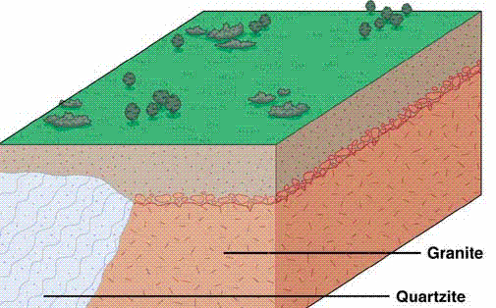
I. Parent Material

Slide 5
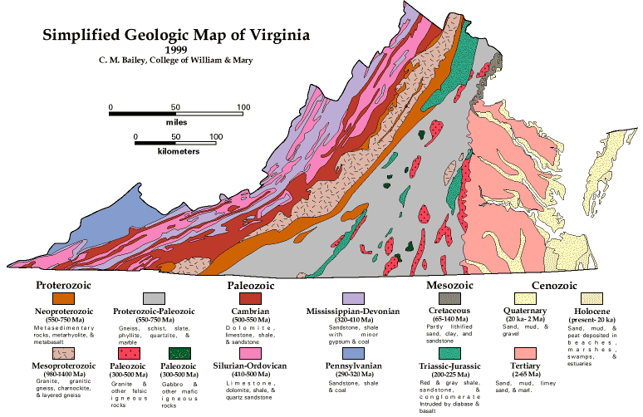
Parent Material

Slide 6
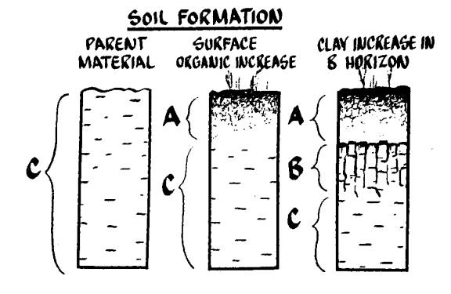
Parent Material
A. Residual Soils
R

Slide 7
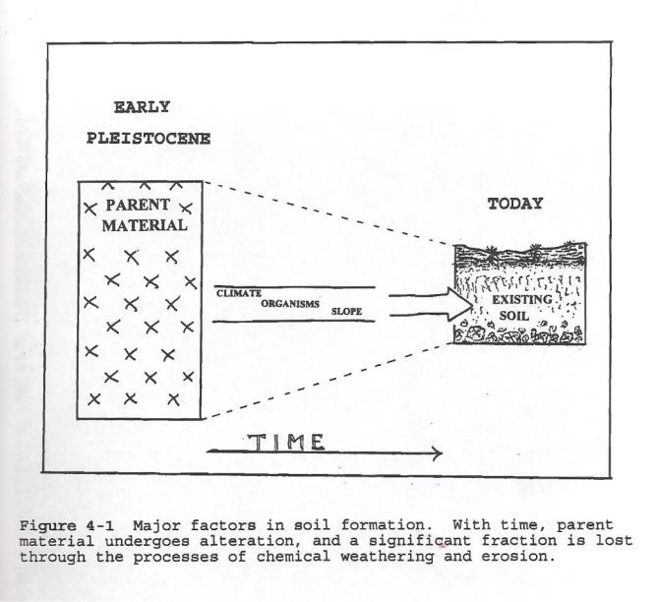
Parent Material
A. Residual Soils

Slide 8
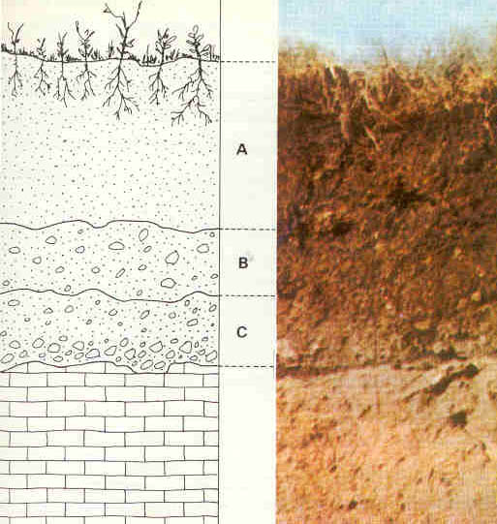
Parent Material
A. Residual Soils
R

Slide 9
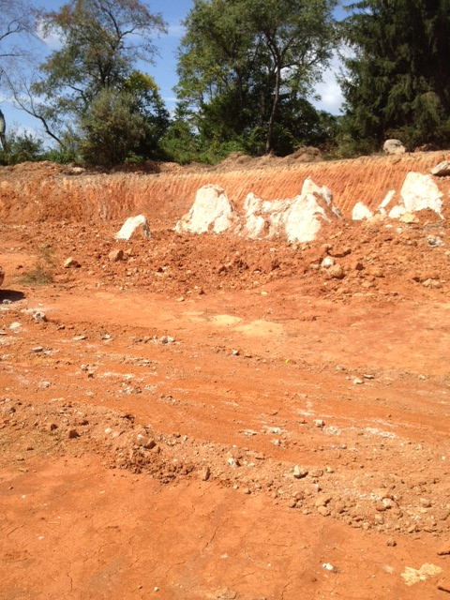
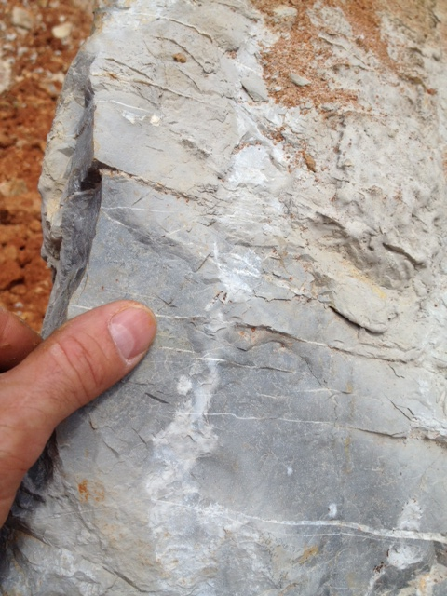
pinnacle weathering

Slide 10
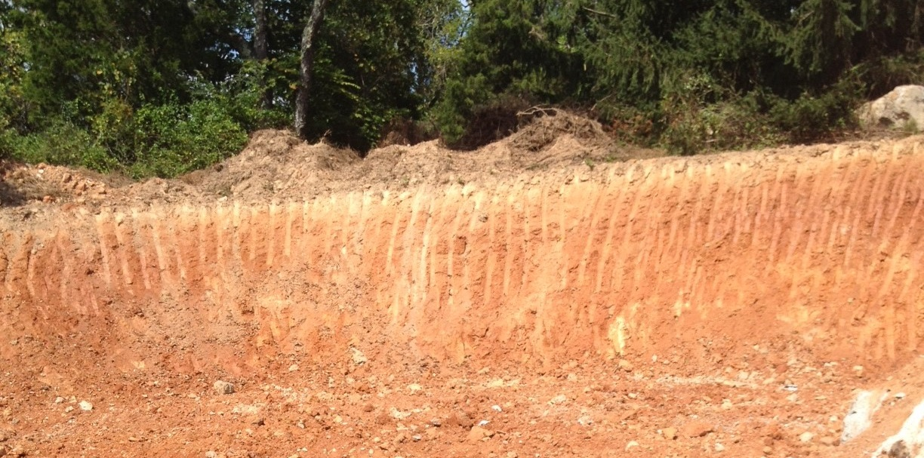

Slide 11
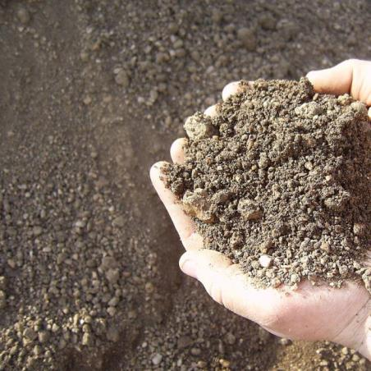
Parent Material
Residual Soils
Over Igneous Rocks
Granite (Piedmont and Blue Ridge)
Sandy A Horizon
Strong B Horizon
Saprolite (deep)

Slide 13
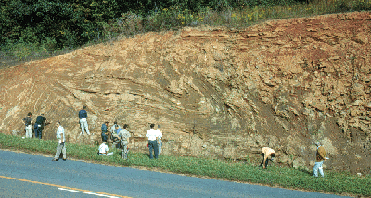
Parent Material
A. Residual Soils
Saprolite “rotten rock”
Residuum that has the appearance of rock,
but some properties of soil
R

Slide 14
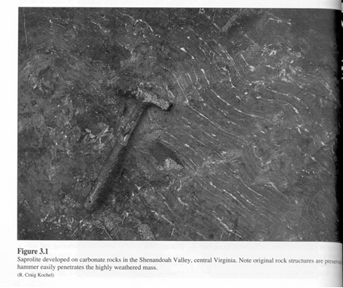

Slide 15
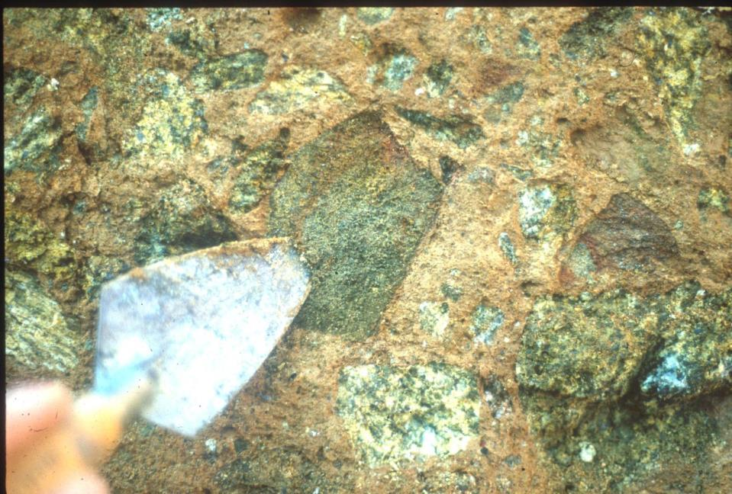
“GRUS”

Slide 16
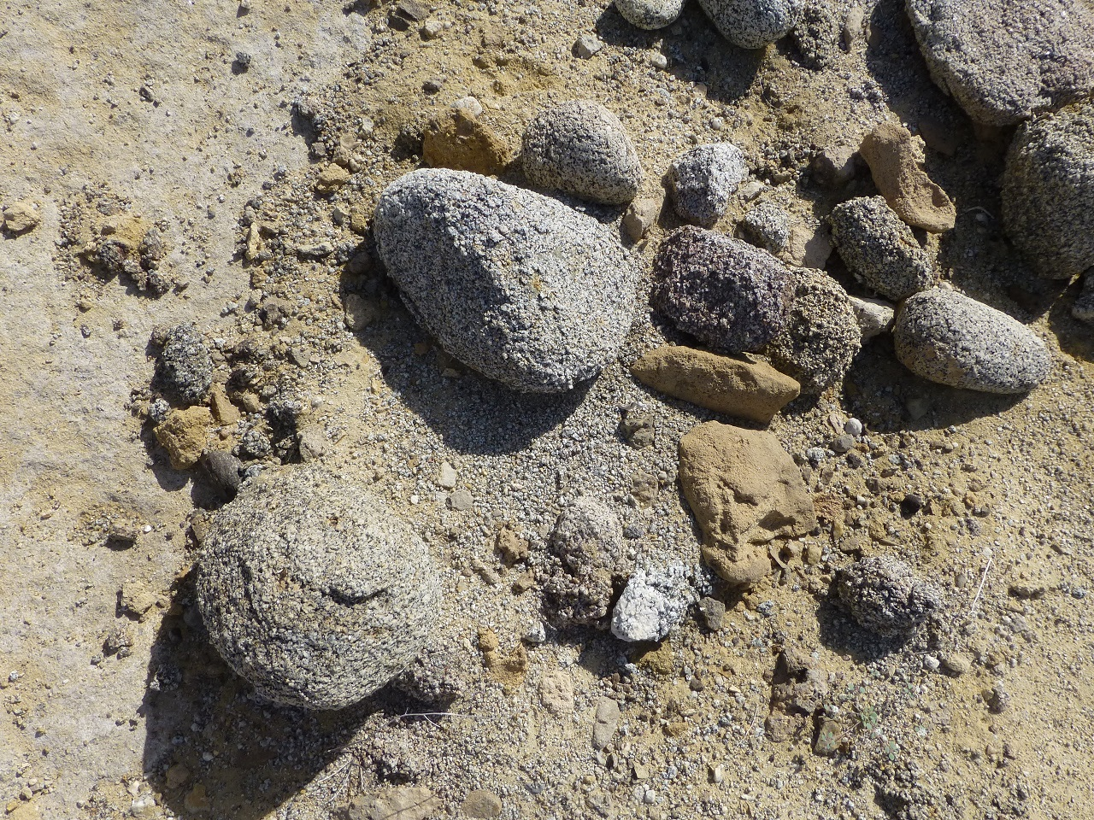

Slide 17
Parent Material
Residual Soils
Over Igneous Rocks
Gabbro (Piedmont)
Heavy Clay Soils
Shallow Profiles

Slide 19
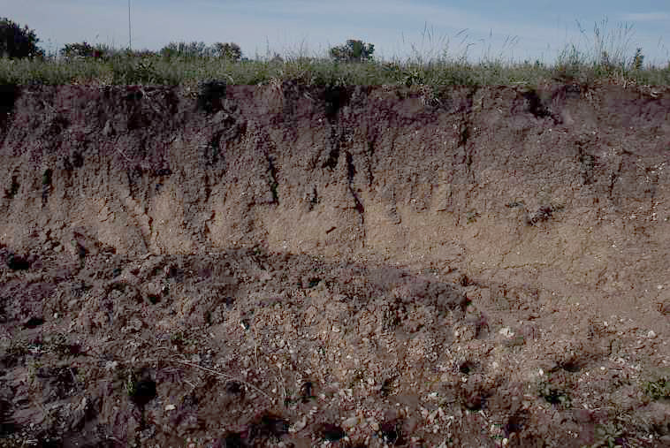

Slide 20
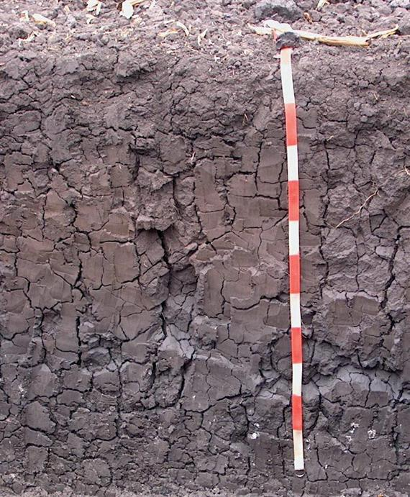
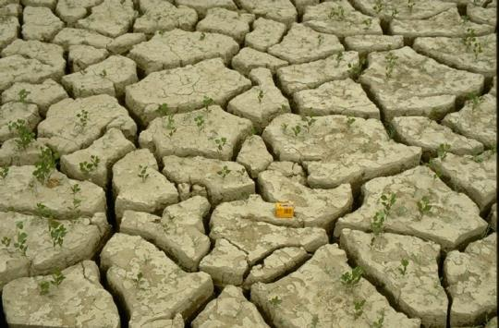
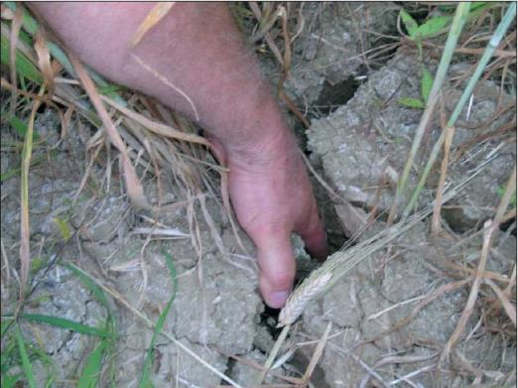

Slide 21
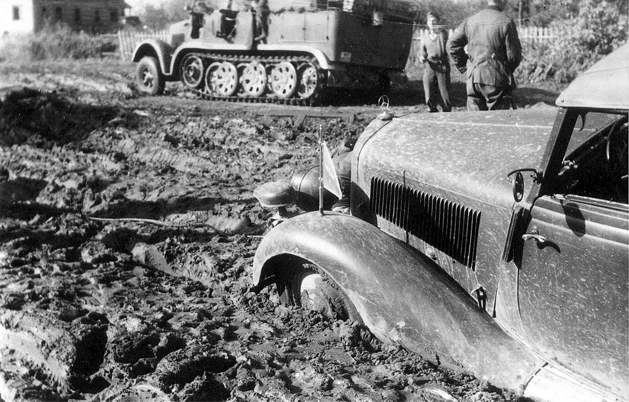

Slide 22
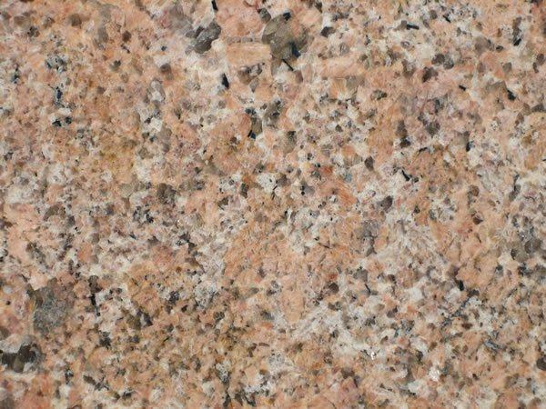
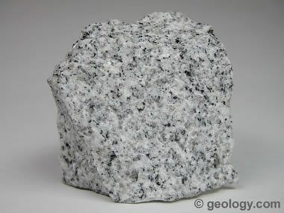
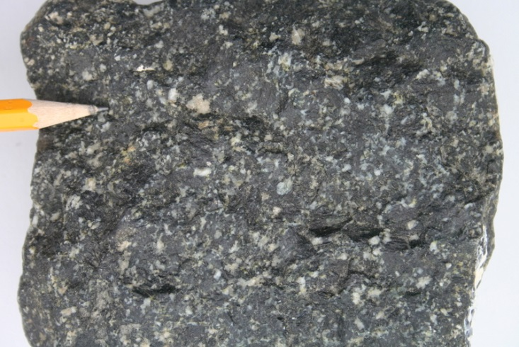
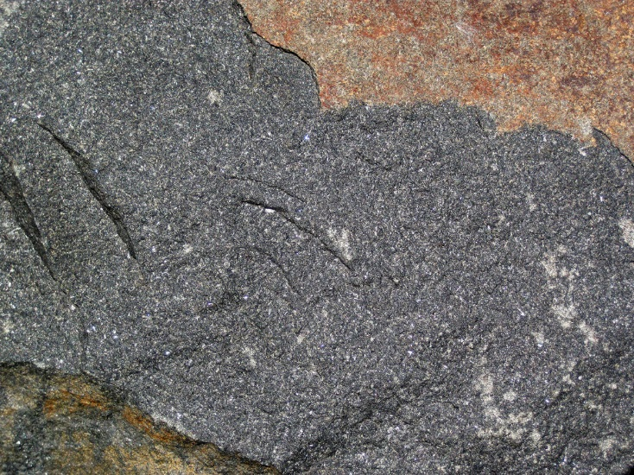
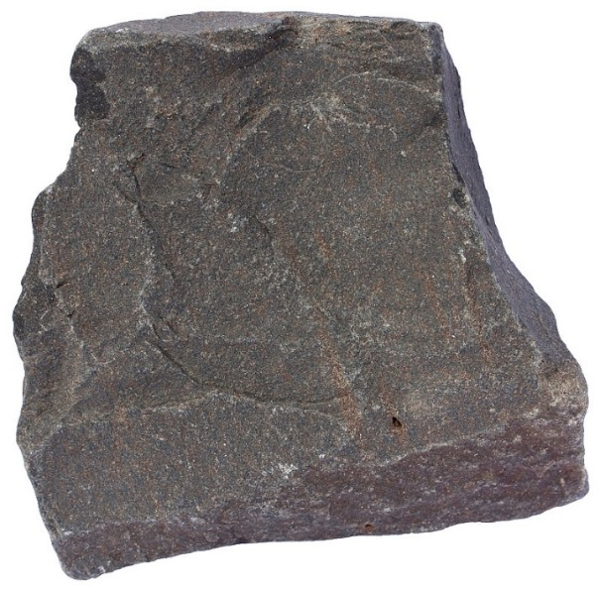
Gabbro
Parent Material
Residual Soils
Over Igneous Rocks
Granite (Piedmont and Blue Ridge)
Sandy A Horizon
Saprolite
Gabbro (Piedmont)
Heavy Clay Soils
Shallow Profiles
Diabase (primarily in Mesozoic Basins)
Soils similar to Gabbros
Diabase
Basalt

Slide 23
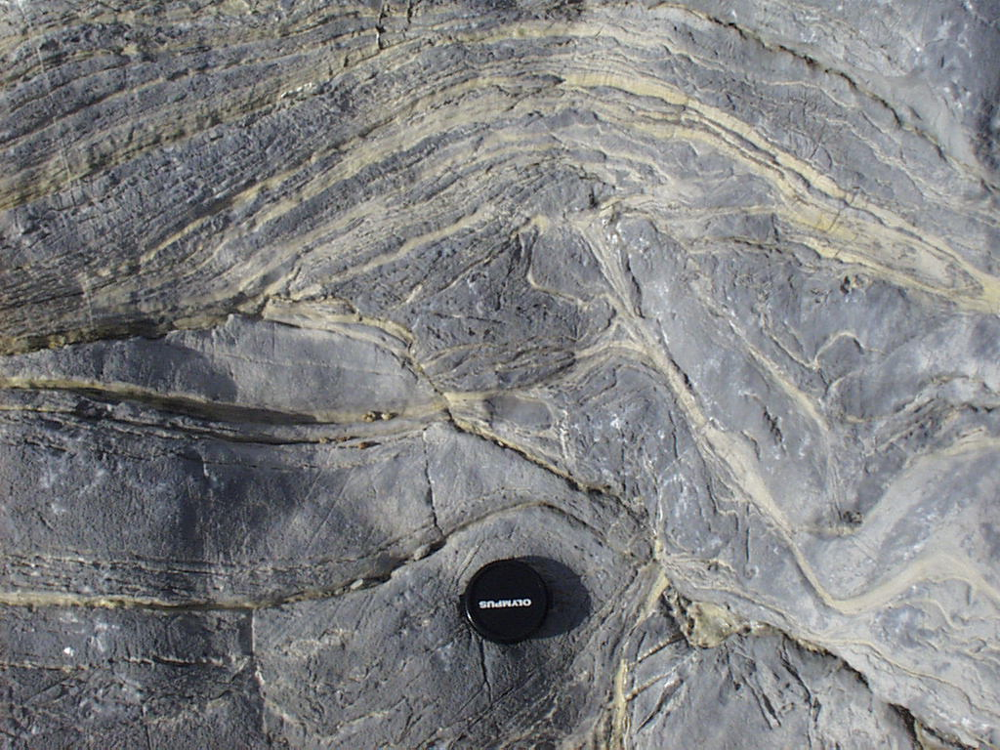
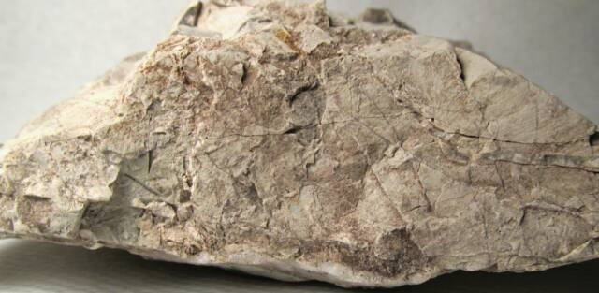
Parent Material
Residual Soils
2. Over Sedimentary Rocks
a. Limestone and Dolomite (Valley and Ridge)
Deep, well drained
Clay-rich, Productive

Slide 25
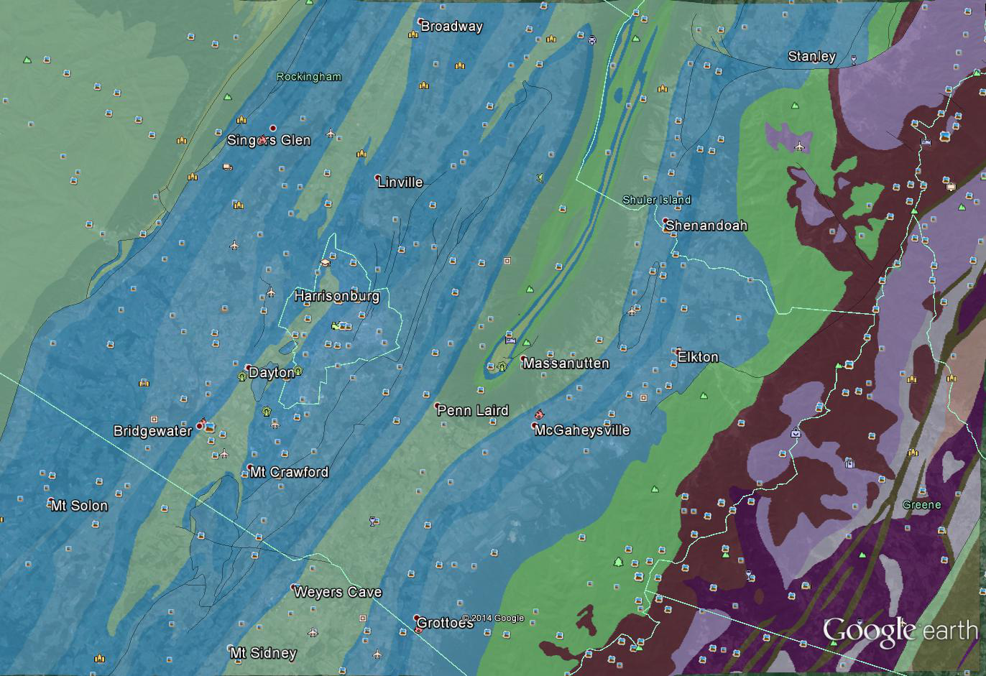

Slide 28
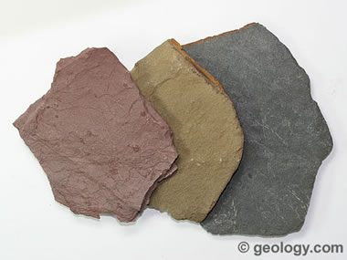
Parent Material
Residual Soils
2. Over Sedimentary Rocks
b. Shale (Valley and Ridge, Appalachian Plateau)
Shallow, Immature
Low Nutrients

Slide 31
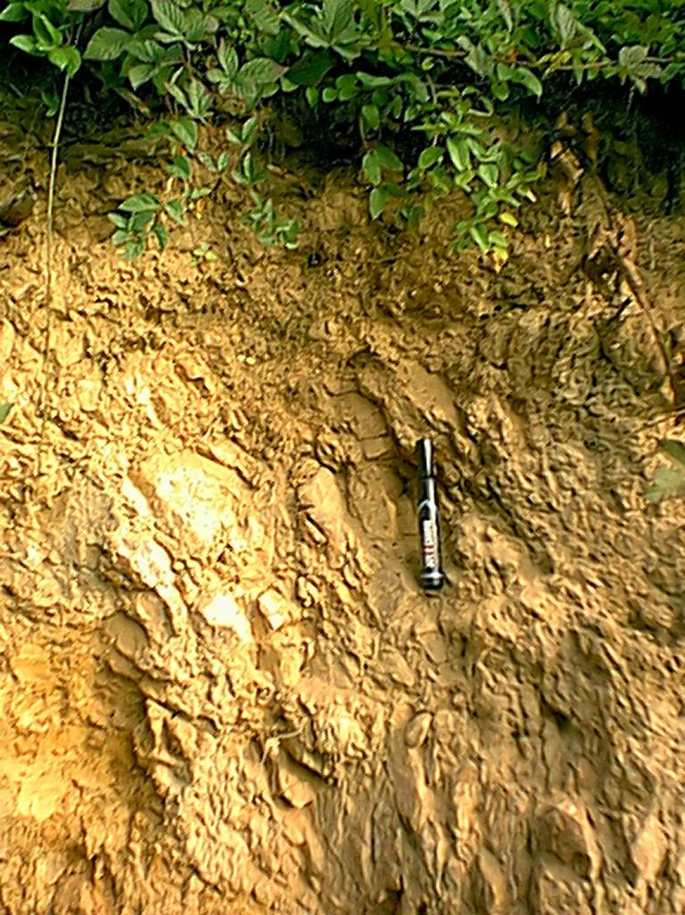
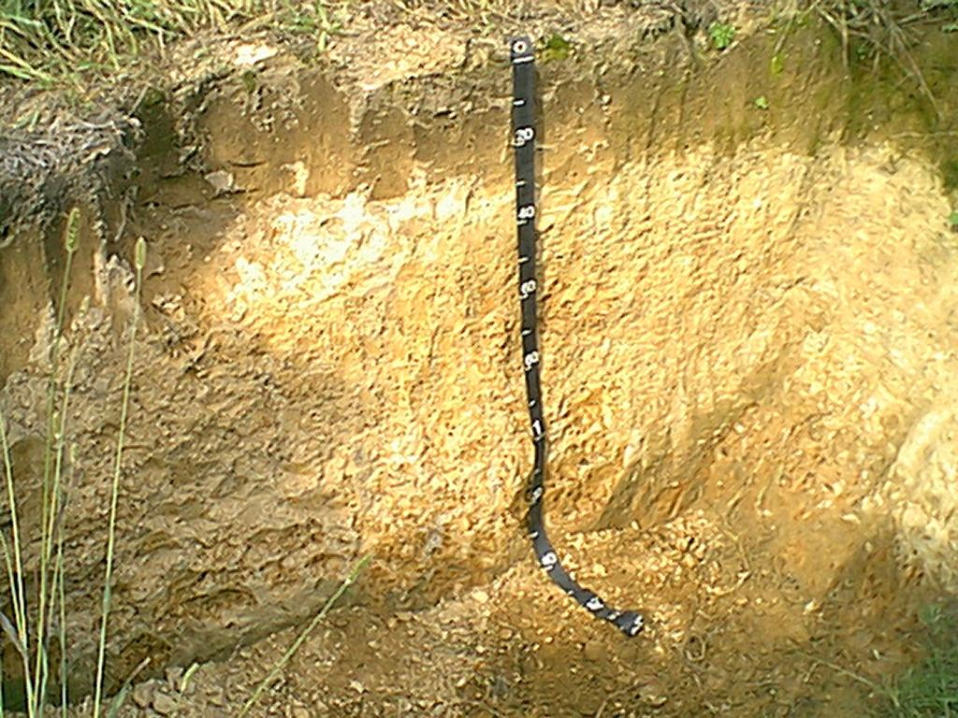

Slide 32
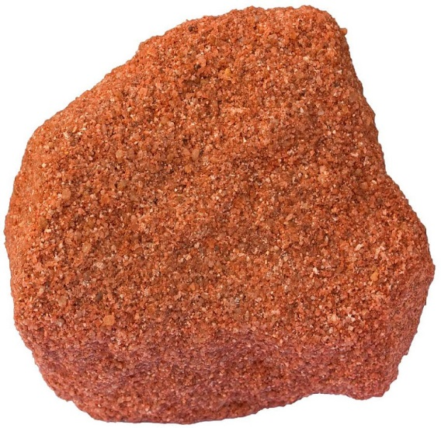
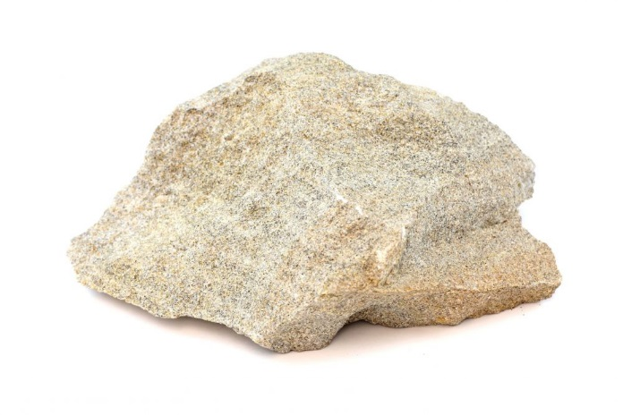
Parent Material
Residual Soils
2. Over Sedimentary Rocks
c. Sandstone (Valley and Ridge, Plateau, and Mesozoic Basins)
Ridge Makers, shallow profiles
Coarse, sandy textures, excessively drained

Slide 33
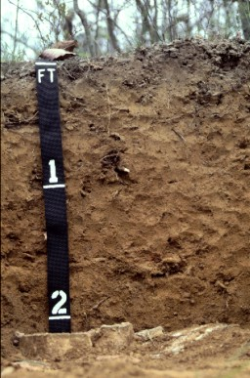
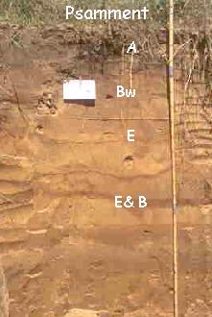

Slide 35
Parent Material
Residual Soils
From Coastal Plain Sediments
Wide range of ages
Mostly sandy and friable

Slide 37
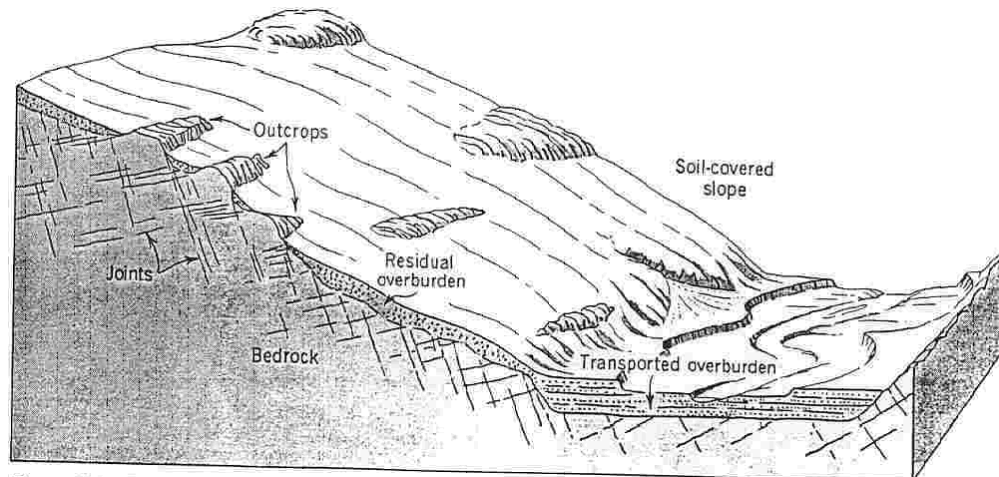
Parent Material
B. Transported Soils
R

Slide 38
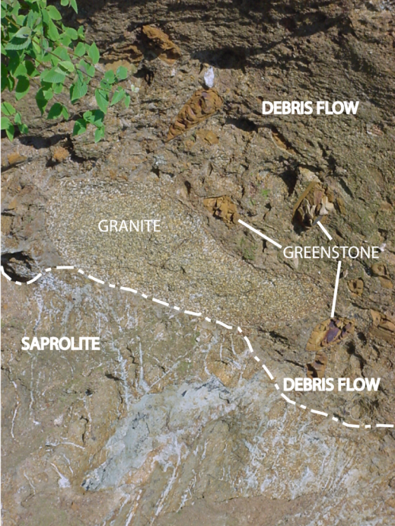
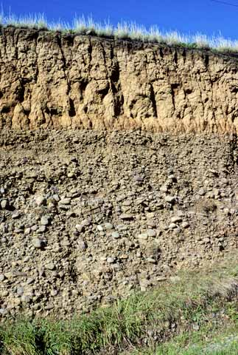
Parent Material
B. Transported Soils
R

Slide 39
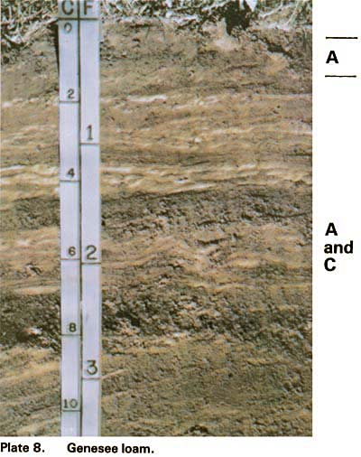
Parent Material
B. Transported Soils
From Alluvium
Floodplains
young soils, sandy,
friable
moist, productive
Poor horizon develop-
ment

Slide 40
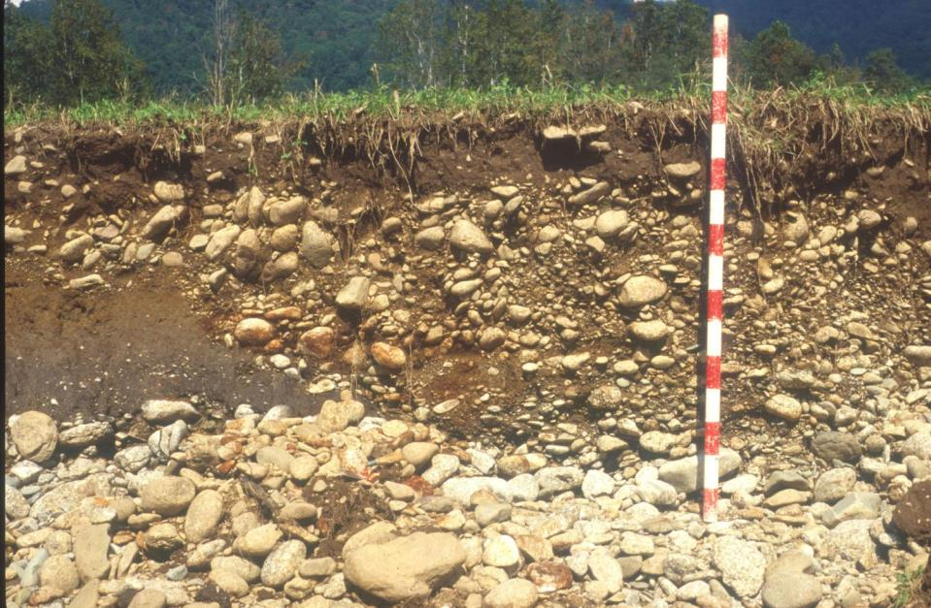

Slide 41
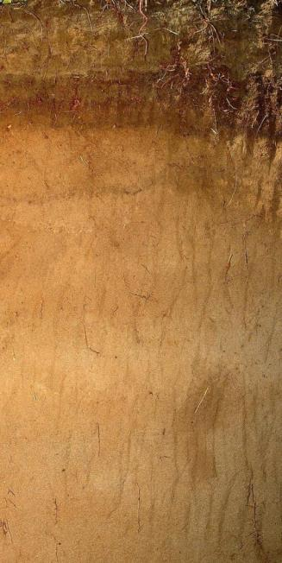
Parent Material
B. Transported Soils
From Alluvium
Floodplains
young soils, sandy
moist, productive
Terraces
Varying ages and development
Friable, productive

Slide 42
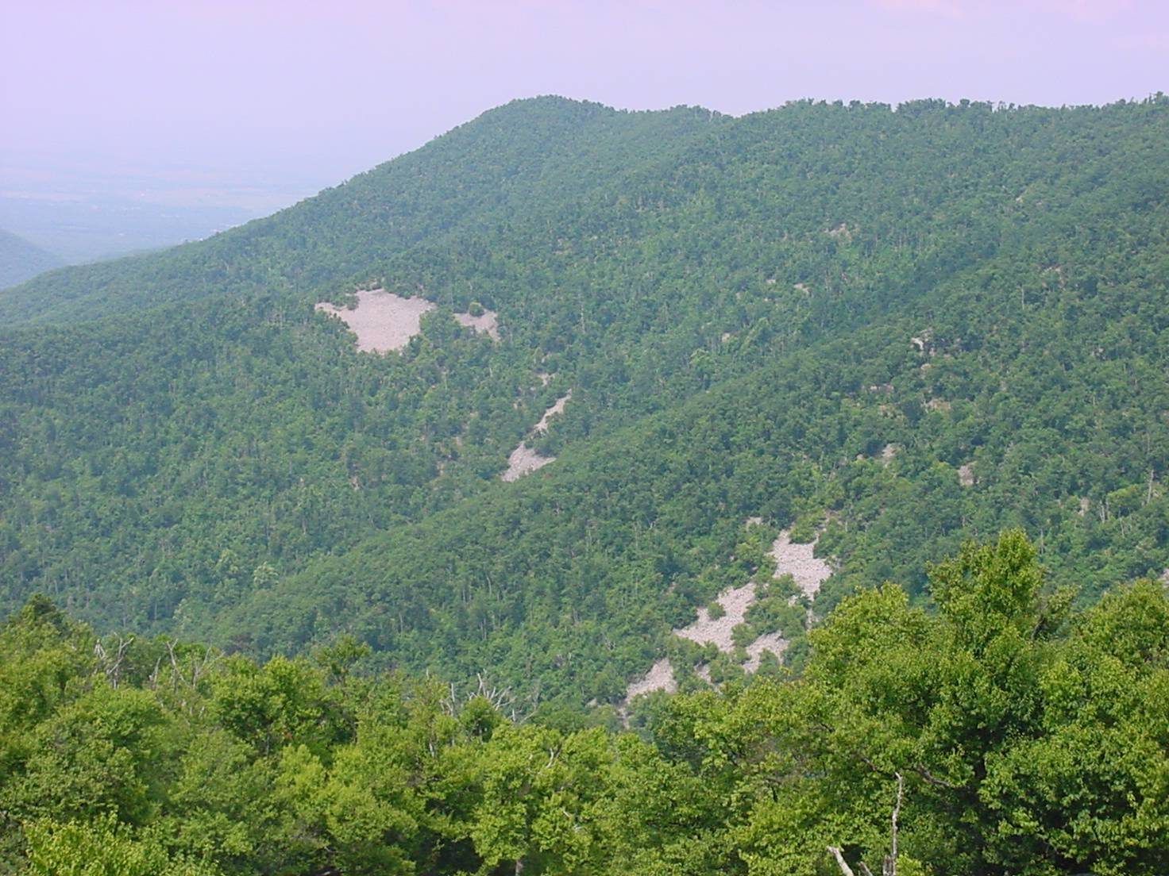
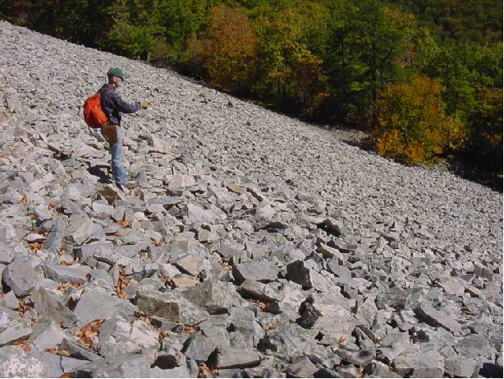
Parent Material
B. Transported Soils
2. From Colluvium
Base of steep slopes
Thick, moist
Weak profile
development
Productive

Slide 44
Parent Material
B. Transported Soils
2. From Colluvium
b. Debris/Alluvial Fans
Thick, moist
Weak profile development
Productive (frequently site of orchards)

Slide 45
Thick, moist
Productive (frequently site of orchards)

Slide 47
3. From Aeolian Processes
Loess
High silt content
Weak-to-moderate profile development
Productive, but highly erosive

Slide 49
Loess Deposits

Slide 50
Loess Deposits

Slide 51
Parent Material
B. Transported Soils
4. From Glacial Processes
Glacial Till
Highly dependent on mode of deposition
Weak profile development
Often rocky, thin profiles

Slide 55
In General:
Most landscapes contain both residual and transported soils.
Transported materials are generally high in silt and sand, assuming they are not extremely old.
Transported soils are generally less developed than residual soils.
Texture and clay mineralogy largely controlled by original parent material.
Parent material is probably the single most important factor on a regional/local scale.

Slide 56
II. Climate

Slide 57
II. Climate
Overview
“Temperature and Precipitation”
Recognized by Russian soil scientists in the 19th century that similar climate zones produced similar soils.
Probably the single most important factor in soil development on a global scale.

Slide 60
II. Climate
B. Microclimate
Exposure
Boulder
Hillside

Slide 64
II. Climate

Slide 67
II. Climate
Weeping
Love
Grass
Crown
Vetch

Slide 68
II. Climate
Weeping
Love
Grass
Crown
Vetch

Slide 69
2. Heat Conductivity
Type of material (most rocks have low cond.)
Moisture (dry vs. moist soils)

Slide 70
2. Heat Conductivity
Type of material (most rocks have low cond.)
Moisture (dry vs. moist soils)
Albedo
Depth of Frost

Slide 71
3. Vegetation
Cools – provides shade and transpiration

Slide 72
II. Climate
C. Macroclimate
Most important worldwide
V.V. Dukuchaev
(zonal classification)
Podzols, Chernozems, Desert, Tundra

Slide 73
II. Climate & Vegetation
C. Macroclimate
2. Climate Effect
Vegetation
Nitrogen
Organic Matter

Slide 74
Vegetation
Nitrogen
Organic Matter

Slide 75
Vegetation
Nitrogen
Organic Matter
Organics increase exponentially
as temperature decreases to some
threshold

Slide 76
Clay Content

Slide 77
Linear relationship with moisture
Exponential relationship with temperature
Clay Content

Slide 78
III. Organisms
Microflora
Bacteria
Actinomycetes
Fungi
Algae
(do best in warm, wet conditions)
B. Macroflora
Grasses
Shrubs
Trees
(tend to react to conditions rather than create them)
Produce large amounts of organics
Protect soil from erosion

Slide 79
III. Organisms
C. Microfauna
Protozoa
Nematodes
Gonnabiteyouwhilesleeping
D. Macrofauna
Earthworms,
Ants
Reptiles
mammals

Slide 80
III. Organisms
E. Native Vegetation –USA
Climate is the driving factor
1. Vegetation vs. Slope
Mid-Atlantic (PA)
New England (glaciated)
Florida Coast (Sand Dunes)
Southwest USA (Desert)

Slide 84
Soil Moisture Regimes
Soil moisture regime | Characteristics
Xeric | Soils of temperate areas that experience moist winters and dry summers (i.e., Mediterranean climates)
Aridic/Torric | Soils are dry more than half the time (in arid climatic zone)
Ustic | In most years soils are dry for 90 consecutive days and moist in some part for half the days the soil temperature is above 5°C (i.e., during potential growing season)
Udic | In most years soils are not dry more than 90 consecutive days
Perudic | In most years precipitation exceeds evapotranspiration every month of the year
Aquic | Soils that are sufficiently saturated, reducing conditions occur. They usually have low chroma mottles or have gleyed subsoils

Slide 86
Soil Temperature Regimes
Really Hot
Hyperthermic
Thermic
Mesic
Frigid
Cryic
Pergelic
Really Cold

Slide 88
Pergelic (L. per, throughout in time and space, and L. gelare, to freeze; meaning permanent frost): Soils with a pergelic temperature regime have a mean annual temperature lower than 0°C. These are soils that have permafrost if they are moist, or dry frost if there is no excess water. It seems likely that the moist and the dry pergelic regimes should be defined separately, but at present we have only fragmentary data on the dry soils of very high latitudes. Ice wedges and lenses are normal in such soils in the United States.
Cryic (Gr. kryos, coldness; meaning very cold soils): Soils in this temperature regime have a mean annual temperature higher than 0°C but lower than 8°C.
Frigid: The concept of the frigid soil temperature regime and other soil temperature regimes listed below are used chiefly in defining classes of soils in the low categories. A soil with a frigid regime is warmer in summer than a soil with a cryic regime, but its mean annual temperature is lower than 8°C, and the difference between mean summer and mean winter soil temperatures (June-July-August and December-January-February) is more than 5°C

Slide 89
Mesic (Gr. mesos, intermediate): The mean annual soil temperature is 8°C or higher but lower than 15°C, and the difference between mean summer and mean winter soil temperatures is more than 5°C either at a depth of 50 cm from the soil surface or at a densic, lithic, or paralithic contact, whichever is shallower.
Thermic: The mean annual soil temperature i s 15°C or higher but lower than 22°C, and the difference between mean summer and mean winter soil temperatures is more than 5°C either at a depth of 50 cm from the soil surface or at a densic, lithic, or paralithic contact, whichever is shallower.
Hyperthermic: The mean annual soil tem perature is 22°C or higher, and the difference between mean summer and mean winter soil temperatures is more than 5°C either at a depth of 50 cm from the soil surface or at a densic, lithic, or paralithic contact, whichever is shallower.

Slide 91
IV. Slope
A. Very few completely flat areas

Slide 92
IV. Slope
A. Very few completely flat areas
Soil Catena

Slide 94
V. Time
A. A dynamic system

Slide 96
V. Time
B. Dating Methods
Pedogenesis
Pollen
C¹⁴
Be¹⁰
OSL (optically stimulated luminescence)

