Slide 1
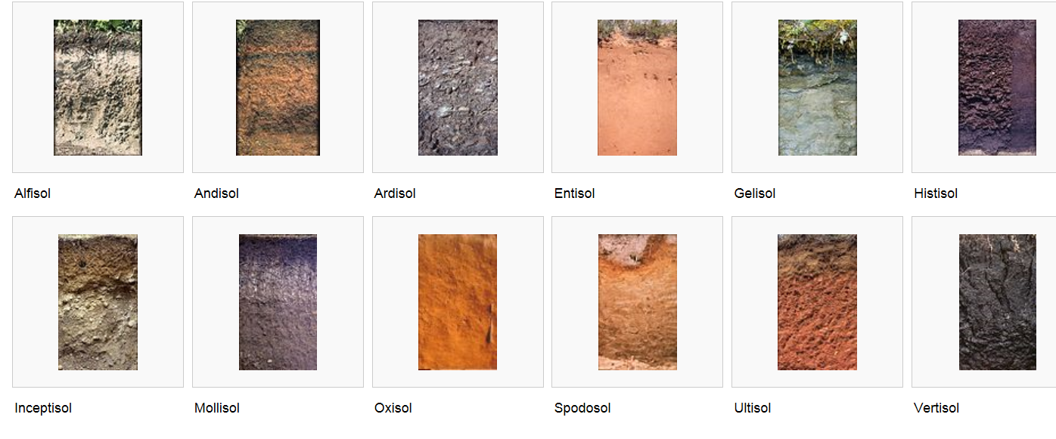
Classification of Soils

Slide 2
Zonal Classification of Soils
Russian School
V.V. Dokuchaiev—proposed a zonal (climatic) classification:
Chernozems, Podzols
Noted the powerful relationship among climate, vegetation, and soil type.

Slide 3
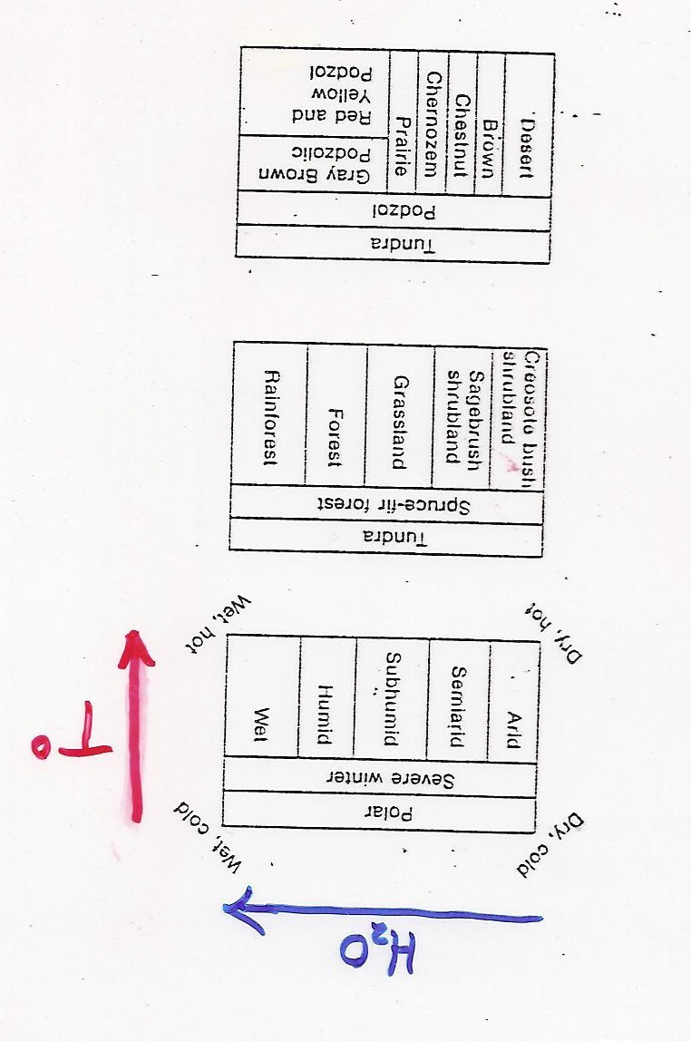
Strong relationship among
climate, parent material,
and vegetation
Climate
Vegetation
Soil Type

Slide 4
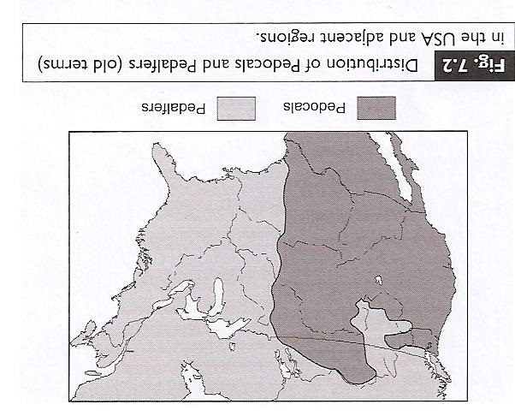
Classification scheme for USA from 1927-1950s
Referred to as
‘Zonal Classification’

Slide 5
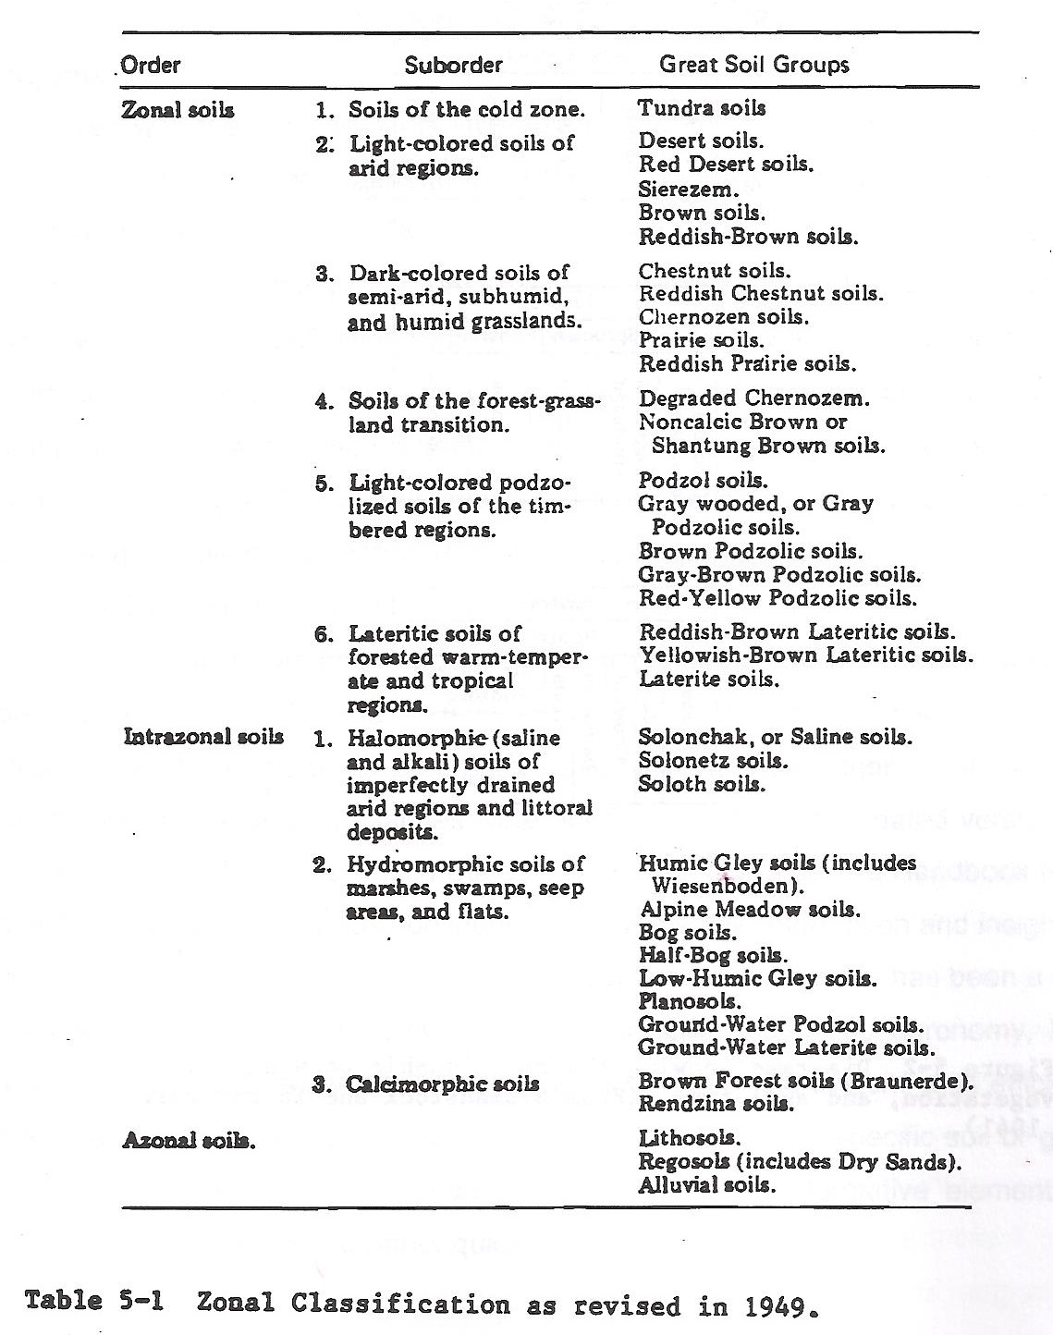

Slide 6
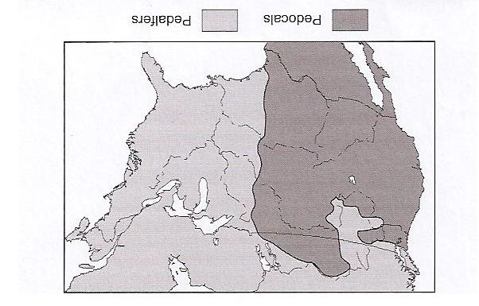
II. Soil Taxonomy
History:
Initially modified Russian system, then started to modify to focus more on descriptive rather than genesis.
1950s……Became evident that the old zonal classification system was inadequate.

Slide 7
II. Soil Taxonomy
History:
Initially modified Russian system, then started to modify to focus more on descriptive rather than genesis.
1950s……Became evident that the old zonal classification system was inadequate.
USDA Soils Survey Staff began working on a Comprehensive Soil Classification System
Worked through six revisions (approximations) by 1965
Finally satisfied with the 7th approximation by 1971

Slide 8
II. Soil Taxonomy (Overview)
B. Twelve Orders
Common Set of Characteristics

Slide 9
III. Soil Orders (the specifics)
Entisol
Inceptisol
Alfisol
Ultisol
Oxisol
Mollisol

Slide 10
III. Soil Taxonomy (the specifics)
G. Aridisol
H. Vertisol
I. Spodosol
J. Histosol
K. Andesol
L. Gelisol

Slide 11
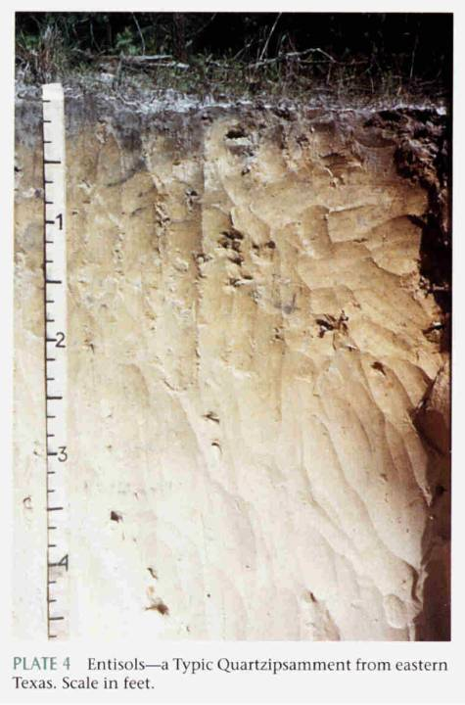
Entisol (ent: recent)
Soils on floodplains, dunes
Little-to-no horizon development
Inherently fertile
Usually no B horizon present
due to frequent disturbances or
forming on difficult weathering sites.

Slide 12
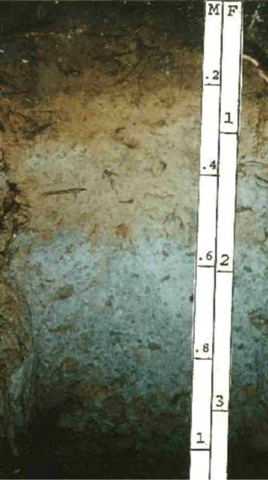
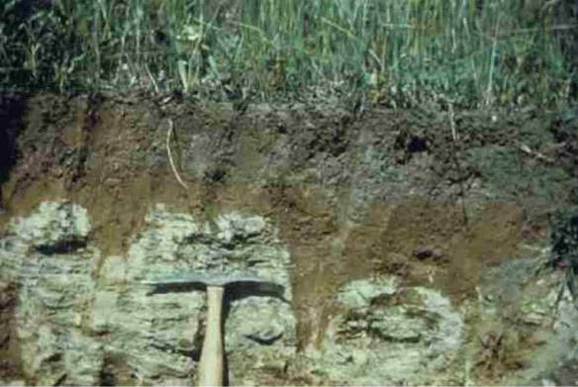
Inceptisol (ept: L. inceptum, beginning)
Upland soil, natural erosion at a normal
rate
Weak horizon development
Thin B horizon
Common on steep slopes, especially on
shales; and low river terraces

Slide 13
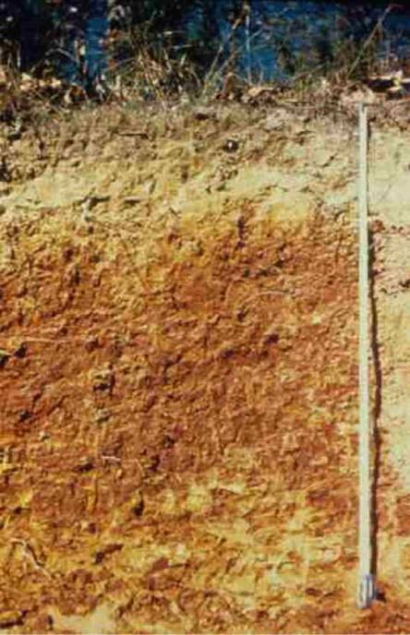
Ultisols
Ultisol (L. Ultimus, last)
Acid, leached soils of warm,
humid climates
B horizon enriched with clays and
oxides
Clays are responsive to fertilization
Typically forested if left undisturbed
Sometimes has E horizon from leaching

Slide 14
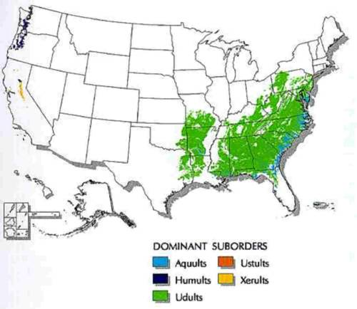
Ultisols

Slide 15
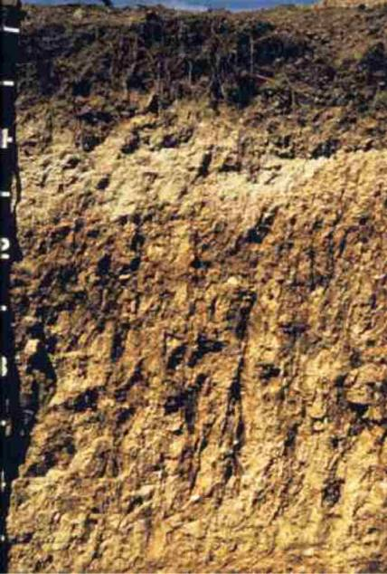
Alfisols (from Al and Fe concentrations)
Medium-to-high in
natural fertility
Heart of the corn belt, fertile soil
Strong Bt Horizon (silicate clays)
High Base Saturation (<35%)
Usually moist, but dry in late summer
(locally) Generally over the Edinburg,
New Market, Lincolnshire Limestones
Not as well developed as Ultisols (which are
more leached and acid)
Old “Grey-Brown Podzols” designation

Slide 16
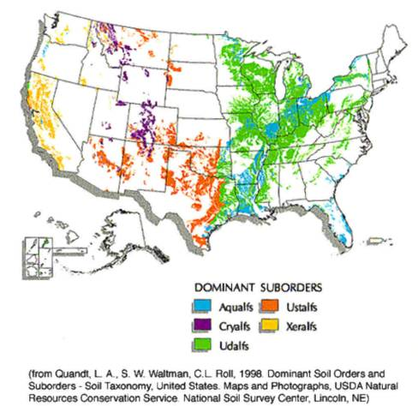
Alfisols

Slide 17
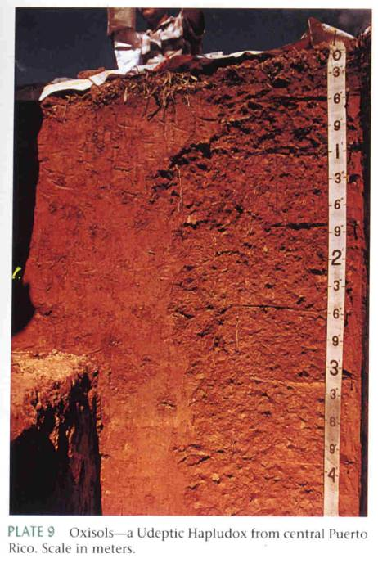
Oxisol (F. oxide,)
Highly weathered, relatively
Infertile soils dominated by
Oxide, low-activity clays
Tropical in nature
Old “Laterite” soil name
High concentrations of Fe and Al oxides
in soil

Slide 18
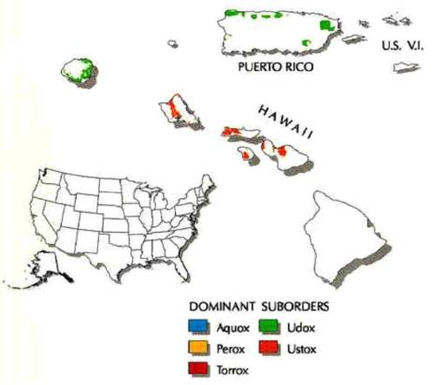
Oxisol

Slide 19
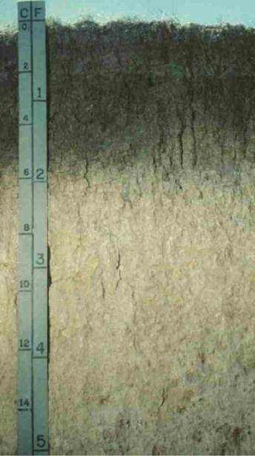
Mollisol (L. Mollis, soft)
Base-rich soils that have a thick, dark
A horizon, often formed under grasslands
or savanna/steppe.
Intermediate arid-to-humid climate
Black, fertile, and high in organics
Lacks moisture at certain times of the year
Can grow winter and spring small grains
Old terminology: Chernozems, Chestnut,
Prairie Soils

Slide 20
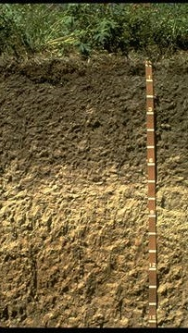
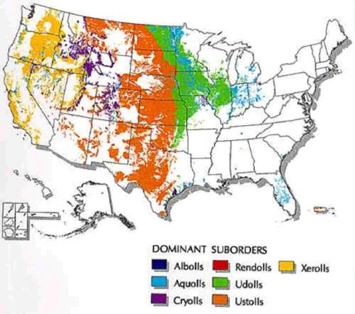
Mollisol

Slide 21
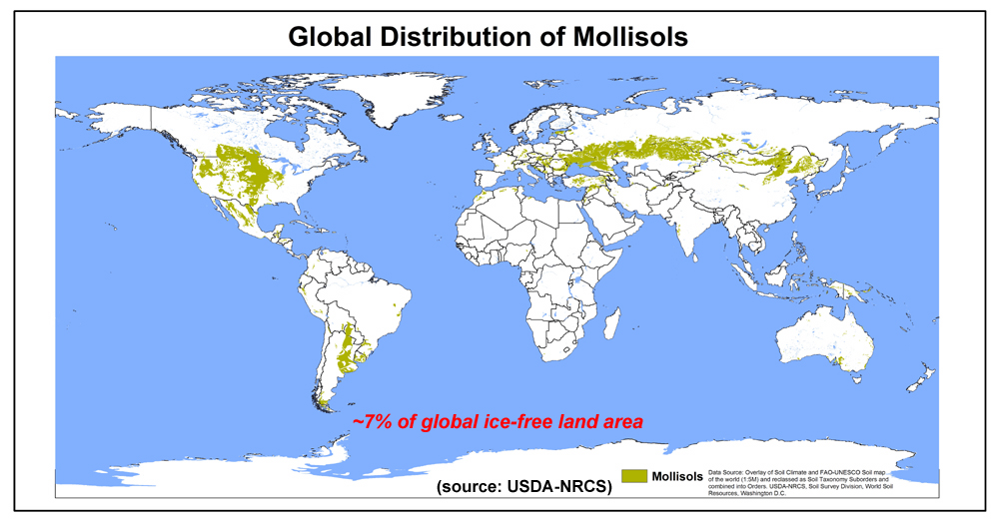

Slide 22
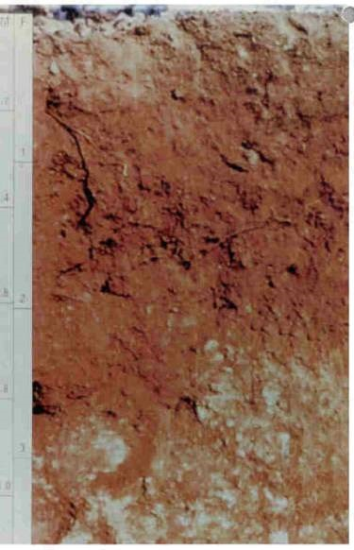
Aridisol (L. aridus, dry)
Soils of dry climates with some devel-
opment in the B horizon, often as
precipitates of calcium and other salts.
Low organics, but high fertility
Never moist for more than 3 months per
year.
Found in cold and hot deserts of USA
Old ‘Pedocals’ / Desert Soils designation
Caliche Fun!!!
Saline/alkaline

Slide 23
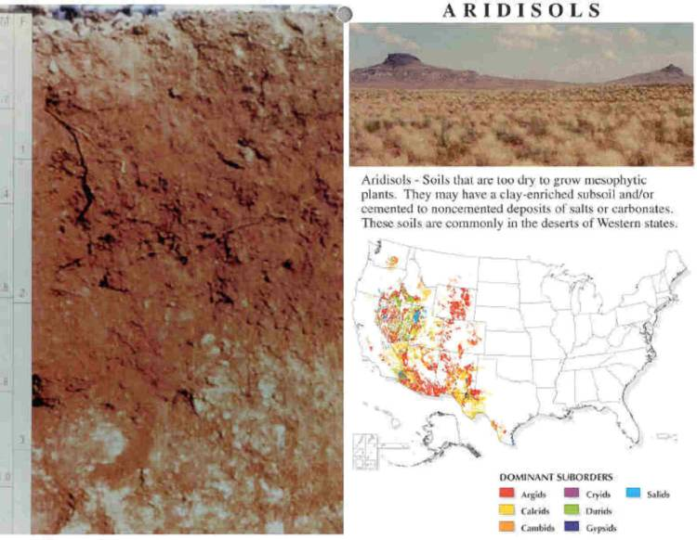
Aridisols

Slide 24
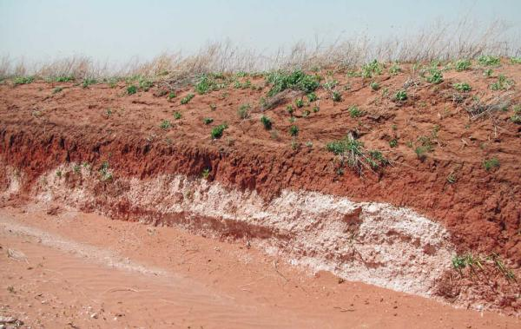
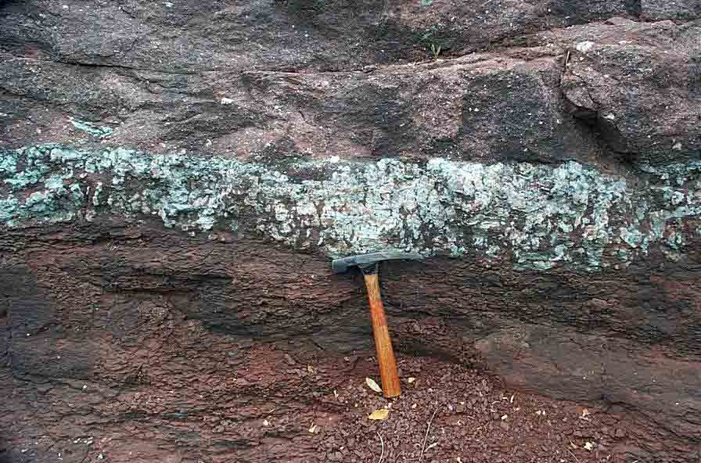

Slide 25
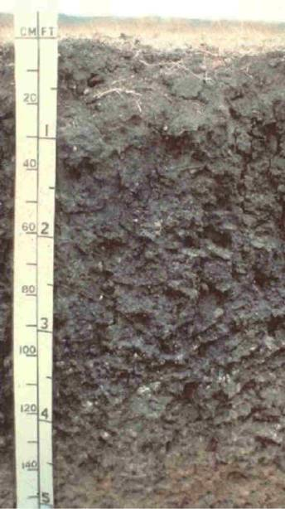
Vertisol (L. verto, turn, mix)
Dark soils of semi-arid grasslands and savannas
which develop deep cracks in the dry season; cracks swell shut in the wet season as the shrink-swell clays
rehydrate and expand.
Also common over mafic igneous rocks in
humid regions, or soils containing
high concentrations of Montmorillonite
High in clay!!
Lack of horizonation
Are the dark colors due to high organics??

Slide 26
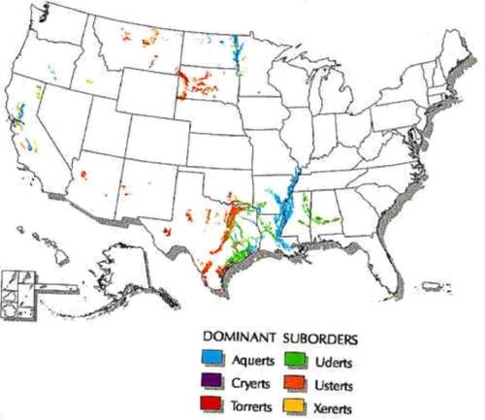
Vertisol

Slide 27
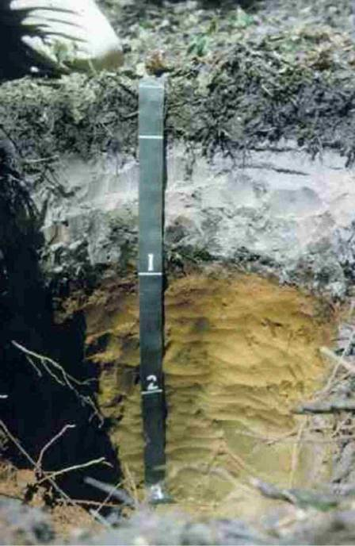
Spodosol(Gr. Spodos, wood ash)
Soils in which translocation of
compounds Fe, humus, and
Al is dominant.
Tends to dominate in sandy terrains
Most extensive in sub-arctic, but
also found throughout New
England
High degree of leaching (clay).
Ash-grey A horizon
Low temperatures, but also found in
locales such as Florida.
Low in natural fertility

Slide 28
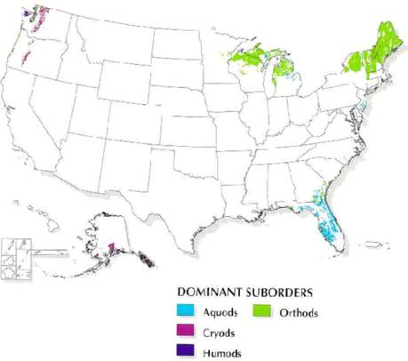
Spodosols

Slide 29
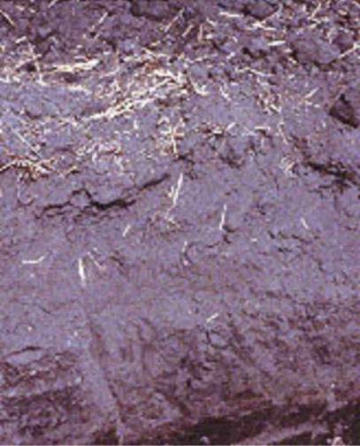
Histosol (Gr. histos, tissue)
Organic soils without shallow permafrost,
dominated by decomposing organic
matter; most are saturated with
water at times.
Plants, plants, plants….bogs, swamps.
“Has an organic carbon content (by weight)
of 12 to 18 percent, or more, depending
on the clay content of the soil.”

Slide 30
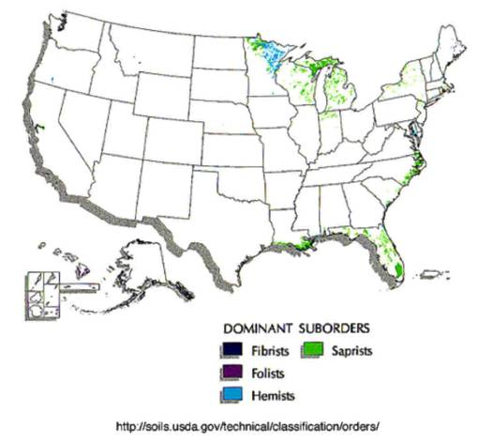
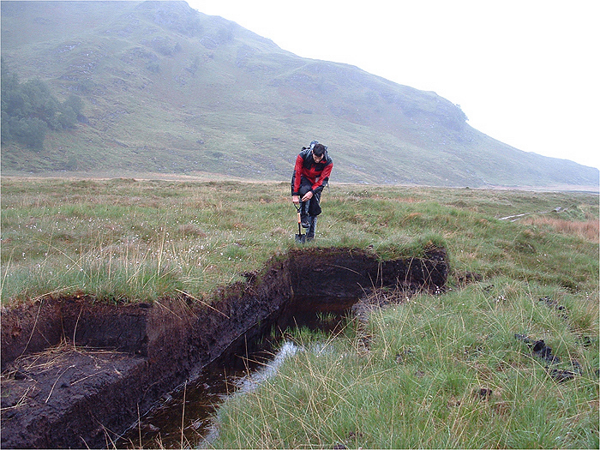
Histosols

Slide 31
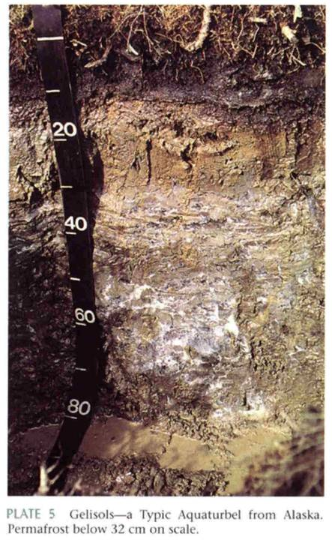
Gelisol (L. gelare, to freeze)
Soils with permafrost within 1 m of
the surface.
They have no B horizon; the A horizon
rests on top of Permafrost.
Highly leached, low nutrients
Severe restriction on construction,
engineering, etc.

Slide 32
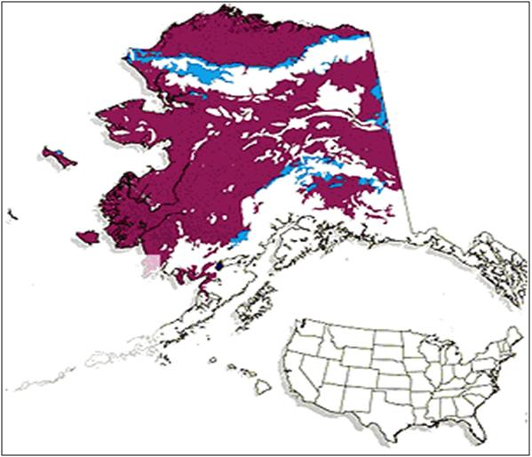
Gelisols

Slide 33
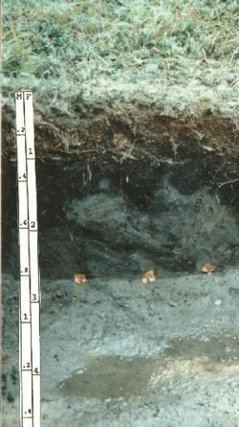
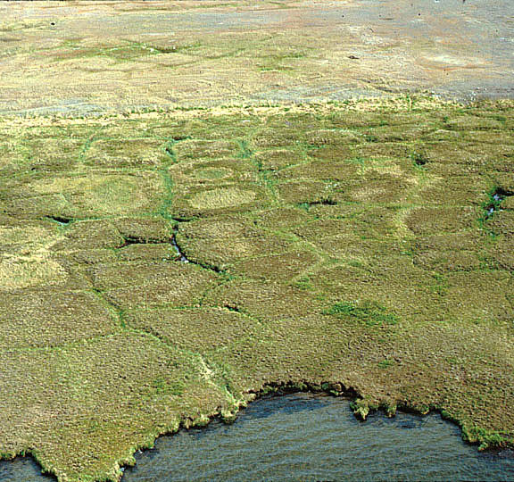

Slide 34
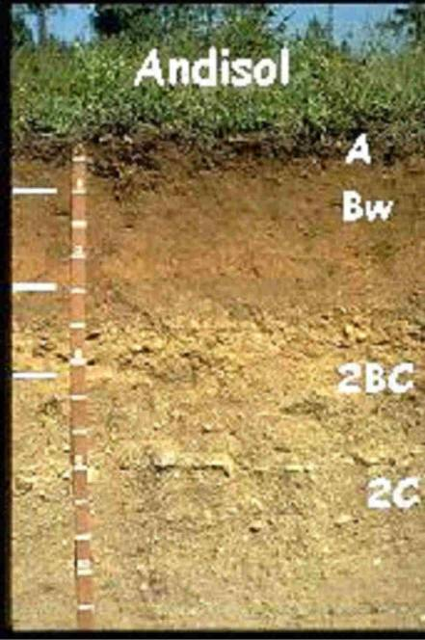
Andisols (modified from ando)
Soils that have often formed in parent
material with a large component of
volcanic ash.
Split out of Inceptisols due to weak
Horizon development
Most common in Pacific Northwest
Very high in Phosphorus

Slide 35
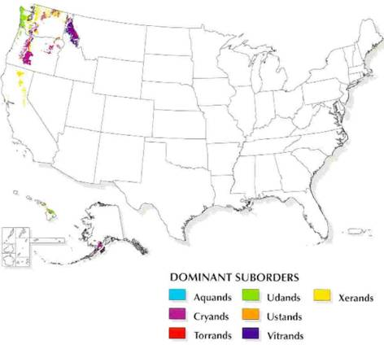
Andisols

Slide 36
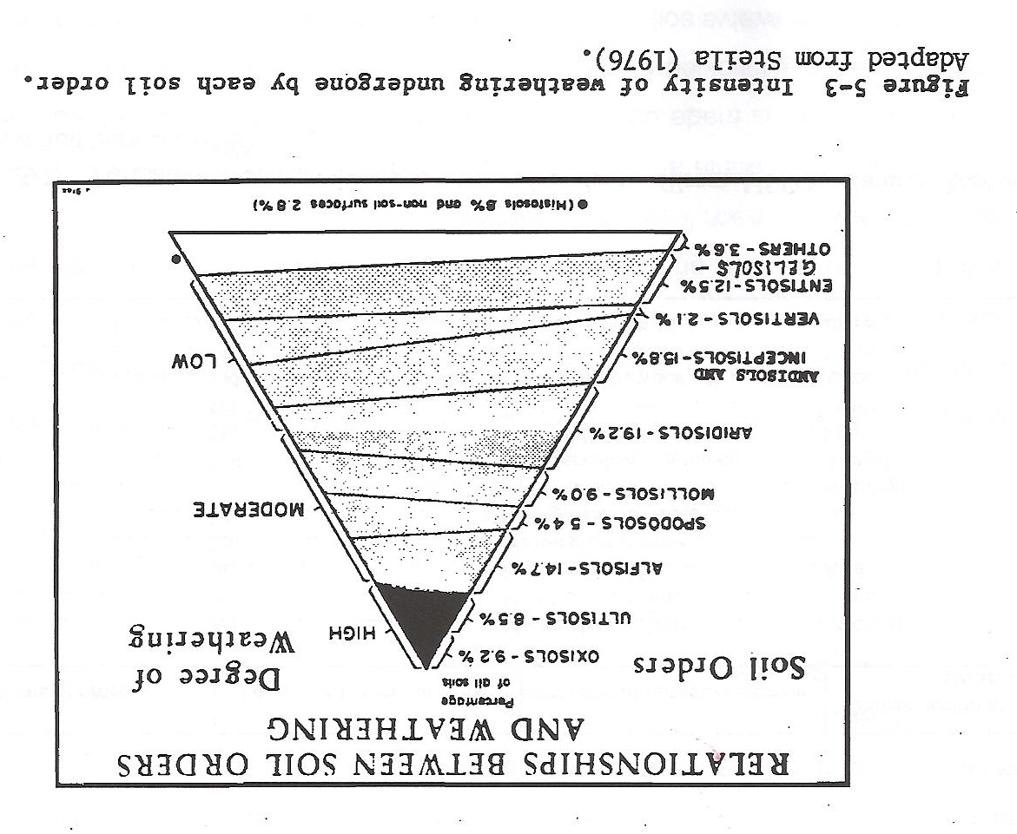

Slide 37
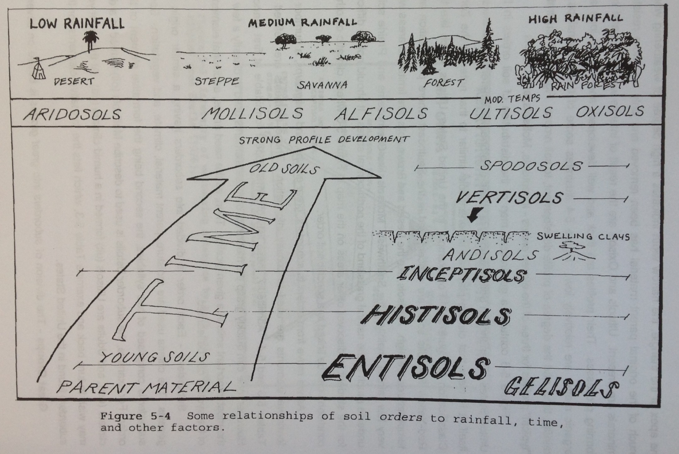

Slide 38
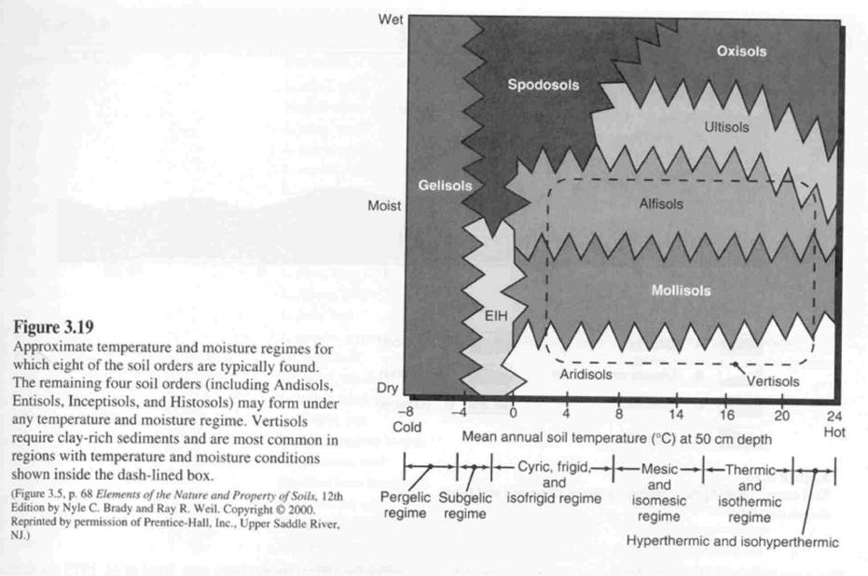

Slide 39
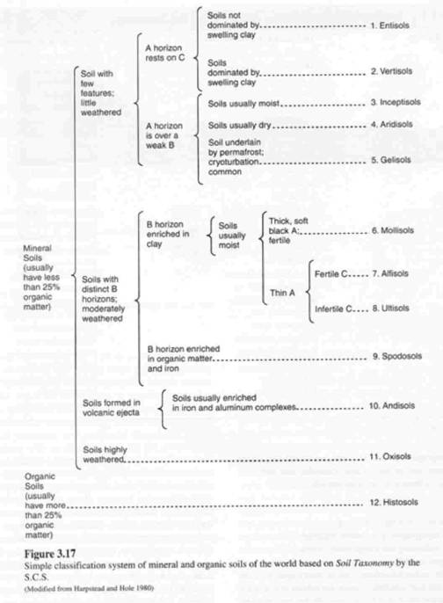

Slide 40
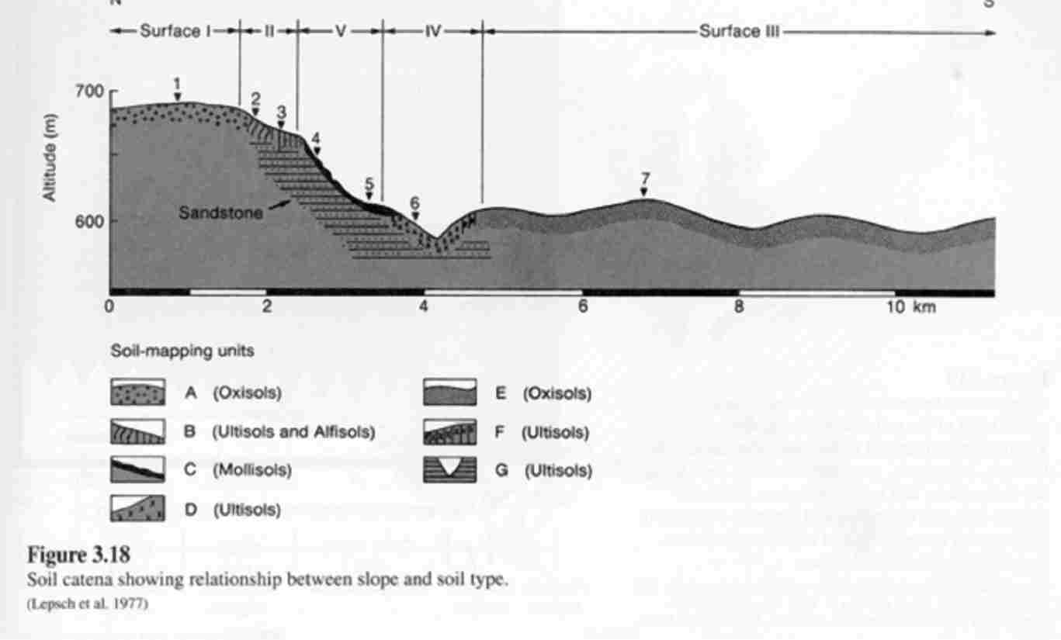
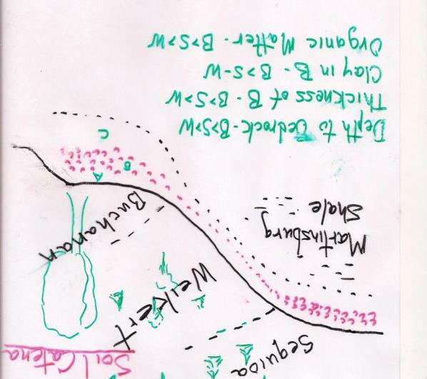
Soil Catena

Slide 41
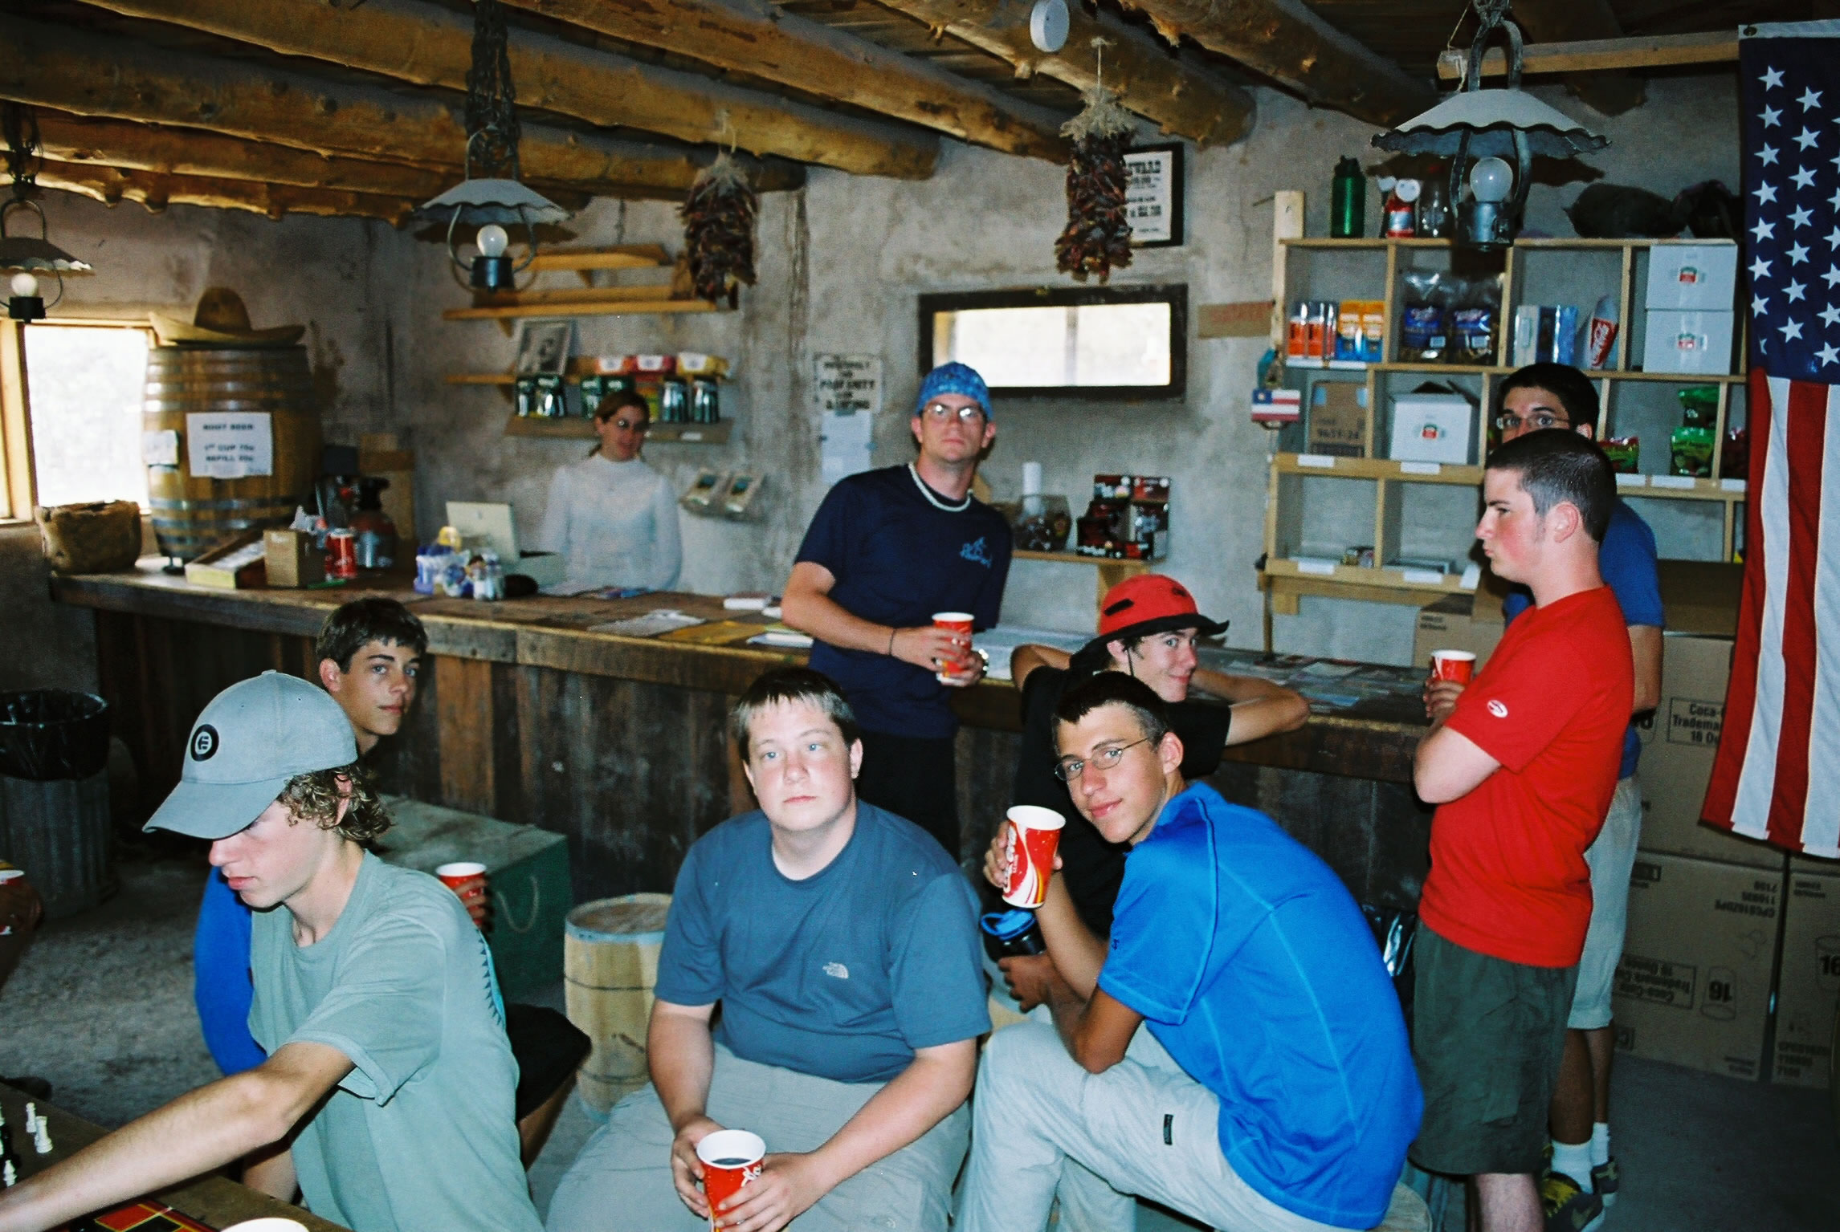
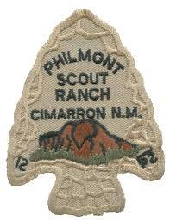
Philmont Scout Ranch Cantina at Ponil Camp

Slide 42
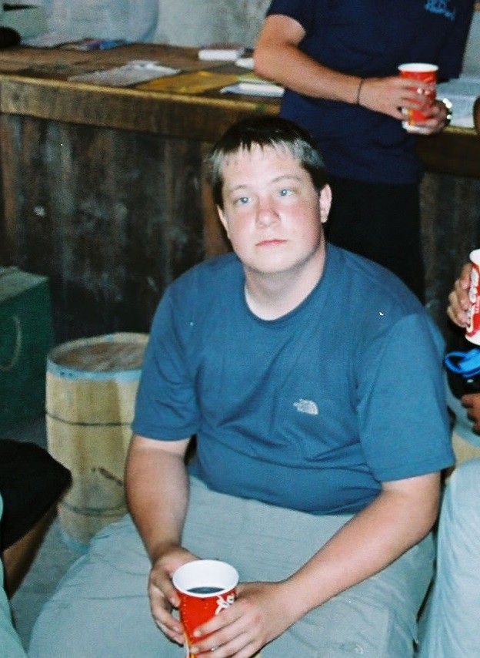
Philmont Scout Ranch Cantina at Ponil Camp
“Are you sure that’s
Root beer you’re drinking?”

Slide 43
A peek at our next section of material……
IV. Soil Taxonomy Hierarchy
Order
Suborder
Great Group
Subgroup
Family
Series

Slide 44
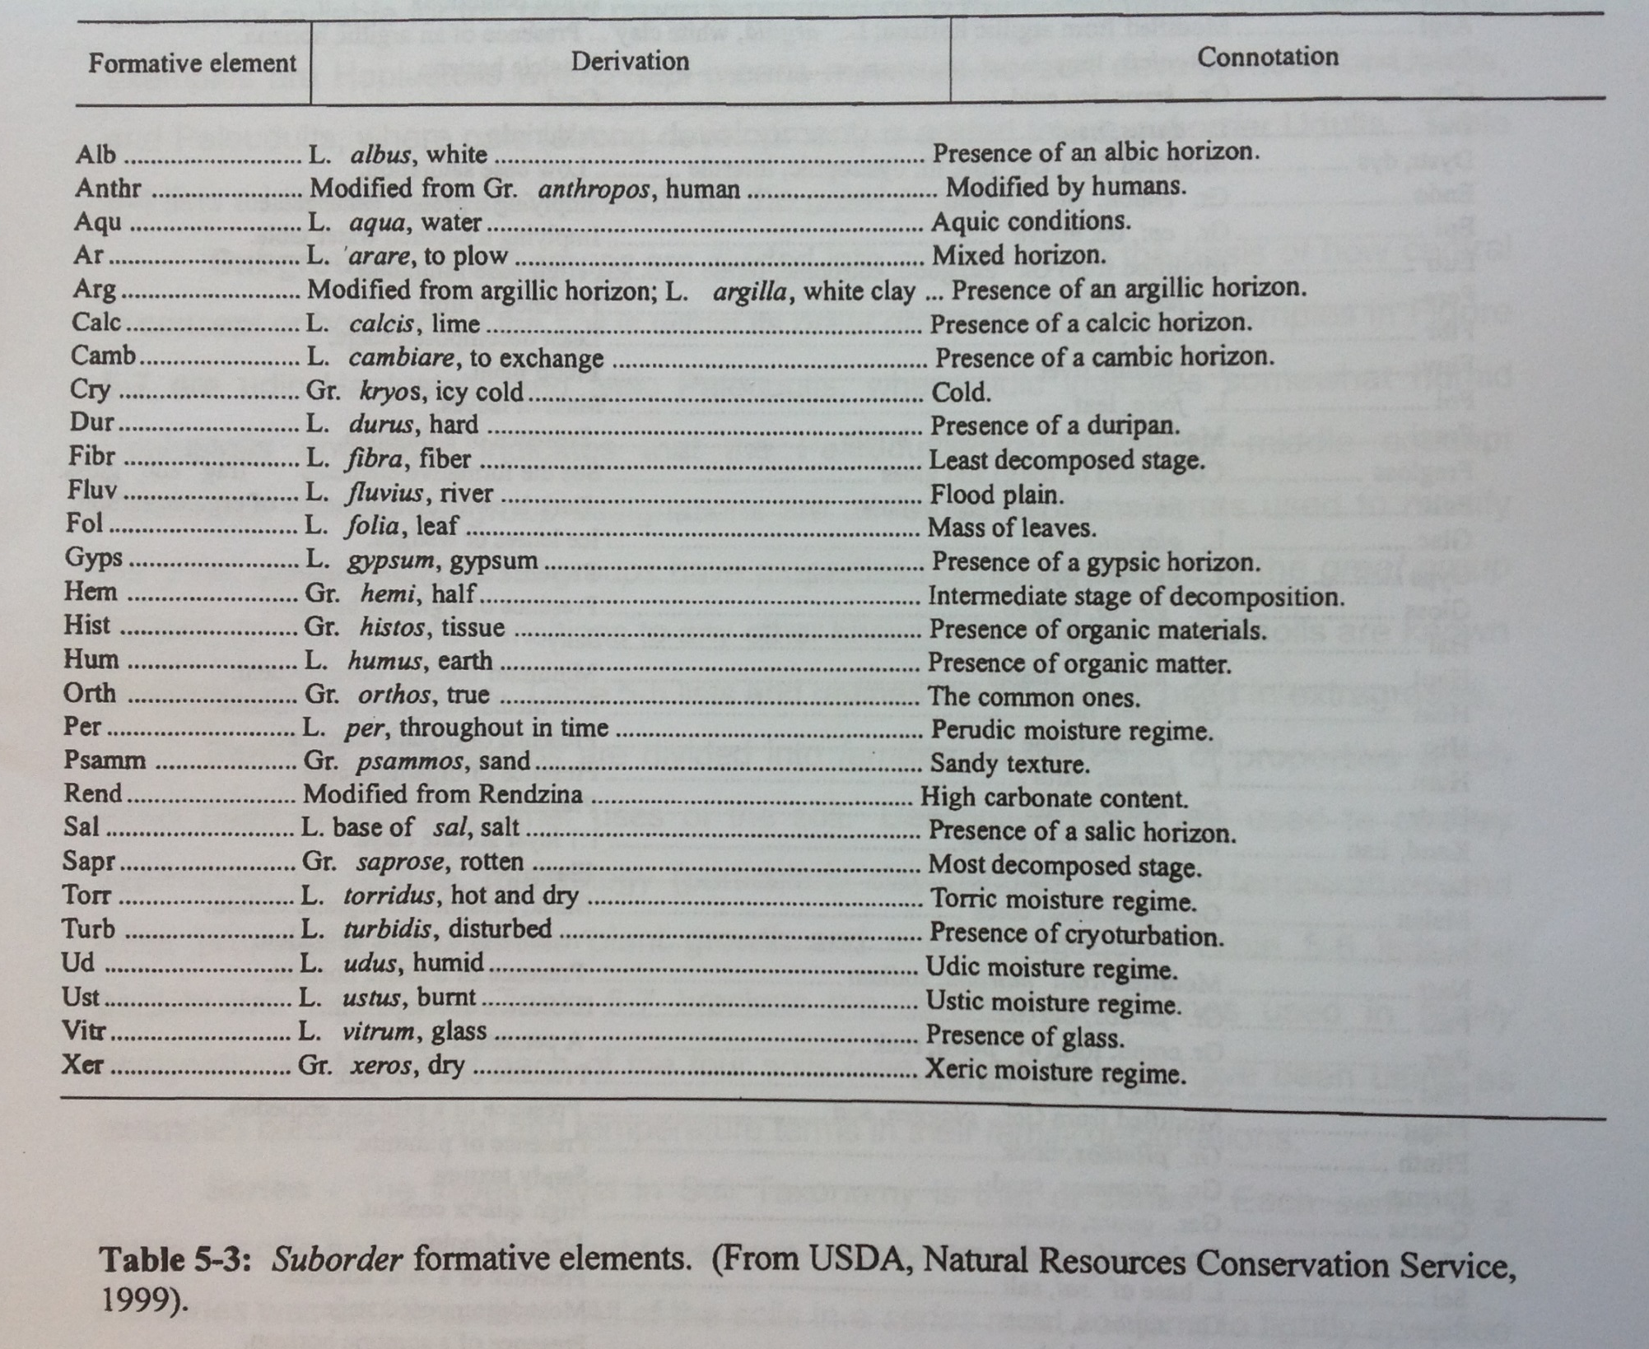

Slide 45
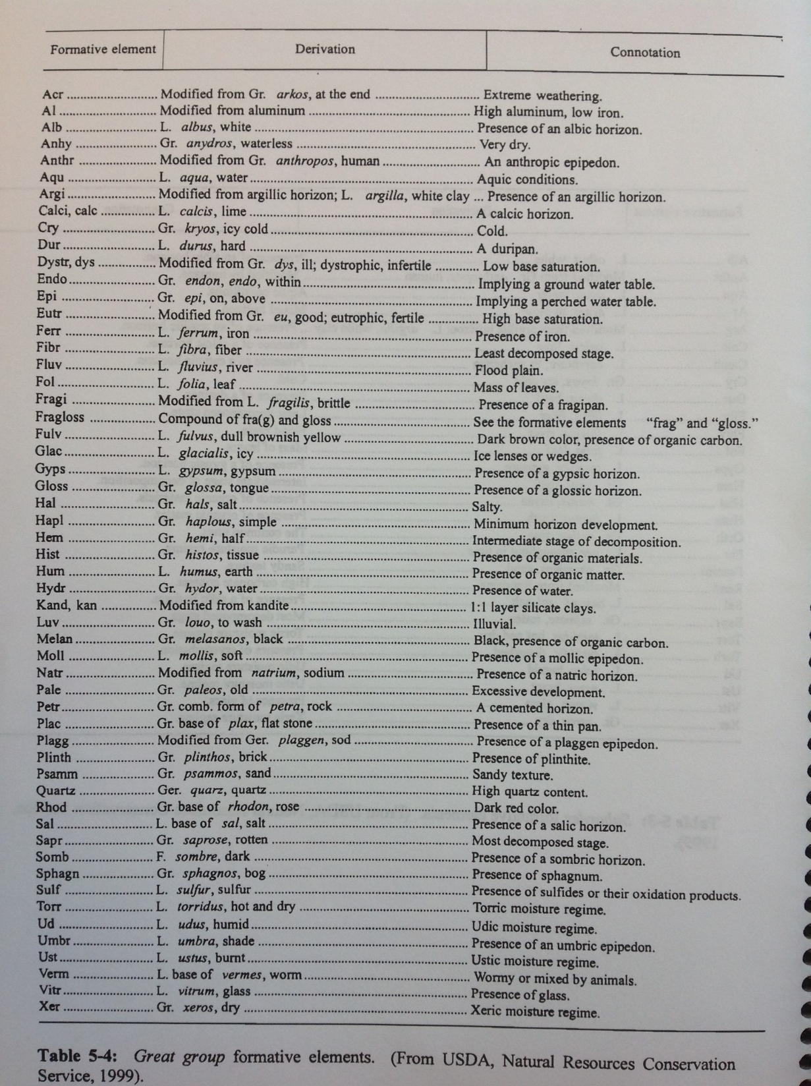

Slide 46
IV. Soil Taxonomy Hierarchy (Frederick Series)
Order (Ultisols)
Suborder (Udults)
Great Group (Paleudults)
Subgroup (Typic Paleudults)
Family (Clayey, Kaolinitic, Mesic)
Series (Frederick)
Clayey = > 35% clay
Kaolinitic = clay > 50% Kaolinite
Mesic Temperature = 47 -59 degrees F
Clayey, Kaolinitic, Mesic, Typic, Paleudults

