Slide 1
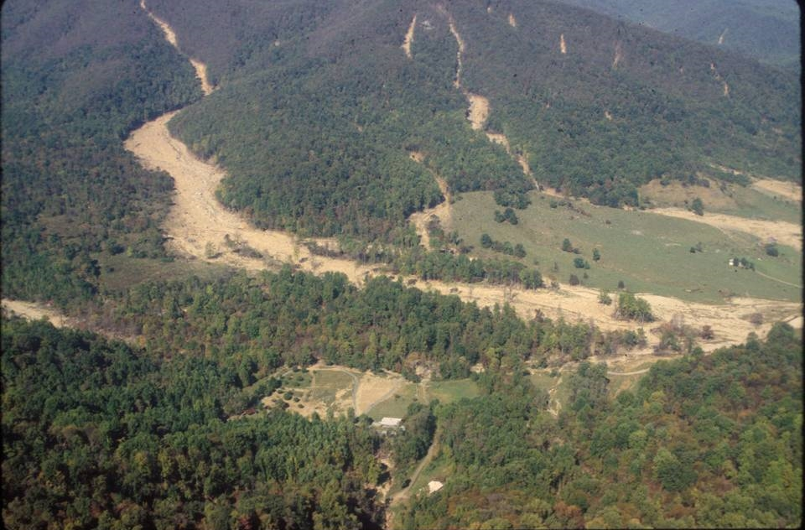
The Geology of Virginia
(and why it matters)
L. Scott Eaton
Department of Geology and Environmental Science
James Madison University

Slide 2
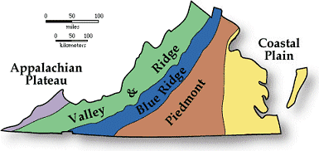
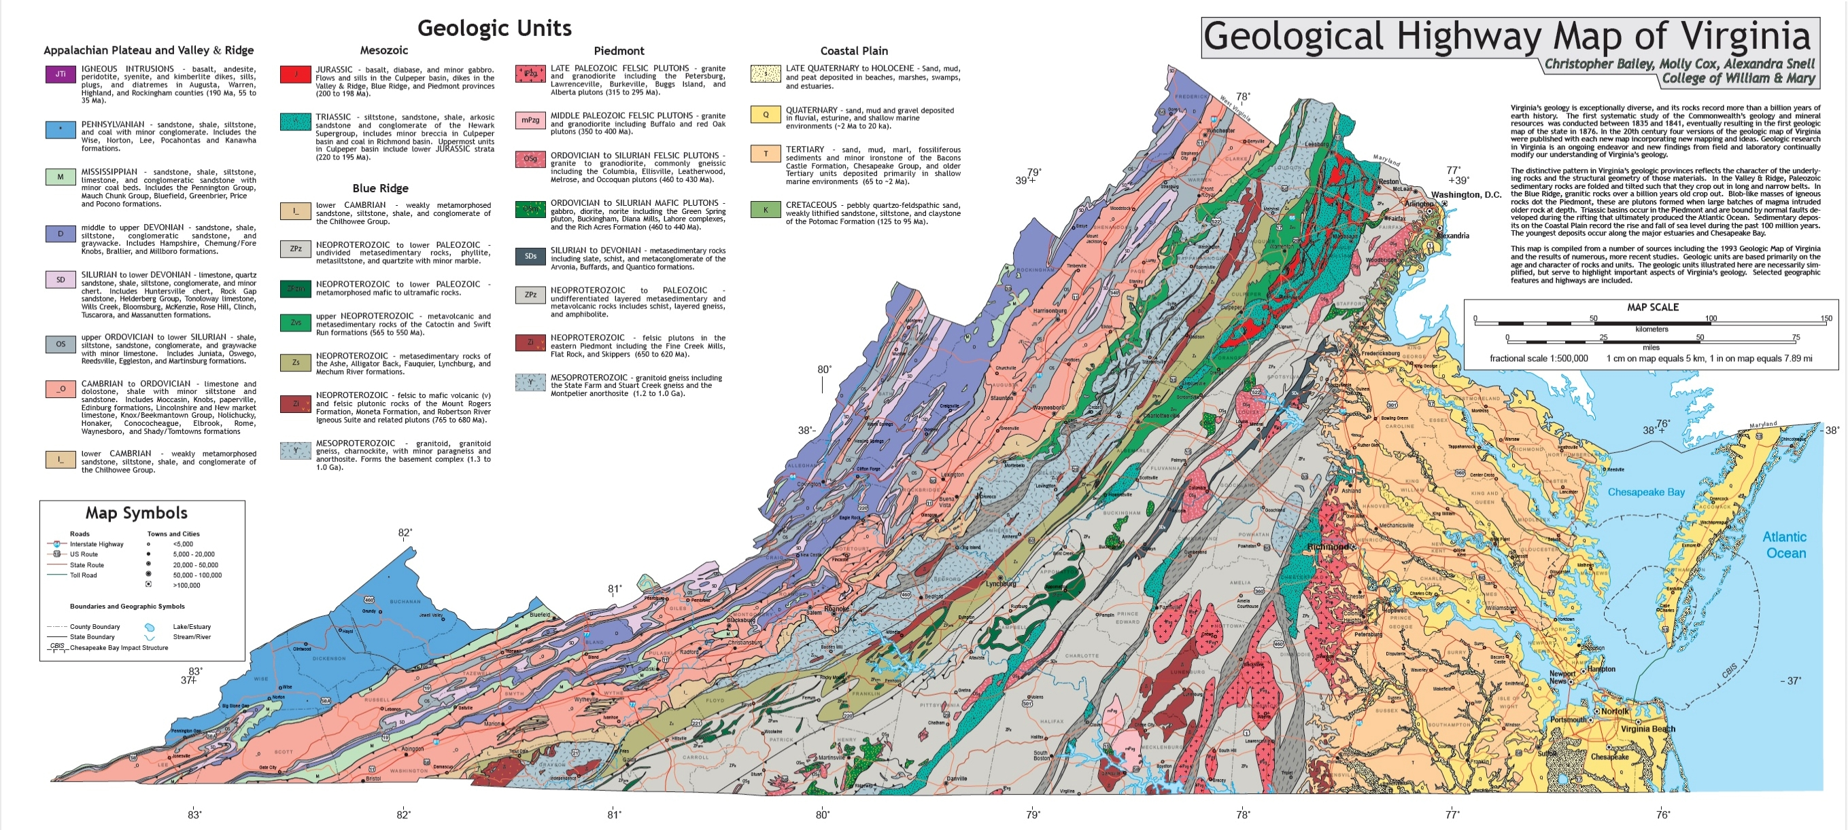

Slide 3
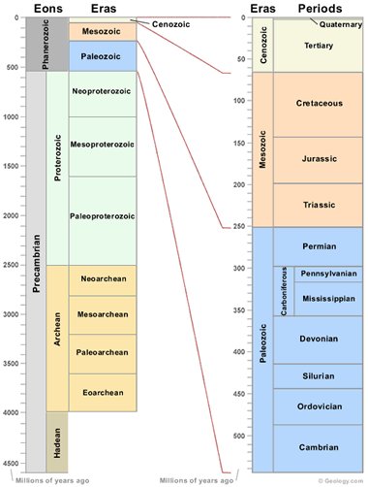

Slide 4
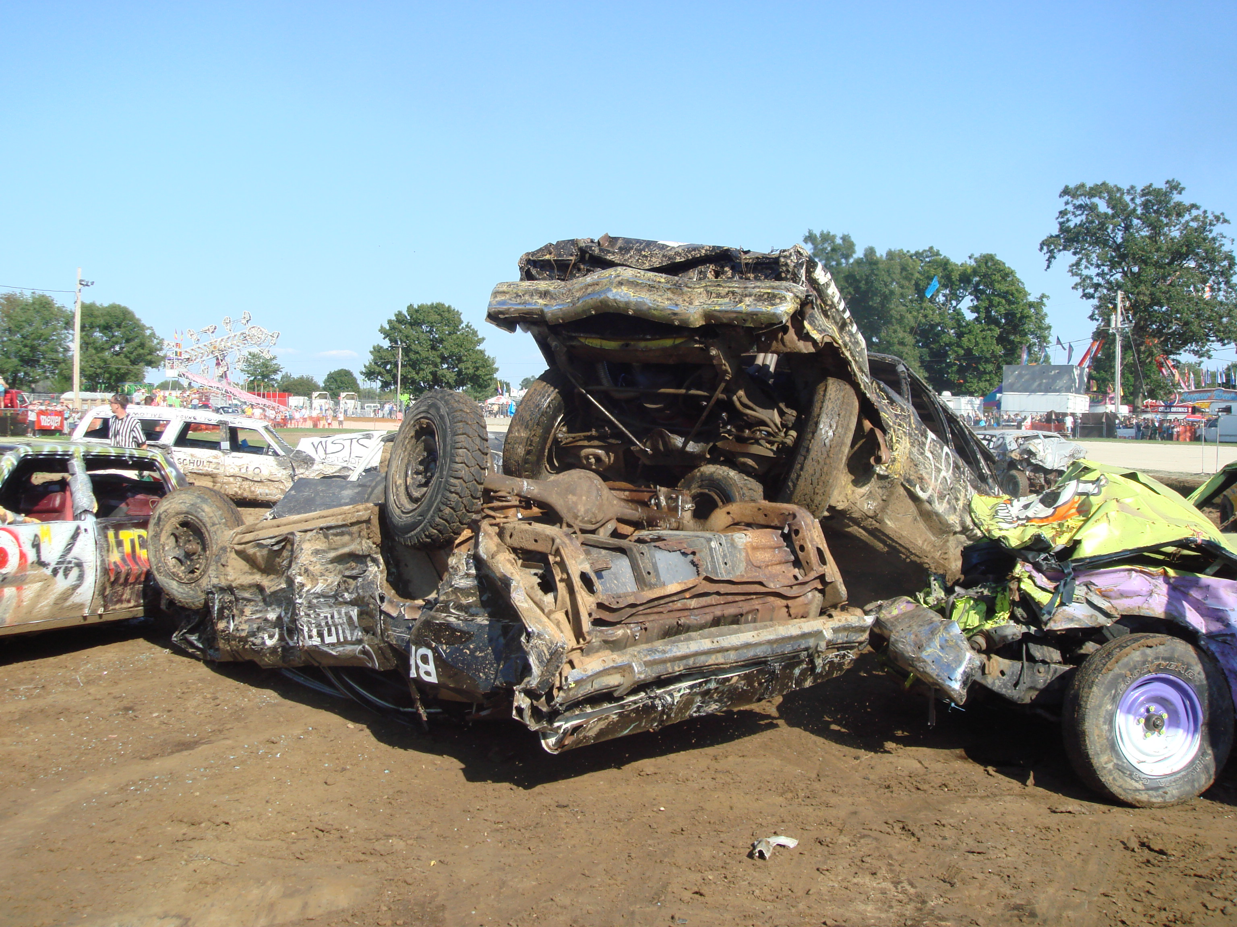


Slide 5
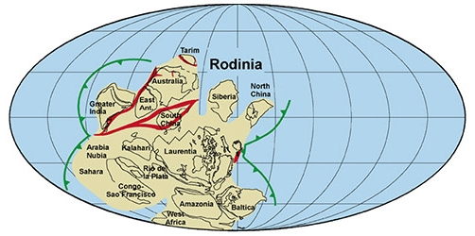
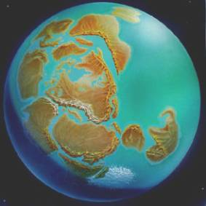
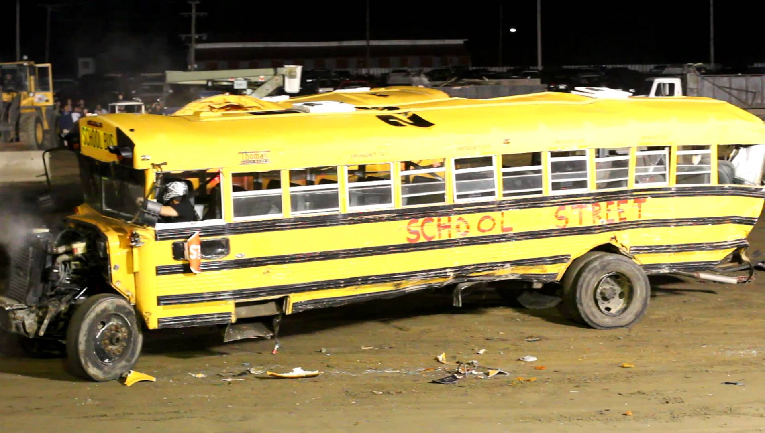
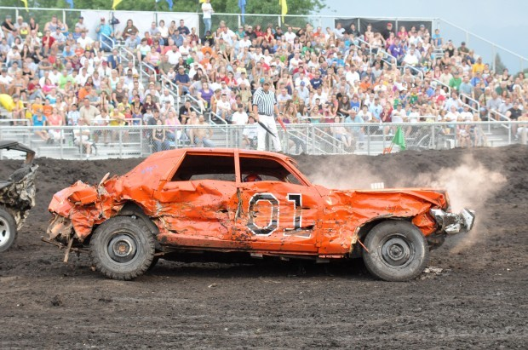

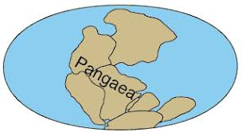
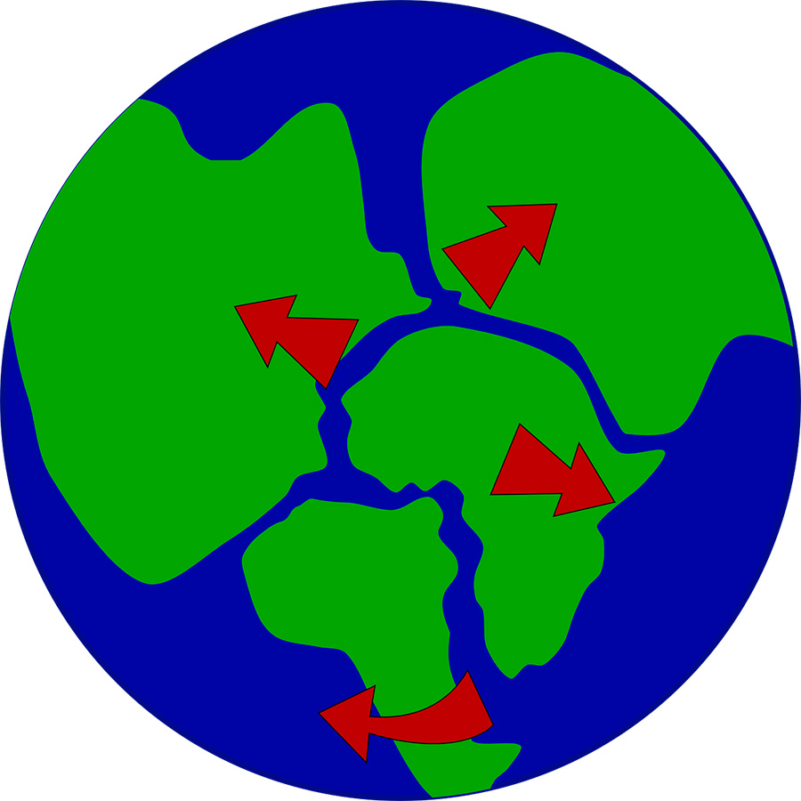

Slide 6
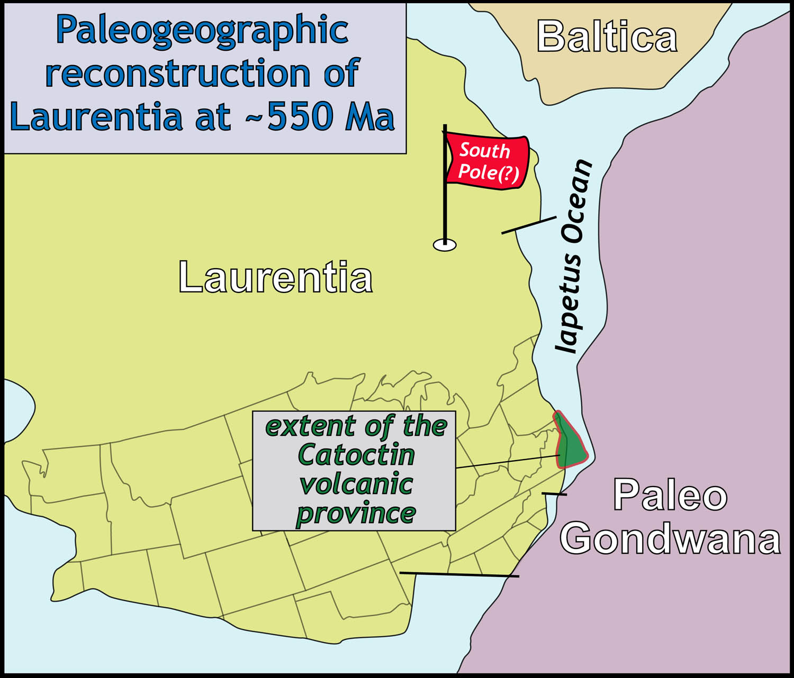
Image courtesy: C.M. Bailey

Slide 7
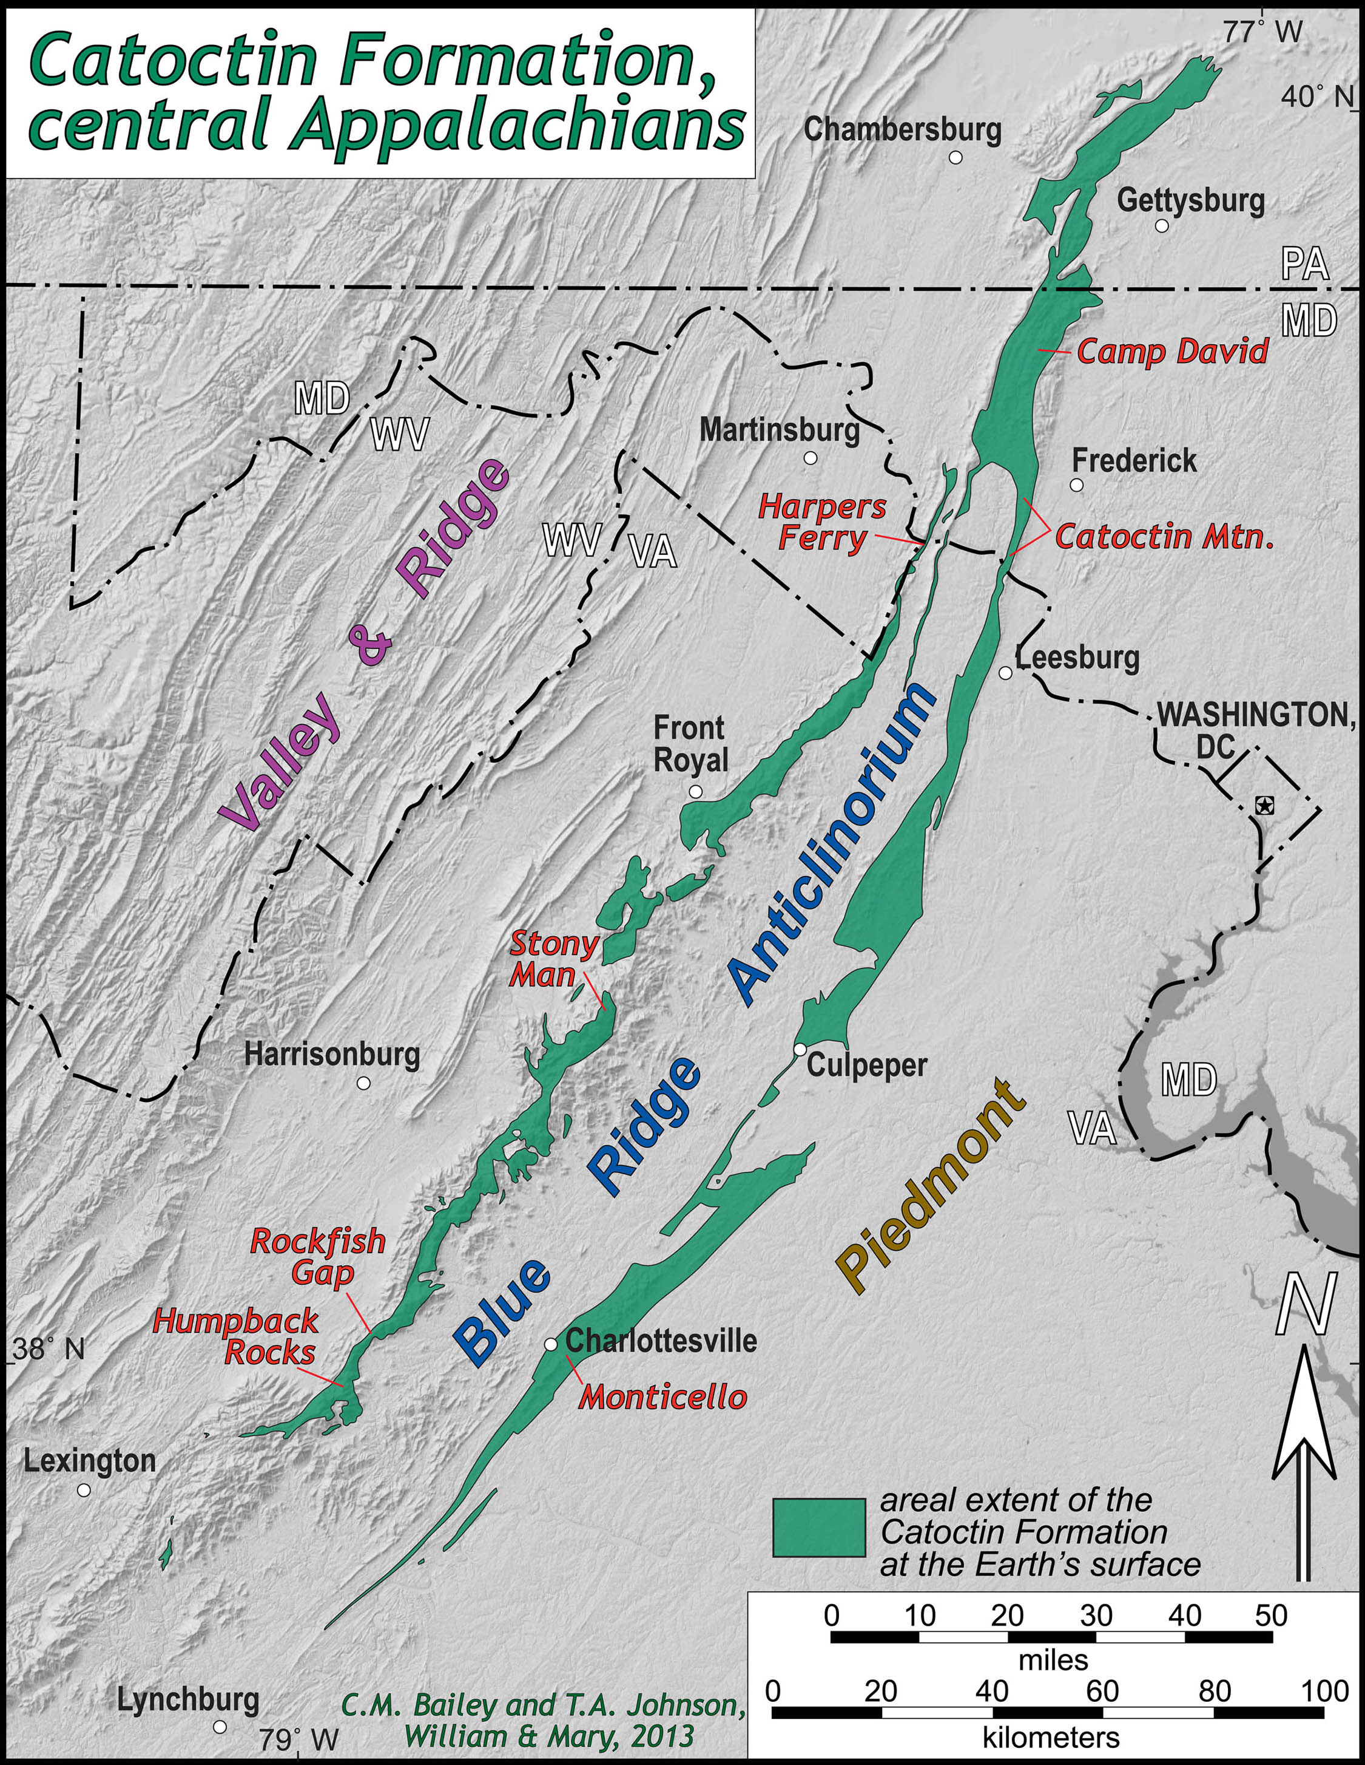
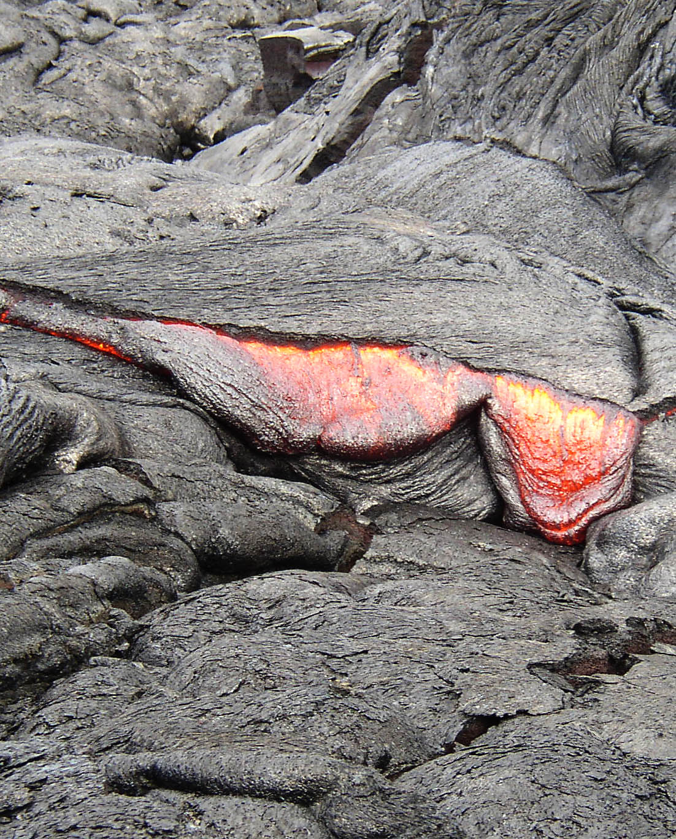
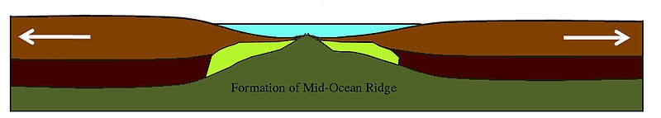

Slide 8
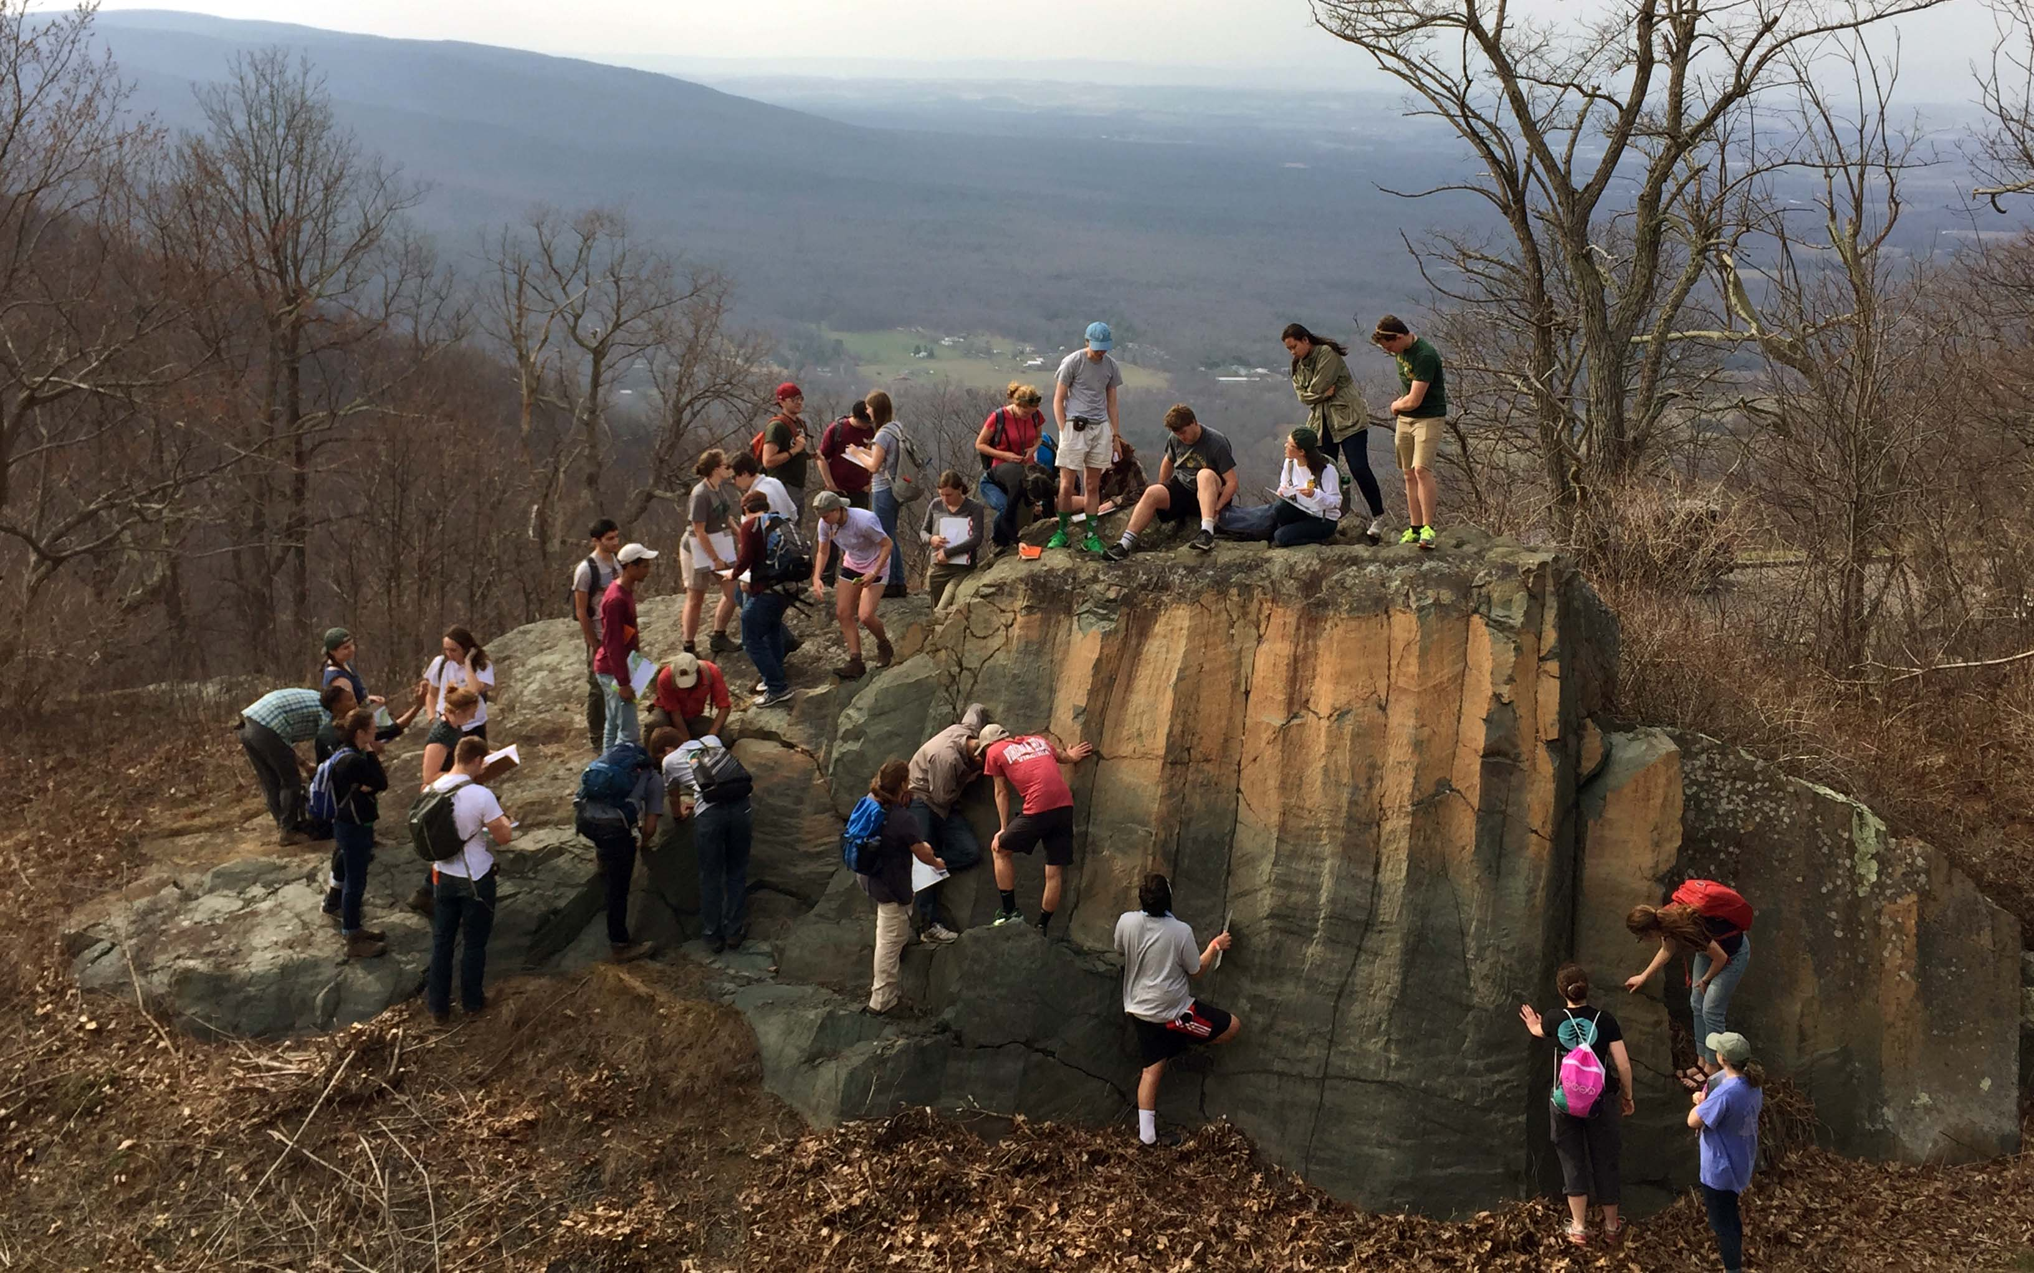
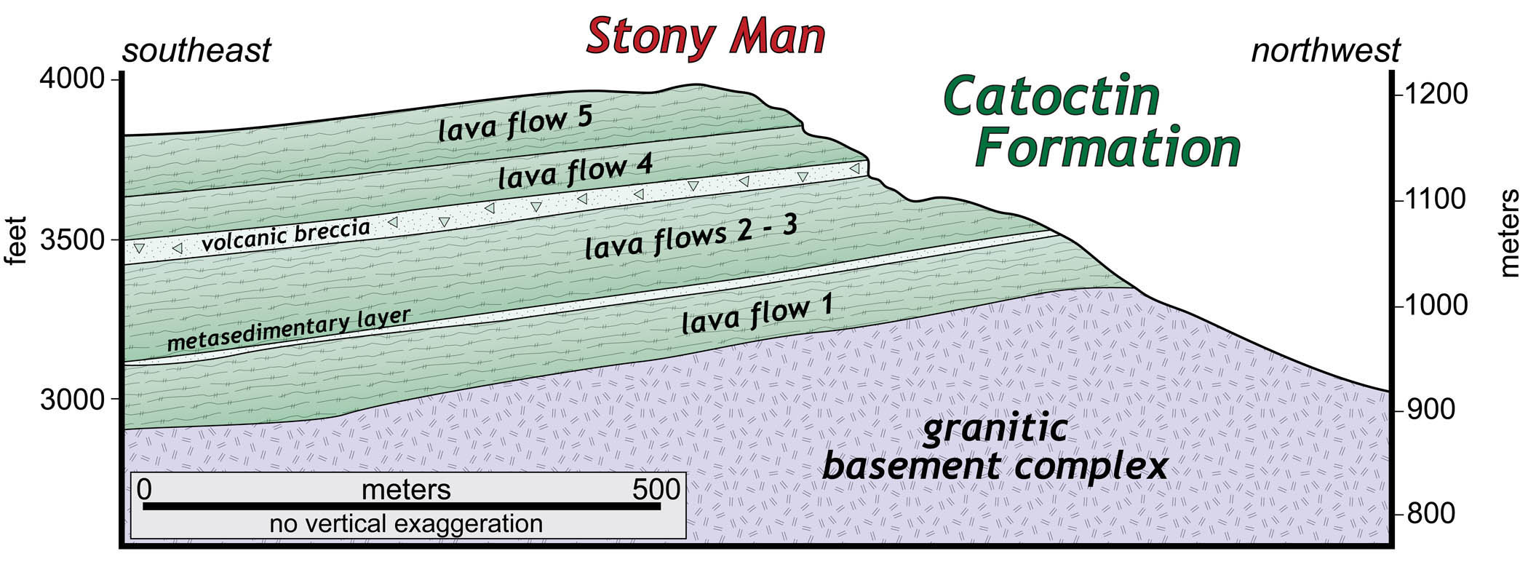
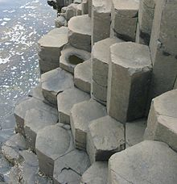

Slide 9
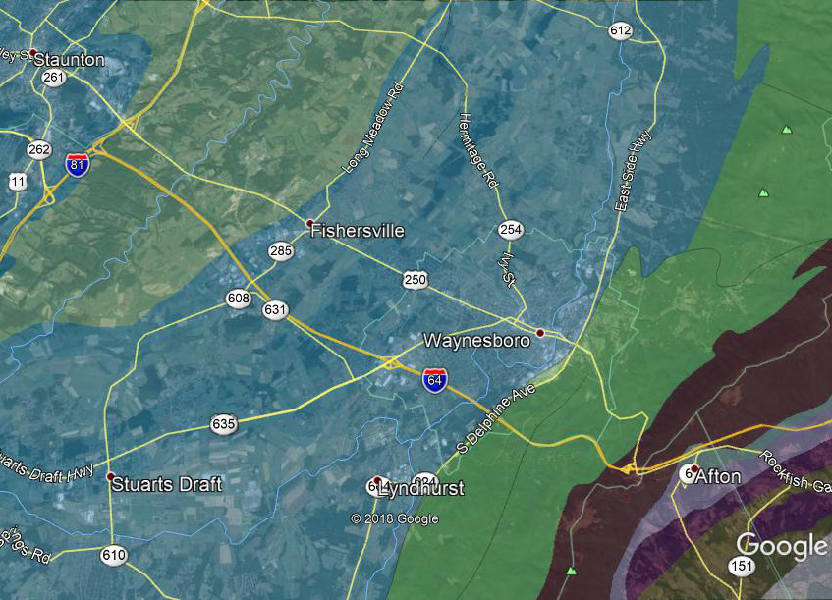
Basalt

Slide 10
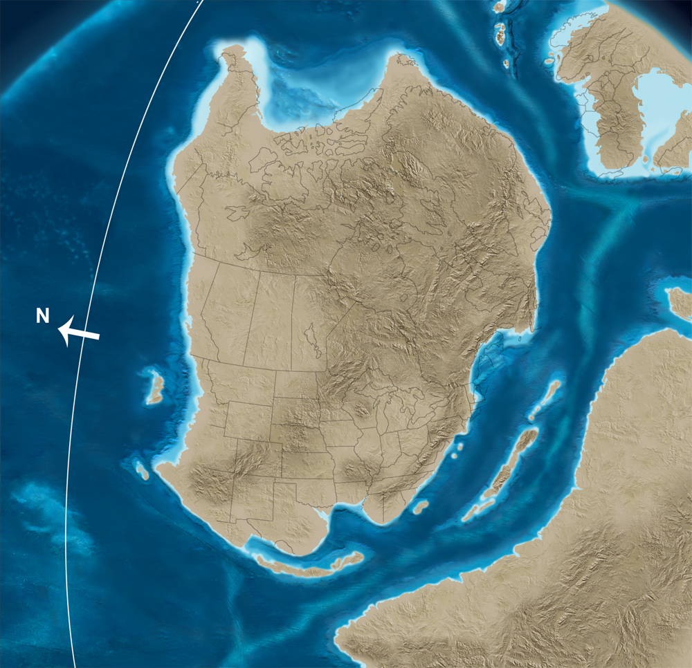

550 Ma
Neoproterozoic
Baltica
Breakup of the
supercontinent
of Rodinia;
Opening of the
Iapetus Ocean
Laurentia
(Ancestral North America)
Extrusion of
Catoctin basalts;
Deposition of
Chilhowee Group:
Weverton,
Harpers,
Antietam
Gondwana
http://cpgeosystems.com/paleomaps.html

Slide 11

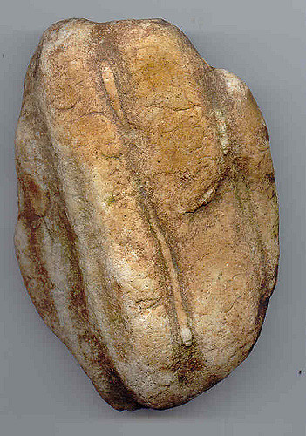
550 Ma
Neoproterozoic
Baltica
Breakup of the
supercontinent
of Rodinia;
Opening of the
Iapetus Ocean
Laurentia
(Ancestral North America)
Extrusion of
Catoctin basalts;
Deposition of
Chilhowee Group:
Weverton,
Harpers,
Antietam
Gondwana
http://cpgeosystems.com/paleomaps.html

Slide 12
Quartzite
Quartzite

Slide 13
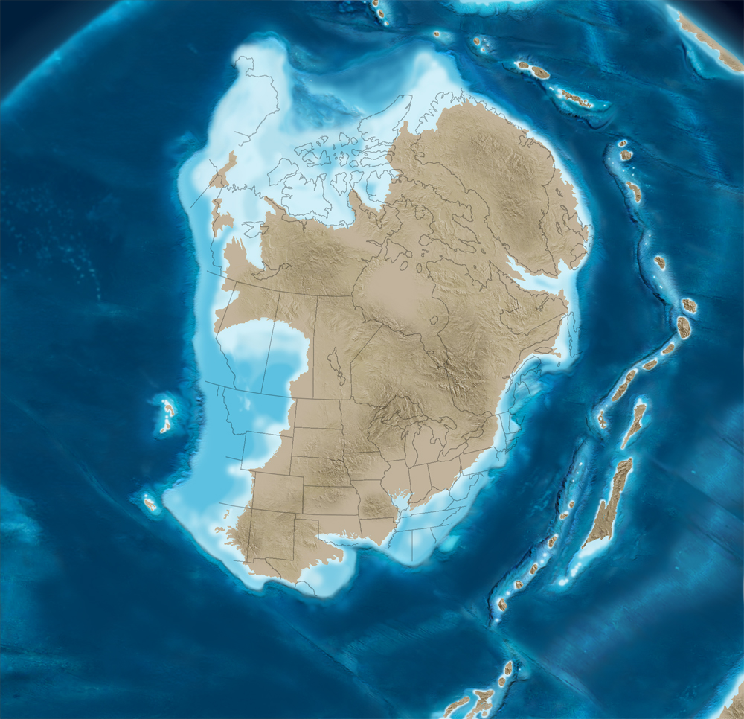
510 Ma
Cambrian
Initial approach of
Taconic arcs;
Iapetus Ocean
closing;
Initiation of
carbonate
platform in east
Deposition of
carbonates:
Shady,
Waynesboro,
Elbrook
Taconic arcs
http://cpgeosystems.com/paleomaps.html

Slide 14
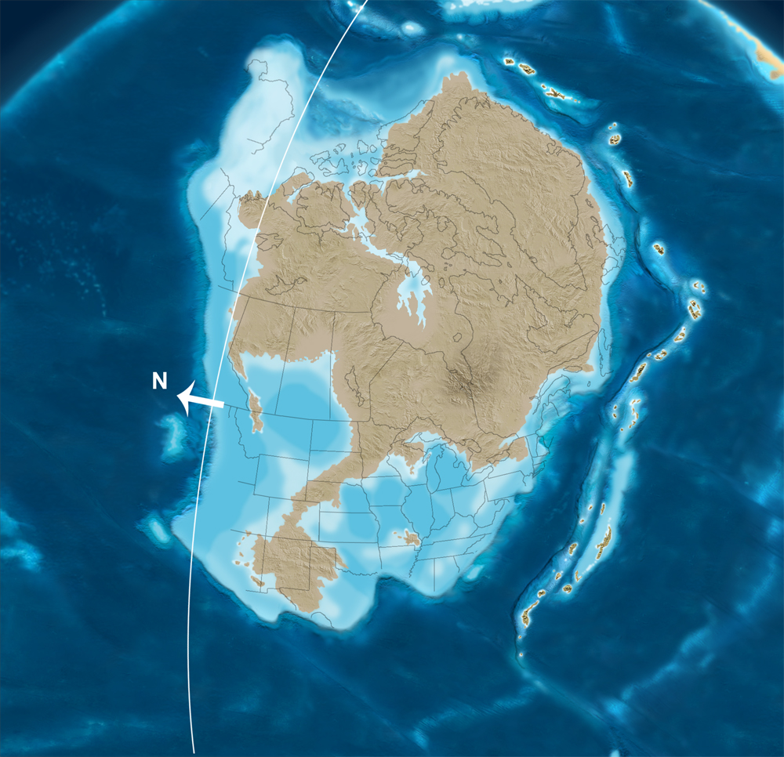
500 Ma
Cambrian
Approach of
Taconic arcs;
Carbonate
platform across
east-central
Deposition of
carbonates:
Shady,
Waynesboro,
Elbrook,
Conococheague
Taconic arcs
http://cpgeosystems.com/paleomaps.html

Slide 15
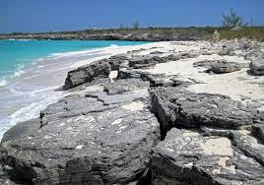
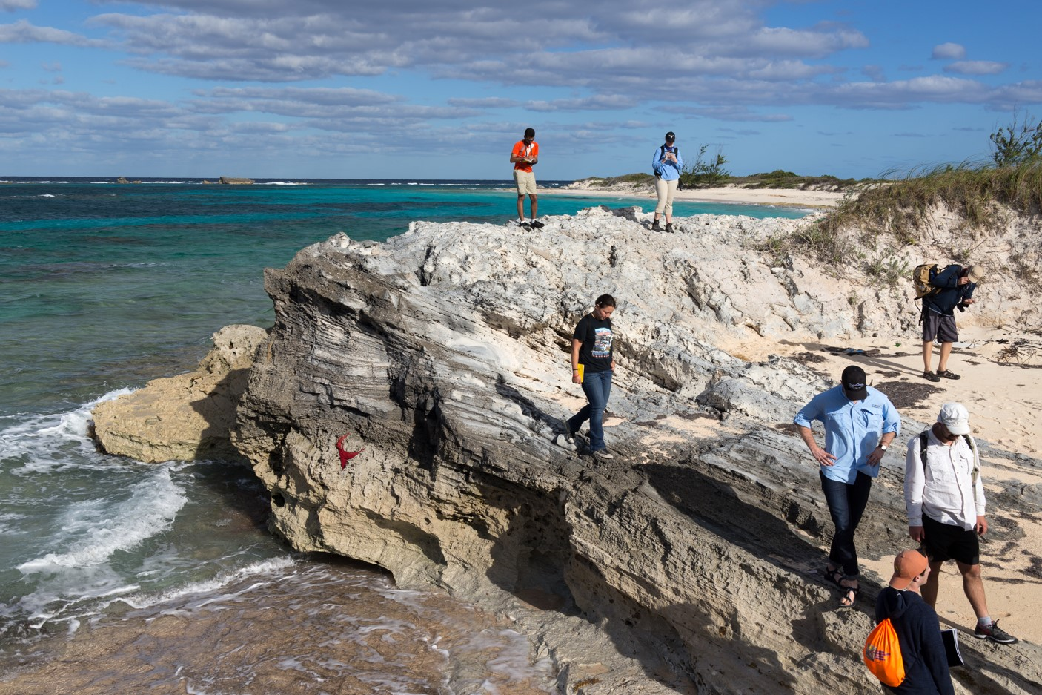
500 Ma
Cambrian
Approach of
Taconic arcs;
Carbonate
platform across
east-central
Deposition of
carbonates:
Shady,
Waynesboro,
Elbrook,
Conococheague
Taconic arcs
http://cpgeosystems.com/paleomaps.html

Slide 16
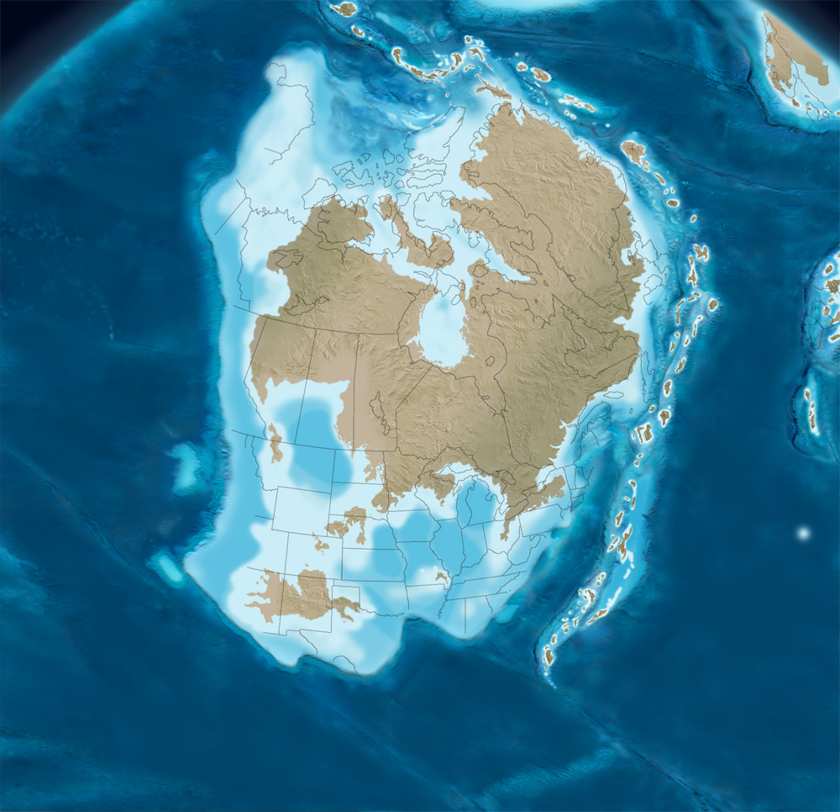
485 Ma
Ordovician
Approach of
Taconic arcs;
Carbonate
platform across
east-central
Deposition of
carbonates:
Conococheague,
Beekmantown,
Lincolnshire,
Newmarket
Taconic arcs
http://cpgeosystems.com/paleomaps.html

Slide 17
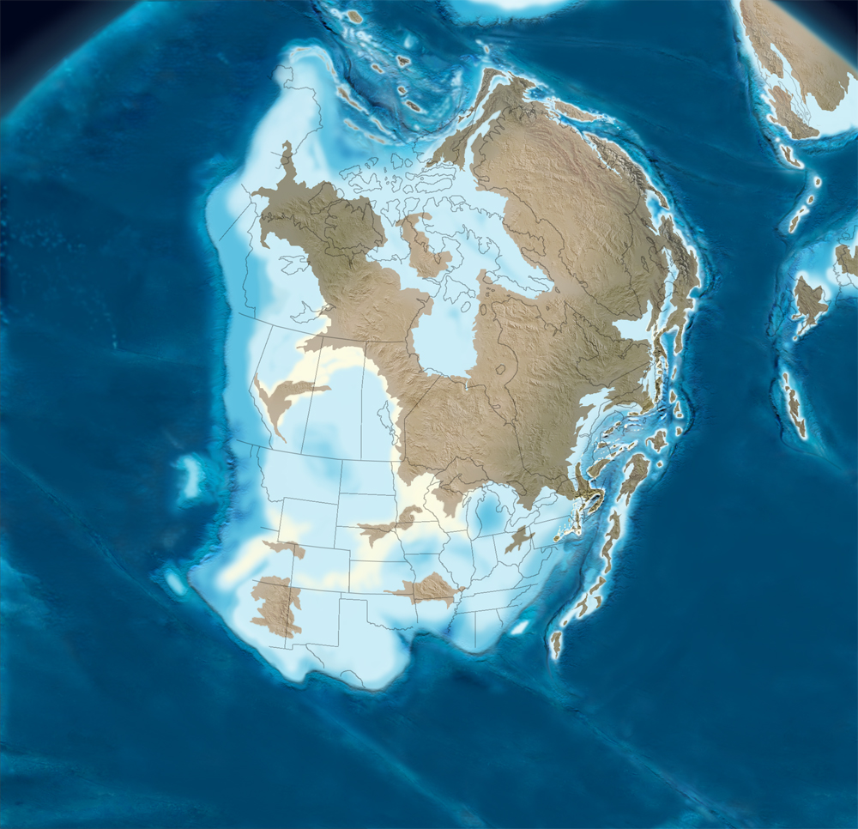
470 Ma
Ordovician
Baltica
Approach of
Taconic arcs;
Eastern basin
forms;
Carbonate
platform across
east-central
Deposition of
carbonates:
Edinburg
Taconic arcs
http://cpgeosystems.com/paleomaps.html

Slide 18
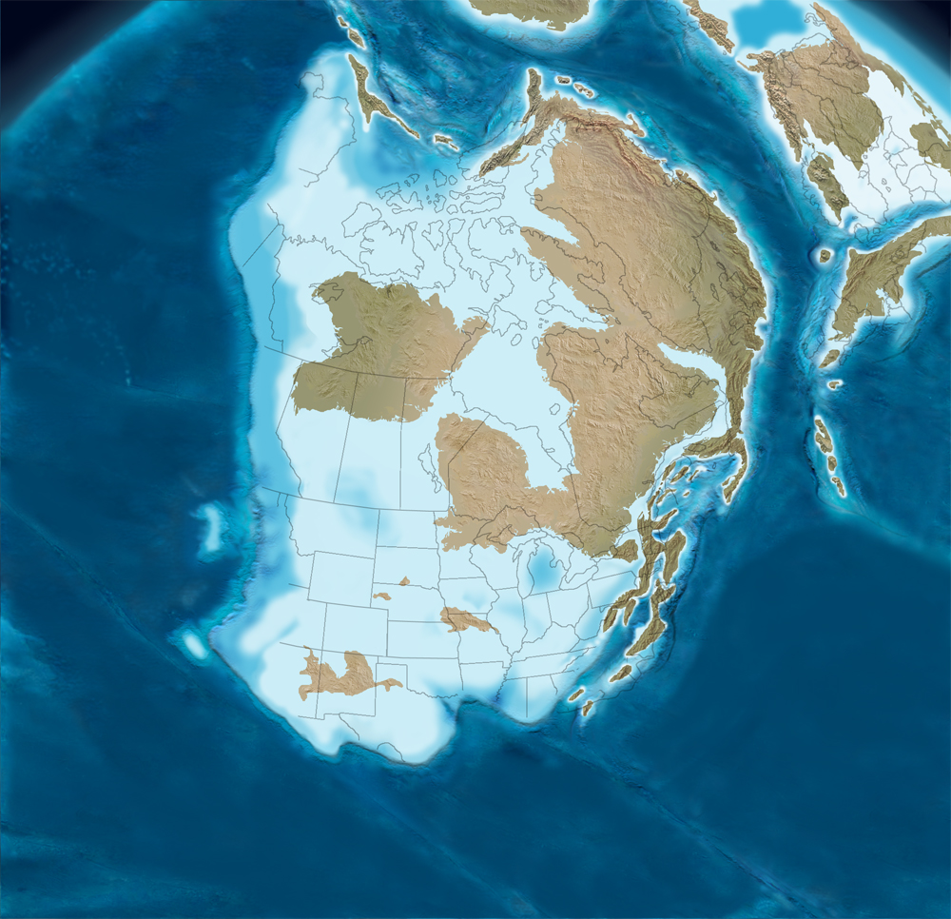
450 Ma
Ordovician
Baltica
Taconic orogeny:
Collision of Island
arcs;
Eastern basin fills
Deposition of:
Martinsburg
http://cpgeosystems.com/paleomaps.html

Slide 19
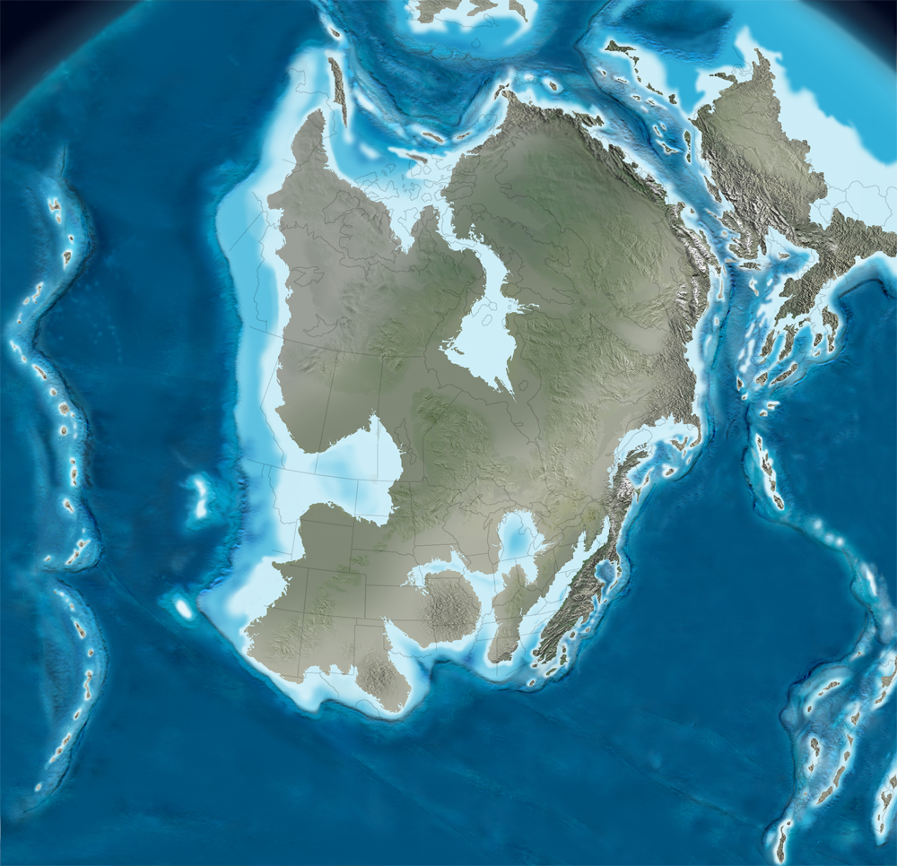
430 Ma
Silurian
Taconic mtns in
east;
Approach of
Avalon terranes
Baltica
Deposition of:
Massanutten SS
Avalon
http://cpgeosystems.com/paleomaps.html

Slide 20
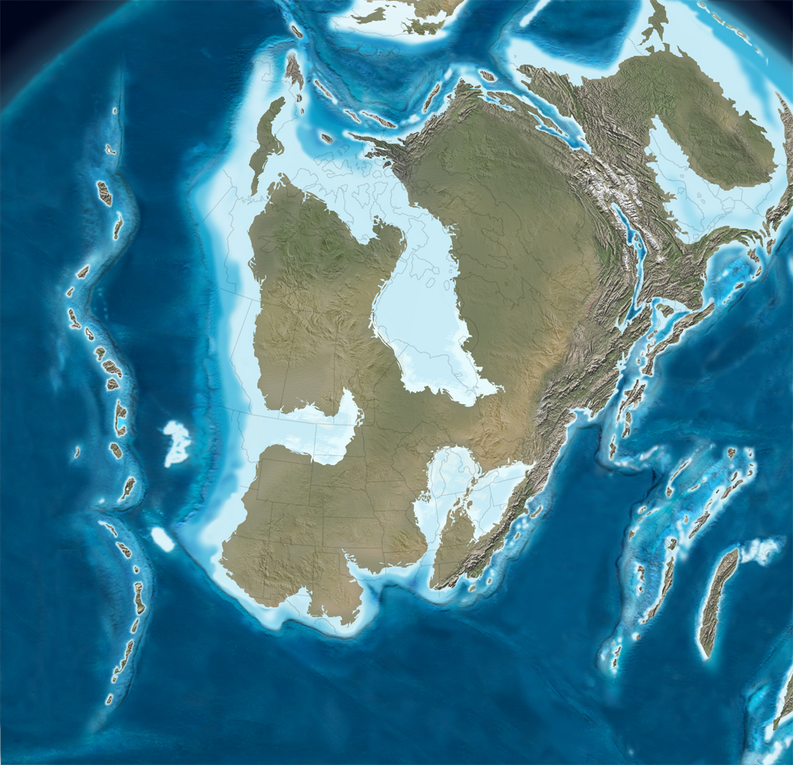
420 Ma
Silurian
Baltica
Taconic mtns in
east;
Approach of
Avalon terranes
Deposition of:
Massanutten SS
Avalon terranes
http://cpgeosystems.com/paleomaps.html

Slide 21
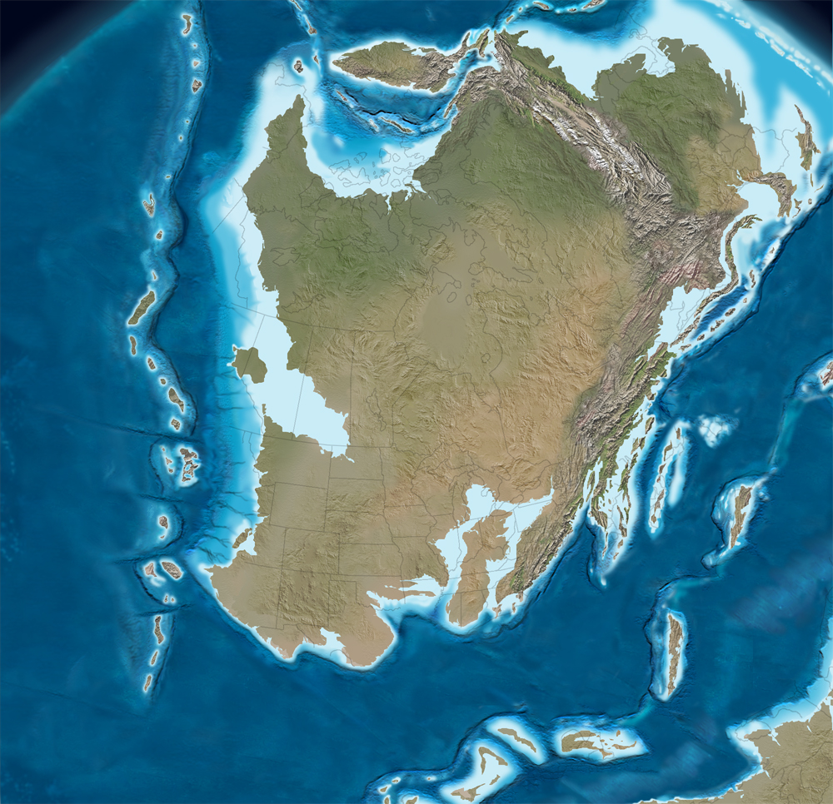
400 Ma
Devonian
Acadian orogeny;
Initial collision of
Avalon terranes
Deposition of:
Devonian clastic
rocks: shales,
sandstones
Avalon terranes
http://cpgeosystems.com/paleomaps.html

Slide 22
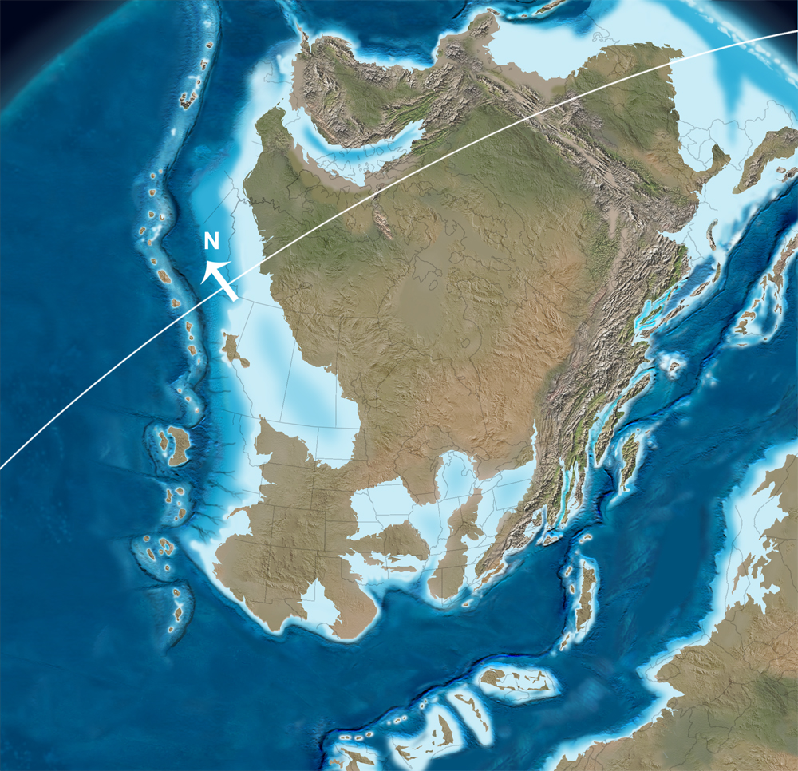
385 Ma
Devonian
Acadian orogeny;
Collision of
Avalon terranes;
Approach of
Gondwana
Deposition of:
Devonian clastic
rocks: shales,
sandstones
Gondwana
http://cpgeosystems.com/paleomaps.html

Slide 23
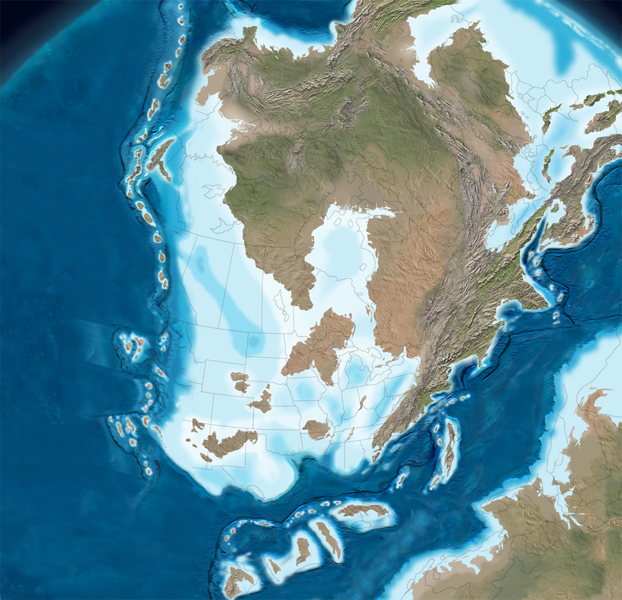
360 Ma
Devonian
Acadian orogeny;
Collision of
Avalon terranes;
Approach of
Gondwana
Deposition of:
Devonian clastic
rocks: shales,
sandstones
Gondwana
http://cpgeosystems.com/paleomaps.html

Slide 24
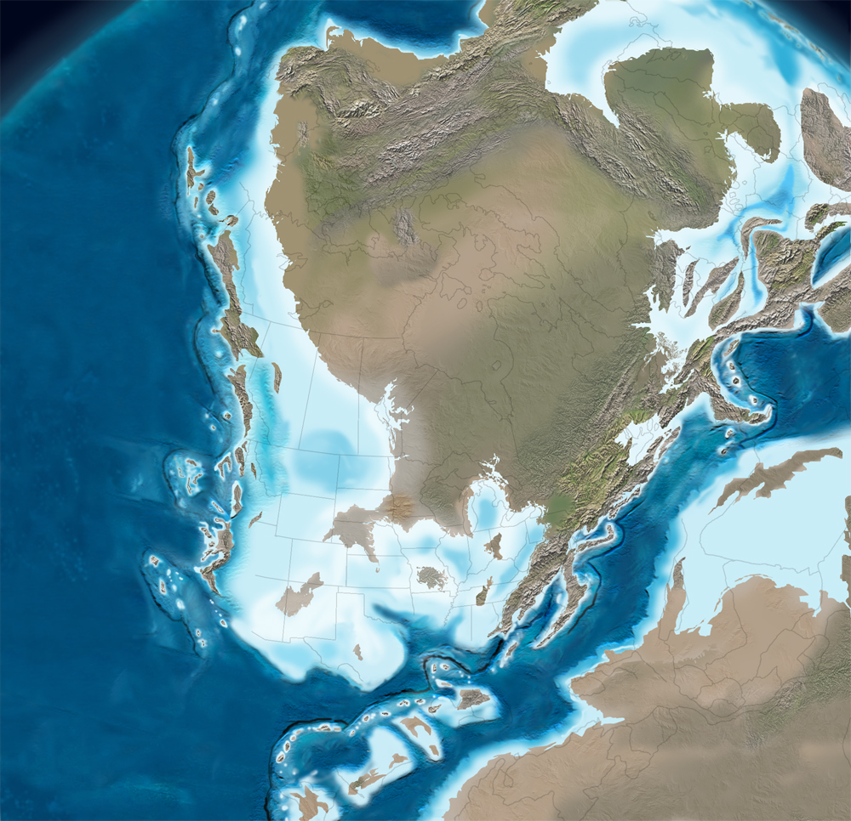
345 Ma
Mississippian
Approach of
Gondwana
Gondwana
http://cpgeosystems.com/paleomaps.html

Slide 25
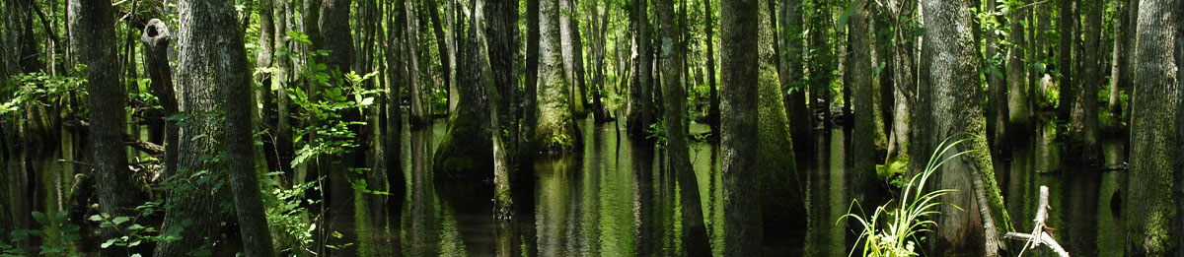
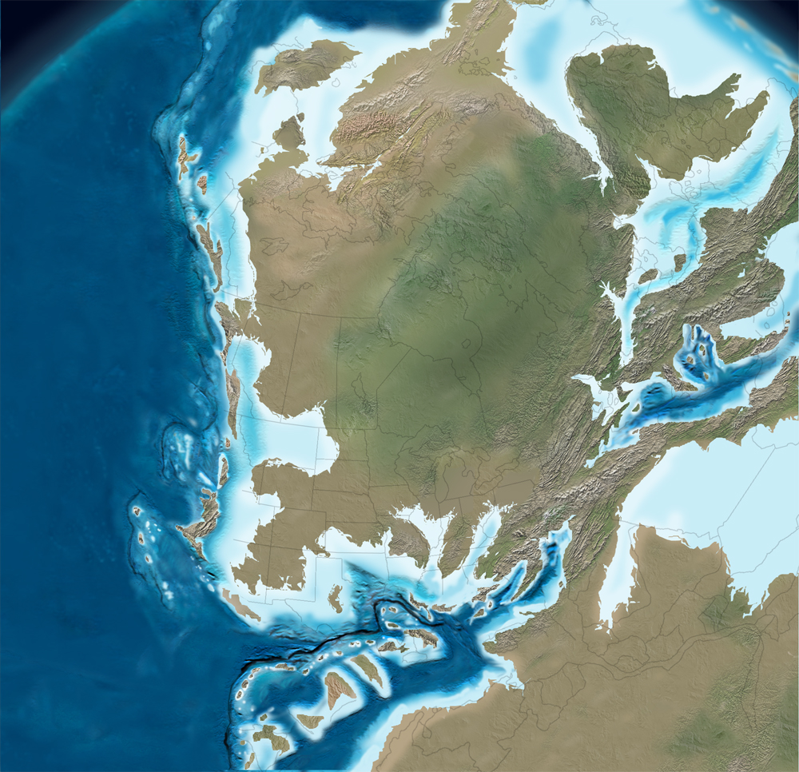
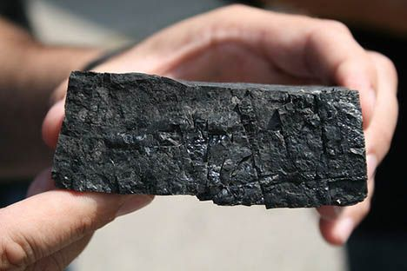
325 Ma
Mississippian
Alleghanian
orogeny;
Initial formation of
the Pangaea
supercontinent
Folding and faulting
throughout the
Valley and Ridge;
Uplift and westward
transport of Blue
Ridge basement
rocks
http://cpgeosystems.com/paleomaps.html

Slide 26
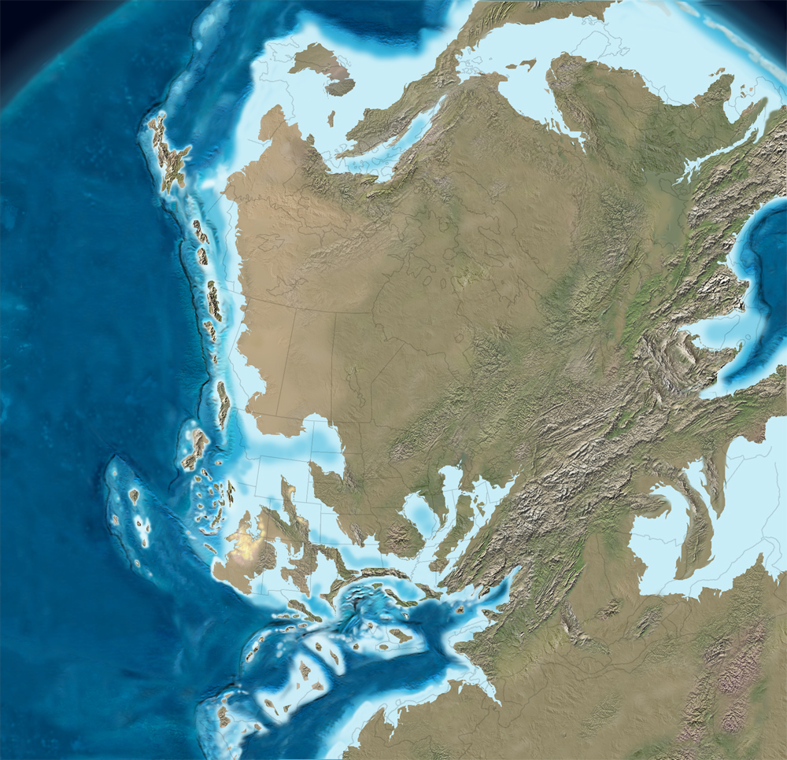
315 Ma
Pennsylvanian
Alleghanian
orogeny;
Formation of
the Pangaea
supercontinent
Pangaea
Folding and faulting
throughout the
Valley and Ridge;
Uplift and westward
transport of Blue
Ridge basement
rocks
http://cpgeosystems.com/paleomaps.html

Slide 27
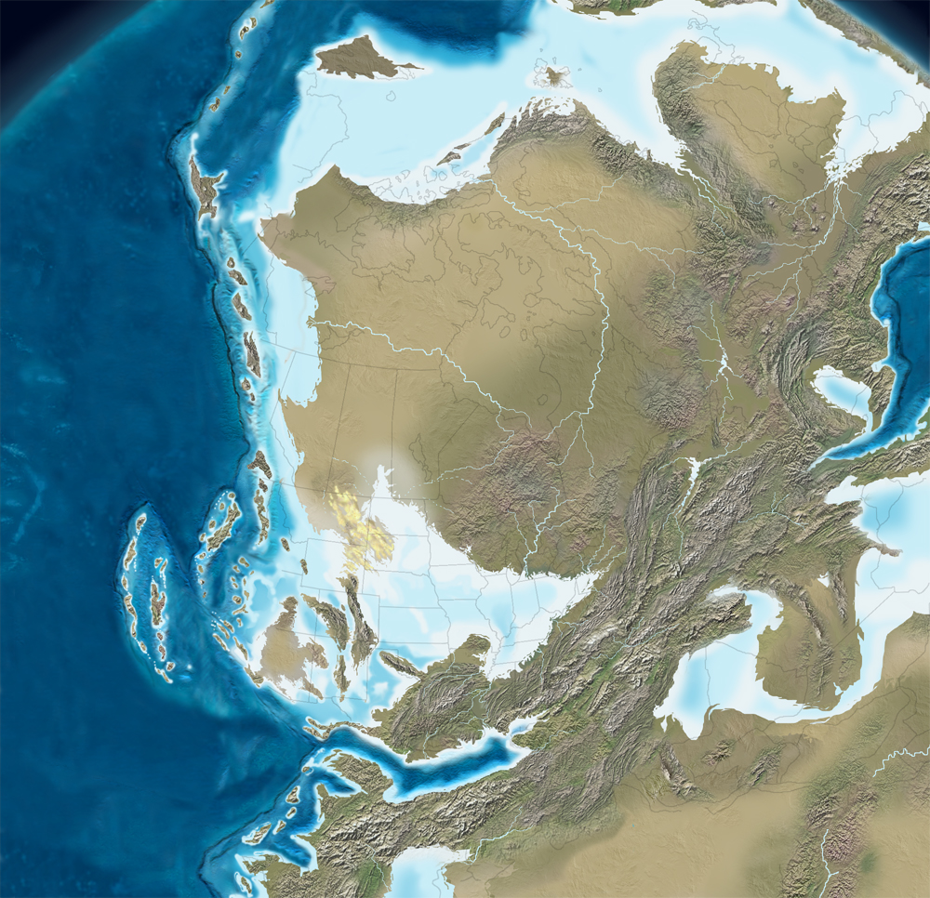
300 Ma
Pennsylvanian
Alleghanian
orogeny;
Formation of
the Pangaea
supercontinent
Pangaea
Folding and faulting
throughout the
Valley and Ridge;
Uplift and westward
transport of Blue
Ridge basement
rocks
http://cpgeosystems.com/paleomaps.html

Slide 28
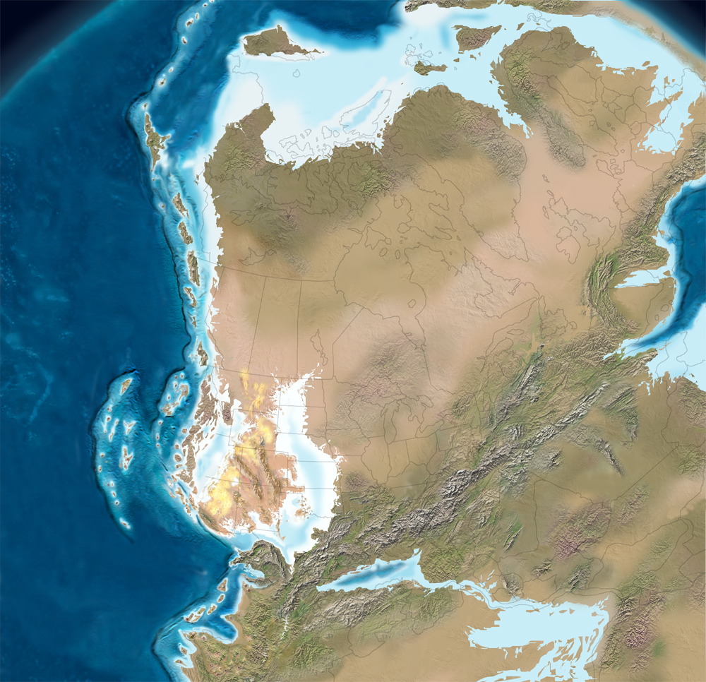
290 Ma
Permian
Pangaea
supercontinent
fully formed
Pangaea
http://cpgeosystems.com/paleomaps.html

Slide 29
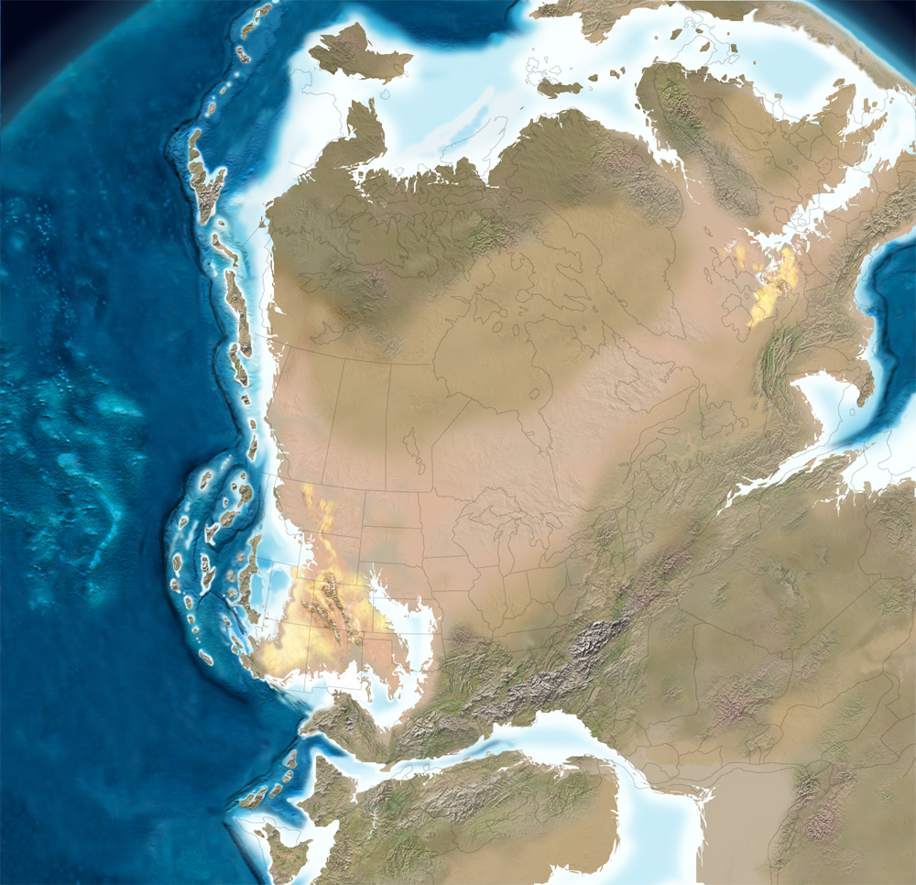
275 Ma
Permian
Pangaea
supercontinent
fully formed
Pangaea
http://cpgeosystems.com/paleomaps.html

Slide 30
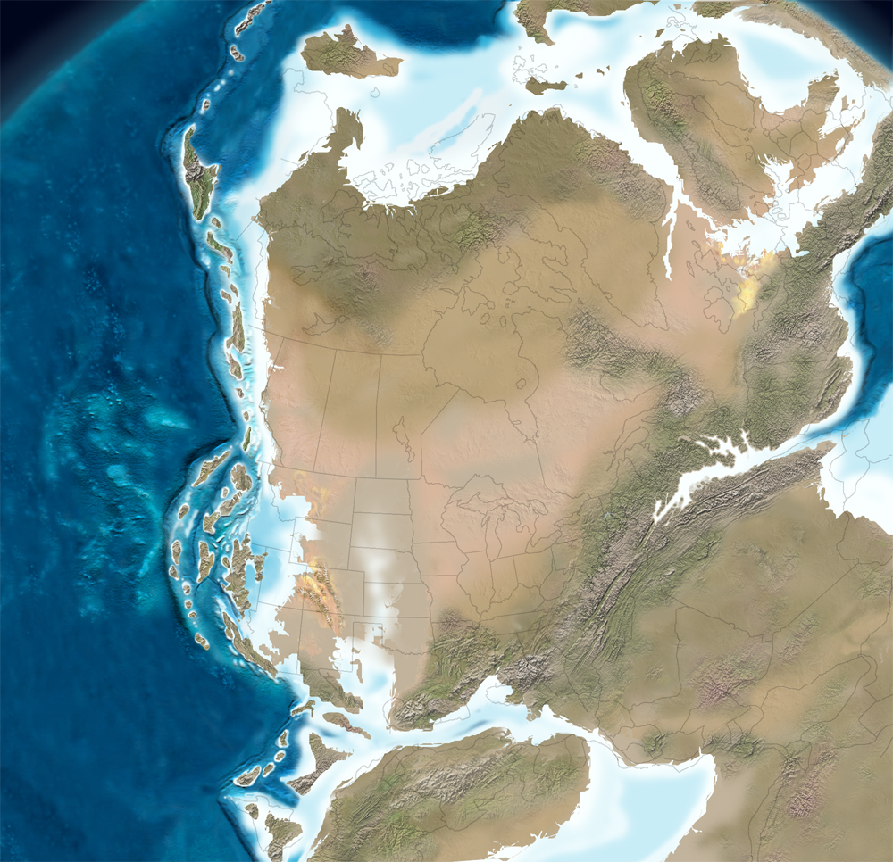
260 Ma
Permian
Initial rifting of
Pangaea;
Rift basins open
east of the Blue
Ridge
Pangaea
http://cpgeosystems.com/paleomaps.html

Slide 32
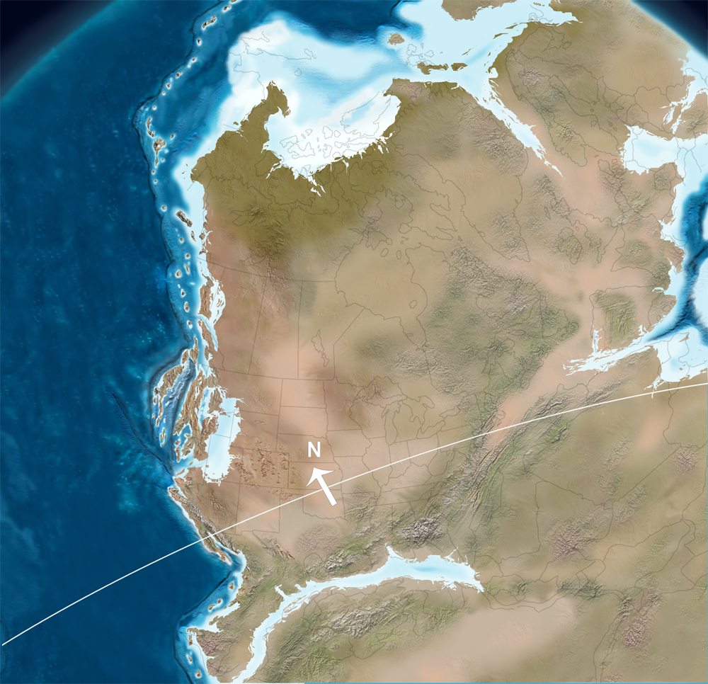
245 Ma
Triassic
Rifting of
Pangaea;
Rift basins open
east of the Blue
Ridge
Pangaea
Deposition of:
Culpeper Group
http://cpgeosystems.com/paleomaps.html

Slide 33
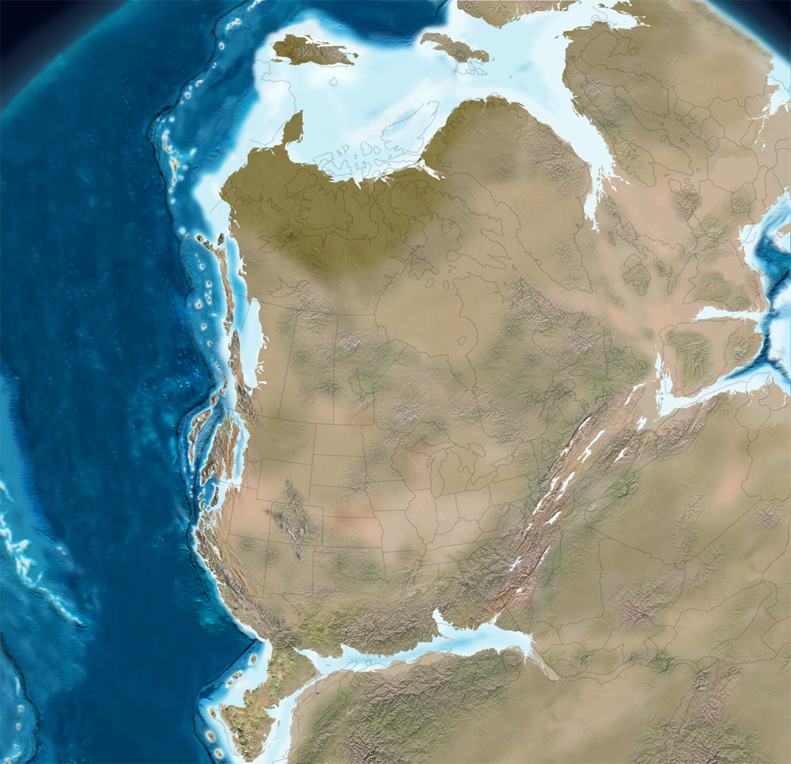
230 Ma
Triassic
Rifting of
Pangaea;
Rift basins
expand east of
the Blue Ridge
Pangaea
Deposition of:
Culpeper Group
http://cpgeosystems.com/paleomaps.html

Slide 34
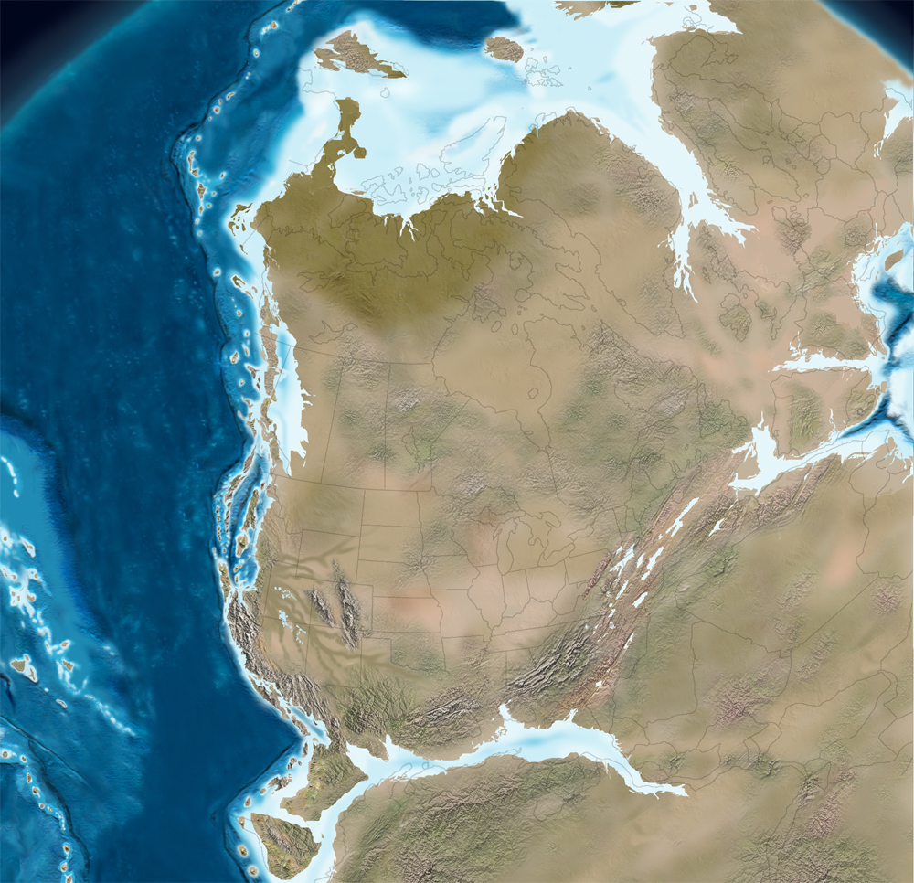
210 Ma
Triassic
Rifting of
Pangaea;
Rift basins
expand east of
the Blue Ridge
Pangaea
Deposition of:
Culpeper Group
http://cpgeosystems.com/paleomaps.html

Slide 35
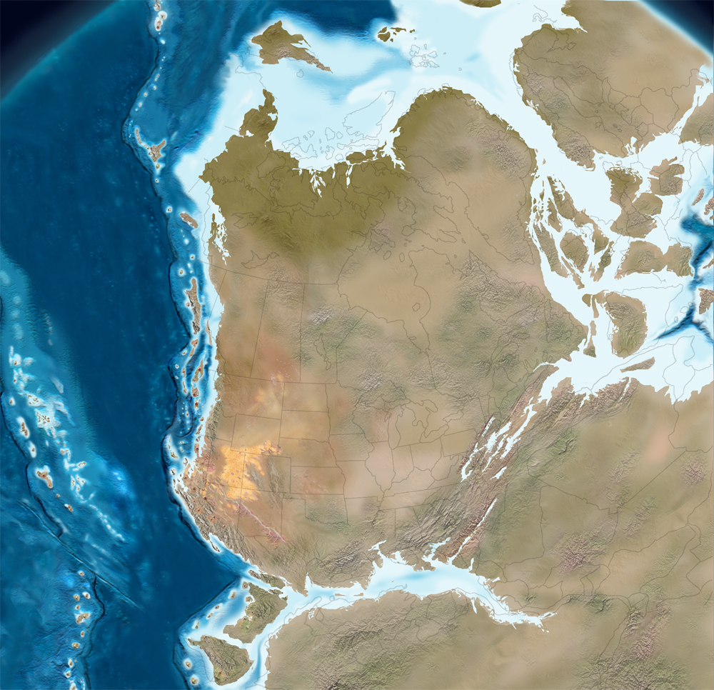
195 Ma
Jurassic
Rifting of
Pangaea;
Rift basins
expand east of
the Blue Ridge
Pangaea
Deposition of:
Culpeper Group
http://cpgeosystems.com/paleomaps.html

Slide 36
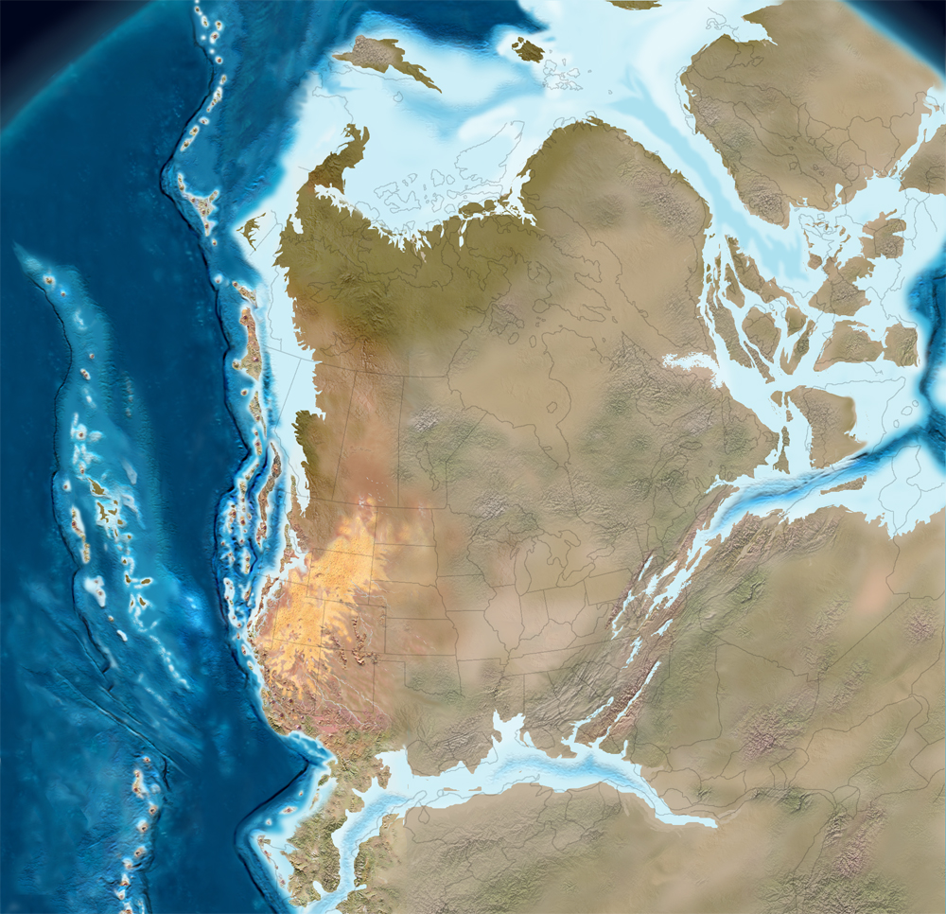
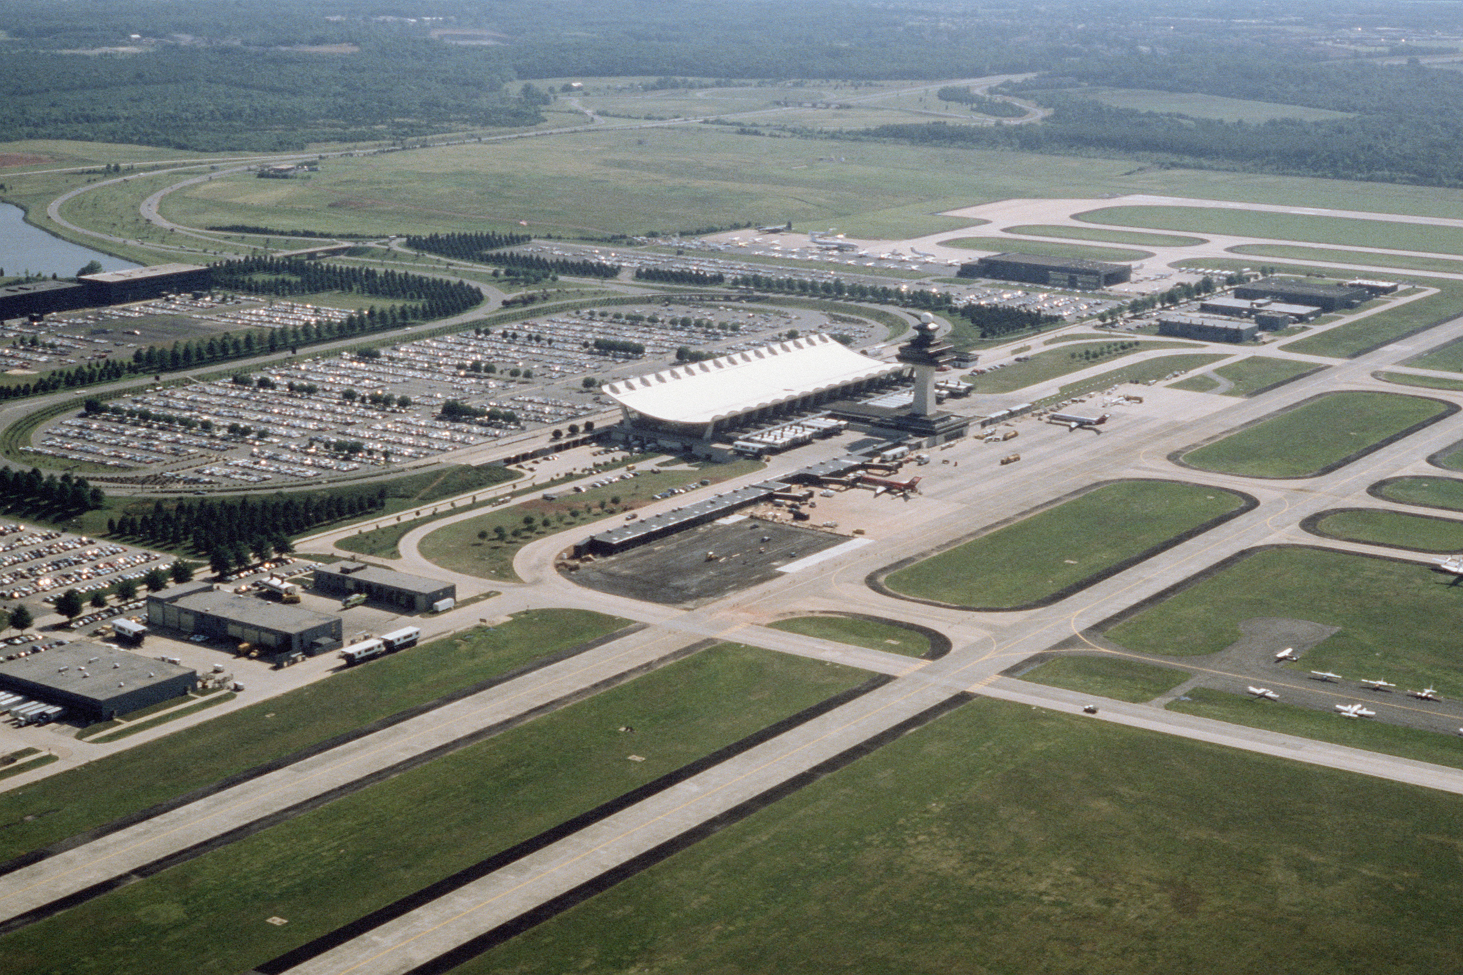
180 Ma
Jurassic
Rifting of
Pangaea;
Opening of the
Atlantic ocean
http://cpgeosystems.com/paleomaps.html

Slide 37
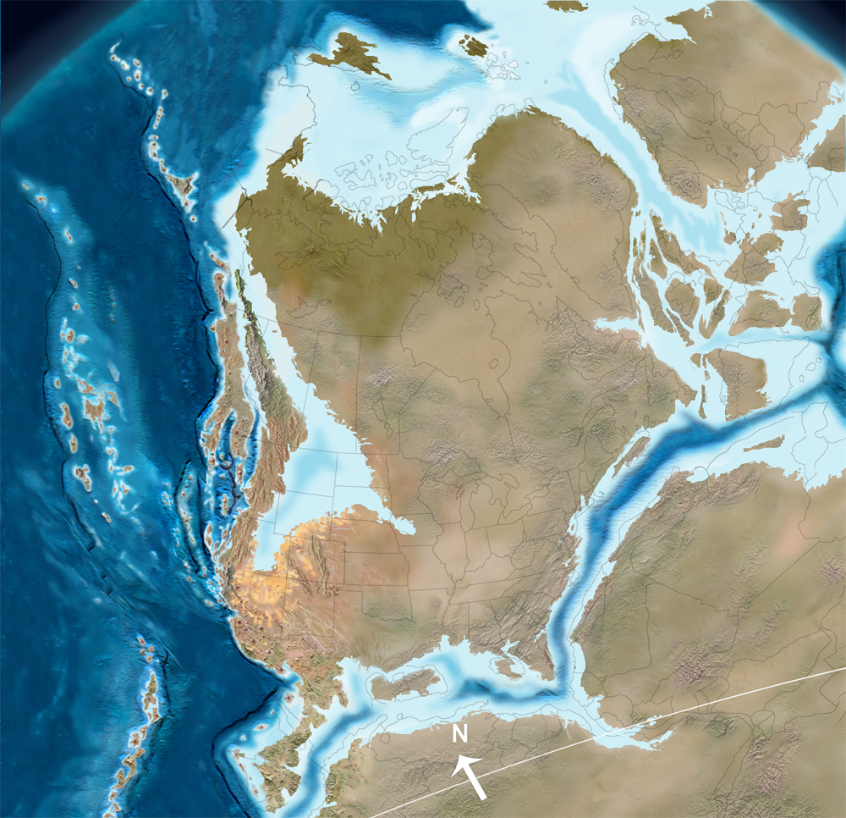
170 Ma
Jurassic
Rifting of
Pangaea;
Opening of the
Atlantic ocean
http://cpgeosystems.com/paleomaps.html

Slide 38
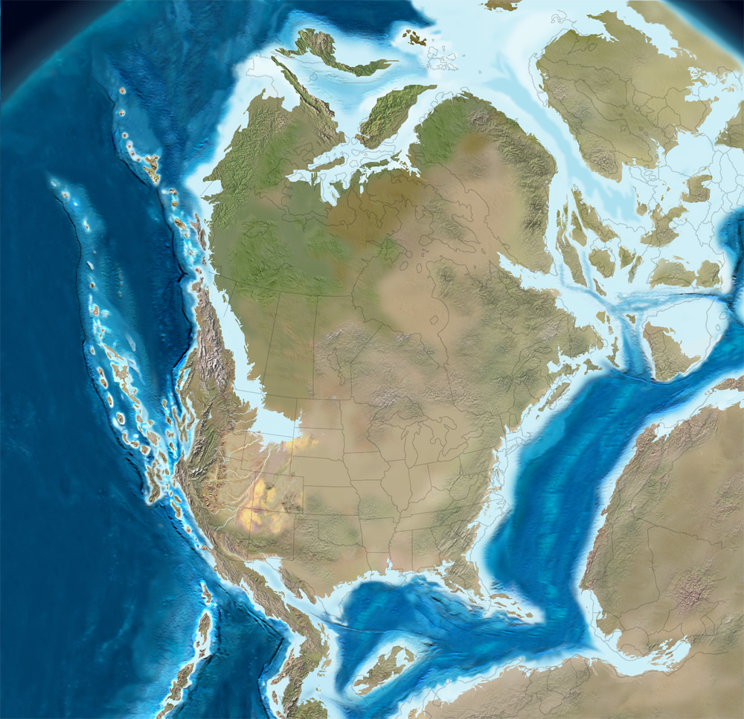
150 Ma
Jurassic
Opening of the
Atlantic ocean
Atlantic Ocean
http://cpgeosystems.com/paleomaps.html

Slide 39

Opening of the
Atlantic ocean
Atlantic Ocean
http://cpgeosystems.com/paleomaps.html

Slide 40

140 Ma
Cretaceous
Atlantic Ocean
http://cpgeosystems.com/paleomaps.html

Slide 41

130 Ma
Cretaceous
Atlantic Ocean
http://cpgeosystems.com/paleomaps.html

Slide 42

115 Ma
Cretaceous
Atlantic Ocean
http://cpgeosystems.com/paleomaps.html

Slide 43

100 Ma
Cretaceous
Atlantic Ocean
http://cpgeosystems.com/paleomaps.html

Slide 44

85 Ma
Cretaceous
http://cpgeosystems.com/paleomaps.html

Slide 45

75 Ma
Cretaceous
http://cpgeosystems.com/paleomaps.html

Slide 46

65 Ma
Cretaceous –
Paleogene
http://cpgeosystems.com/paleomaps.html

Slide 47

60 Ma
Paleogene
(Paleocene)
http://cpgeosystems.com/paleomaps.html

Slide 48

50 Ma
Paleogene
(Eocene)
http://cpgeosystems.com/paleomaps.html

Slide 49

40 Ma
Paleogene
(Eocene)
http://cpgeosystems.com/paleomaps.html

Slide 50

25 Ma
Paleogene
(Oligocene)
http://cpgeosystems.com/paleomaps.html

Slide 51

15 Ma
Neogene
(Miocene)
http://cpgeosystems.com/paleomaps.html

Slide 52

8 Ma
Neogene
(Miocene)
http://cpgeosystems.com/paleomaps.html

Slide 53

3 Ma
Neogene
(Pliocene)
http://cpgeosystems.com/paleomaps.html

Slide 54

0.125 Ma
Holocene
Laurentide
glaciation
http://cpgeosystems.com/paleomaps.html

Slide 55

0.0 Ma
Present Day
http://cpgeosystems.com/paleomaps.html

Slide 56

WHY DOES IT MATTER?

Slide 57



SOILS

Slide 58

SOILS
SHALE
QUARTZITE
BASALT
LIMESTONE

Slide 59

Limestone and
Dolomite
SOILS
Limestone and
Dolomite
Shale
QUARTZITE
Quartzite
Limestone and
Dolomite
Basalt
Granite and
Gneiss
Quartzite

Slide 60

WATER
(QUALITY AND QUANTITY)
Shale
Quartzite
Limestone and
Dolomite
Basalt
Granite and
Gneiss
Quartzite

Slide 61
WATER
(QUALITY AND QUANTITY)
Shale
Quartzite
Limestone and
Dolomite
Basalt
Granite and
Gneiss
Quartzite

Slide 62

WATER
(QUALITY AND QUANTITY)
Shale
Quartzite
Limestone and
Dolomite
Basalt
Granite and
Gneiss
Quartzite

Slide 63

The Burren, western Ireland

Slide 64



Slide 65
Shale
Quartzite
Limestone and
Dolomite
Quartzite

Slide 66

Shale
Quartzite
Quartzite

Slide 67





SINKHOLES

Slide 68
Limestone and
Dolomite
Limestone and
Dolomite
Shale
Quartzite
Limestone and
Dolomite
Basalt
Granite and
Gneiss
Quartzite

Slide 69

LANDSLIDES
Shale
Limestone and
Dolomite
Basalt

Slide 70


LANDSLIDES AND FLOODING
Landslide: the downslope movement of rock, soil,
or artificial fill under the influence of gravity.
Death Valley, CA
northern Venezuela

Slide 71

Nelson County,
August, 1969
~ 150 fatalities
Photo: Tom Gathright, 1969

Slide 72


C
Rapidan Storm,
June, 1995
Madison County, Virginia

Slide 73


Slide 74



Slide 75


Slide 76


Slide 77


Slide 78


Slide 79


Slide 80

???
???

Slide 81







Nelson County
from Eaton and others, 2003

Slide 82

Rainfall Thresholds
Hurricane Isabel, 2003

Slide 83

Virginia IFLOWS system

Slide 84
IFLOW ppt. Data (in) for Augusta County, Virginia
ID 15MIN 30MIN 1HR 3HR 6HR 12HR 24HR
Toms Branch 1200 0.00 0.00 0.00 0.16 1.32 5.00 7.12
Sherando 1201 0.00 0.00 0.00 0.20 1.84 6.00 8.48
Robinson Hollow 1202 0.00 0.00 0.00 0.04 0.92 4.72 7.24
Spottswood 1203 0.00 0.00 0.00 0.08 0.64 2.92 4.20
Middlebrook 1205 0.00 0.00 0.00 0.00 0.84 4.72 6.44
Stoney Creek 1207 0.00 0.00 0.00 0.04 0.56 4.55 6.67
Stokesville 1209 0.00 0.00 0.00 0.04 1.56 3.52 4.32
Craigsville 1211 0.00 0.00 0.00 0.08 0.68 2.32 3.44
Upper Sherando 1240 0.00 0.00 0.00 0.08 1.24 14.38 20.20
Jones Hollow 1242 0.00 0.00 0.00 0.04 0.84 4.92 7.36
Elkhorn Lake 1244 0.00 0.00 0.00 0.04 1.40 3.44 4.36
Todd Lake 1246 0.00 0.00 0.00 0.00 1.56 3.60 4.32
Mills Creek Dam 1248 0.00 0.00 0.00 0.04 0.88 6.16 9.16
Hearthstone Lake 1250 0.00 0.00 0.00 0.00 0.00 0.04 0.40
Waynesboro 1436 0.00 0.00 0.00 0.00 0.44 2.24 2.28

Slide 85

debris flow active
stable

Slide 86


Slide 87
APPRECIATION OF OUR
LOCAL LANDSCAPES

Slide 88


APPRECIATION OF OUR
LOCAL LANDSCAPES

Slide 89


Slide 90



ICE AGE ROCK GLACIERS?

